Slide 1
The secret valley
After:Örnu Maren and Hildi Völu

Slide 2
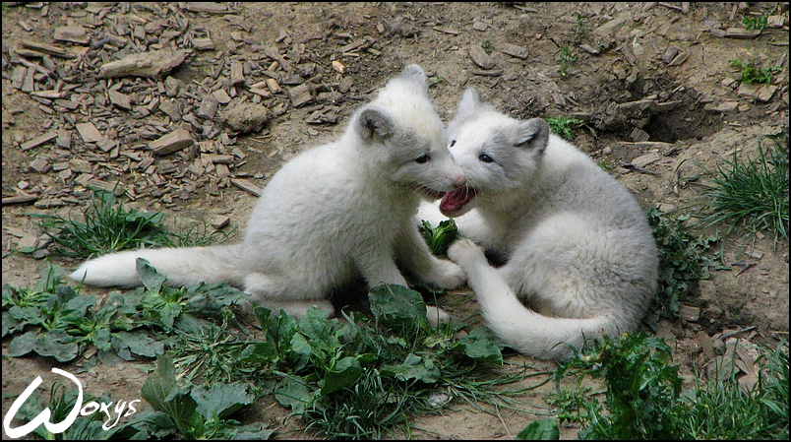
One beautiful autumn day did a fox had five beautiful pups.Their mom named them Logan and Snowy.They where the most lifefull of all the another pups.One day did the fox family og on hunting.

Slide 3
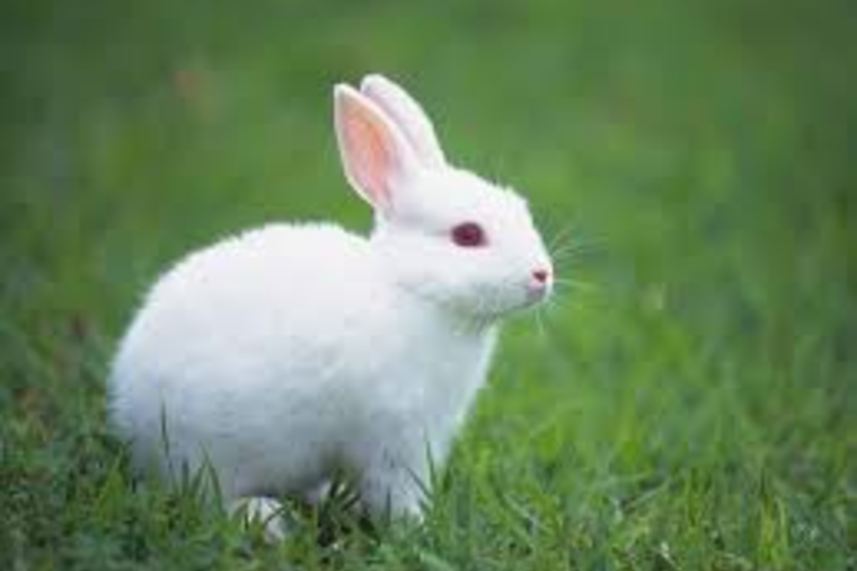
They was trying to catch a bunny.Logan and Snowy saw bunny and they wanted to make their parents proud of them so they did wanted to try to catch the bunny.

Slide 4
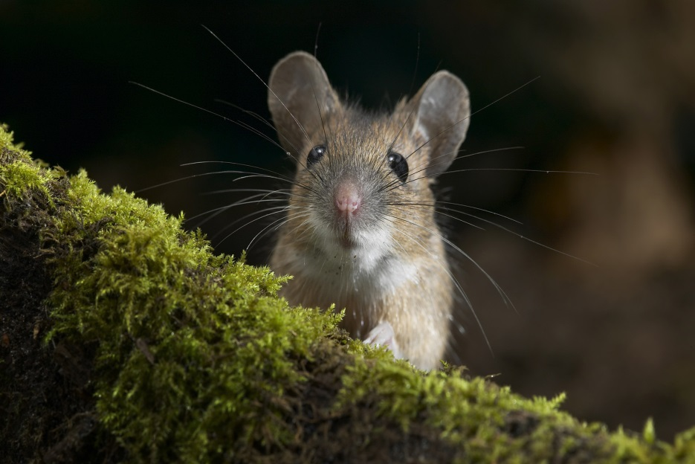
The bunny was so fast,so they decided to reach a small mouse that slipped by them.They started to run after the mouse.The mouse ran into a cave and in a hole that was in the wall at the cave.Then a really big rock falled at the entance.

Slide 5
They couldn´t get any where out,they walked for a long time.Finally they saw a light, so they ran and ran to the light.They saw a hole where the light came from.Logan and Snowy crawled through the hole,and when the got out of the cave they saw a small valley.´´WOW´´said snowy ´´I know´´said Logan.They got tired after the walk,they decided to sleep there for the night and then the next morning try to find there their mom, dad and their siblings.

Slide 6
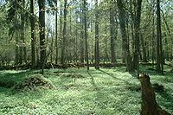
They crawled up on a rock and layed down,but suddenly the rock shouted in too the ground.The stone shoutted down a tunnel that formed.Suddenly they came up of the ground at the other side of the cave.

Slide 7
Look we got home said them both at the same time.They ran to their mom,dad and siblings.Their mom and dad where alsleep when they came. ´´Mom,dad we got home!They woke up,and the family hugged each other.´´Good that u tow got home´´said their mom. THE END

