Slide 1
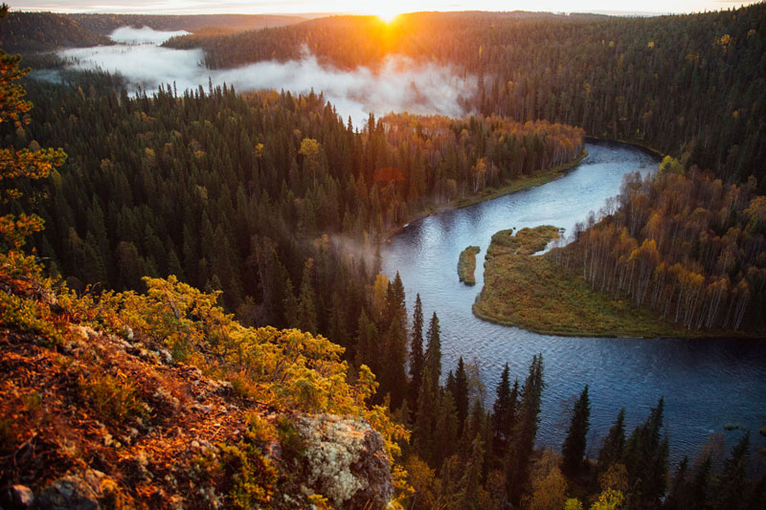
Natural wonders
Of Finland

Slide 2
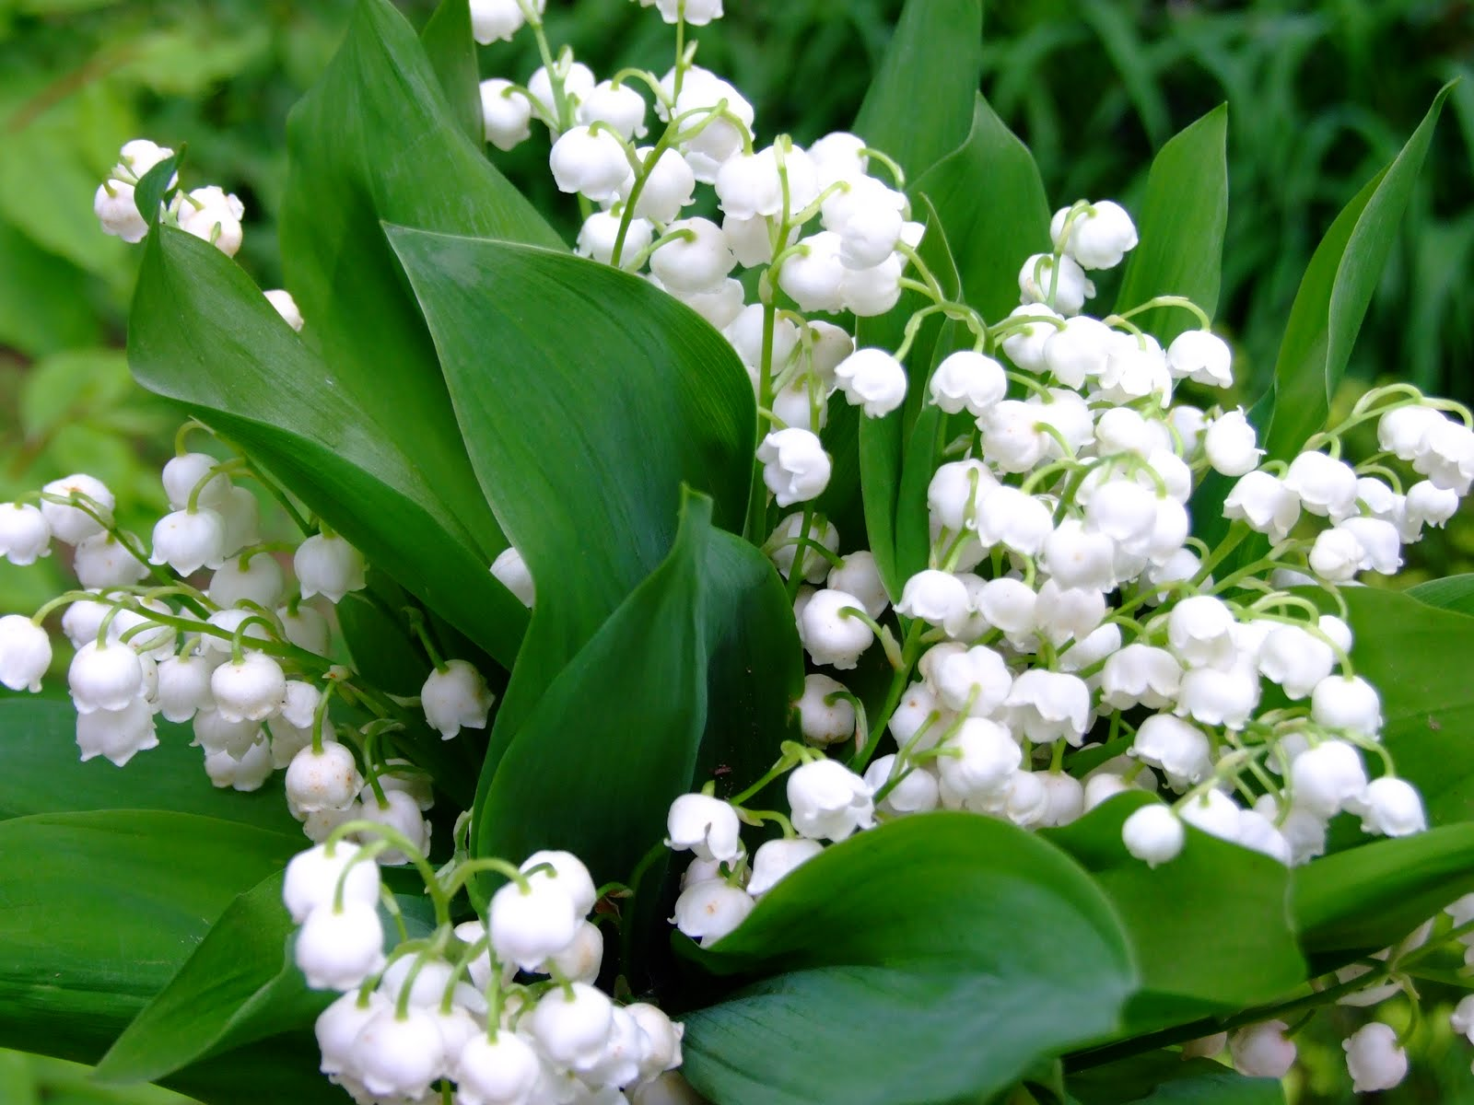
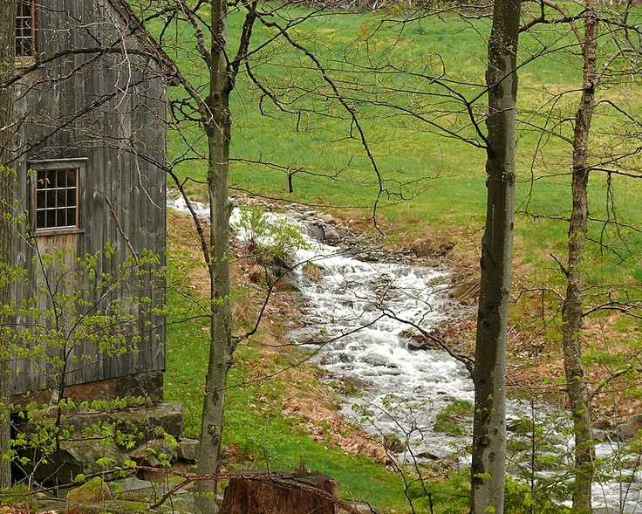
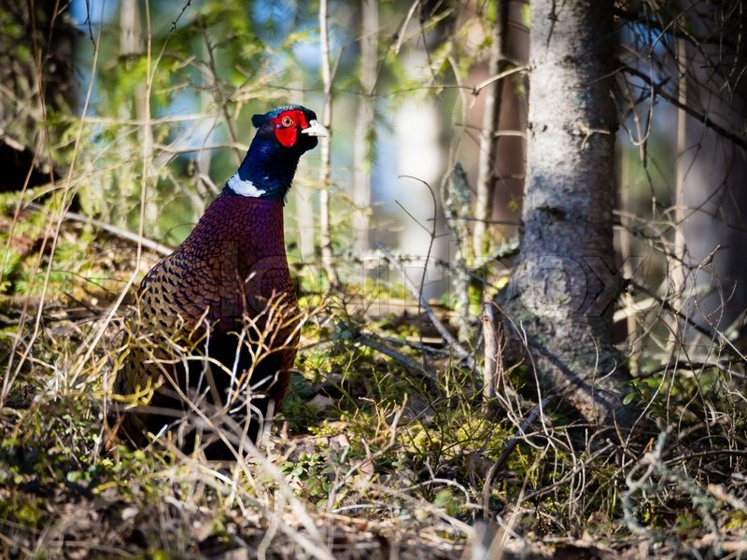
Spring is the most lively
season of the year.
The flowers start to rise
up from the ground again and the birds are
making their beautiful sounds.
On the left we have the
Finnish national flower,
Lily of the valley.
This is a common bird in the woods called the pheasant.
In Finnish it’s called fasaani.
When the snows are melting down, the waters start to flow.

Slide 3
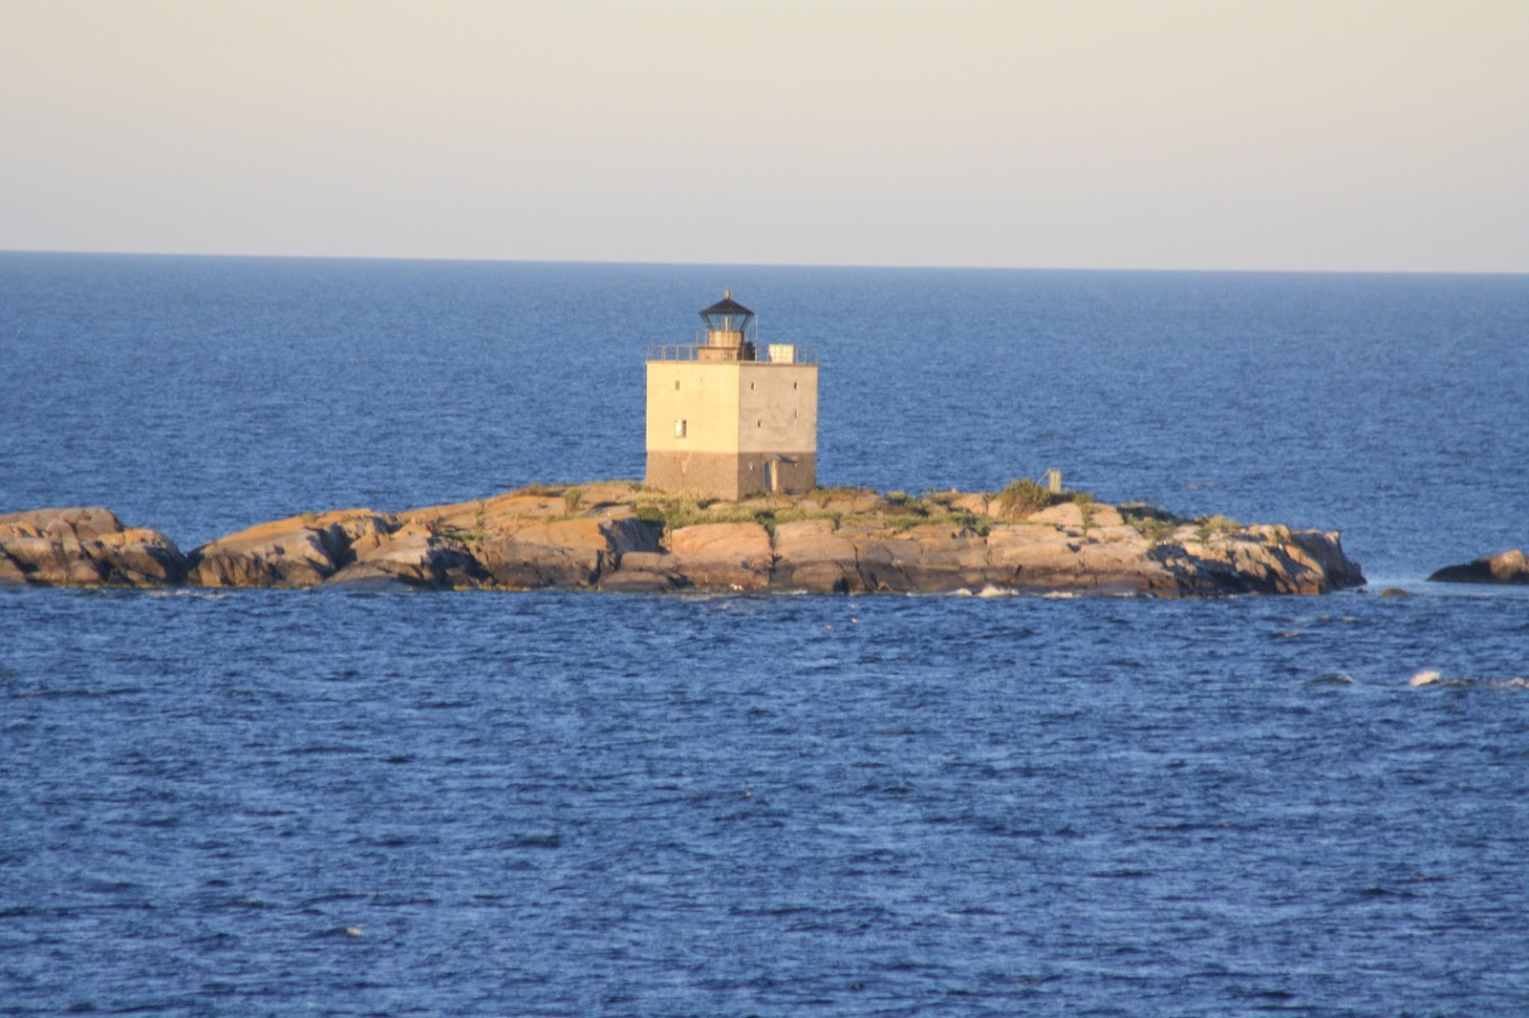
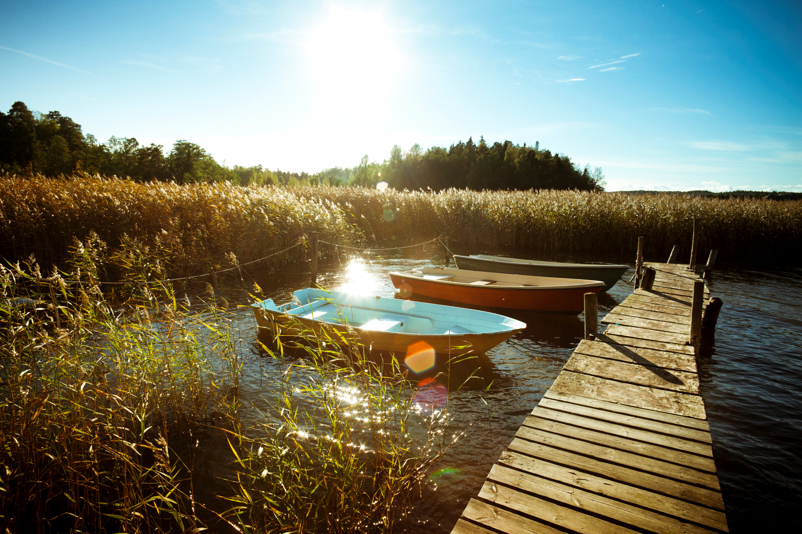
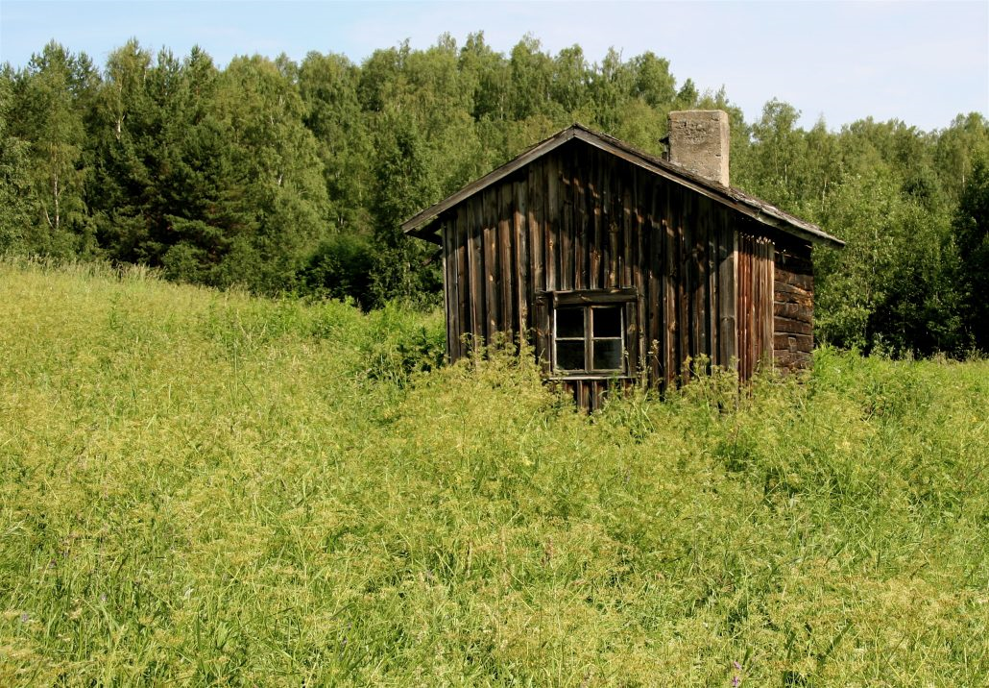
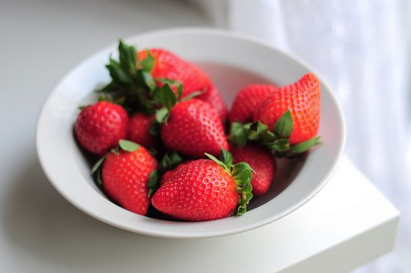
In the summers the weather changes a lot. Sometimes it’s warm, sometimes it’s windy and it can also rain! Although that happens rarely.
Finnish summer.
Swimming and eating strawberries are the best thing to do in the summer!

Slide 4
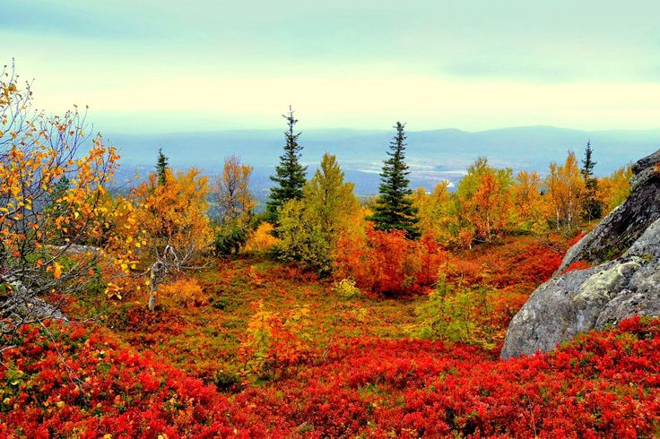
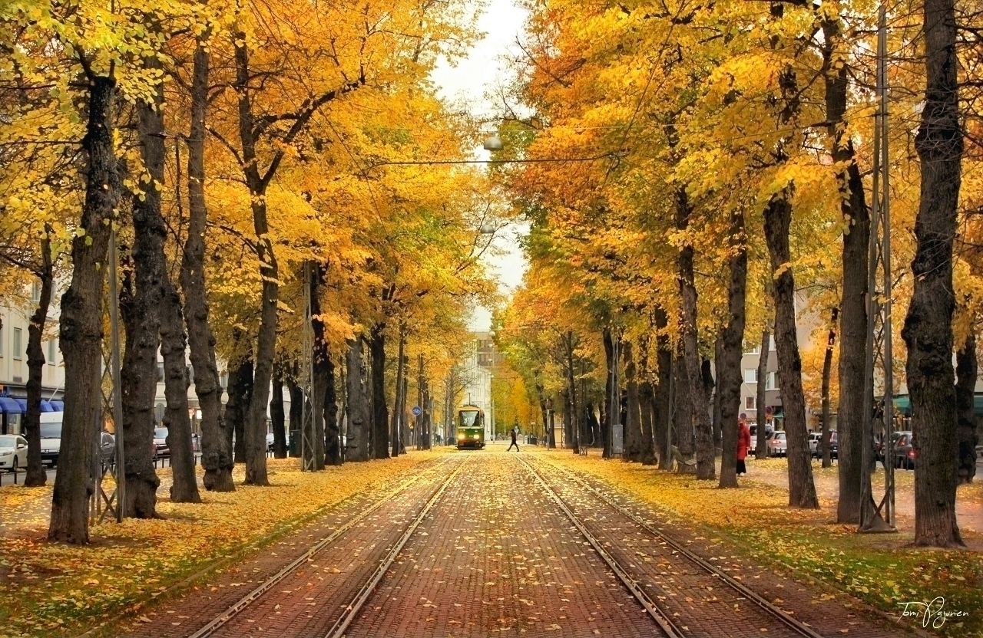
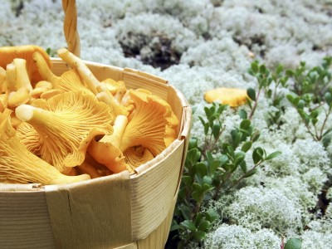
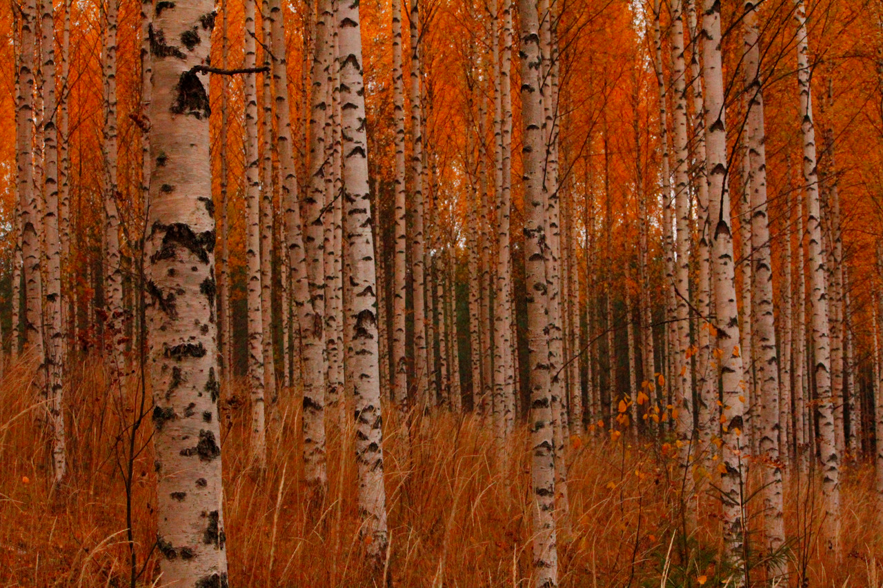
Finnish autumn is the most beautiful season of the year. It has beautiful colors and beautiful weather.

Slide 5
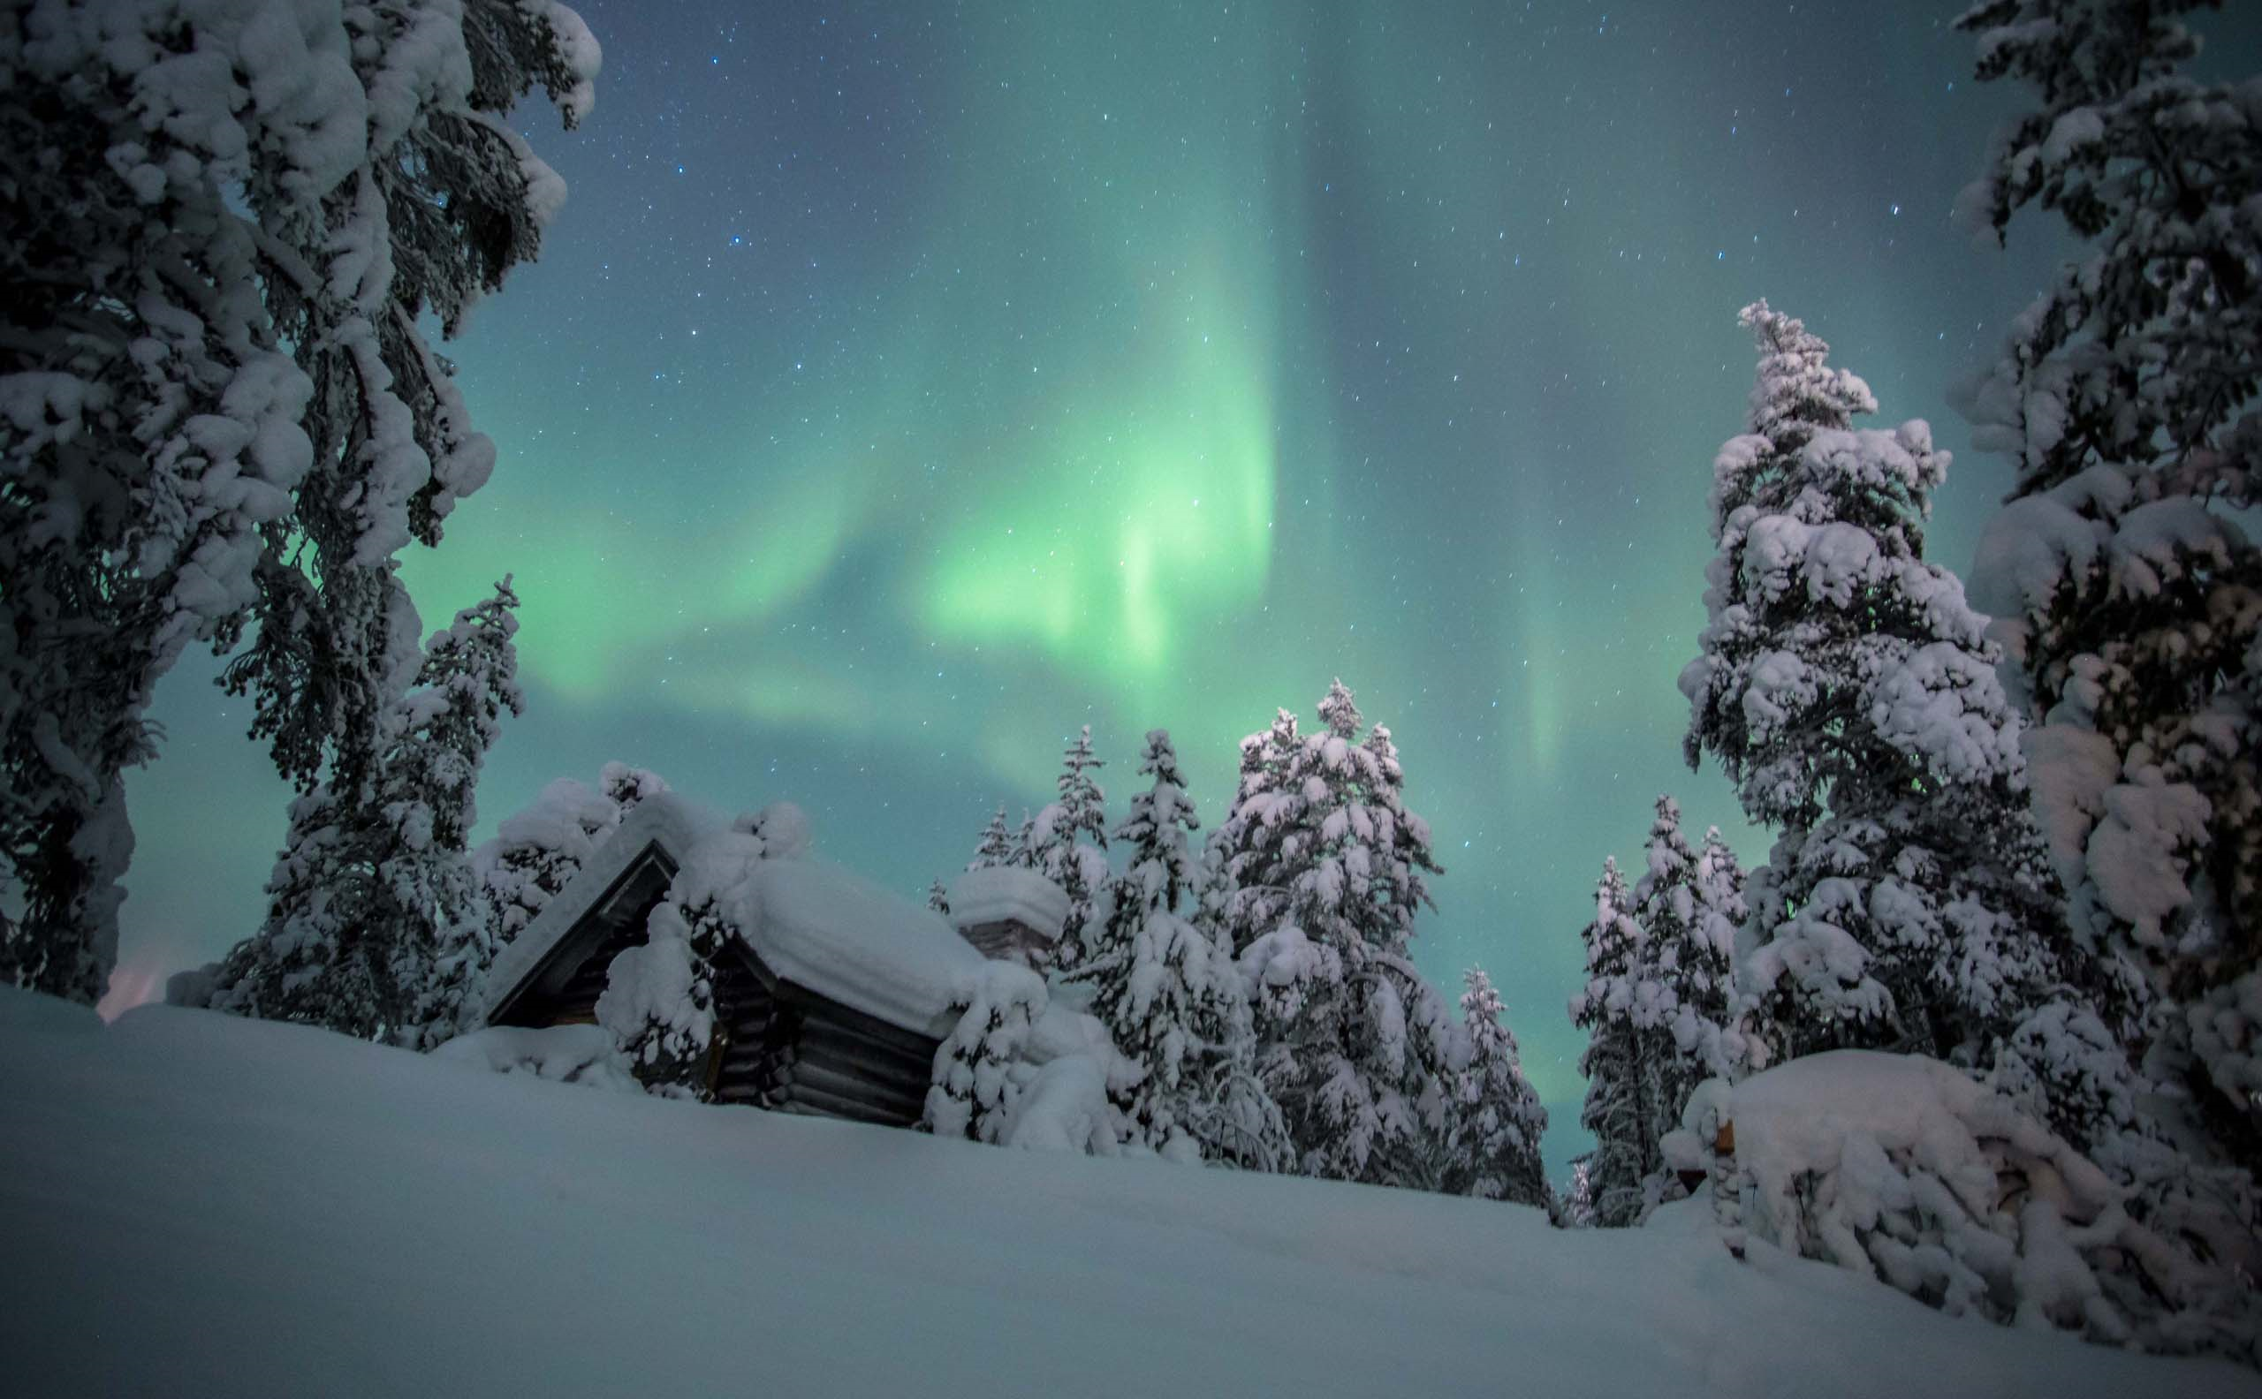
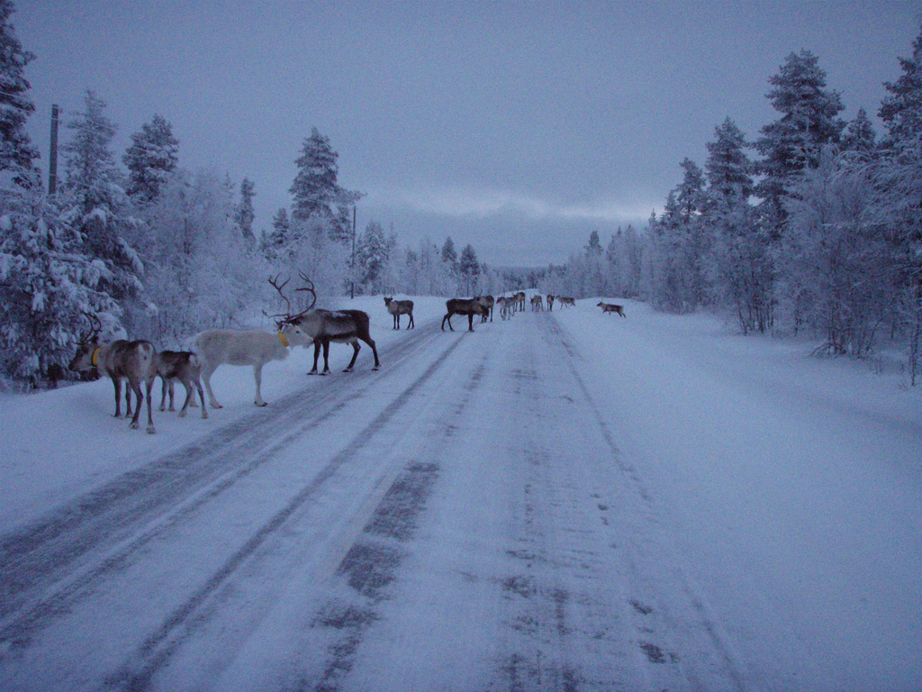
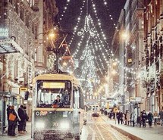
Finnish winter is cold and snowy. You can see northern lights and stars in the sky. In Lapland there are reindeer on the roads.
This is the capital of Finland, Helsinki. In the winters it’s really pretty.

