Slide 1
Project method + CLIL
6th graders, English class

Slide 2
Task
Constructive project
Groupwork project
Realisation free: a poem, a story, a poster, a show/a play
The problem: dealing with the subject matter in foreign language, English terminology -> English product
Planning: the subject matter given by teacher (several choises): -> how to deal with it, what is the product, from what angle to approach the subject matter, how to limit the subject matter?
Producing: gathering information, materials needed, sum up, the show
Showing the final products to others
Evaluation orally

Slide 3
The list of subject matter
The subject matter is based on the things handled in the English book and related to science, in addition with seasons:
English speaking countries and areas in the world: Great Britain, USA, Canada, Ireland, Australia, New Zealand, South Africa, Malta, Gibraltar, India, Hong Kong, Singapore
Animals of the English speaking countries
Dinosauruses
Our solar system
Science and technology
Seasons of the year: one to be chosen

Slide 4
Working and outcome
6th grade was devided in to groups of three people by a lottery
Each group got 3-4 lessons, after which they had to present the product
The groups used their English books, dictionaries and Internet for information search
Group working was succeeded, everybody worked despite the level of language skills
Although several choises were offered to be the final product, all groups were eager to make posters
Reporting and evaluation was made orally

Slide 5
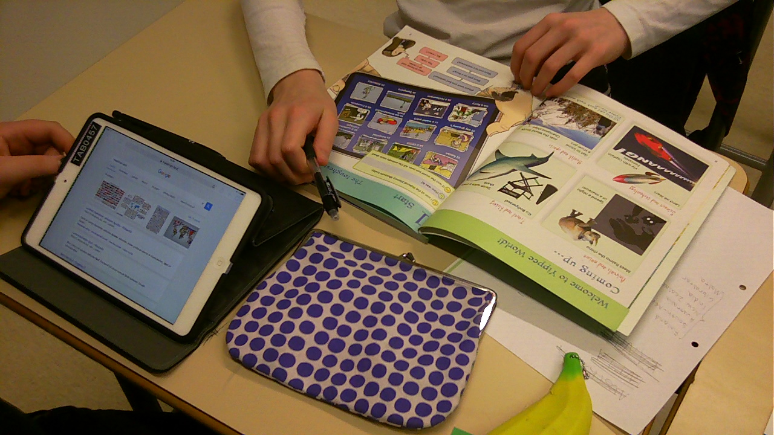

Slide 6
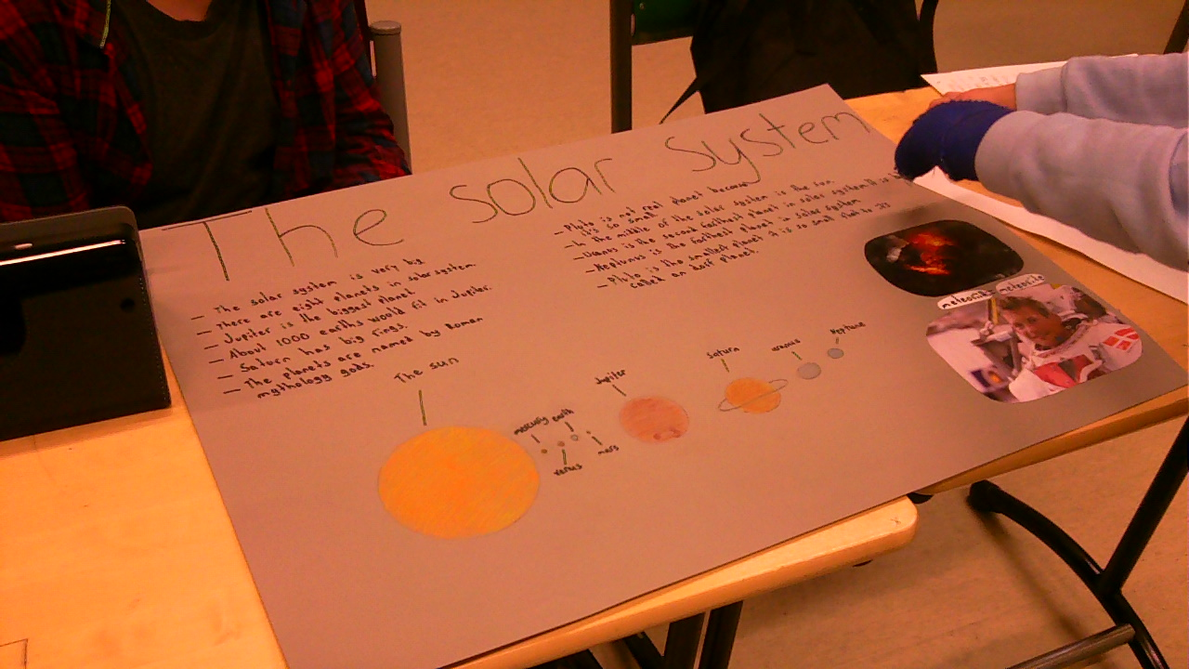

Slide 7
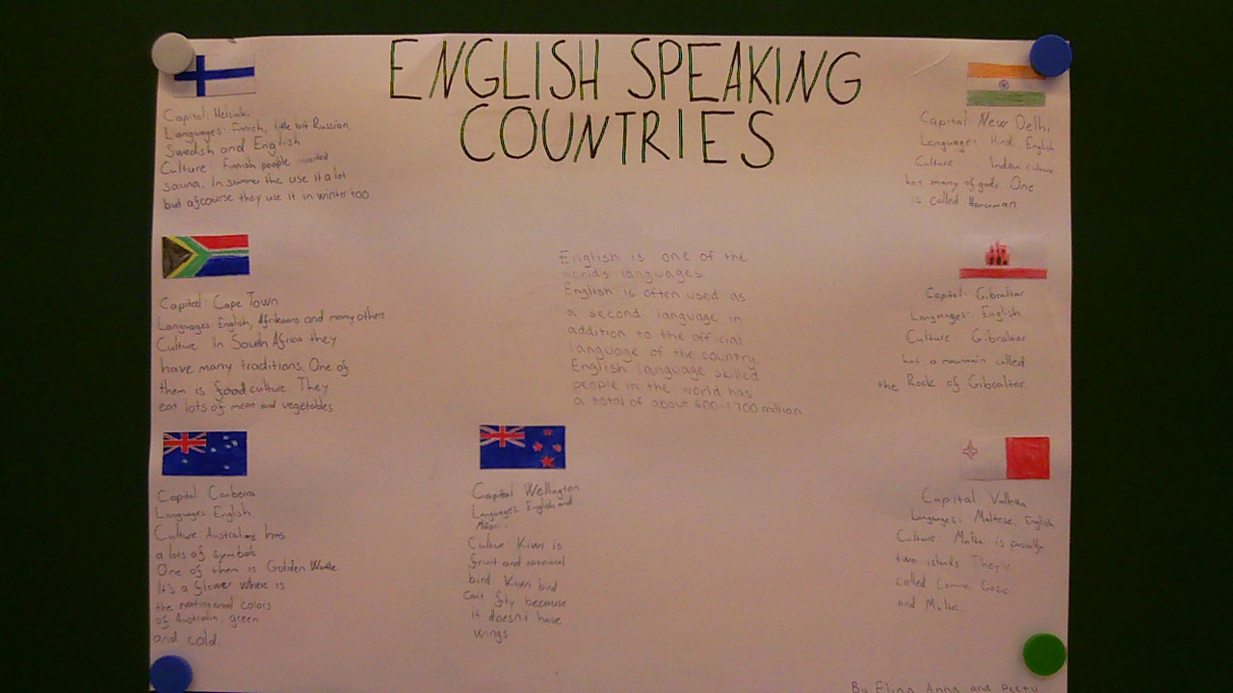

Slide 8
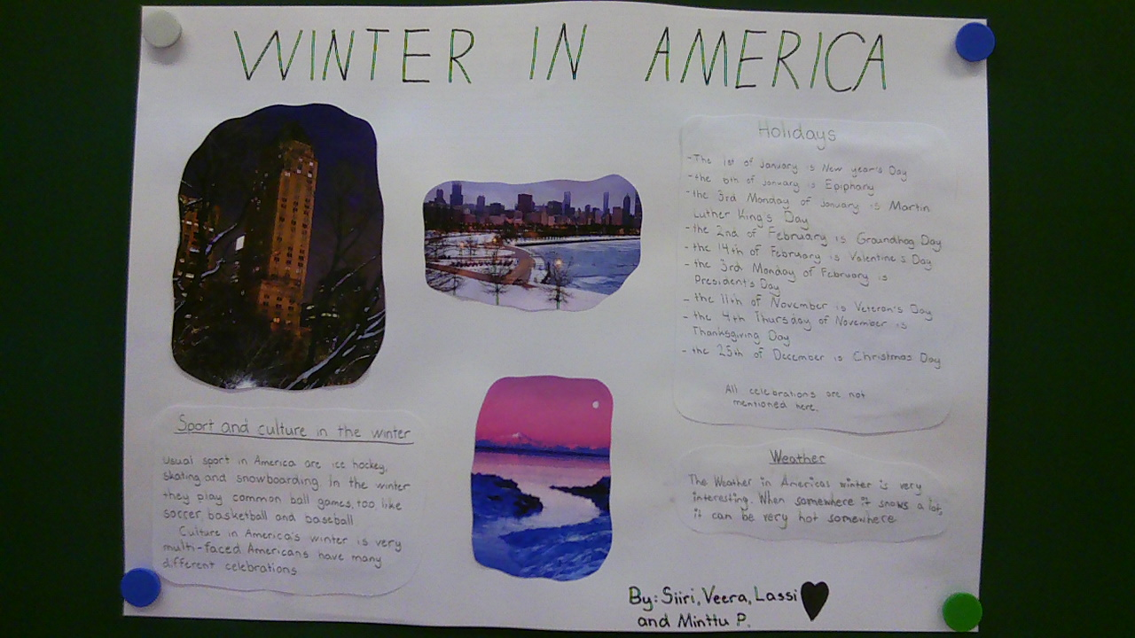

Slide 9
Pupils’ opinions
Pupils were asked questions afterwards and this is how they answered (no repeated opinions here):
Was the project method task nicer than the traditional class working?
- Yes. Yes because it was groupwork. It was nice, because you can work more freely than in doing exercises. Yes, a little. Yes, in some phases. I think the traditional class work is a bit nicer, but it doesn’t always teach so much. Yes and no, nice to decide on your own, but listening to units in the book is also nice.
What was best?
- To do group work. To be able to decide and plan on your own. Freedom of choise. I got a lot of help. Freedom in working. To be able to do something. That there was no real instruction on what we had to do. Presenting the project work for others. I don’t know.
What was worst?
- Maybe translating into English. When we didn’t come up with any ideas. If someone didn’t listen or work properly. Presenting to others. When I got to do nothing. Difficult to say. Nothing.

Slide 10
  What did you learn/did you learn anything?
  - Group working. Cooperation and things related to my subject. More about culture and a few words. I got to know others better. Animals. More grammar by writing the text. Something. No.
  How would you like to change the task?
  - No. More options. Smaller groups. Nothing much to change. To be able to choose the group on your own. I would have wanted a different topic. Wider choise of things to choose from.
  Anything else:
  - The project was educating and nice from every aspect.

