Slide 1
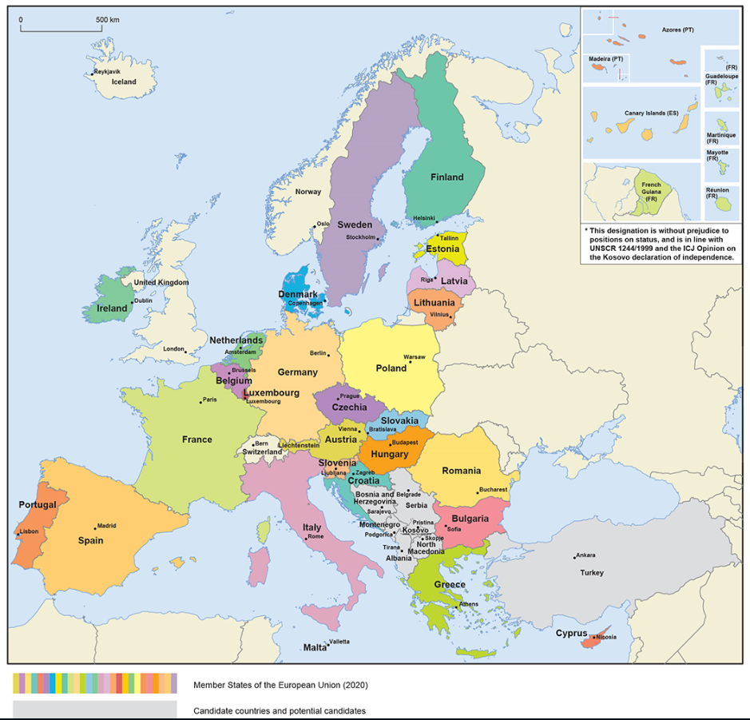
The European Union: 446 million people – 27 countries

Slide 2
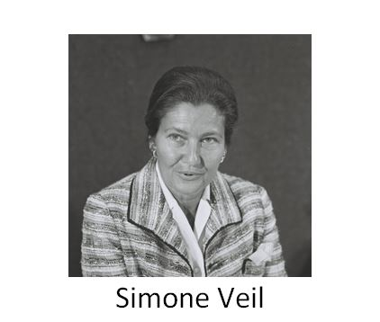
Pioneers – some of the architects of the European project
Their contribution to lasting peace and prosperity…
Konrad Adenauer
Alcide De Gasperi
Winston Churchill
Robert Schuman
Jean Monnet

Slide 3
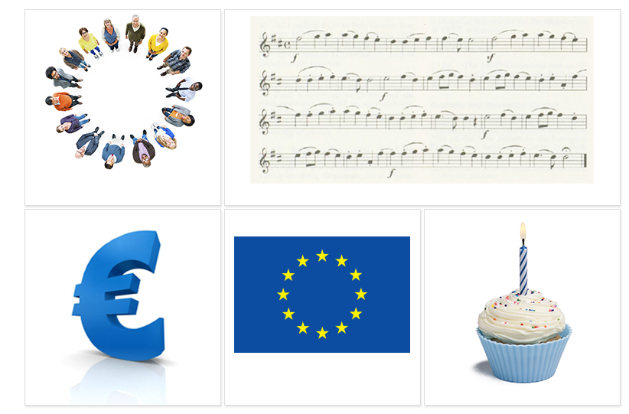
The EU symbols
The motto:
United in diversity
The European anthem
The euro
The European flag
Europe Day, 9 May

Slide 4
24 official languages
Български
Čeština
dansk
Deutsch
eesti keel
Ελληνικά
English
español
français
Gaeilge
hrvatski
Italiano
latviešu valoda
lietuvių kalba
magyar
Malti
Nederlands
polski
português
Română
slovenčina
slovenščina
suomi
svenska

Slide 5
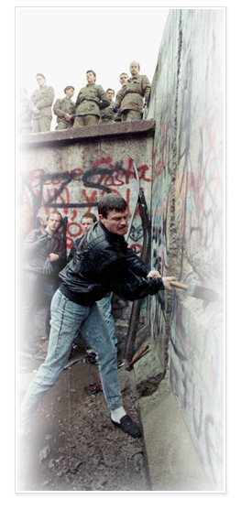
The big enlargement: uniting east and west
1989
Fall of Berlin Wall – end of Communism
EU economic help begins: Phare programme
1992
Criteria set for a country to join the EU:
• democracy and rule of law
• functioning market economy
• ability to implement EU laws
1998
Formal negotiations on enlargement begin
2002
Copenhagen summit agrees to a big enlargement of 10 new countries
2004
Ten new EU members: Cyprus, Czech Republic, Estonia, Hungary, Latvia, Lithuania, Malta, Poland, Slovakia, Slovenia
2007
Bulgaria and Romania join the EU
2013
Croatia joins on 1 July

Slide 6
EU population compared to the rest of the world
Population in millions

Slide 7
How many people live in the EU?
Population in millions (2019)
446 million in total

Slide 8
How does the EU spend its money?
The annual EU budget in 2019 was around €165.8 billion – a large sum in absolute terms, but only about 1% of the wealth generated by the economies of the Member States every year.

Slide 9
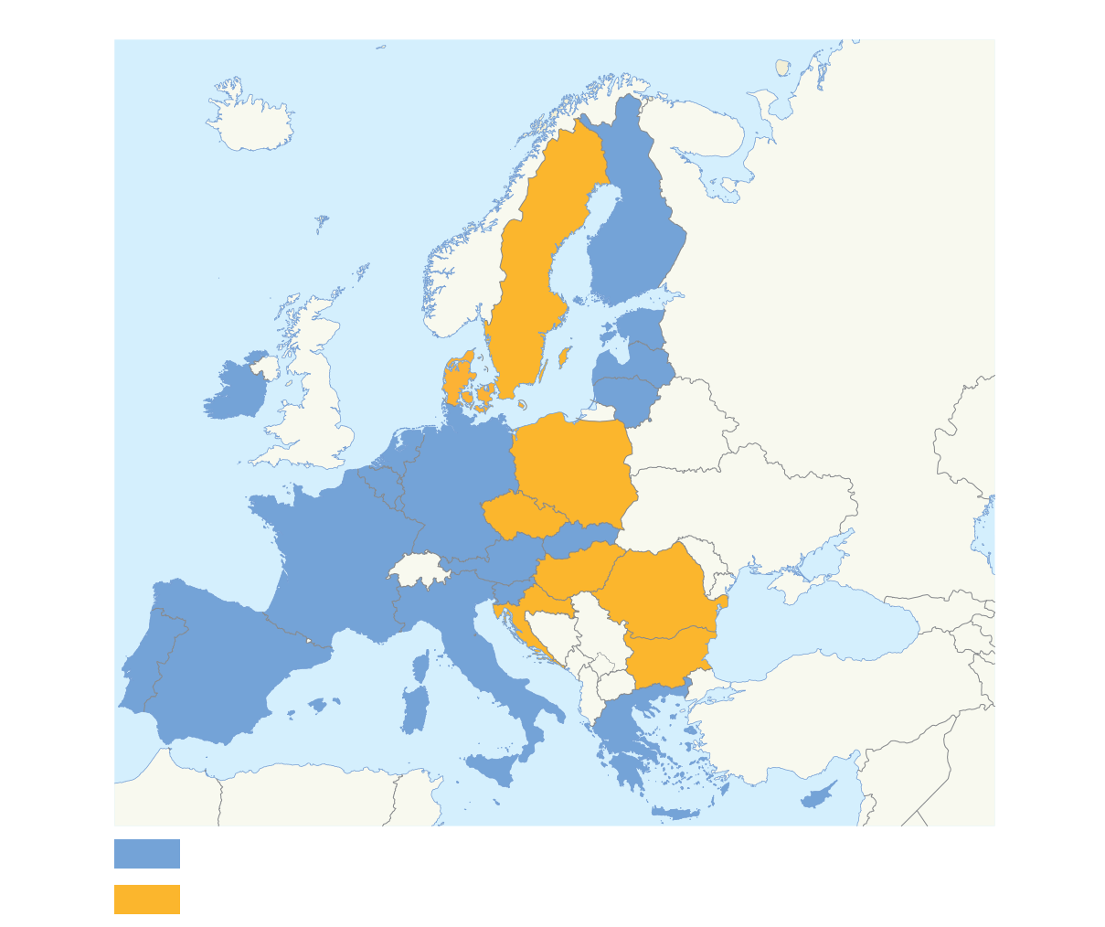
The euro – a single currency for Europeans
EU countries using the euro
EU countries not using the euro

Slide 10
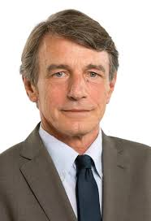
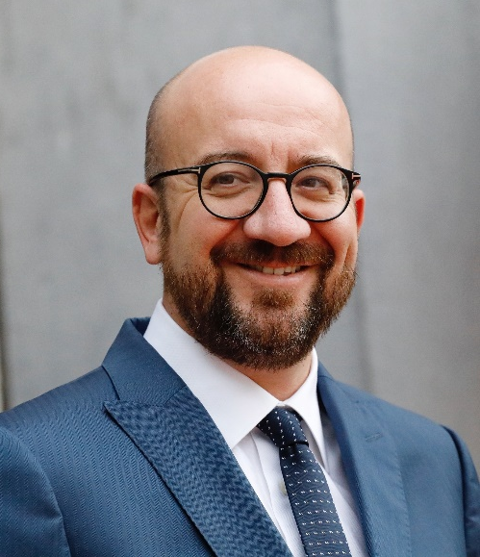
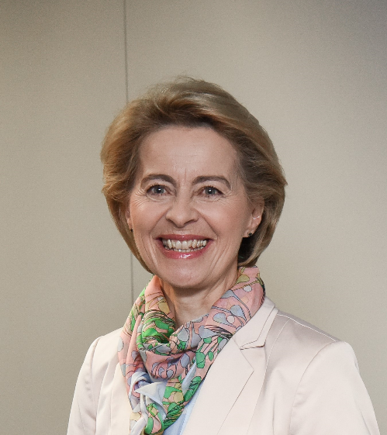
Three key players
The European Parliament
- voice of the people
David Sassoli, President of the European Parliament
The European Council and the Council
- voice of the Member States
Charles Michel, President of the European Council
The European Commission
- promoting the common interest
Ursula von der Leyen, President of the European Commission

