Slide 1
Glossary, science, A page 65
1. investigation
2. theory
3. research
4. studies
5. trial and error
6. variable
7. hypothesis
8. observing
9. researchers

Slide 2
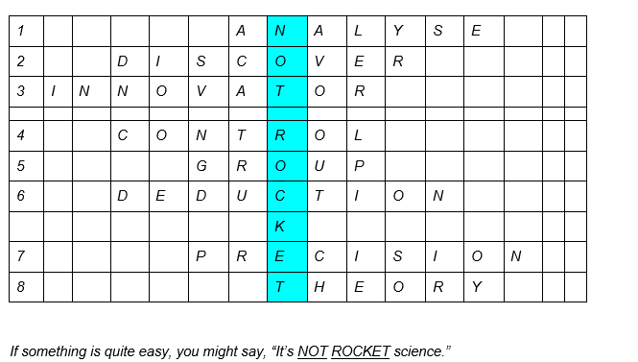

Slide 3
C
Where was this gadget/device/appliance assembled?
Do we already know how to recycle e-waste/electronic refuse?
The development of batteries enables shorter charging times.
Is artificial intelligence / AI able to generate/produce new information/data?
The precision/accuracy of these predictions is questionable.
The evidence was analysed/analyzed carefully.
Will today's technology be out-of-date/dated/obsolete/outdated as early as tomorrow?

