Slide 2
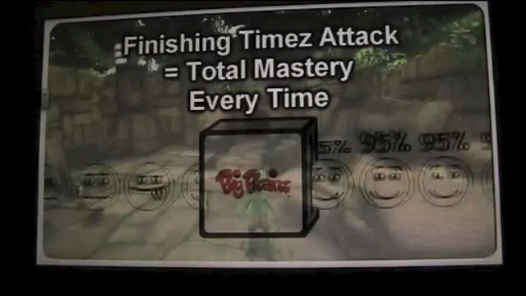
Timez Attack

Slide 3
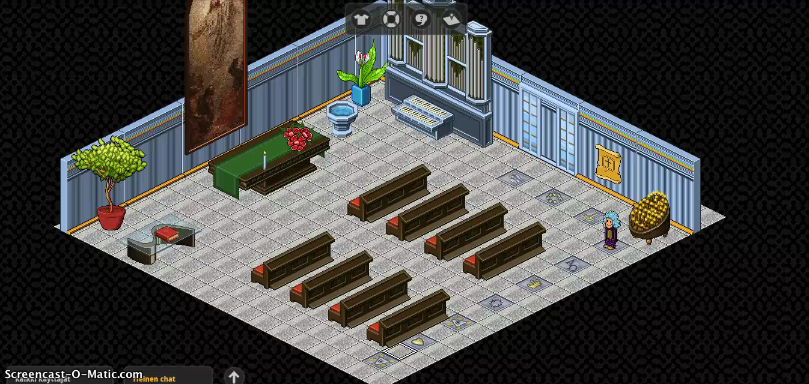
Lastenkirkko.fi (Childrens church)

Slide 4
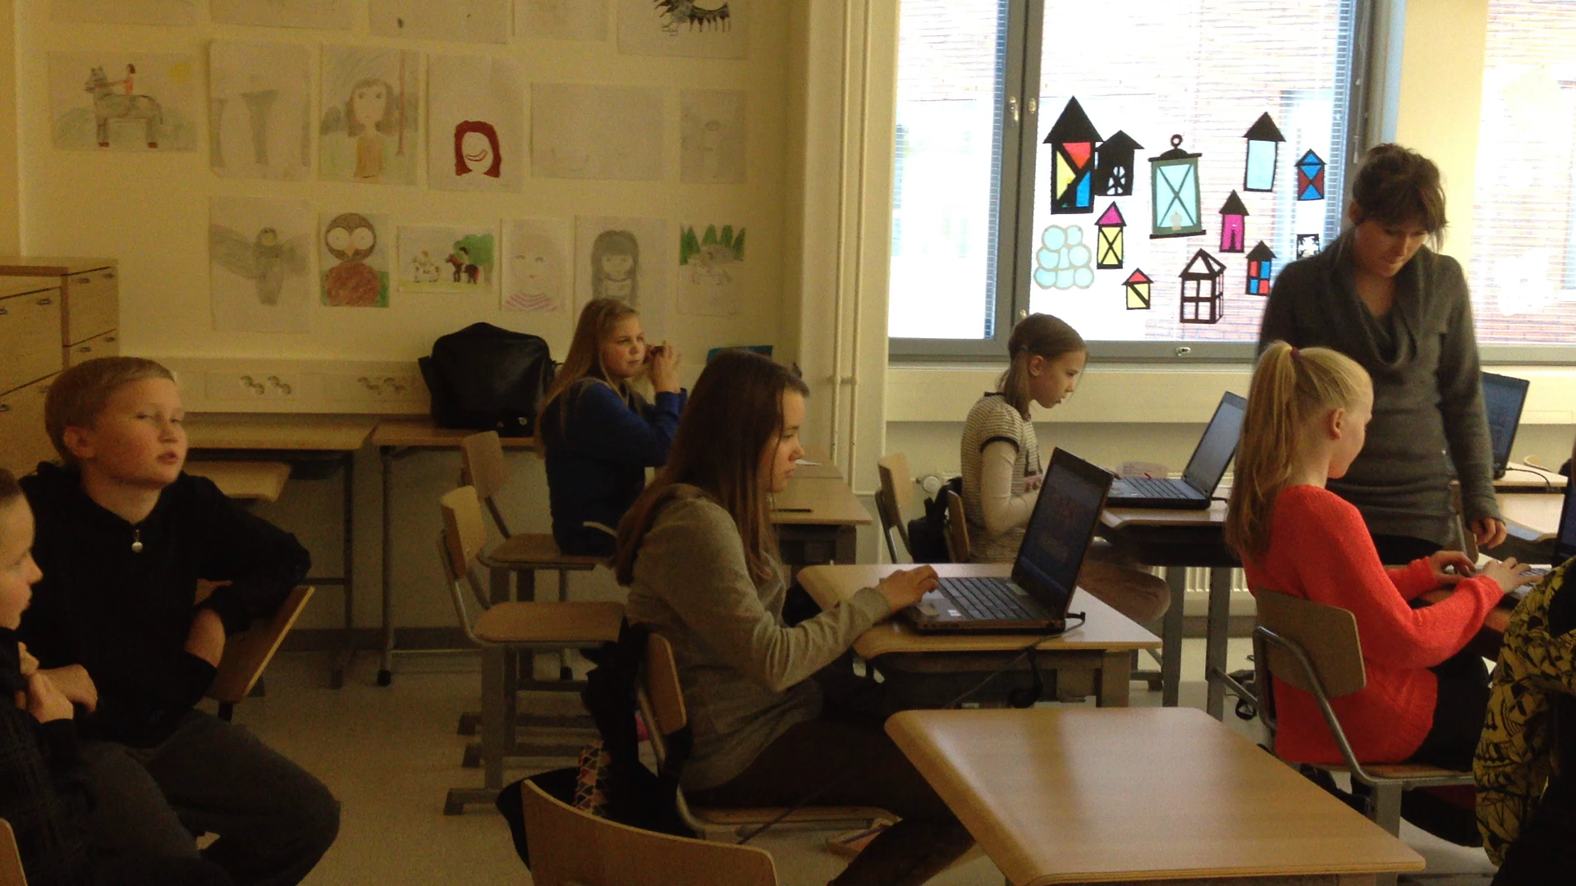

Slide 5
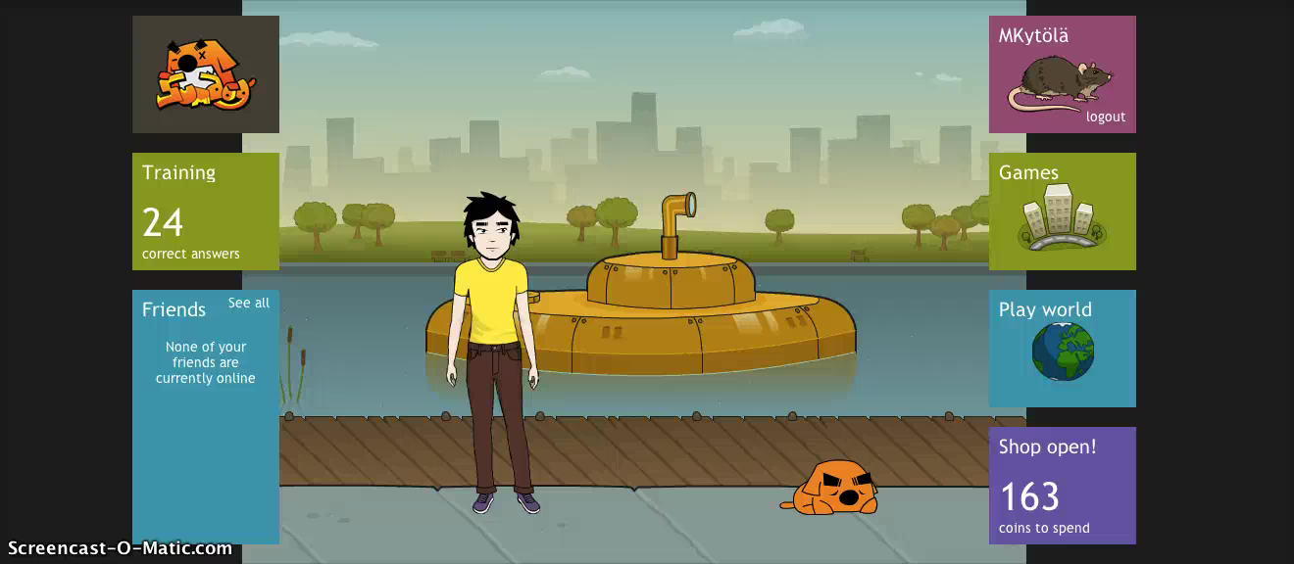
Sumdog

Slide 6
Sumdog.com

Slide 7
Sumdog.com

Slide 8
Sumdog.com

