Slide 1
Rev. Christine Downey
Rector of St Mary’s, Dalmahoy,
and Member of the International Committee
Rev. Sarah Shaw
Rector of Christ Church, Falkirk,
and Synod Clerk for the Diocese of Edinburgh

Slide 2
Spiritual Leadership
in the
Diocese of Edinburgh

Slide 3
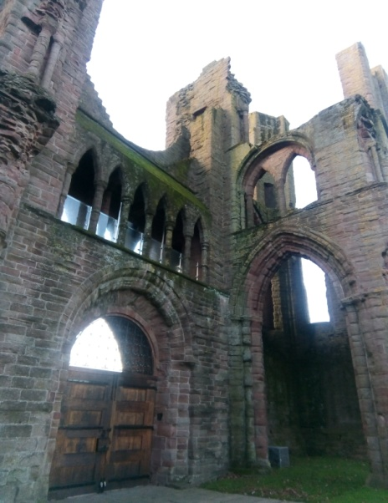
The origins of Christianity in Scotland
Monks came from Ireland to Scotland in the fifth century
St Columba found the monastic community on Iona in 563. Many monasteries were founded, over the centuries, such as Arbroath Abbey, above (now a ruin)
After the Scottish Reformation which started in 1560, the Scottish Church was at times Presbyterian, and at others Episcopalian, until 1690.
Some pre-reformation places of worship and artefacts can still be seen, entirely or partially

Slide 4
Monastic origins
In the Scottish Episcopal Church, our monastic origins show themselves in the praying of The Offices – Morning, Evening, and Night Prayer.
Clergy are obliged to say Morning and Evening Prayer, either privately or publicly.
The Bishop prays for the Clergy and in turn, the Clergy and people of the Diocese pray for The Bishop.

Slide 5
Commitment to prayer
Baptism vows
N., as a disciple of Christ will you continue in the Apostles‘ teaching and fellowship, in the breaking of bread and in the prayers?
Answer With the help of God, I will. (Or, when an infant is being baptised):
NN., as those who will love and care for N., will you continue in the Apostles‘ teaching and fellowship, in the breaking of bread and in the prayers?
Answer With the help of God, I will.

Slide 6
Commitment to prayer
The Ordination of Deacons and Priests
Bishop: Will you devote yourself to prayer, to reading the Holy Scriptures and to all studies that will increase your faith and deepen your understanding of the truth?
Answer: By the help of God, I will
(Scottish Ordinal 1984)

Slide 7
Spiritual Leadership examples
Welcome and Induction
Ministerial Review process
Diocesan Prayer Diary
Diocesan Mission and Ministry Committee (DMMC)/Advisor for Christian Life
‘Let us Pray!’ Diocesan Gathering 2024
Play Church – a Diocesan resource

Slide 8
Welcome and Induction; Ministerial Review
On arrival in the Diocese, Clergy are offered pastoral supervision (free, for 1 year)
Clergy are expected to have regular Spiritual Direction and an annual Retreat; help can be given to organise these
The annual Ministerial Review process is a ‘peer review’ system where each clergy person meets with one other, to review the past year of ministry
One of the aspects of this is to reflect on the following promise in the Ordinal: “Will you devote yourself to prayer, to reading the Holy Scriptures and to all studies that will increase your faith and deepen your understating of the truth?”

Slide 9
Diocesan Prayer Diary
The Diocese of Edinburgh publishes a ‘Prayer Diary,’ whereby the clergy and people of each Church are encouraged to pray for every other church, in a Cycle of Prayer
Included in the Prayer Diary are our friends in our linked Dioceses of Espoo, Cape Coast, Ghana, and Dunedin, NZ
We also pray for particular groups, such as our ministries to children and young people; older people; workplace chaplains; and religious communities
As of October 2023 we have a new religious community of Franciscan brothers in our Diocese, who pray, live and work in an urban priority area of Edinburgh.

Slide 10
DMMC Advisor for Christian Life
The Diocesan Mission and Ministry Committee (DMMC) (lay and ordained members) supports the Diocese in offering and promoting initiatives for spiritual and ministerial formation (study groups; gatherings; retreats; pilgrimages; quiet days; courses; prayer events)
The Advisor for Christian Life (a paid, Diocesan staff member) takes their work forward and keeps in touch with all Clergy and Vestry Secretaries to promote and organise such events.

Slide 11
Diocesan Gathering 2024

Slide 12
‘Let us Pray!’
Let Us Pray! 2024 Diocesan Gathering
Saturday 11th May 2024, from 10:30am until 3:30pm, in St Mary’s Cathedral. It is a free day for the whole Church family to learn, worship, and pray together.
Workshops:
A Prayer Walk; Lectio Divina; Imaginative prayer; The Examen; Bible journalling; Prayer and movement; The Lord’s Prayer in British Sign Language; ‘Stations of the Cross’ for the Climate Crisis; and more.

Slide 13
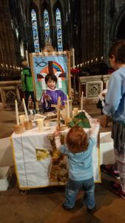
Play Church – a Diocesan Resource
Edinburgh churches have designed
and created a child-sized altar
to help children explore their faith
and church in a fun and unique way.
‘Play Church’ visits 6 churches a year.
Everything is child-sized, including
a Bishop’s mitre!
Notes:
Just as young children explore life
by playing homes and shops with child-sized kitchens and grocery stores, Edinburgh’s play church is made up of a beautifully carved and engraved altar, with drawers for items used in various church services.
It is portable, travelling to six churches in the diocese each year.

