Slide 1
Indicators for a Sustainable Future

Slide 2
Okka-background organisation: The Trade Union of Education in Finland OAJ
Sustainable Development Certification -system for Educational Establishments. System is financed by the Ministry of Education
Each educational establishment (early childhood-kindergarten, primary and secondary school, vocational school, arts education, liberal adult education) has their own priorities for sustainable future which are evaluated in eDelphi online future tool, if the institution participates in certification process.
In Finland there is 128 certified units since 2004
24 institutions of liberal adult education since 2014
Indicators for a sustainable future are a new innovation and reform to the sustainable certification system 2020-2022
Theoretical basis in transformative learning, future studies and learning organisation

Slide 3
Sertification process in Finland
Self-evaluation of the institution
Discussion of the results
Development plan
Implementation of the plan
Indicators for a sustainable future
External audit
The process of self-evaluation
Criteria for the basic level of operation
Development plan and commitment to implementation
Applying the certificate from the OKKA-Foundation

Slide 4
Kaukametsä civic college history of auditing
Sustainable Development (SD) program since 2012->
- What does sustainable development (SD) mean for us in different teaching subject areas, projects, communication, management, operating culture... etc.
- Updating the sustainable development program annually
- Documentation of actions
- sustainable development coordinator, who is allocated hours and working time for development work
Annually self-evaluation
- We have annual self-evaluation day, where SD-actions are reviewed and new ones are planned.
- Sustainable development is brought up especially in public lectures, meetings, subject group meetings, communication. Partnerships are sought from sustanainable development operators
- Participating in SD-projects and possible pilots, acquiring updated SD information and studying
Auditing 2014, 2017, 2020 and 2023
We have participated in planning and piloted with OKKA and other liberal adult education organisations the audit criteria for liberal adult education in 2012.
-Auditor qualification 2014.
At Kaukametsä liberal adult education college, the first audit in 2014 was the busiest. Over the years, the assessment forms and evaluation methods of audits have become more future- and development-oriented.

Slide 5
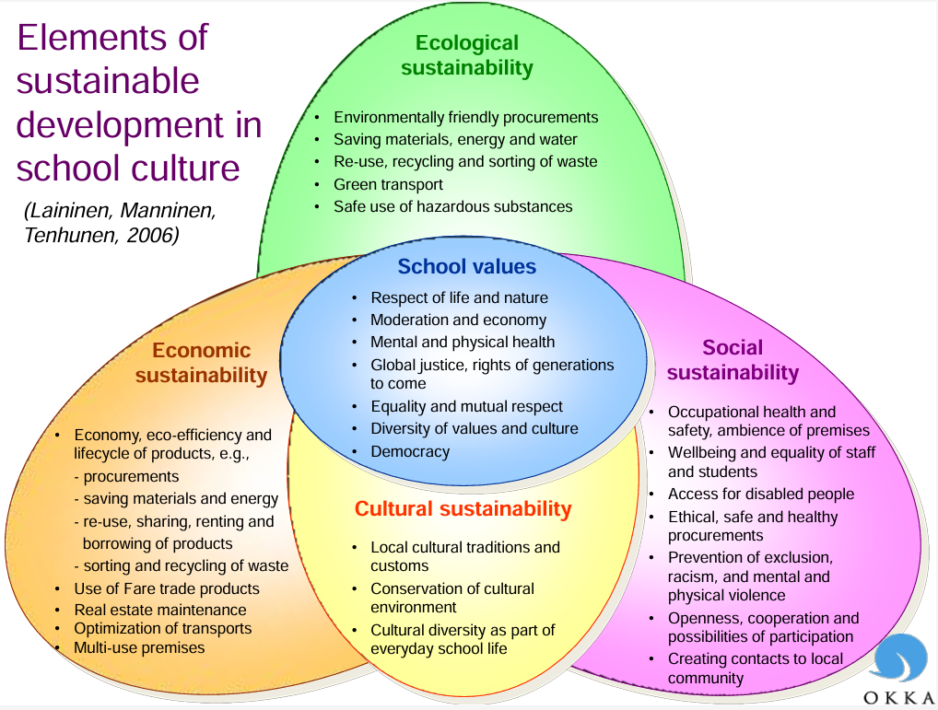
Kaukametsä civic college
Ecological and economic goals:
reduces the need for raw materials and other resources
reduces energy consumption
reduces the amount of waste generated and the costs of its processing
reuse materials
increase the use of digital tools, remote working, distance teaching
-> Operational culture, teaching, management
Cultural and social goals:
improve safety
prevent exclusion
increase well-being (Loving, Being, Doing, Having)
to increase the nurturing of cultural heritage and multiculturalism and domestic internationalism
value education in accordance with the eco-social concept of civilization
-> Operational culture, teaching, management

Slide 6
Levels of learning (teaching, management, operational culture)
1) Reproductive orientation Doing things better PRODUCTIVITY | 2) Proactive orientation Doing better things INNOVATIONS | 3) Transformative orientation Renewing our relationship with the wolrd REDEFINING THE NEEDS
Reason
Reason + experience
Reason + experience + imagination
Adapted from Arto O. Salonen, lähteitä: Sterling (2003, 2010), Bateson (1972)

Slide 7
1. Relationship with society
Networked
Global perspective
Transformation of society as a goal of the organisation
2. Work community
Interaction and diversity
Co-creative organisation
Transformative partnerships
TRANSFORMATIVE EDUCATIONAL INSTITUTION
4. Learning
From individual learning to organisational learning
Learning as making a change
3. Future orientation
From foresight to utopias
Shared visions as the drivers of change

Slide 8
The contents of the indicators
Indicator | Reproductive | Proactive | Transformative
TEACHING | Knowledge | Experiences | Meanings
 | Opportunities for influencing | Relationships | Alternative futures
 | Sustainable practices | Ethics | Changing society
OPERATIONAL CULTURE | Environmental guidelines | Responsible behaviour | Influencing stakeholders
 | Health and safety norms | Community and interaction | Compassion, human dignity
 | Adaptation to operational culture | Shaping the operational culture | Cultural transformation in society
MANAGEMENT | Reactive and preserving | Proactive and reforming | Transformative and sustainable
 | Control and uniformity | Participation and diversity | Shared values and visions
 | Skilled individuals | Learning organisation | Learning networks

Slide 9
Characteristics of the three orientations
++
TRANSFORMATIVE
Encounters, sharing, meanings
Change agency
Embodied
experience
Visions and utopias
?
+
TRANSFORMATIVE ORIENTATION
REPRODUCTIVE
PROACTIVE
Support and safety
Narrowing perspectives?
Critical
Broadening perspective
REPRODUCTIVE ORIENTATION
Reaching towards the future
Bedrock
Preventing reformation?
Seeing the whole
+
++
PROACTIVE ORIENTATION

Slide 10
Kaukametsän opisto has thought about how the Agenda2030 sub-areas should be displayed in its own operations
Finland's plan includes two priorities:
* Carbon-neutral and resource-wise Finland
* An equal, equal and competent Finland

Slide 11
What kind of world we want to live in? How we can reduce inequality, strive for equality and be happy?
Inequality is influenced by four significant resources: income, wealth, education and power. Life conditions are unequal for different people in our world, also in Finland, and existential conditions are also unequal, unfortunately. Examples of existential conditions are racism, unequal treatment of men and women, the status of the disabled, the effect of sexual orientation on being a person. Different groups of people have different amount of right, different amount of power, different amount of wealth.
How do we guarantee that, for example, young people of special needs (ADHD, Autism, Tourette…) do not fall out of our system, get sidelined. How to guarantee their equal rights to succeed in life. How to guarantee the inclusion of disabled people in our society. How to guarantee respect for cultural diversity. How can liberal arts work and civic college be involved in helping ensure that no young person of special needs, disabled person, member of a cultural minority, or elderly person is excluded because adequate inclusive support is not available?

Slide 12
The relational theory of sustainable well being
Civic college studies
A lifestyle based on the overconsumption of Western society
Ecosocial awareness: degrowth-thinking, personal ecosocial transition, coherence
Loving
Doing
Being
Having
Inter-
personality
Responsibility
Moderation
<
systemicity
Future and solution
orientation

Slide 14
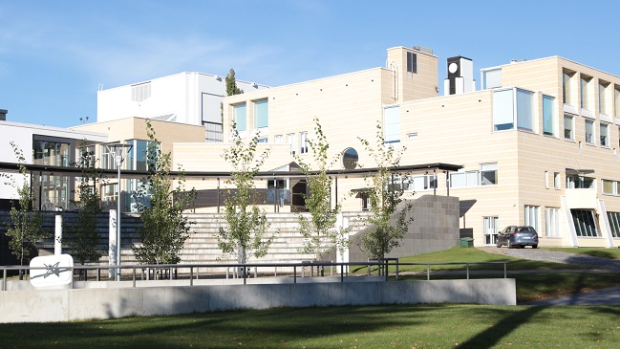
Thank you !

