Slide 1
AKADEMIJA UGNE KARVELIS GYMNASIUM
“SANUS PLANTA”
CALENDAR

Slide 2
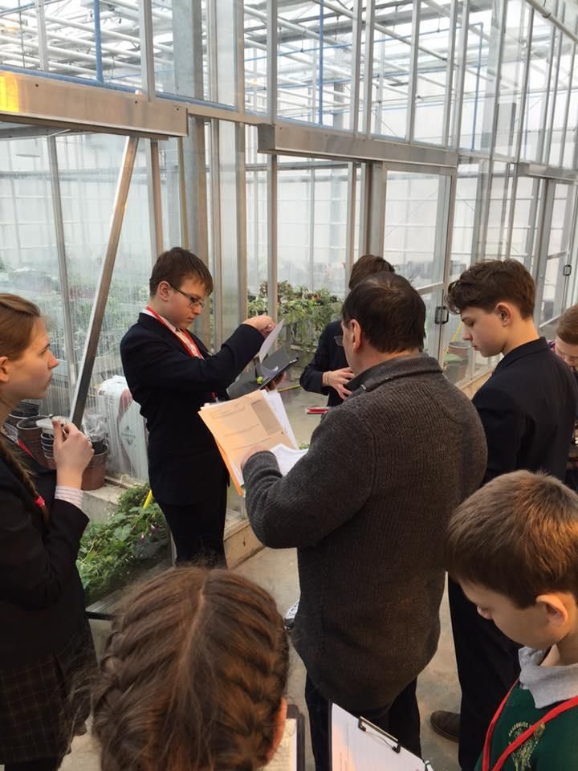
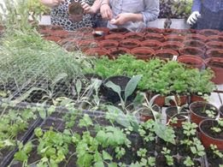
2016 March-May
Activities in A. Stulginskio university greenhouse.
Students with the help of teachers Lineta Bartkevičienės, Irena Gronskienė and Dalia Mikalauskienė raised plats.
Performs integral tasks (physics, chemistry, biology, mathematics)

Slide 3
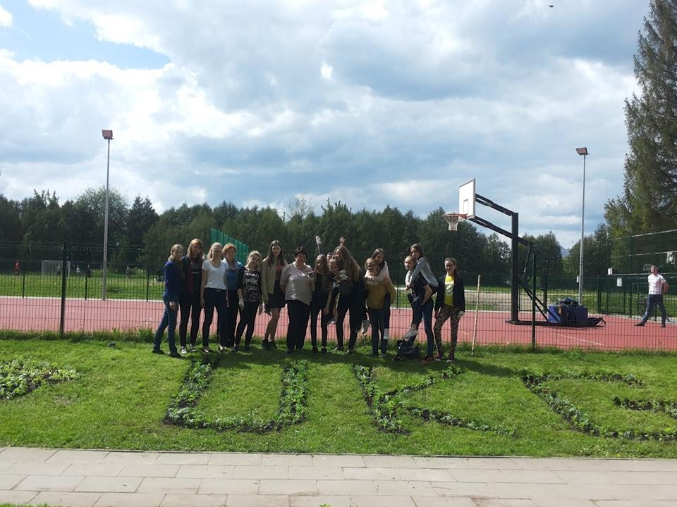
2016 June
Saplings are transferred into school yard.
Students vegetables saplings are takeing home for raising themselfs.

Slide 4
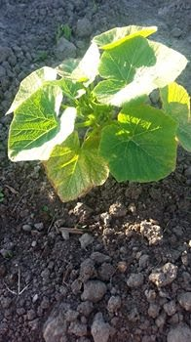
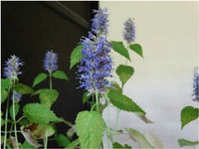
2016 July-August
Teachers and students are on vacation.
Plants, that are in school yard, are taken care by school janitor.

Slide 5
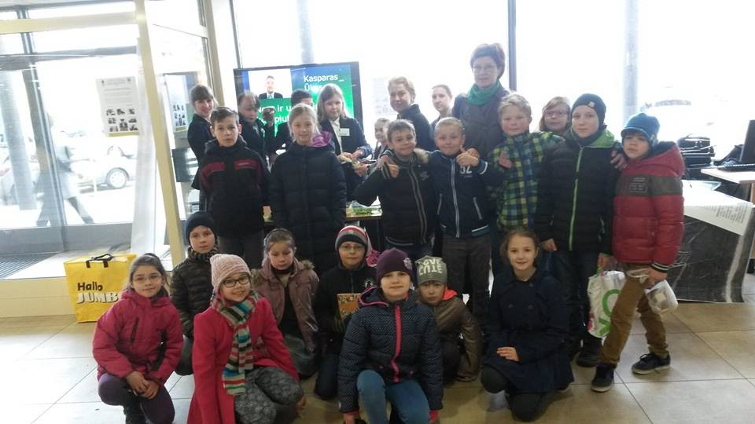
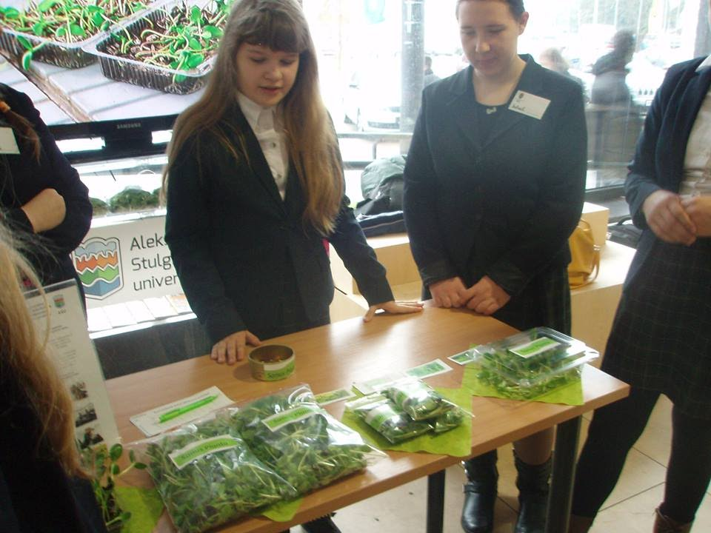
2016 September
Pumpkin exhibition.
Participation in exhibition “Decision circle”.
Starting natural science module “ Learning in and from nature” activities.
Takeing care of plants in school teritiry.
Implemented international project, for birds protection,“Spread your wings: birds’ world”
Implementation of the project “The sapling academy”

Slide 6

2016 October
Cleaning school area
Planting flowres (tulips, daffodils and saffron)
Takeing care of vertical plant growing wall
Preparing for winter

Slide 7
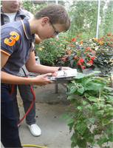
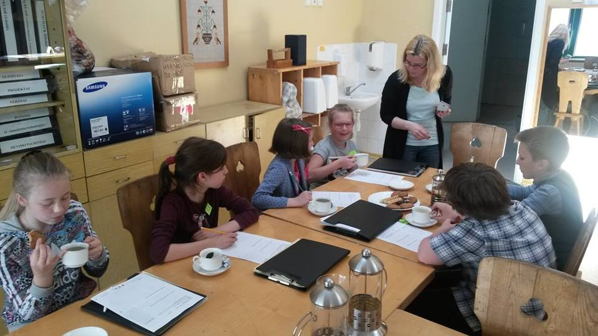
2016 November
Research work in greenhouse “ Interesting lessons”
“Cackes day” event. School’s community is tasteing natural tea, deep coffee and tasteing sweets
Planting apple trees in school yeard
Work calendar’s refill

Slide 8
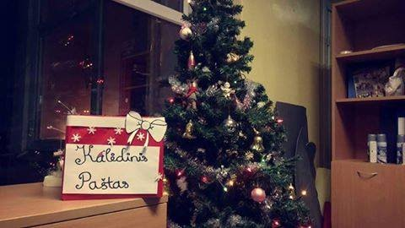
December
Decorating school. Waiting for Christmas.
Apple trees garden maintenance, preparation for winter
Working on project with Finland.

Slide 9
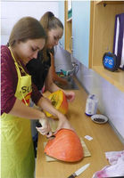

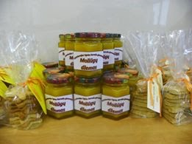
2017 January-February
“ Interesting lessons” in gymnasium.
Work planing in spring, buying seeds.
Birds care.

Slide 10
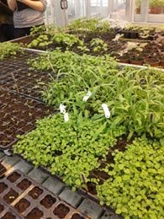
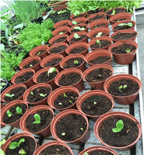
2017 March
Planting plants
Takeing care of plants in greenhouse( students preforms integrated tasks)
Working in universitys laboratory,
Project with Finland work.

Slide 11
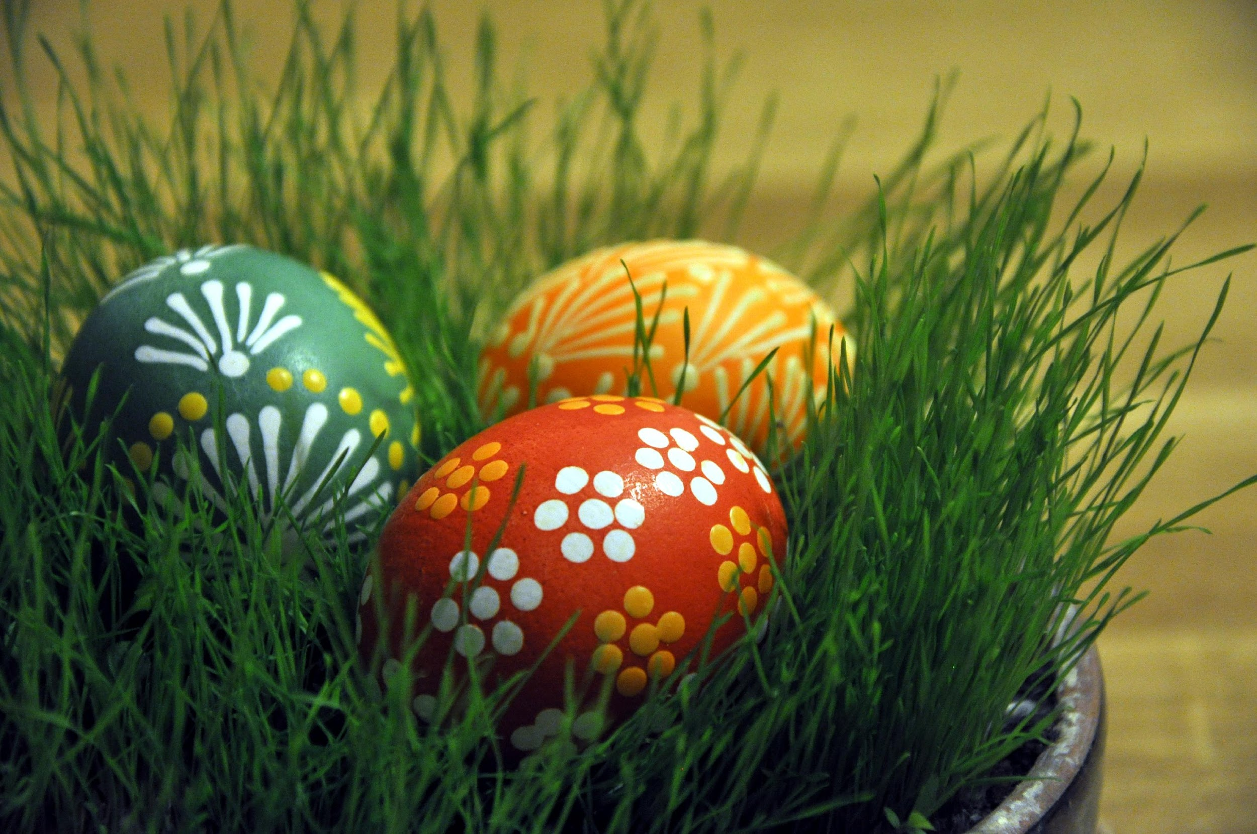
2017 April
Easter
“Egg rolling festival”
Takeing care of apple trees.
Trip to Finland.

Slide 12
2017 May-June
Planning work for summer
Planting takeing care of plants in gymnasium yard.

Slide 13
2017 July-August
Summer vacation

Slide 14
2017 September
Waiting for our guests from Finland

