Slide 1
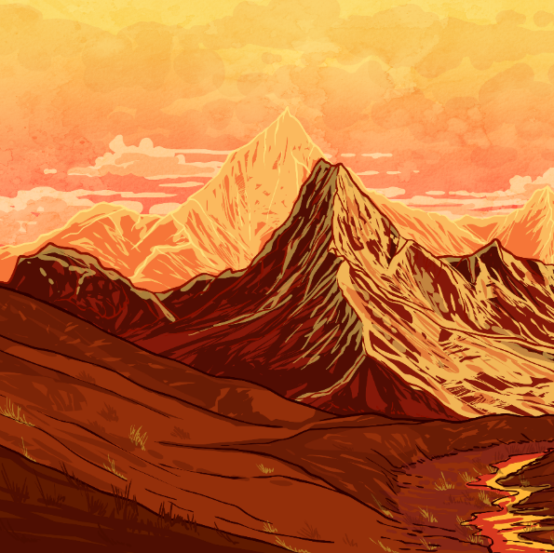
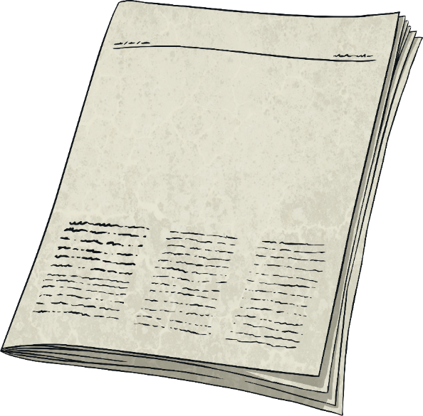
Headlines
Global
Warming
Talk about it.
Global warming is in the news a lot. What do you know about it?

Slide 2
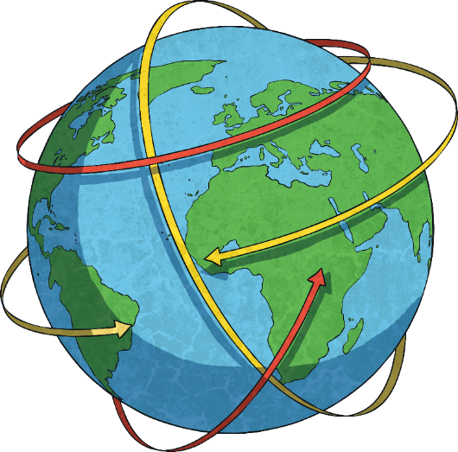
What Is Global Warming?
Global warming (a large part of climate change)
is the increase in temperature of Earth. Hotter
weather might sound lovely but the reality
is very different.
In the past century, the average temperature has risen by 1°C. This might not sound like very much, but this increase has had a huge impact on our planet.
The rate of the increase in temperature is increasing. This means that in the next 100 years, the average temperature is likely to increase by more than 1°C.

Slide 3
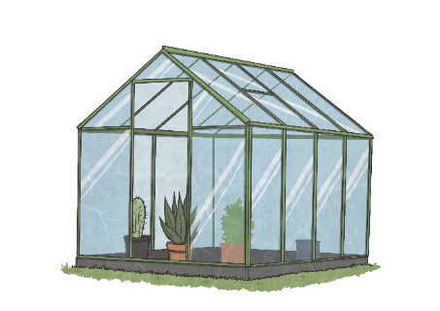
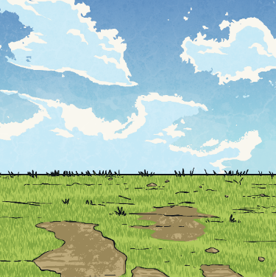
What Causes Global Warming?
Global warming is caused by greenhouse gases. These gases include carbon dioxide, ozone, methane and water vapour.
Have you ever been in a greenhouse? Even on a cold day, the temperature inside a greenhouse will be warmer than outside. Sunlight goes through the glass and the heat is trapped inside. Greenhouse gases do the same thing, acting like a blanket around the Earth, keeping heat in.
Greenhouse gases occur naturally. The average global temperature is around 15°C. Without greenhouse gases, scientists estimate that the temperature would be -18 °C!
However, human activity is causing more greenhouse gases, which means the temperature is increasing
by too much.

Slide 4
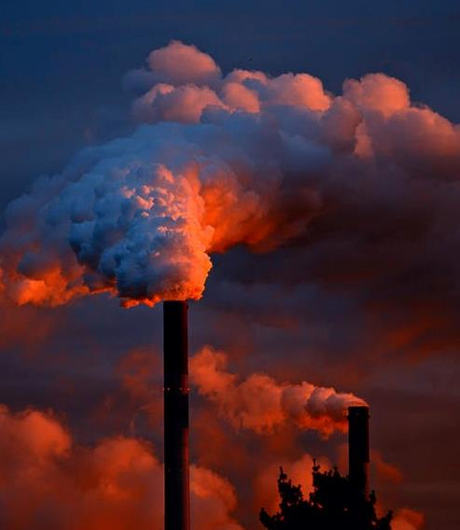
Humans Make Pollution
Human activity that has increased levels of greenhouse gases include the use of fossil fuels.
Fossil fuels are things such as coal, gas and oil.
They are burnt in power stations to make electricity and are used to run cars.
When fossil fuels are burnt, carbon dioxide is released. Carbon dioxide is a greenhouse gas.

Slide 5
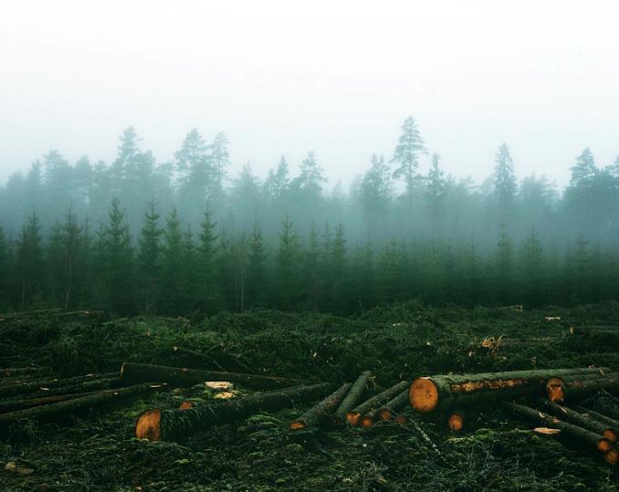
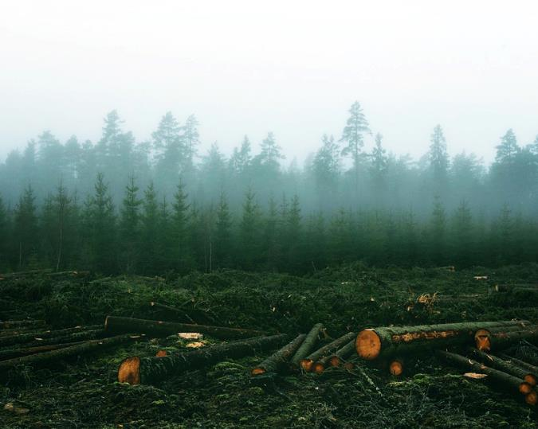
Humans Cut-Down Trees
Deforestation (cutting down huge areas of trees for different reasons, such as using the wood for fuel, building houses or factories) is another cause. Trees absorb carbon dioxide. Fewer trees means more carbon dioxide in the atmosphere.

Slide 6
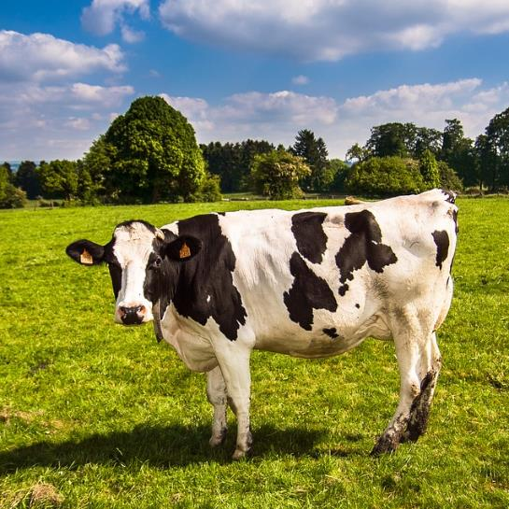
Humans Produce Food
Farming is important and without it we wouldn’t have food. However, some types of farming are contributing to global warming because of the greenhouse gases they produce.
Animals, such as cows, release a greenhouse gas called methane when they burp and break wind (that’s the polite term for it, you can probably think of other terms).
Fertilisers that farmers use to help plants grow well and pesticides to keep insects away release greenhouse gases.
The world’s population is over 7 billion and it
is continuing to grow at a fast rate. This means
more food is needed, so more farming is done.
This means even more greenhouse gases are
being produced.

Slide 7

How Is Farming Tackling Climate Change?
The farming industry have developed a Greenhouse Gas Action Plan that aims to reduce greenhouse gas.
Farmers are tackling climate change in a number of ways
Drones can be used to help farmers identify areas in fields that need treating for issues, such as weeds. The drone can target a certain area of the field where the problem is.
Battery-powered robots are being developed that will apply pesticides and fertilisers and sow seeds. Because the seeds are being applied one at a time, the need for ploughing will be reduced. Large-scale ploughing disturbs the top layer of soil and this releases a lot of carbon dioxide.
Farmers are also planting more trees and growing bigger hedgerows. Plants absorb carbon dioxide and produce oxygen as part of a process called photosynthesis.
Did You Know…?
Some companies say that manure can be used to generate electricity.

Slide 8
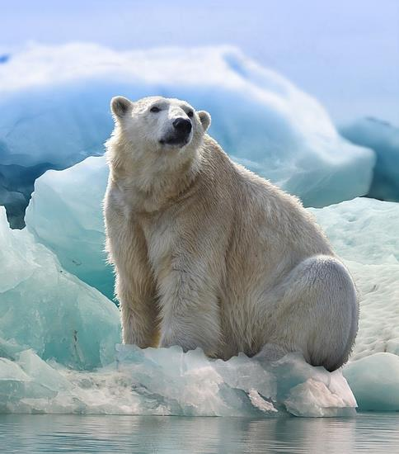
Global Warming Melts Ice
Global warming is causing ice at both the North and South Poles to melt.
This means animals, such as polar
bears, penguins and seals, are losing their habitats.
When ice melts, it turns to water. The melting polar ice caps are causing sea levels across the world to rise. Sea levels are rising at around 0.3cm per year. This could see coastal areas flooded, leaving less land to live on and grow food on.

Slide 9
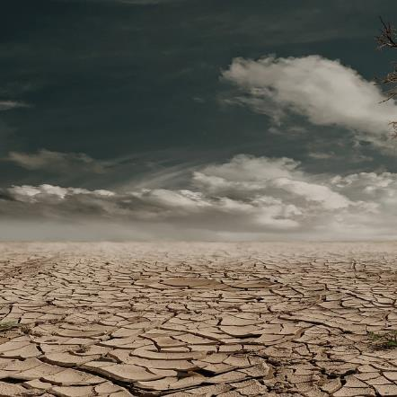
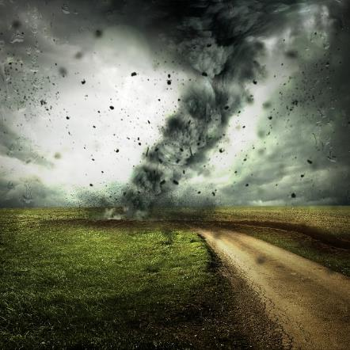
Global Warming = Hotter Temperatures
Hotter temperatures will result in droughts. Droughts not only mean less water for people to drink but also less water to produce crops for both humans and animals.
More heat causes increase in evaporation of ocean water which in turn increases the amount of water vapour in the atmosphere. This leads to more extreme weather, such as hurricanes and tornadoes.

Slide 10

Being Green
Saving electricity is a great way to be more green. You can achieve this by doing simple things, such as switching the lights off when you leave a room. (Make sure other people are not still in there!)
Appliances, such as TVs and computers, should be properly switched off and not left on stand-by when not being used. You could ask the grown-ups you live with to use energy-saving lightbulbs.
Reduce, reuse and recycle! Although recycling is very important, people need to think more about the first two parts of that phrase. Reduce the amount of waste you create and reuse whatever you can.

Slide 11
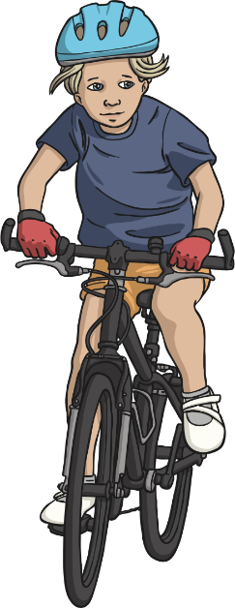
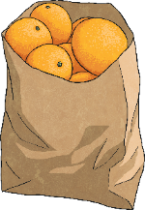
Being More Green
Living an environmentally-friendly life is the best way to help the planet.
Using less plastic and walking or cycling rather than using a car
makes a big difference.
Buying locally-grown food is another great way to be more green.
When food from the other side of the world is transported on
aeroplanes to our country, lots of carbon dioxide is released into
the atmosphere from engines of aeroplanes. A lorry transporting
vegetables from a few miles down the road is much more
environmentally-friendly.

