Slide 1
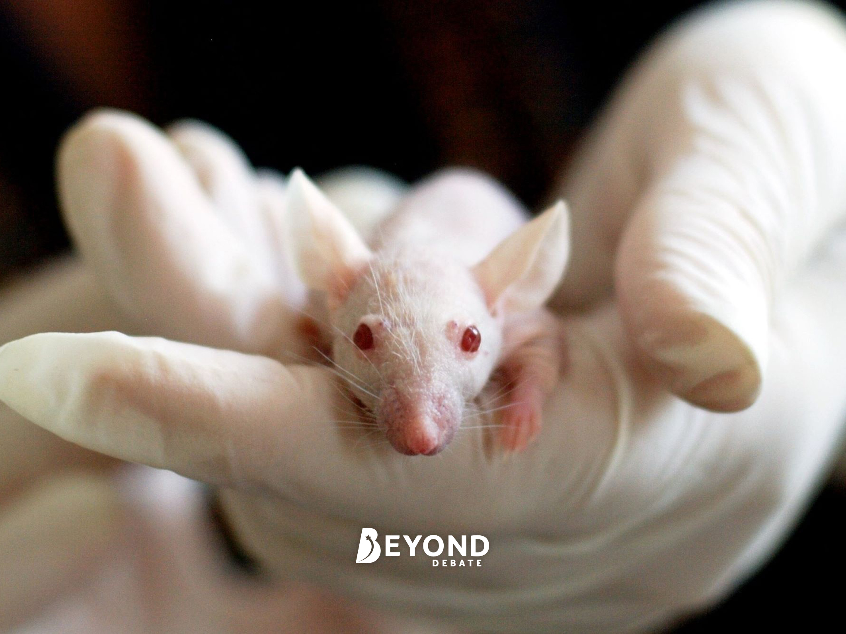
Should Animal Testing for Medicinal Research Be Banned?
Debate

Slide 2
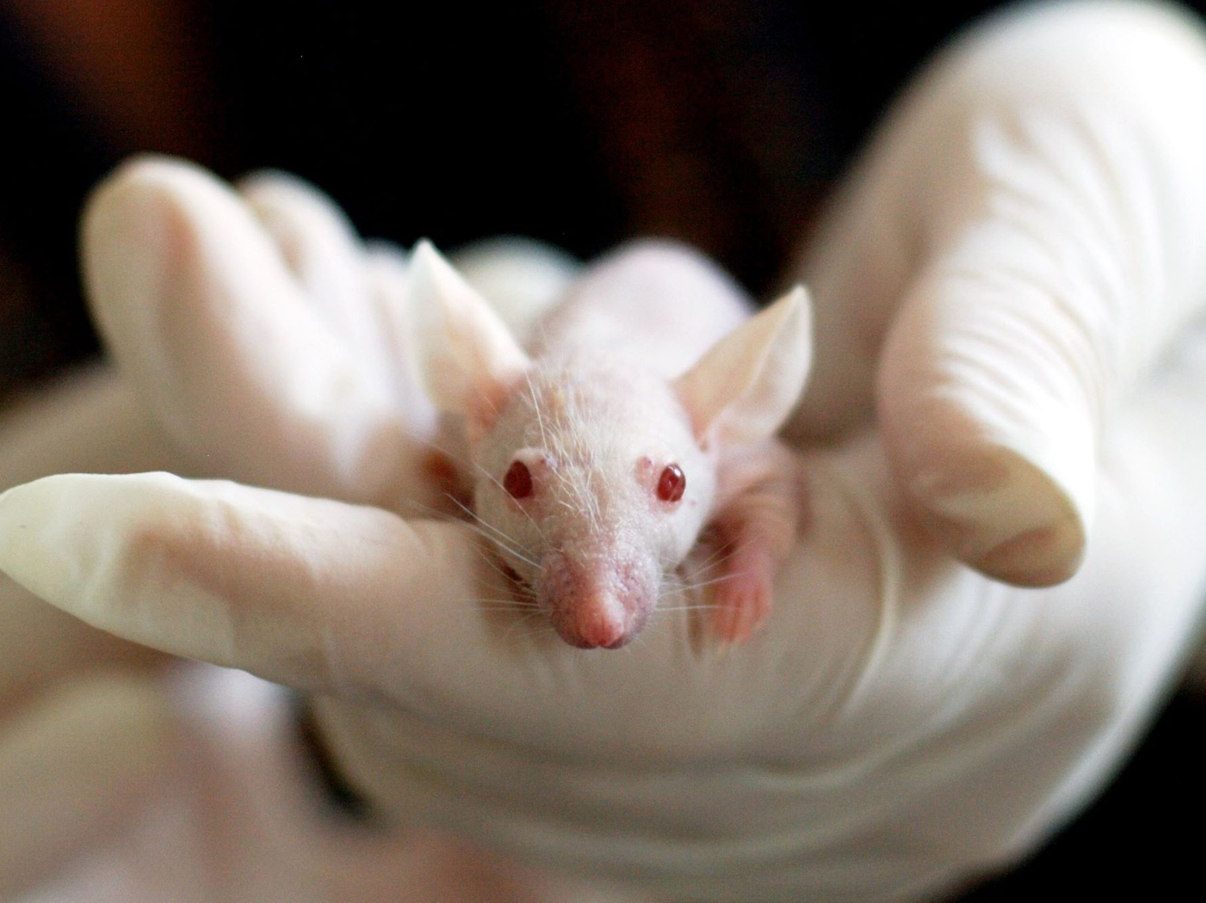
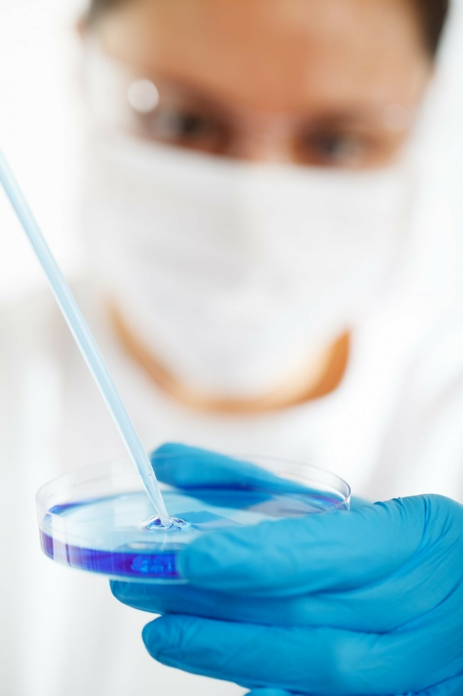
Animal Testing: The Context
Testing cosmetic products on animals has been banned for a number of years in the UK. It has also been illegal to sell cosmetics test on animals as of 2013 in the UK and the EU.
Testing on animals for the purpose of medicinal research, developing treatments and the creation and breeding of genetically altered animals remains legal. In 2017, almost 3.8 million animals were tested upon in the UK for these purposes.
Animals such as cats, dogs, monkeys and horses are exempt from testing without special reasoning and the most-commonly used animals are mice, fish and rats.
Should testing on animals for medicinal and scientific purposes be legal? Should the government look into alternatives?

Slide 3
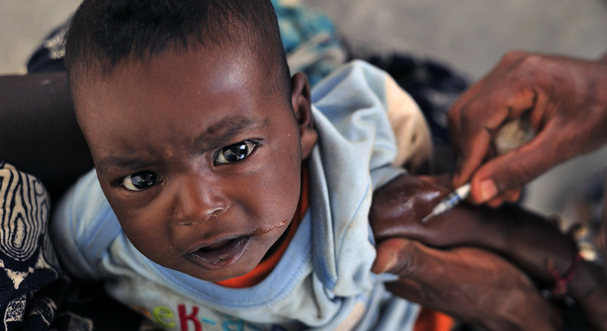
For and Against
Consider the benefits and costs of animal testing for the purposes of scientific research. Think about the potential suffering that animals may experience and weigh it against the potential to cure deadly diseases and illnesses.
Create a list of the pros and cons of animal testing.

Slide 4
Research Activity
Animal testing laws differ around the world and some counties have loose laws regarding testing while some are far stricter. Using the Internet, choose 4 countries and find out whether animal testing is legal, to what extent and whether there are any animals that this country will not allow testing upon.
Make a note of your findings and share them with the class.

Slide 5
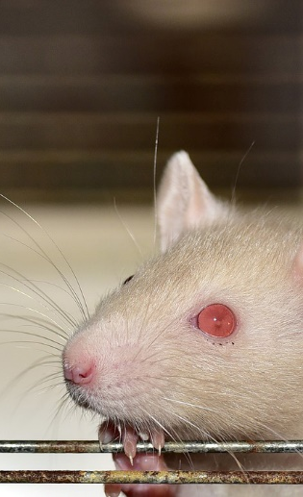
Personal Response
What is your opinion on the matter? Is it important to test upon animals for research purposes or are there alternatives?
Offer your own opinions on the matter: should testing upon animals for scientific and medicinal purposes remain legal?

Slide 6
The Big Question: Should Animal Testing for Medical Research Be Banned?
Working with your group, prepare a speech or presentation to tackle the question above. Consider the pros and cons and come to a conclusion that you can present to the rest of your class.

Slide 7
