Slide 1
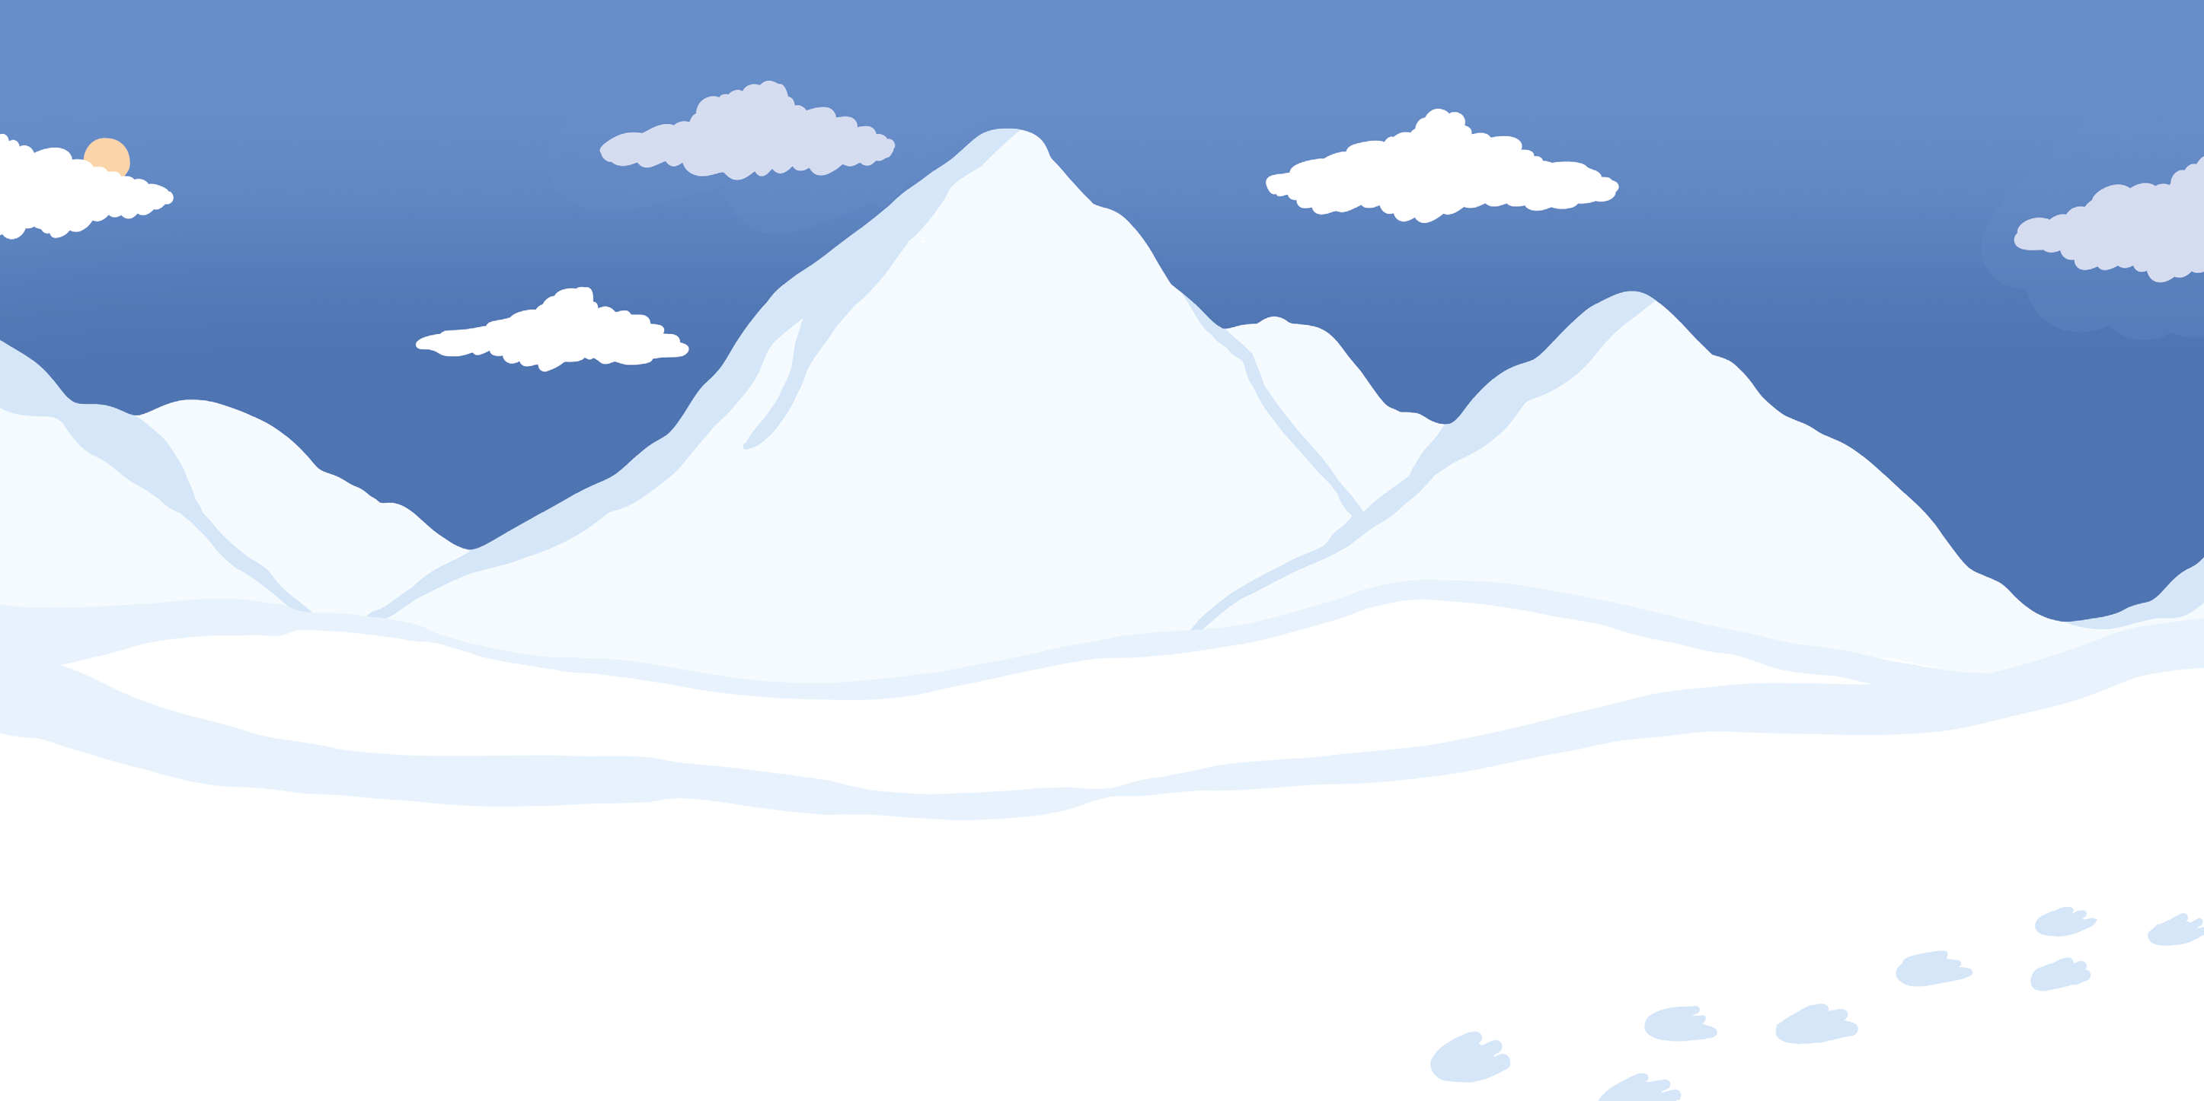
The Runaway Iceberg

Slide 2
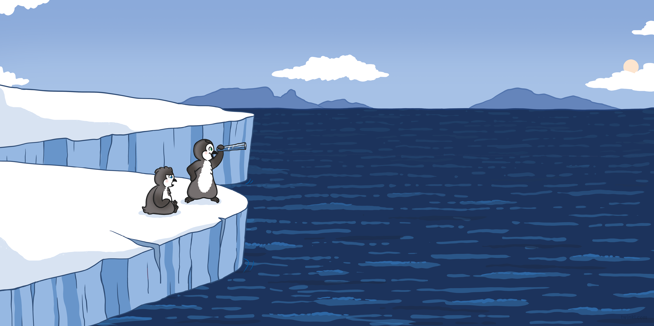
“Land ahoy!” shouted Rossi, looking out to sea with her telescope. “Shall we dive in and explore, Captain?”
“You know I don’t like swimming,” Gaspar said with a sigh.

Slide 3
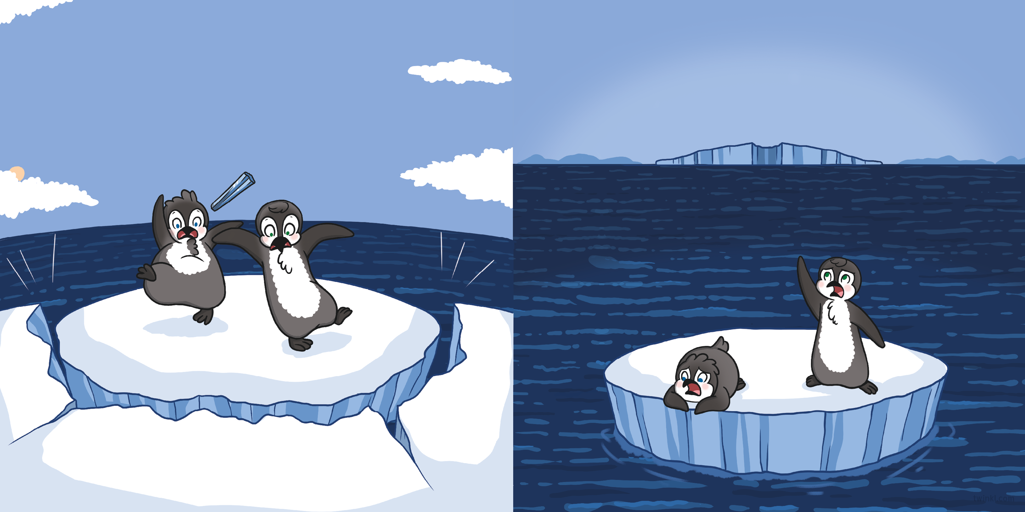
Suddenly, a cracking sound came from below them.
Before they had realised what was happening, a chunk of ice had broken off and Gaspar and Rossi were floating out to sea on an iceberg.
“Quick, swim!” shouted Rossi.
But Gaspar was afraid. “I can’t!” he cried, peering into the deep, dark sea below.

Slide 4
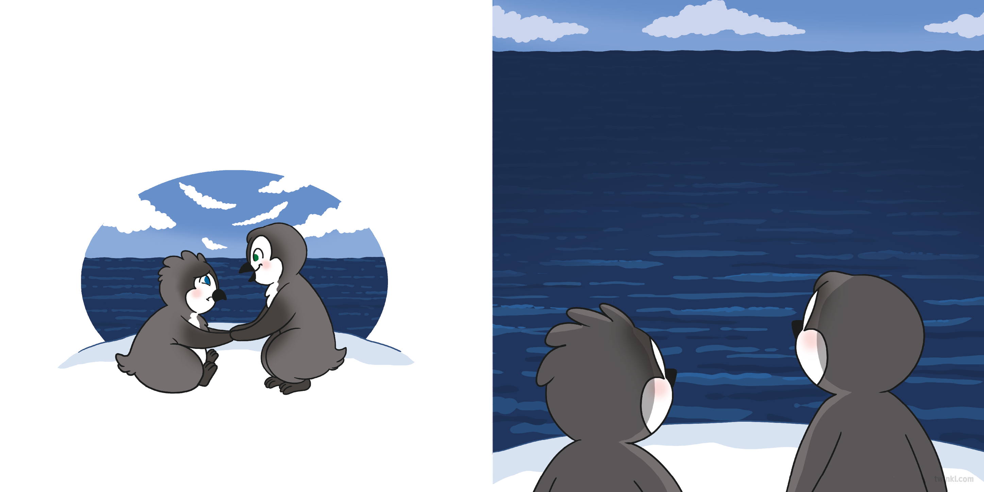
The iceberg floated out farther and farther until they could no longer see land.
“What are we going to do?” asked Gaspar, trembling.
Gaspar took a deep breath. “I guess we could use our flippers to row back,” he said. “But which way is home?”
“How will we ever get back?”
“We’re brave explorers, remember,” said Rossi, holding Gaspar’s flippers. “We will find a way.”

Slide 5
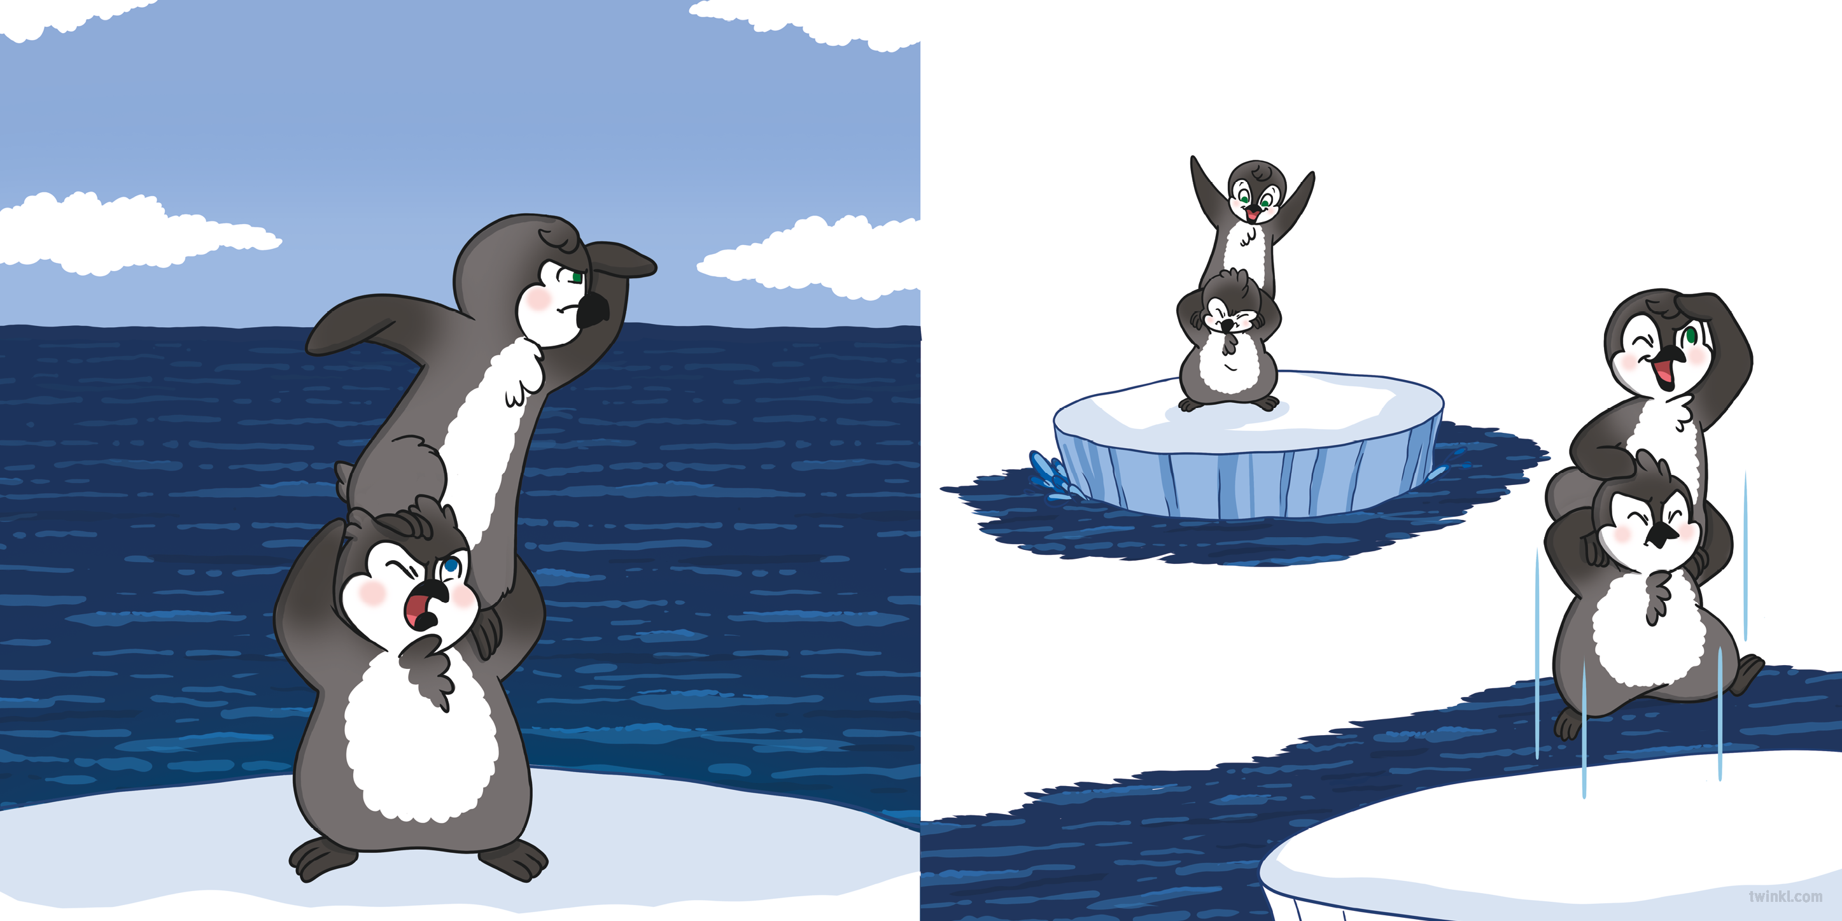
“Lift me up!” said Rossi. She climbed onto Gaspar’s head but she was still not high enough to see land.
“Try jumping!” she suggested, giving him a little nudge with her foot.
Gaspar jumped...

Slide 6
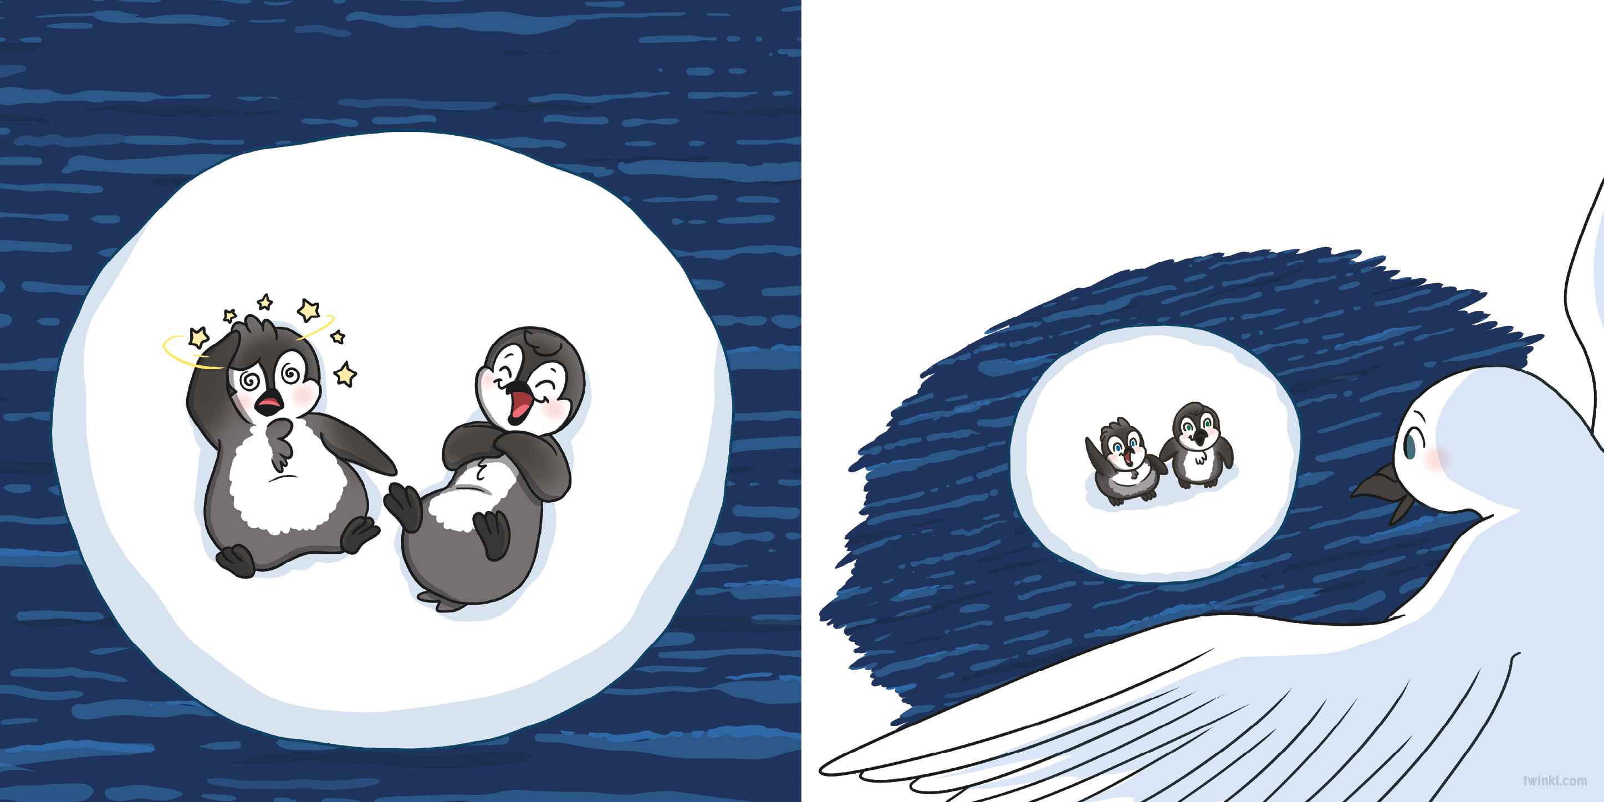
....and they both landed on the ice with a thud.
“Need some help finding your way?” asked a snow petrel from above.
“Oh, yes, please!” called Gaspar. “Which way is land?”

Slide 7
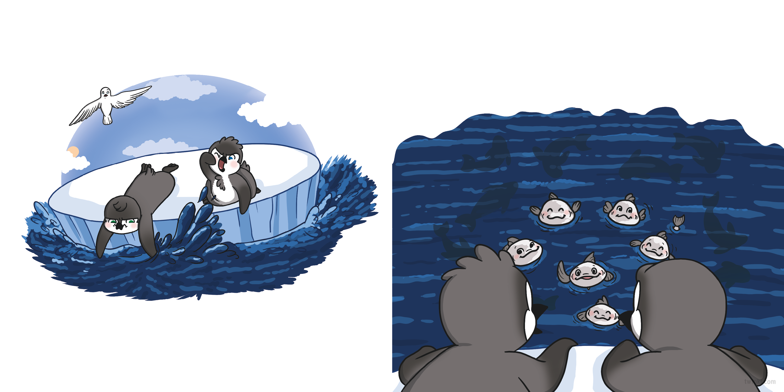
“It’s this way,” called the snow petrel, flying high above them.
“Need us to give you a push?” asked an Antarctic silverfish from below.
“Oh, yes, please!” called Gaspar.
Gaspar and Rossi used their flippers to row as hard as they could but the current kept pushing them the wrong way.

Slide 8
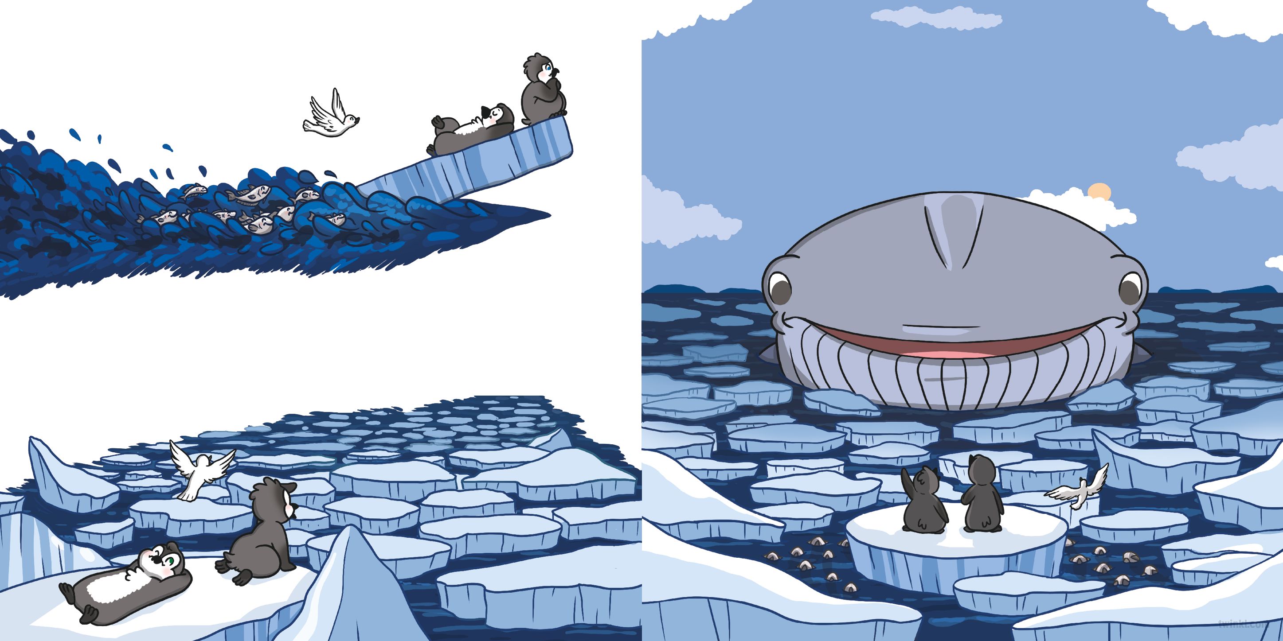
The silverfish pushed the iceberg along...
“Need some help breaking through the ice?” asked a blue whale from the deep.
“Oh, yes, please!” called Gaspar.
until suddenly, it became stuck.
“We’ll never get through here!” exclaimed Gaspar.

Slide 9
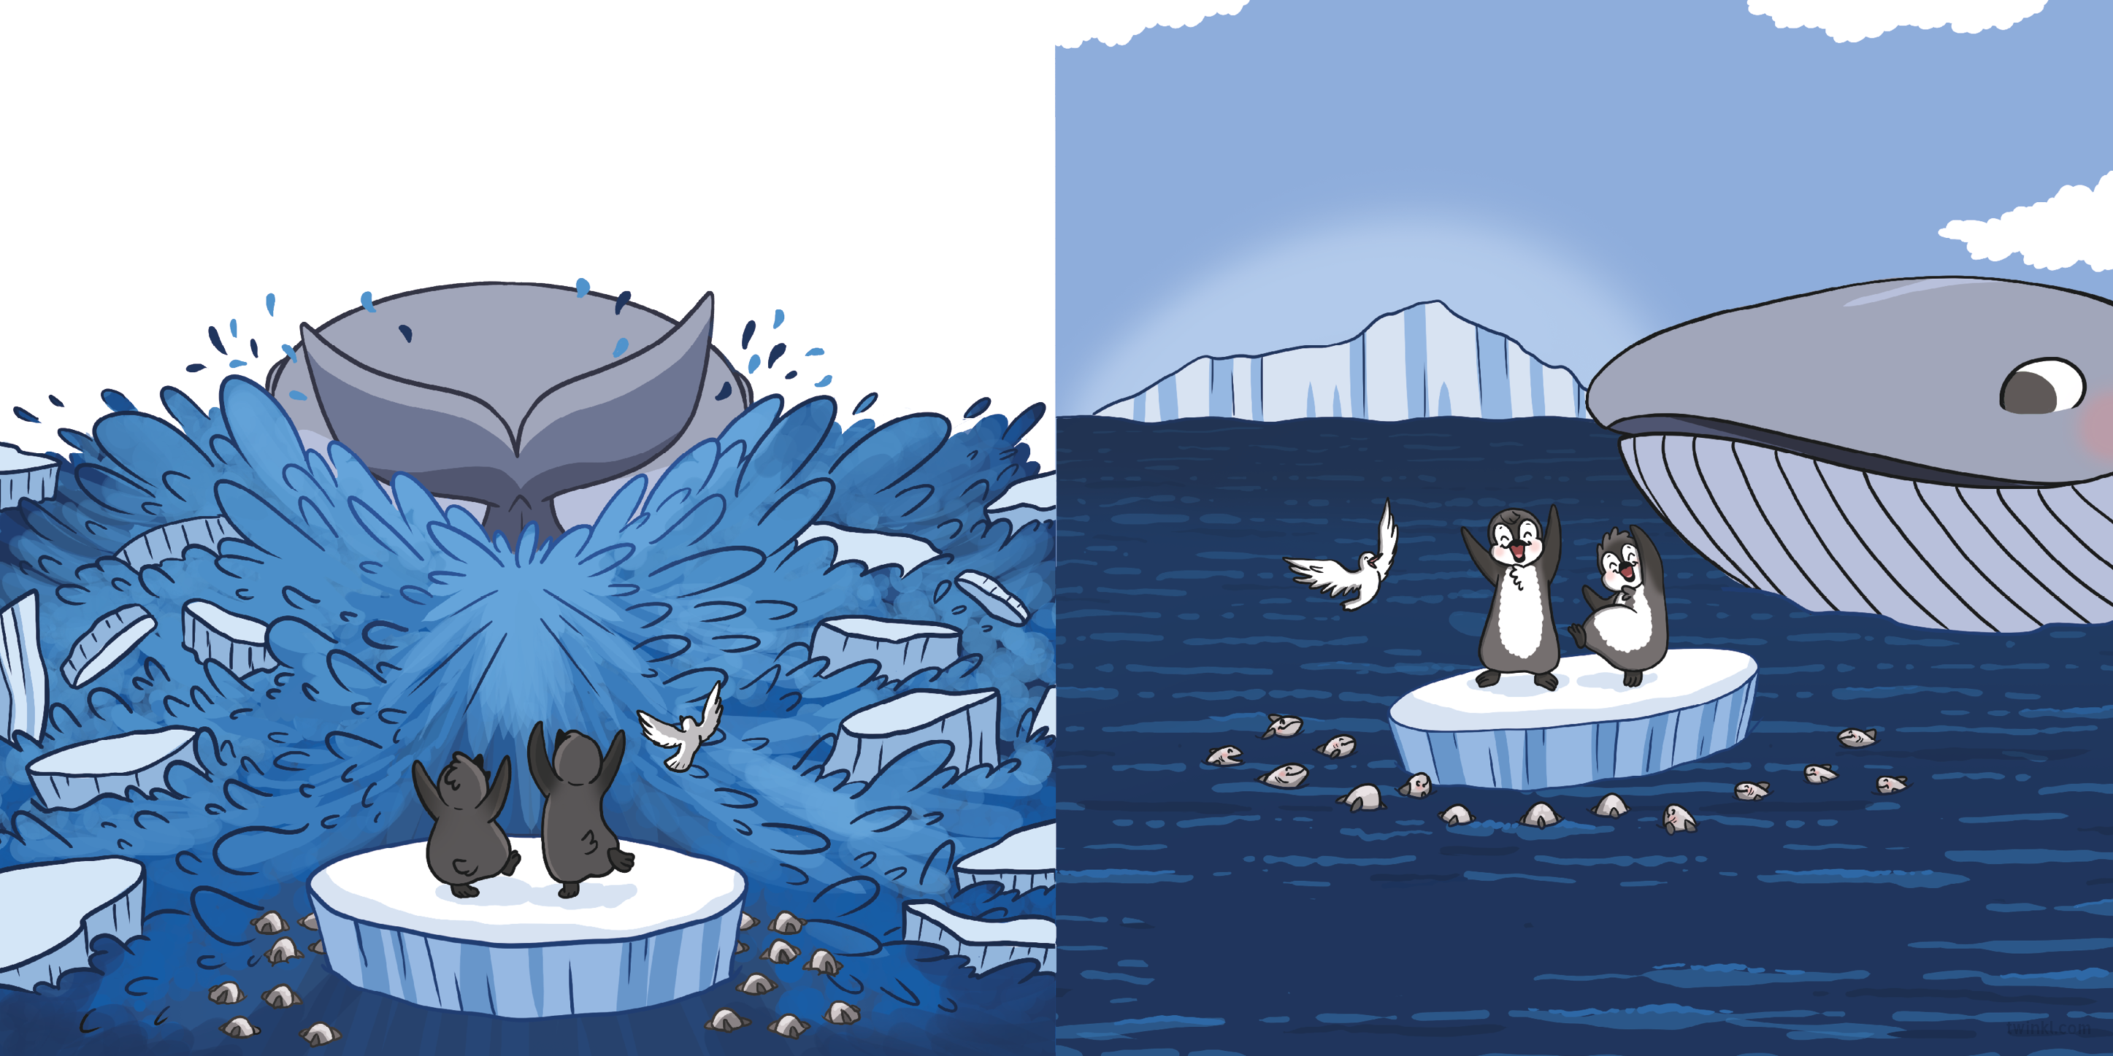
With a huge flip of its tail, the whale smashed the ice and cleared the way. Gaspar and Rossi bobbed along behind it, glad to finally be on their way back to safety.
“Land ahoy!” squawked the snow petrel.
“It’s all been a great adventure,” said Rossi, grinning. “We’re just like real explorers!”
The sun shone brightly in the sky as Gaspar and Rossi headed for home.

Slide 10
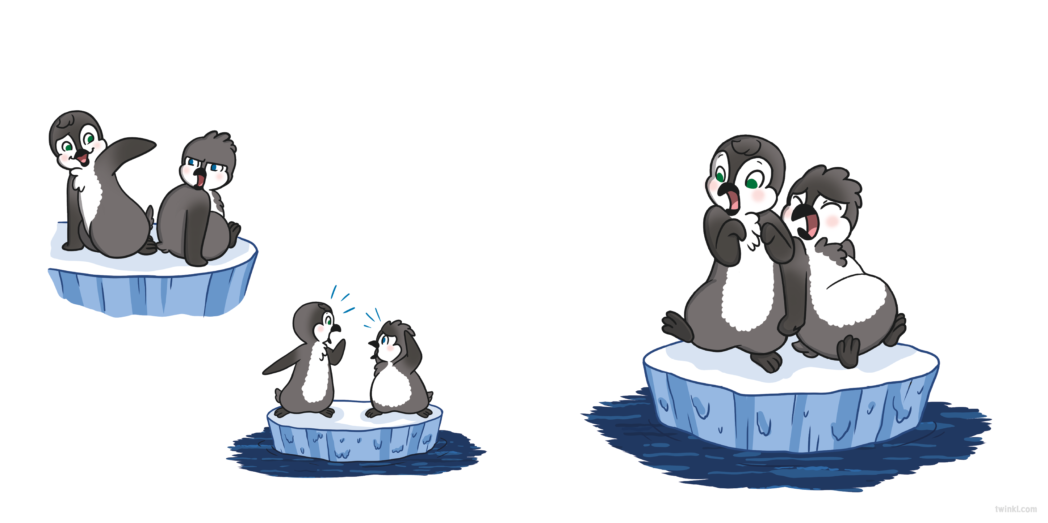
“Hey! Stick to your side, Captain!” laughed Rossi as Gaspar’s tail feathers tickled her feet.
and smaller!
“It’s melting!” shrieked Gaspar. “We need to move faster!”
“I’m right on the edge!” grumbled Gaspar.
The two penguins turned to face each other in shock. The iceberg was getting smaller…

Slide 11
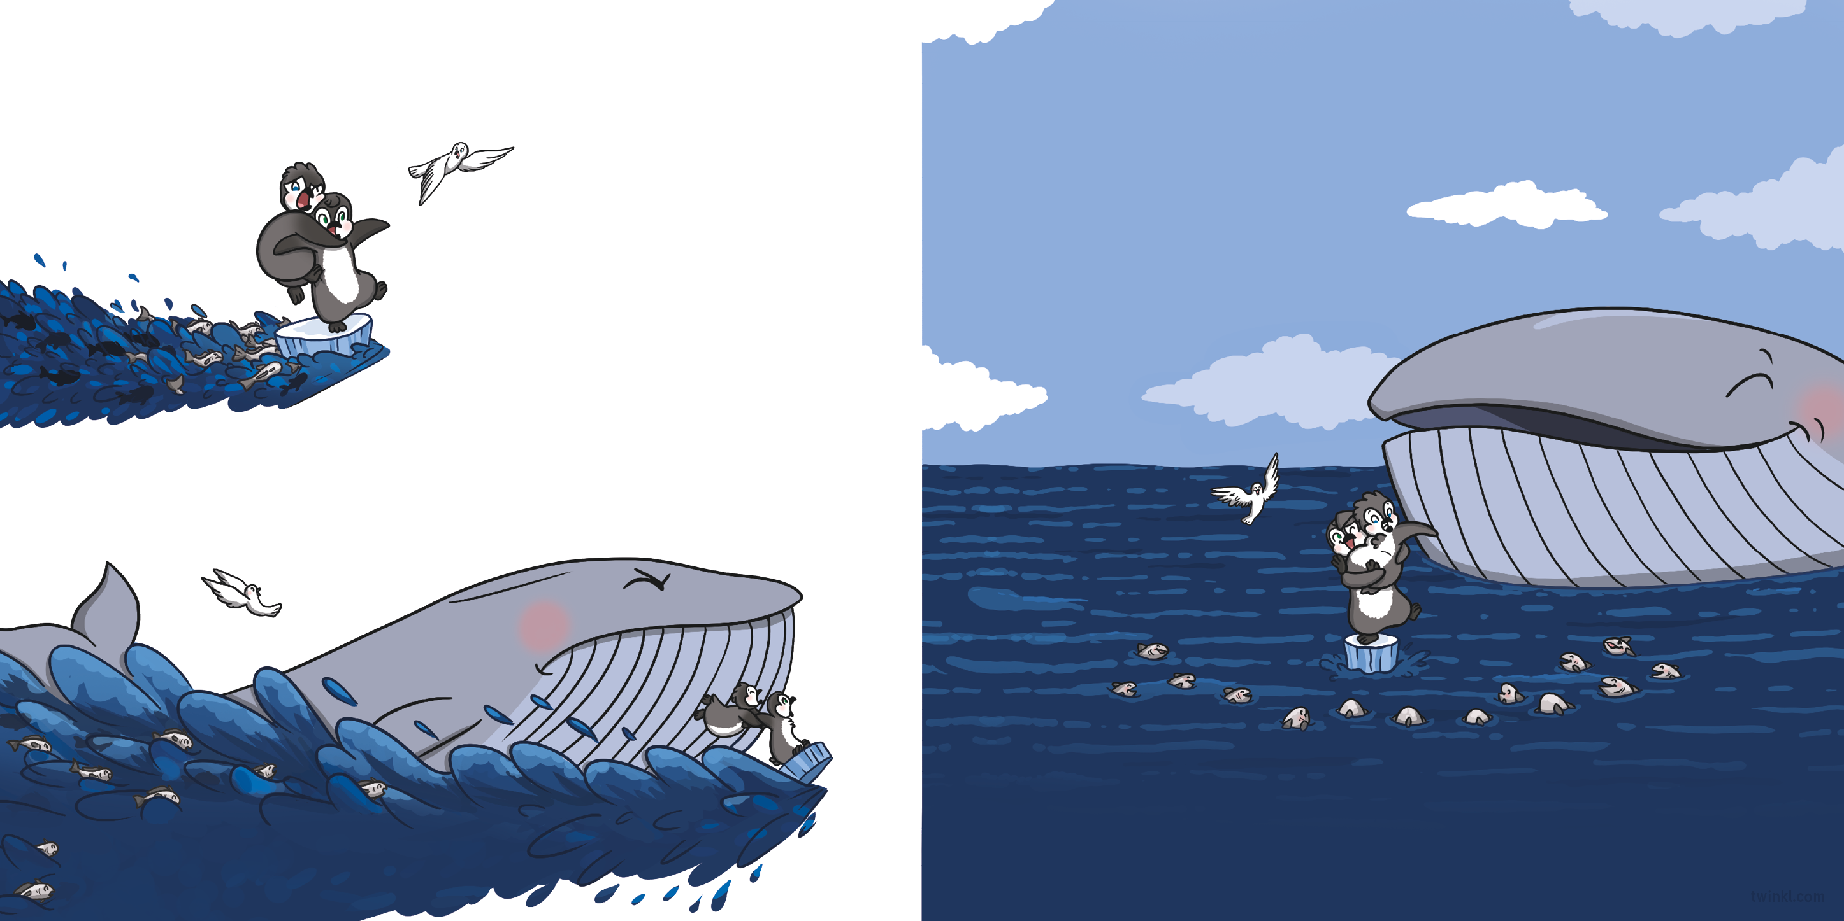
The silverfish swam quicker...
“We’ll have to swim from here,” said Rossi. “You can do this, Gaspar. I know you can. You are the captain, after all!”
The silverfish started to cheer.
“Gaspar! Gaspar! Gaspar!”
and the blue whale helped to push...
Soon, everyone had joined in, and Gaspar began to feel braver.
but the ice was melting too fast.

Slide 12
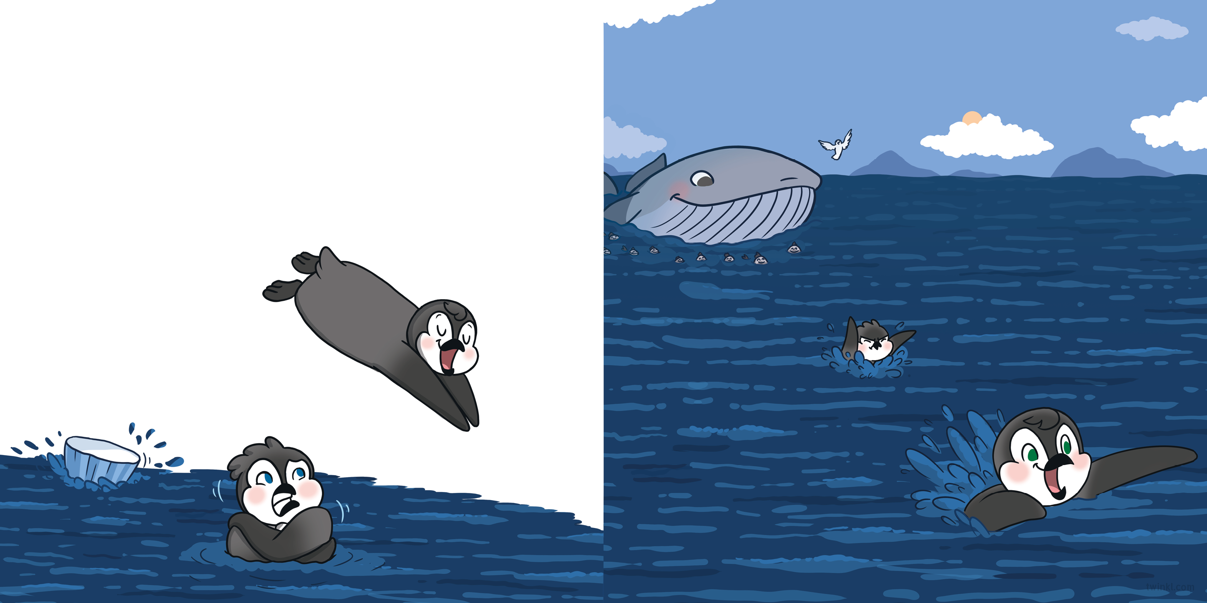
Gaspar gulped. Then, with one big jump, he sploshed into the water.
“Wheeeeee!” said Rossi, as she headed for home. Gaspar flapped his flippers and followed nervously behind.
“Brrrr!” he spluttered. “It’s so chilly!”
“Use your flippers!” shouted Rossi as she dived in over Gaspar’s head.

Slide 13
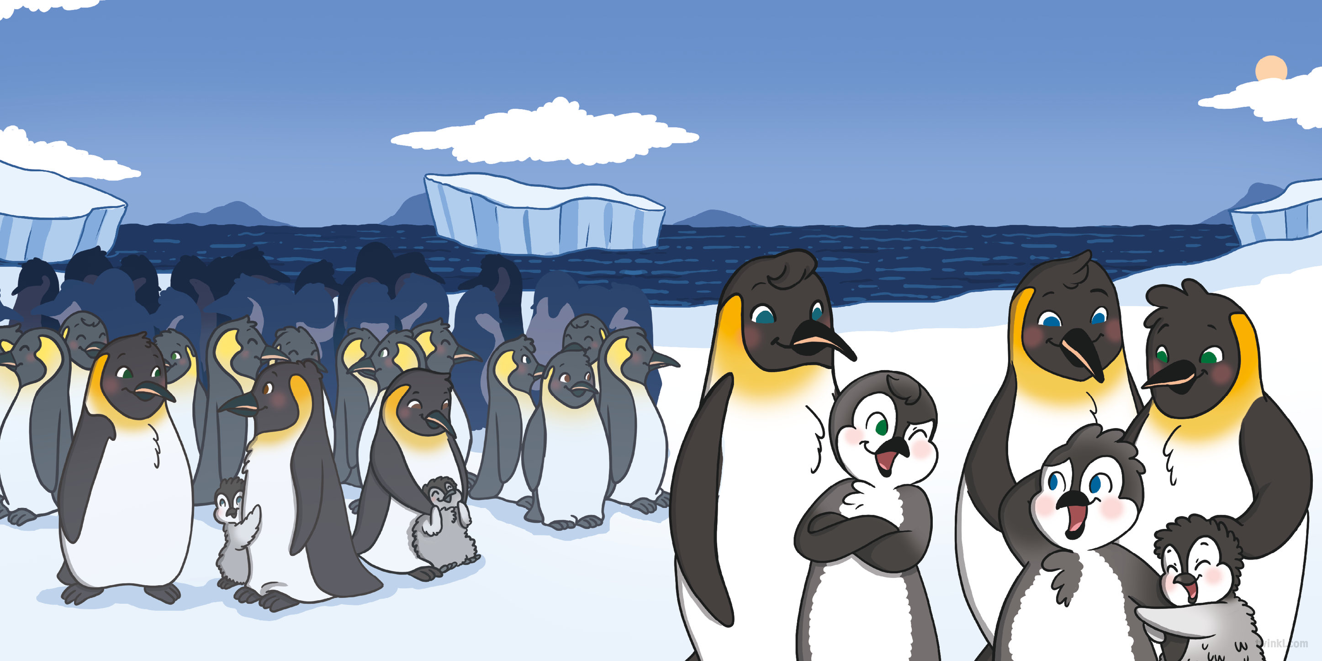
It wasn’t long before Rossi and Gaspar were back home with their families.
“You did it, Captain!” said Rossi. “You got us through our most dangerous adventure yet.”
“I guess I did!” agreed Gaspar, feeling proud. “But I couldn’t have done it without my trusty first mate.”

Slide 14
