Slide 1

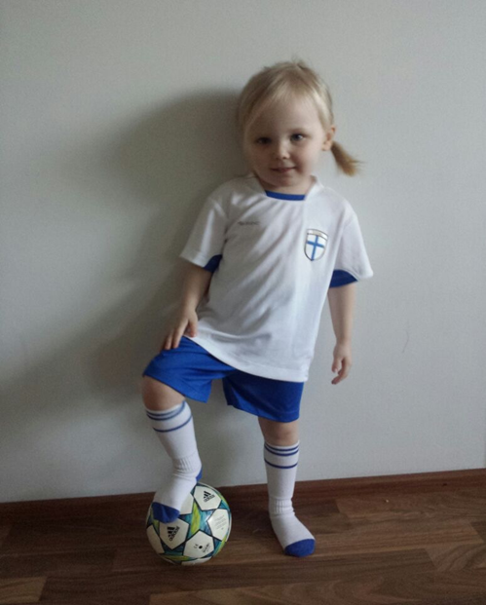
Mari Kääpä & Mariana Siljamäki
University of Jyväskylä
Faculty of Sport and Health Sciences

Slide 2


Education in Finland
A central objective is to provide all citizens with equal opportunities
Everyone has the right to basic education free of charge. The public authorities shall guarantee for everyone equal opportunity to receive other educational services in accordance with their ability and special needs, as well as the opportunity to develop themselves without being prevented by economic hardship. (Constitution of Finland)
The Finnish National Board of Education is responsible for drawing up the National Core Curriculum.
The National Core Curriculum is a national regulation, the basis of which the local curriculum drawn up.

Slide 3
National Core Curriculum 2014
The fundamental value is that every pupil is unique and has the right to high-quality education
  Pupils are heard, valued and encouraged.
  They feel that their learning and well-being matter.
  Pupils as active actors (independently and together with others)
  Joy of learning
  Use of modern information and communication technology (ICT)
Teacher autonomy in decision-making
  Curriculum set the goals of learning
  The teacher (highly educated, M.Scs.) makes the decisions on the learning environment, teaching methods and content of lessons

Slide 4
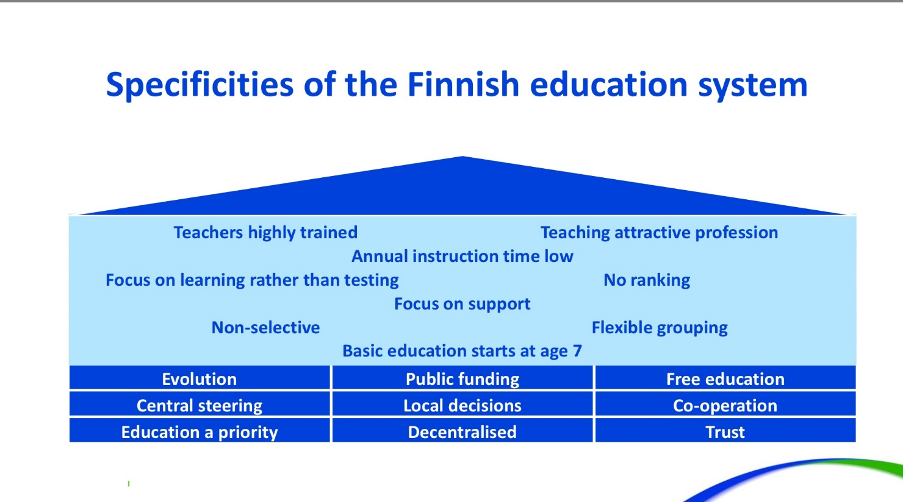

Slide 5
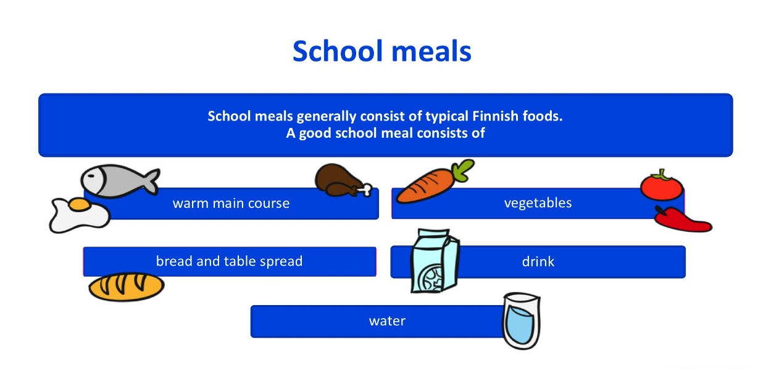
Pupil and student welfare
Collective and individual approach
Health care
School meals
Safety

Slide 6
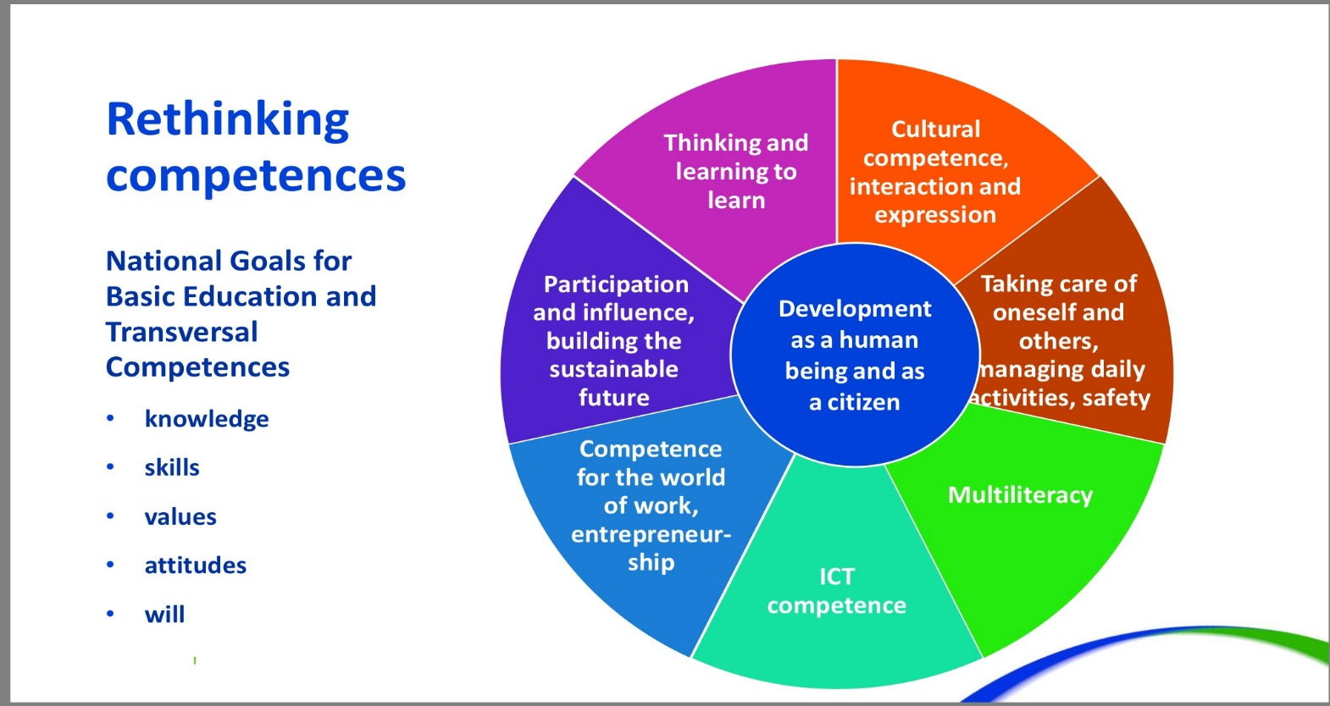

Slide 7
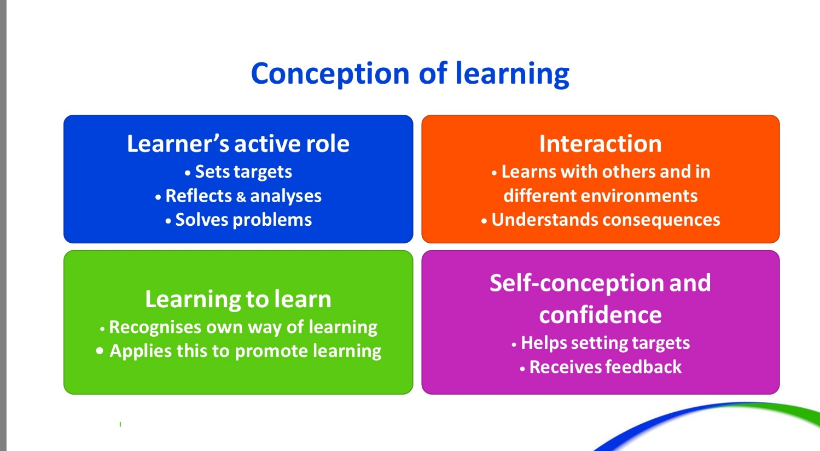

Slide 8
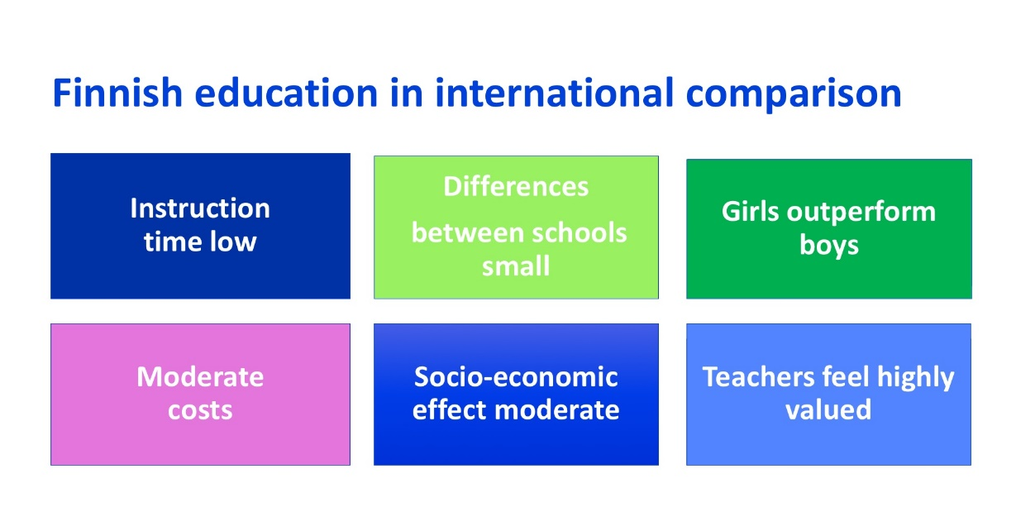
The high-performing school system
What do the high-performing school systems have in common?
They get the right people to become teachers.
They develop these people into effective instructors.
They put in place systems and targeted support to ensure that every child is able to benefit from excellent instruction.

Slide 9
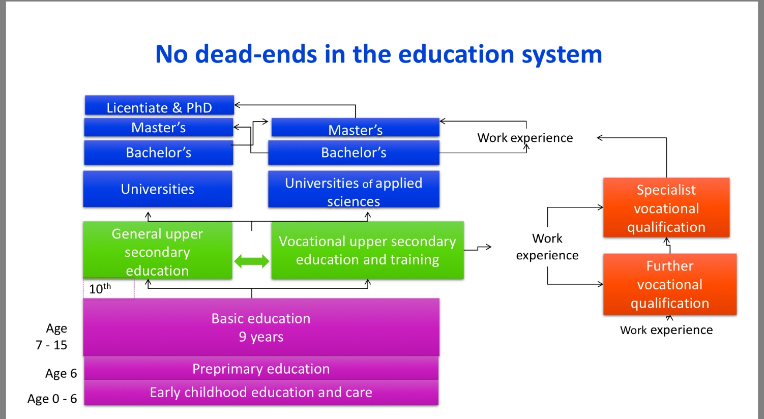

Slide 10
After basic education (9 years)
Upper secondary education
Vocational education and training
Flexible
Personalised
Individualisation
Modular/course structure
Combining general & vocational studies
Eligibility for higher education
Close cooperation with the labour market
Work-based learning
Flexible learning pathways
Open pathways from vet to higher and further education

Slide 11
Higher education
14 universities
25 universities of applied sciences
Conduct research and provide education based on research
Universities interact with society and promote the effectiveness of research results
Education is based on labour market needs
UAS aims to support instruction and promote regional development

Slide 12
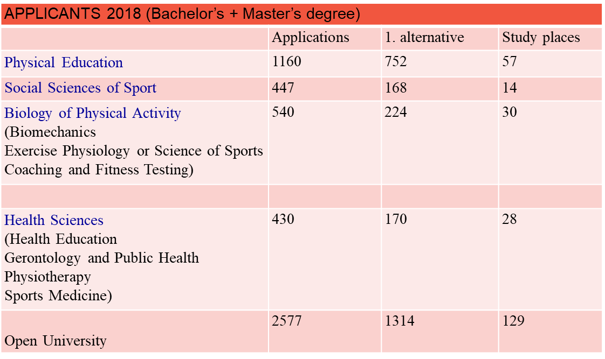
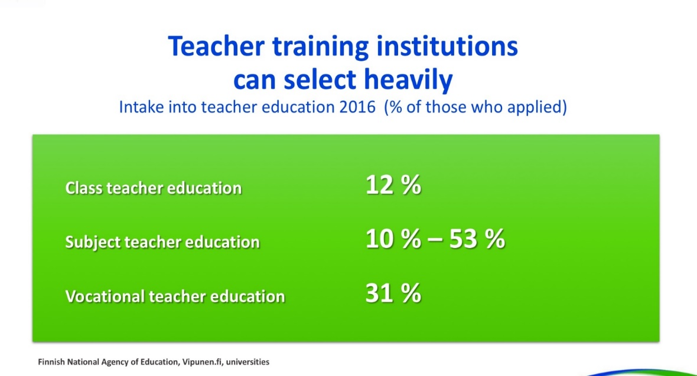
The teaching profession is valued in society

Slide 13
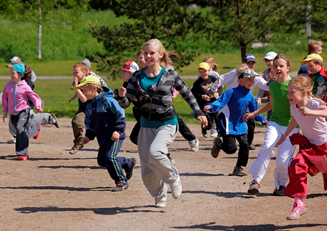
National Core Curriculum 2014:
PHYSICAL EDUCATION
“Fundamental exercise skills at the centre – different sports as tools”
Reinforcing the pupils’ intrinsic motivation =>
Deci & Ryan’s (2000) theory of self-determination
Experienced self-efficacy
Experienced autonomy
Social cohesion

Slide 14
Assessment and evaluation is based on objectives of PE
Perceptual-motor skills
Fundamental movement skills
Knowledge of how to develop
and maintain physical fitness
Swimming and water rescue skills
Practicing while giving one’s best effort
Safe and appropriate action in PE lessons
Working together with everyone and taking other into account
Fair play and taking responsibility
Responsibility for his or her actions and skills in working independently

Slide 15
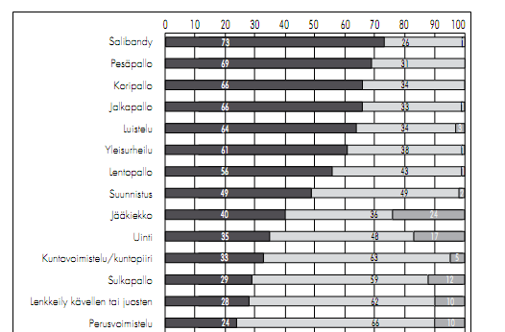
Content of physical education lessons
According to the students, various team games are the most common sports at 7–9 grades (Palomäki & Heikinaro-Johansson 2011)
Floorball
Finnish baseball
Basketball
Football
Ice skating
Track ’n field
Volleyball
Orienteering
Ice hockey
Swimming
Fitness training
Badminton
Jogging
Gymnastics

Slide 16
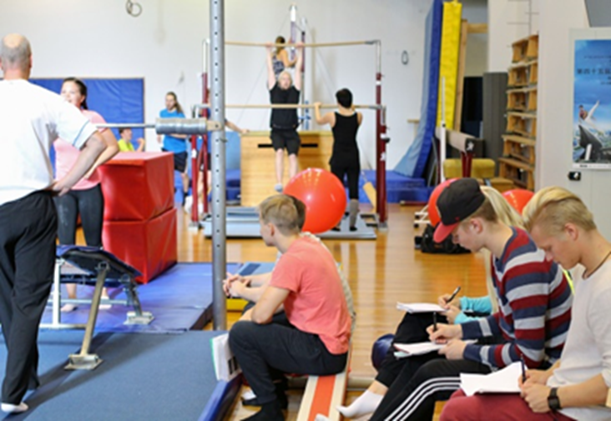
PETE 183 +120 ECTS
5 years
  Year 1-3 Bachelors in PE
    Communication skills
    Sport & PA subjects
    Sport & PE pedagogy and didactics
    (including courses in teaching practice)
    Basic studies in education (incl. practice)
    Research methodology & Bachelor thesis
    Minor Studies (ex. Health education, Adapted PE)
  Year 4-5 Masters in PE
    Advanced studies in Sport & PE pedagogy and Didactics
    Subject studies in education (incl. practice)
    Master thesis

Slide 17
Bachelor in PE+ HEALTH, 183cr
Basic studies in PE (25 cr)
  Introduction to sports pedagogy
  Pedagogy and didactics in PE
  Motor learning
  Observing physical activity/sports
Subject studies in PE (39 cr)
  Teacher as a researcher course
  Advanced course in sports didactics
  School as a social operating environment (godchildren course)
  Curriculum course
  Adapted physical education
  Growth, development and aging
  Quantitative and qualitative methodology
  Bachelors thesis
1st Minor subject (25 cr)
  Teachers’ pedagogical basic studies
2nd Minor subject (25 cr + 35 cr)
  Health science
Language and communication studies (8 cr)
  English, Swedish
  Oral communication
  Information and communication technology
Common methodological studies (16 cr)
  Scientific writing
  Basics in scientific activity
  Basics in statistical methods
  Introduction to making written seminar works
Common studies in sport sciences (10 cr)
  Introduction to sport and health sciences
  Basics in biology of physical activity
  Physical activity and health
  Sports in society
  Basics in sports pedagogy and
  psychology

Slide 18
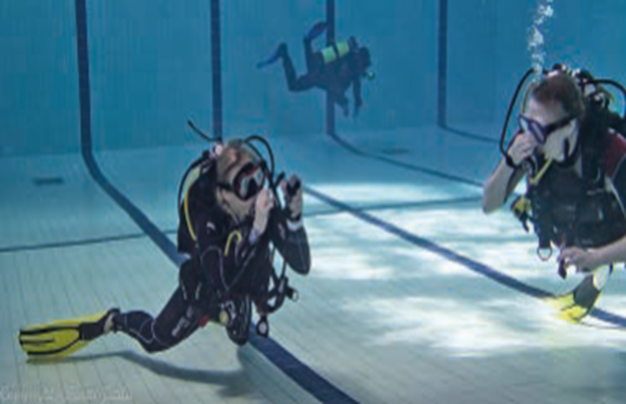
International Master’s Degree Programmes
2-year programmes fully in English
120 ECTS credits
Application period:
November 2019 – January 2020
Master’s Degree Programme in Biology of Physical Activity www.jyu.fi/masterbpa
Master’s Degree Programme in Sport and Exercise Promotion www.jyu.fi/sportpro

Slide 19
Winter School in Sport Sciences
Organized each year in January
Two-week intensive Winter School
Program completely in English
Intended for undergraduate and graduate students interested especially in Social Sciences of Sport or Sport Management
Themes: sport sponsorship, sport tourism, sport marketing, climate change, sport event management and organization of sport in different countries
Application period: October
https://www.jyu.fi/sport/en/study/non_degree/wsss
https://drive.google.com/file/d/0B7W9ZmHQrQVXMWlTUVJySVNmY1k/view

Slide 20
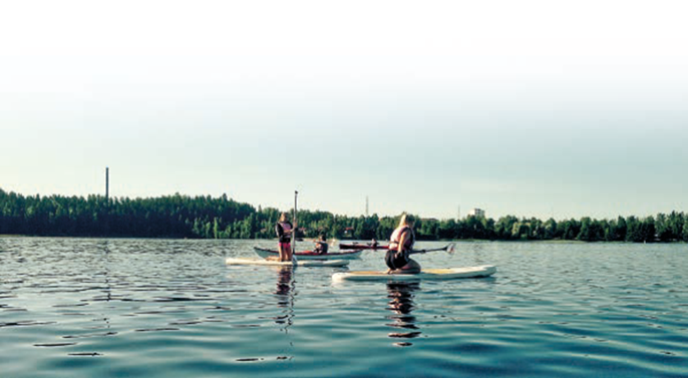
Activity Inclusion Model (AIM)
1. Open activities
–> Everyone can play
Everyone does the same activity with minimal or no adaptations to the environment or equipment
Inclusive so that the activity suits every participant

Slide 21
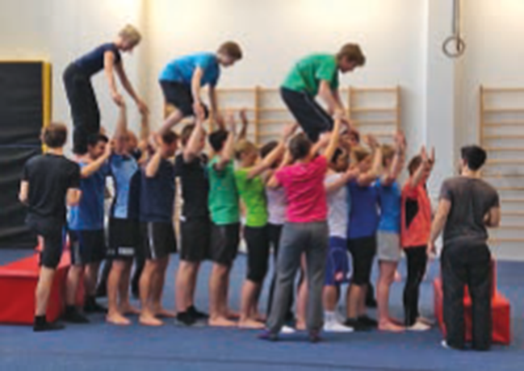
Activity Inclusion Model (AIM)
2. Modified activities
-> Change to include
Everyone plays the same game or performs the same activity but the rules, equipment or area are adapted to promote the inclusion of all individuals regardless of their abilities.
For example throwing activity by using different kind of balls.

Slide 22
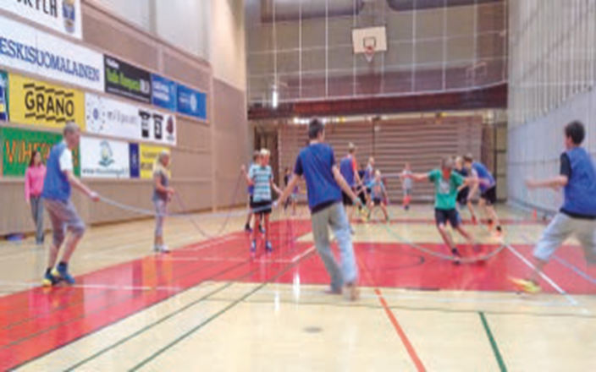
Activity Inclusion Model (AIM)
3. Parallel activities
-> Ability groups
All participants follow a common activity theme, they do so at their own pace and level by working in groups based on their abilities.
For example, two groups can play a seated and standing version of the game -> participants access the version most suited to their abilities.
-> Abilities can change dependent upon the activity.

Slide 23
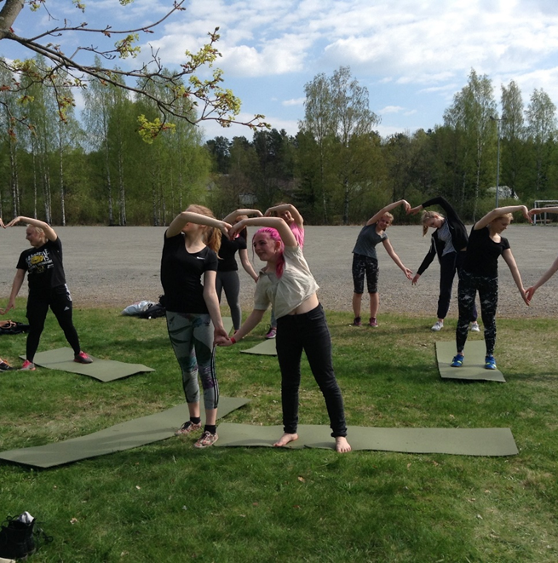
Activity Inclusion Model (AIM)
4. Specific activities
On occasions it might be better for person to practice sports individually or with their disabled peers.
For example, it may be more effective to withdraw an individual (not necessarily a disabled participant) in order to practice individual physical education and sports competencies to enable successful integration into a game situation with the rest of the group.
An example of this might be for a wheelchair user during jumping activities where a throwing activity may be more appropriate.

Slide 24
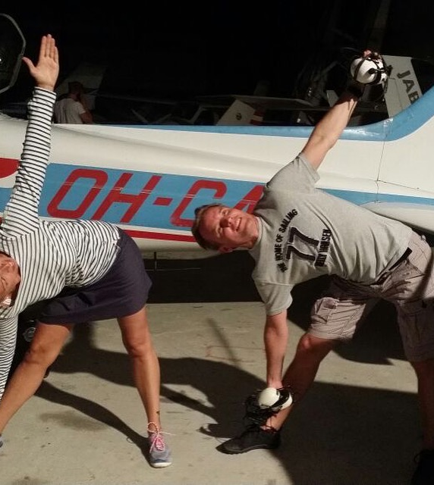
The STEP tool
A simple system for making changes to physical education and sport activities so that everyone can be included and participate together.
Changes in the way the activity is delivered can be made in one or more of the STEP areas
(Space, Task, Equipment, People)
This simple system helps practitioners to adapt the sport, game or activity for different abilities and ages.

Slide 25
The STEP tool
Space
-> Increase or decrease the size of the activity area
-> vary the distance to be covered
-> use zoning
Task
-> ensure that everyone has equal opportunity to participate
-> break down component parts
-> make sure there is an opportunity to practice skills or components individually or with a partner before including in a team game
Equipment
-> increase or decrease the size of the equipment
-> provide options that enable people to participate in different ways
People
-> match participants of similar ability in small-sided or close marking activities
-> balance team numbers

Slide 26
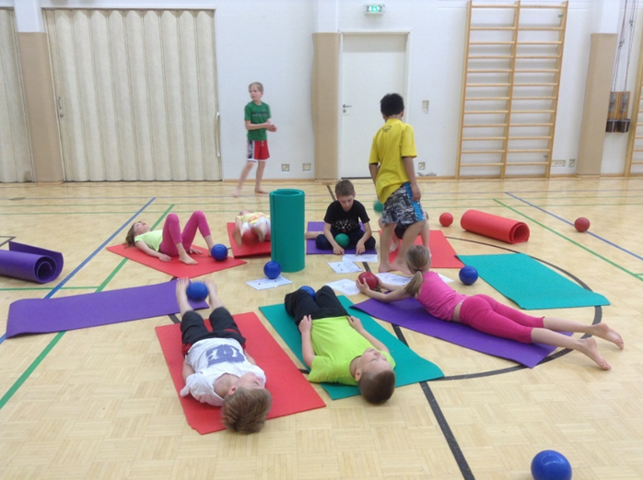
Activity Inclusion Model (AIM)
In practice:
Travelling with a blinded pair
Bell or rattle ball practices
The Goalball
The Table-soccer in real size
Seated volleyball with balloons
Dance map

Slide 27

THANK
YOU!
Mari Kääpä
Sport and Health Education Teacher
Doctoral Student
University of Jyväskylä
Faculty of Sport and Health Science
mari.p.kaapa@jyu.fi

