Slide 1
TEACHING PHYSICAL EDUCATION LPEO577
MARI Kääpä
MARI.P.KAAPA@JYU.FI

Slide 2
Teaching styles
A way to work, the purpose of the teaching is specified for the pupils
Takes in account both the actions of the teacher and the pupils
Helpful for the learning, activation and motivation of the pupils
The choice of a teaching style is depending on e.g. the goals, the teaching skills of the teacher, the topic being taught and the level of the pupils

Slide 3
TEACHING STYLES IN PHYSICAL EDUCATION
A structured teaching is appropriate for teaching of physical education
A clear structure helps focusing on and observing the relevant things in the teaching
Teacher-directed or pupil-directed work methods?
Many different classifications of the teaching styles
The teaching style –classification by Muska Mosston is the most famous

Slide 4
TEACHING STYLES (Mosston)
The Command Style
The Practice Style
The Reciprocal Style
The Self-Check Style
The Inclusion Style
The Guided Discovery Style
The Convergent Discovery Style
The Divergent Discovery Style
The Learner-Designed Individual Program Style
The Learner-Initiated Style
The Self-Teaching Style

Slide 5
THE TEACHING STYLES (Mosston)
The order of the styles is deliberate
The decision-making power switches from the teacher towards the pupils from A → K
Time, space, equipment, planning
Styles A-F represent teaching styles that include reproduction of earlier knowledge
Styles F-K represent teaching styles that include production of new knowledge

Slide 6
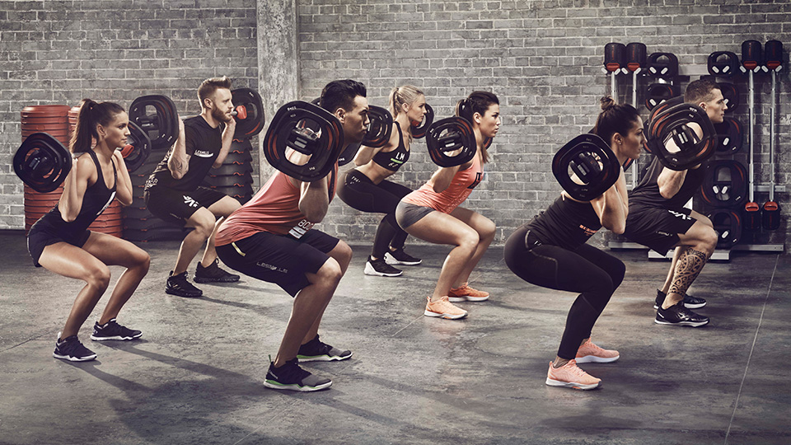
A – THE COMMAND STYLE
The teacher has the decision making power
Same tasks for all pupils
The pupils perform the tasks after the teacher’s commands → developing an automatic movement
The teacher directs and gives feedback
Easy to evaluate
E.g. Aerobic, pair dances, warm ups
-> Special needs? Different abilities?

Slide 7
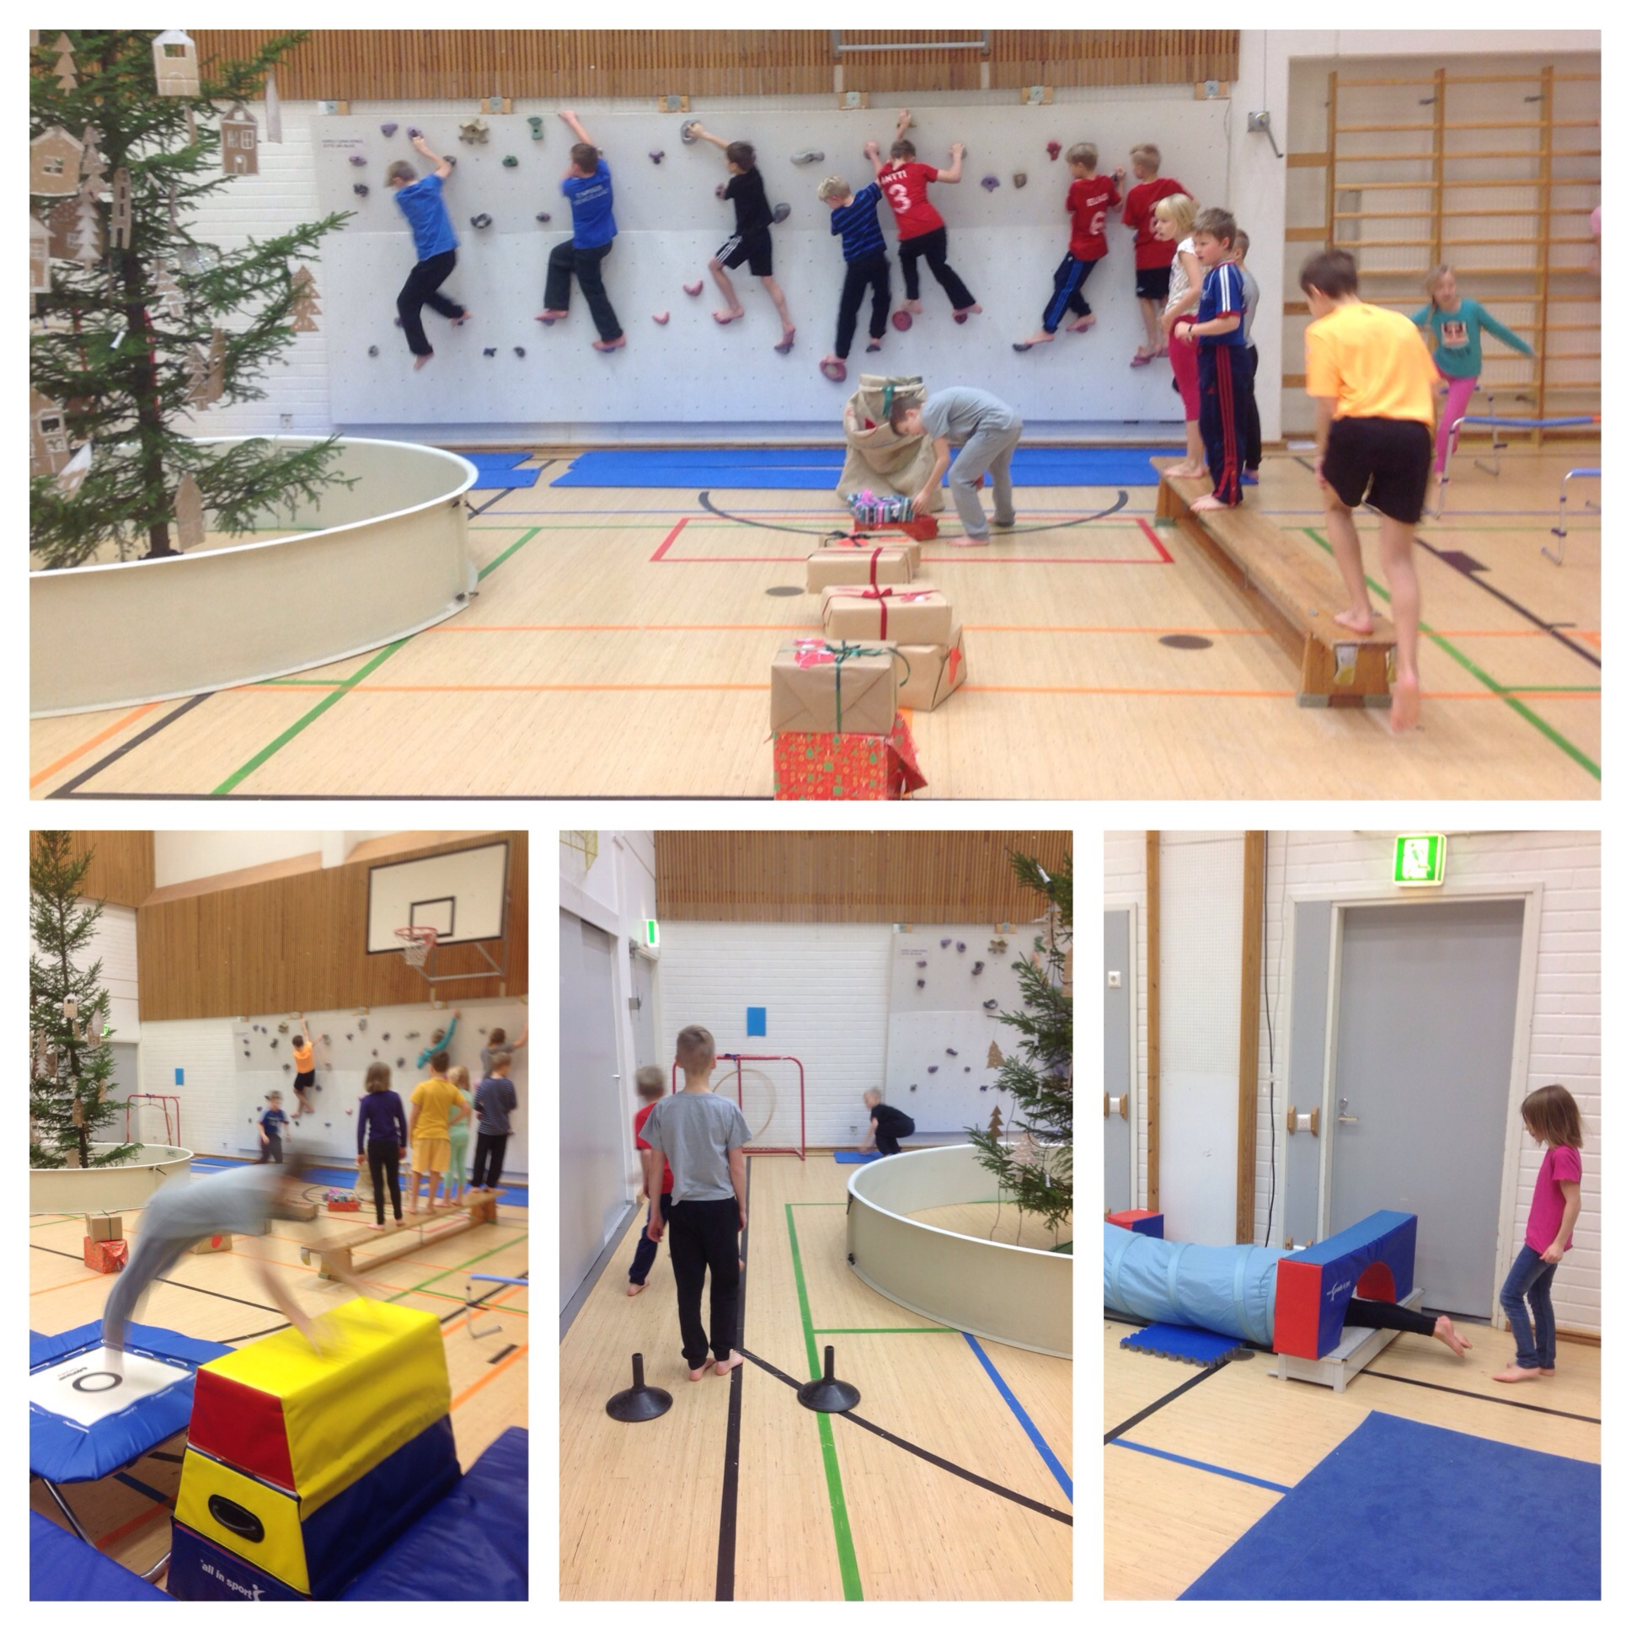
B – THE PRACTICE STYLE
The teacher gives the tasks for the different performance spots
The pupils are practicing autonomously, the teacher has the opportunity to observe and give feedback
The pupils can decide the beginning and end of the activity and the performance speed
E.g. Circuit training, an obstacle course in gymnastics

Slide 8
C – THE RECIPROCAL STYLE
The pupils work in pairs and perform the tasks given by the teacher
The pupils observe each other’s performances and gives feedback
The teacher selects the movements and gives the criteria for evaluation
Immediate feedback and social interaction

Slide 9
D – THE SELF-CHECK STYLE
The teacher plans the activities and gives the feedback criteria
The pupil evaluates their own performance according to the criteria
The dependence of the teacher’s feedback and evaluation decreases
The pupil learns to work individually and to evaluate his/her performance

Slide 10
E – THE INCLUSION STYLE
The teacher plans tasks on different levels of which the pupil selects tasks of an appropriate difficulty
The pupil evaluates his/her performance in relation to the goal level
Everyone can attend using their best effort
E.g.
Kicking a ball into the goal from different distances
Using different sizes of weights in weight training
Using different heights of hurdles
Not like this…

Slide 11
F – THE GUIDED DISCOVERY STYLE
The teacher gives the task to which the pupils try to find the right solution
The teacher helps by giving clues, asking questions and giving instant feedback
The teacher must consider carefully the questions and clues given
Develops consequent thinking
E.g.
Where should the defender’s position be in relation to the offender’s in basketball?
How does the optimal stance in shot put look like?

Slide 12
G – THE CONVERGENT DISCOVERY STYLE
The pupil tries to solve a given problem or issue independently
The teacher observes from the side
The pupils evaluate their solution, the teacher helps if needed
E.g.
In what way can the balance in a movement be kept the easiest?
What would be the most optimal movement of hand in javelin throw?
How should we set up the tactics for our team?

Slide 13
H – THE DIVERGENT DISCOVERY STYLE
The teacher presents a problem or an issue for the pupils to which there are many solutions
The purpose is to produce divergent responses (many correct answers to the same question)
The teacher observes and helps if needed in the production of the solutions
The pupils evaluate the solutions themselves
E.g.
In what different ways can you glide with skates?
What different route choices could there be to the control point?

Slide 14
I – THE LEARNER-DESIGNED INDIVIDUAL PROGRAM STYLE
The teacher gives a general subject matter area
The pupil selects a specific topic and plans an own program according to the topic
Practice of individual work with support of the teacher
The teacher directs and gives feedback if necessary
Eg.
The improvment of a jumping skill, endurance fitness
Can be challenging to implement during PE lessons in schools

Slide 15
J – THE LEARNER-INITIATED STYLE
The pupil plans an own program
The pupil chooses the teaching method according to which the pupil implements the program
The teacher directs and gives feedback if needed
Increasing the independent work
The teacher has to accept the pupil’s ability to make the decisions

Slide 16
K – THE SELF-TEACHING STYLE
The pupil makes all the decisions concerning the teaching-learning process
Sets the goals
Selects the content of the program and the teaching method
Estimates the fulfilment of the goals
Independent work
The teacher is available for the pupil and helps if needed
Challenging to adapt to PE lessons in school, rarely used

Slide 17
SOURCES:
Mosston, M. & Ashworth, S. 2008. Teaching Physical Education. First Online Edition.
Liikuntatieteellinen seura. 2015. Opetusmenetelmät. EIPET (European Inclusive Physical Education Teaching) Teaching materials. www.lts.fi/sites/default/files/page_attachment/l9_opetusmenetelmat.ppt

