Slide 1
Theories of Learning
embodied learning
transformative learning
creative learning
experiential learning
deep learning
expansive learning
incidental learning
intentional learning
lifelong learning
Oppiminen ja Ohjaus KTKP010
Lecture 1
Josephine Moate
Intuitive & expert learning
social & situated learning
emancipative learning
biographical learning
vicarious learning

Slide 2
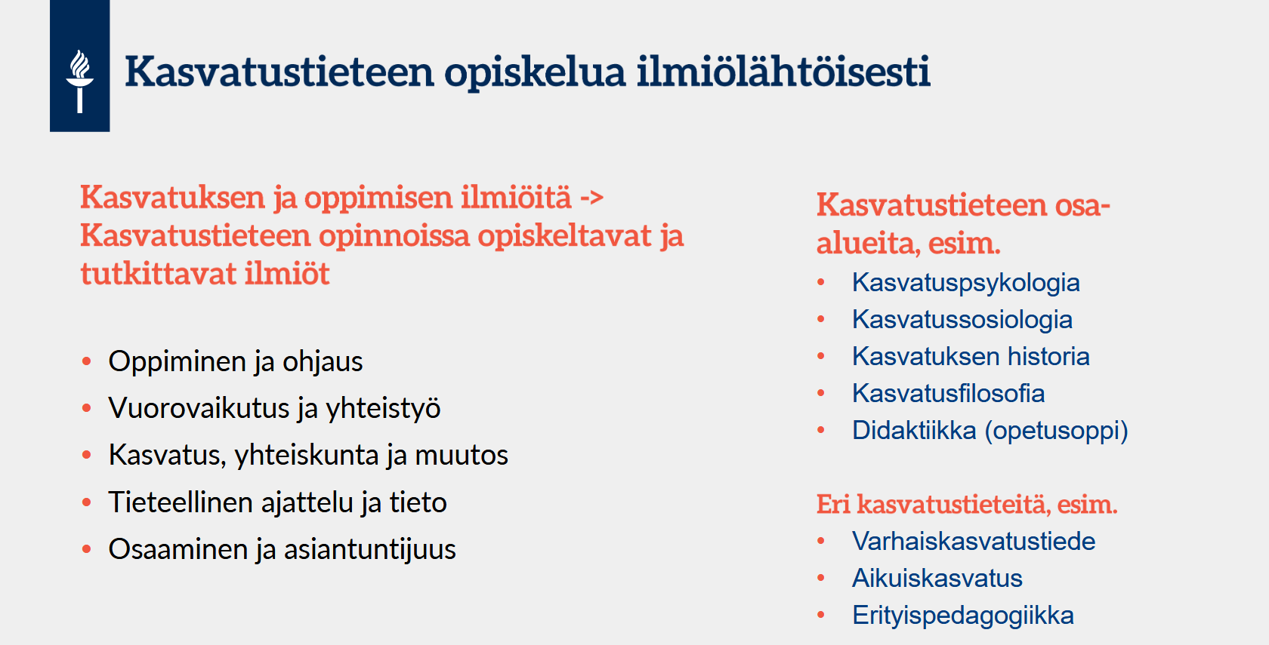

Slide 3
Situating this lecture
- how individuals take shape
- how individuals & schools are part of society
- how practices take shape over time
- how educators think about what they do
- particular practices for the purposes of teaching

Slide 5
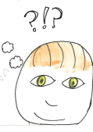
Pohdintaa yksin/pienryhmissä (n. 3 min.)
Mitä oppiminen sinun mielestäsi on? Miten määrittelisit oppimisen? How would you define learning just now?
Why is learning important for you as a student? As an educator?

Slide 6
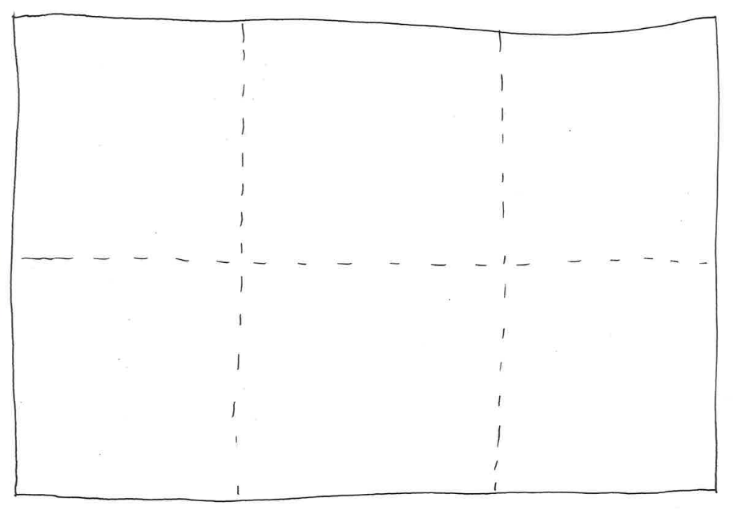
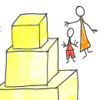
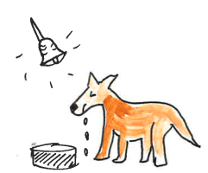
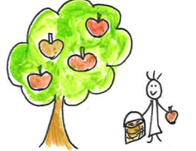
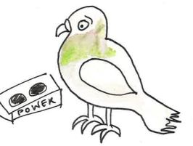
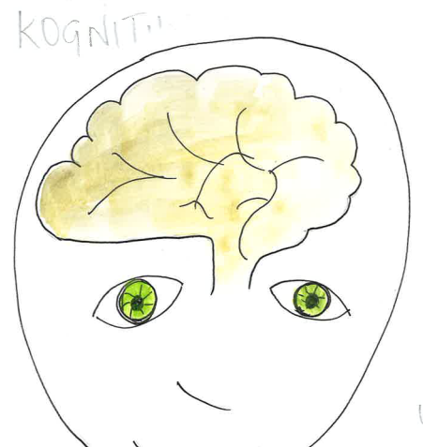
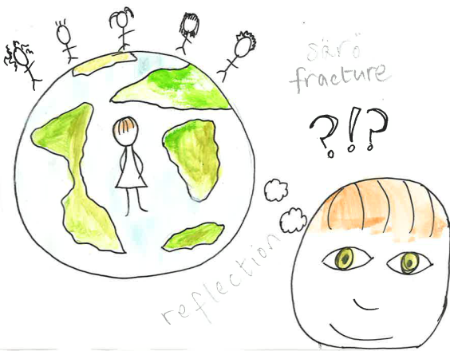
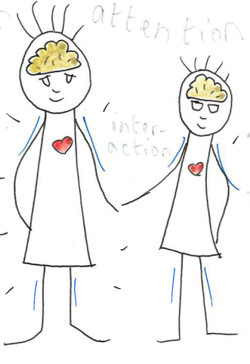
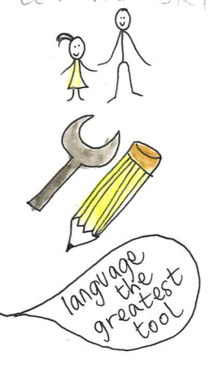
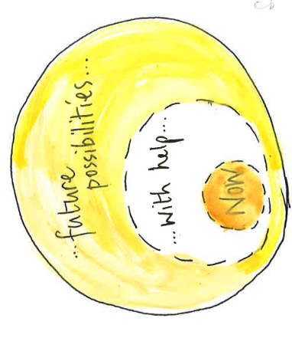
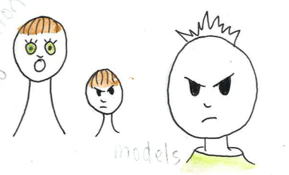
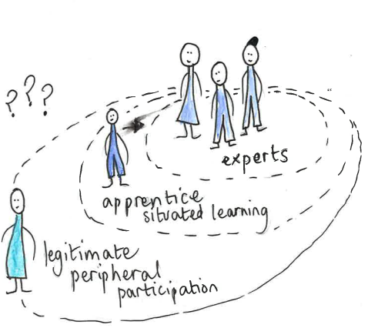
This lecture – an initial map of learning theories
Zoo of behaviorism
Peak of cognition
Discovery learning
Garden of meaningful learning
Experience & reflection
social learning
embodied learning
The planes of
Sociocultural
learning
Community of practice

Slide 7





Theories of learning – different views of learning

Slide 8
What is learning?
What is learning? Is learning to ride a bike the same as learning to play the piano or to read?
A change in behaviour? A change in understanding? A goal-directed process? Only visible afterwards? Always good?
An important, often forgotten, question – what do we learn for? What is the purpose of learning?
Biesta, 2022; Bruner, 2004

Slide 9
Education theorist Gert Biesta (2005) described learning as…
Violent (väkivaltainen)
Mysterious (salaperäinen)
Transcendent (transsendenttinen)
Biesta (2022) also emphasizes that the relationship between teaching and learning is structurally broken (2022; 57) and says this is not a problem to be solved as no direct connection is possible or desirable – why?

Slide 10
Mapping theories of learning – where to begin?
Zoo of behaviorism
Key features
Key character
Educational implications
Huom!
As with all maps, not the full picture!
Your readings during and beyond
this course should continue to add
to this basis!
And these theories have continued
to develop and change over time.
Over time practice and research ’talk
back’ to theories and they change…
Peak of cognition
Discovery learning
Garden of meaningful learning
Experience & reflection
social learning
embodied learning
The planes of
Sociocultural
learning
Community of practice

Slide 11
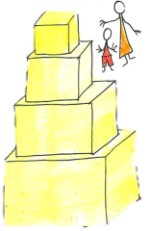
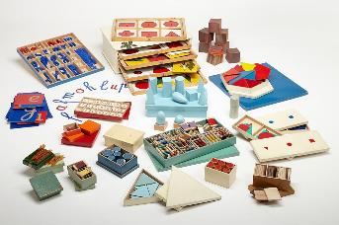
Discovery learning, Maria Montessori (1870-1952)
Teacher a guide and facilitator
Careful observation and action with children highlighted:
Importance of discovering for oneself, hands-on
Importance of independence, choosing what to focus on – although
required to get materials & tidy up afterwards
Concentration and interest to learn innate quality
Authentic and carefully prepared environment – materials, furniture
socical
cognitive
emotional
4 planes of development:
Normalisation (0-6)
Intellectual independence & herd (6-12)
Initial construction of adult self (12-18)
Adult independence (18-24)
personal
https://estaticos.elmundo.es/albumes/2012/07/25/diseno_infantil/1343240389_extras_albumes_0_1024.jpg

Slide 12
Moving on…
Zoo of behaviorism
Peak of cognition
Discovery learning
Garden of meaningful learning
Experience & reflectoin
social learning
embodied learning
The planes of
Sociocultural
learning
Community of practice

Slide 13
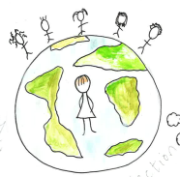
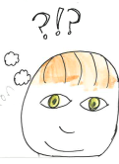
Experiential learning, Kokemuksellinen oppiminen John Dewey, 1859-1952
School is important as no young person alone could discover all
knowledge that has come before
Education is not only for gaining knowledge, but to foster democratic participation – how to live in the world with other people
Through experience an individual knows what is, what is (not) possible, and has more resources for individual & shared life.
Through experience an individual is always connected to the environment and mutual change is happening.
Thinking is as natural as breathing, but we don’t always think well – with careful reflection we can recognise & re-form our habits
Teachers have something to bring to students, and students are active participants in their own (and other’s) education

Slide 14
What do you think?
Consider these two first theories – that are associated with different kinds of practices – what is the role of the learner from these perspectives?

Slide 15
Moving on…
Zoo of behaviorism
Peak of cognition
Discovery learning
Garden of meaningful learning
Experience & reflection
social learning
embodied learning
The planes of
Sociocultural
learning
Community of practice

Slide 16
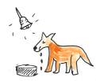
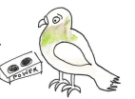
Behaviorist theory of learning, behavioristinen (käytös) B.F.Skinner (1904-1990)
Skinner focused on behaviour shaping through (positive) reinforcement
Focus on development – what is possible at a particular stage, always changing
Environment – multiple stimuli in the present, possible to control (n.b. outside and inside stimuli)
Conditioning – changing the environment to foster and regulate desired development
Reinforcement – vahvike
Stimulus-response: Ärsyke ja reaktio
Habit: tapa – automatic responses
Careful control of the environment can provide structure and reassurance for someone living with internal chaos or struggling with difficulties.
Classical conditioning – klassinen ehdollistuminen
Operant conditioning – välineellinen ehdollistuminen

Slide 17
Skinner’s visit to his daughter’s 4th grade math class:
It was Father’s Day at Shady Hill, and with a few other fathers I sat in the rear of Debbie’s fourth-grade arithmetic class. The students were at their desks solving a problem written on the blackboard. The teacher walked up and down the aisles, looking at their work, pointing to a mistake here and there. A few students soon finished and were impatiently idle. Others, with growing frustration, strained. Eventually the papers were collected to be taken home, graded, and returned the next day.
I suddenly realized that something had to be done. Possibly through no fault of her own, the teacher was violating two fundamental principles: the students were not being told at once whether their work was right or wrong (a corrected paper seen twenty-four hours later could not act as a reinforcer) and they were all moving at the same pace regardless of preparation or ability. (p. 64)
Skinner, B. F. (1983b). A matter of consequences. New York: Knopf.

Slide 18
Dewey’s critical response
The ’stimulus-response’ formula of behaviorism for Dewey was too reductive, too simplistic. Dewey (1930) pointed out that any stimulus could only be considered a stimulus if there was a response and it was the response that determined what kind of stimulus was present. Dewey also insisted that all experiences were part of ongoing events.
What is absent from behaviorism is the active nature of the learner – the willingness to learn (or not) and the significance of the wider environment
Dewey, J. (1930). Conduct and experience.

Slide 19
Moving on…
Zoo of behaviorism
Peak of cognition
Discovery learning
Garden of meaningful learning
Experience & reflection
social learning
embodied learning
The planes of
Sociocultural
learning
Community of practice

Slide 20
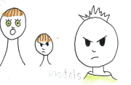
Social learning theory / Sosiaallisen oppimisen teoria Albert Bandura (1925-2021)
Stimuli – need to be contextually appropriate (situated)
Response – needs to be reinforced
Cognitive functions – individuals observe and interpret the world around them – havainto, tulkaus
Agency (toimijuus) – self-regulation, self-efficacy
Adults as models

Slide 21
Consider so far your university experience
What have you discovered? How?
What have you experienced? How?
What have you been conditioned to do? Expect? How?
What have you observed and realised?
What have you reflected on? Why? How?
In responding to these questions see how the different theories of learning help you to name what has been part of – or missing from – your journey so far

Slide 22
Where next?
Zoo of behaviorism
Peak of cognition
Discovery learning
Garden of meaningful learning
Experience & reflection
social learning
embodied learning
The planes of
Sociocultural
learning
Community of practice

Slide 23
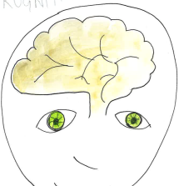
Cognitive learning / Kognitiivinen oppimiskäsitys Piaget (1886-1980), Bloom (1913-1999)
Whereas behaviorism focused on behavior, interest in intelligence focused attention on the inside
Piaget was initially involved in IQ tests, but became interested in how the quality of children’s intelligence was different from the quality of adult intelligence
Piaget considered cognitive development to be dependent on biological maturation

Slide 24
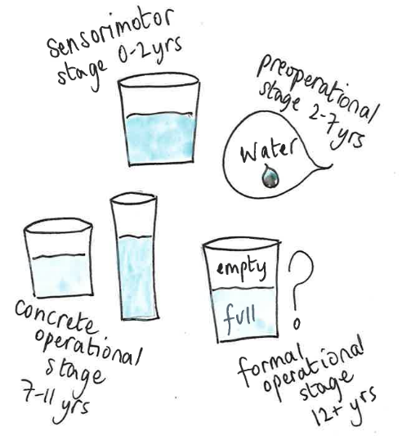
Stages of cognitive development
Piaget worked as the Director of the International Bureau of Education. In 1934 Piaget said, "only education is capable of saving our societies from possible collapse, whether violent, or gradual".^{[7]}
Key terms include:
’readiness’
schemas: skeema mielen sisäinen malli todellisuudesta
assimilation – similar
accommodation
tension nurtures intelligence, peer relationships help but
adults - Every time we teach a child something, we keep him from inventing it for himself’ (Piaget, 1972: 27).
Piaget, J. (1972). Some aspects of operations. In M. W. Peris (Ed.), Play and development (pp. 15–27). New York: Norton.

Slide 25
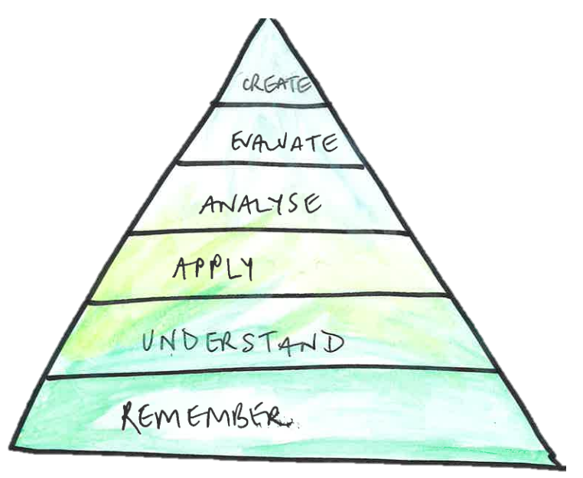
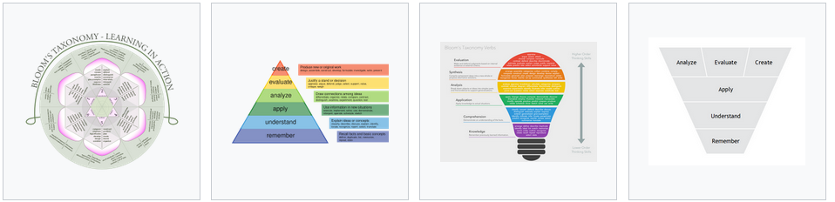
Bloom’s taxonomy – HOTS & LOTS
luoda
arvioida
analysoida
sovella
ymmärtää
muistaa
Bloom’s original version 1956
revised by Krathwohl and Anderson (2001)
https://en.wikipedia.org/wiki/Bloom%27s_taxonomy

Slide 26
Where next?
Zoo of behaviorism
Peak of cognition
Discovery learning
Garden of meaningful learning
Experience & reflectin
social learning
embodied learning
The planes of
Sociocultural
learning
Community of practice

Slide 27

Meaningful learning / Merkityksellinen oppiminen (D. Ausubel, 1918-2008)
Based on Piaget’s conceptual schemas, i.e. building on or rearranging what is known
Learning is:
Active
Constructive
Cumulative
Self-regulated
Goal-oriented

Slide 28
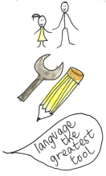
Sociocultural / Cultural history theory of learning Lev Vygotsky (1896-1934)
Learning takes place on 2 planes:
On the social plane between people (inter)
On the individual place within a person (intra)
Tools mediate cultural knowledge and practices across time and space
Gradually everyday concepts and understanding transform into scientific concepts and understanding
Learning leads development

Slide 29
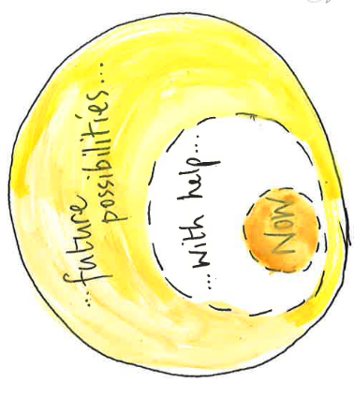
The ZoPed –the zone of proximal development, lähikehityksen vyöhykke
The zone in which a child goes beyond his/her current level of development with the help of an expert other
The ZoPed is dynamic (it moves, changes) and is sensitive
A ZoPed is also personal, individual
A child needing the most help has the most potential
Assessment should be forward looking, not just assessing what development is ’finished’

Slide 30
Consider your university experience again:
What kind of cognitive activity has been going on?
What has been meaningful to you? What has that involved?
What new cultural practices have you encountered?
How would you describe your ZoPed for learning?!

Slide 31

A related concept – scaffolding (Bruner, Wood & Ross, 1976)
Oppimisen oikea-aikainen tuki
Temporary support
Can be provided through activities, guidance, instructions, example, materials…
Interaction is crucial - vuorovaikutus

Slide 32
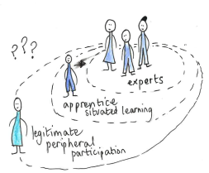
Community of Practice – Oppimisen konteksti- ja tilannesidonnaisuus (Lave & Wenger, 1991)
Key features:
Joint enterprise – shared
Social entity – belonging, membership
Shared repertoire – communal resources
Important terms:
Oppomisympäristö/learning environment
Kulttuuri/culture
Authenticity
Formal and informal learning/ formaali & informaali
intentional & incidental learning / tarkoitettu & tahaton

Slide 33
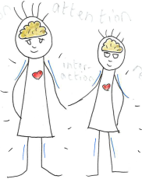
Embodied learning / Kehollinen tieto ajattelu (Eeva Anttila)
Brains and minds, all cognitive activity is connected with a body, a body situated in the world
People first come to know through their body – feeling & sensing, perceiving & attending, interacting & reasoning
N.b. Käsite, käsittää, käsitys
Embodied learning goes beyond language -the body is involved in cognition
Self-regulation, motivation, goal-orientation and the aesthetic are important

Slide 34
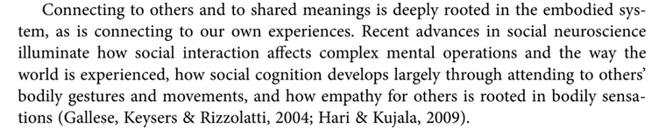
Somatic learning / Embodied learning -
Eeva Anttila, 2015: 375

Slide 35
… of one thing at least I am quite convinced. You cannot strip learning of its content, nor study it in a 'neutral' context. It is always situated, always related to some ongoing enterprise. Perhaps there is no such thing ‘as learning in general’… (Bruner, 2004: 20)

Slide 36
Aesthetic or anaesthetic?
If the aesthetics of education seeks to awaken students for the world and, through this, awaken them for themselves—which is the question of emancipation—it follows that the anaesthetics of education does the exact opposite. Rather than awakening students and trying to keep them awake, it induces a state of slumber. Rather than directing their attention and encouraging them to pay attention, it offers distraction, perhaps first and foremost by encouraging students to stay with themselves, to pursue their own learning trajectories, regulate their own learning, define their own learning needs, but never interrupted, never turned, never stopped in their tracks. (Biesta 2022: 222)

Slide 37
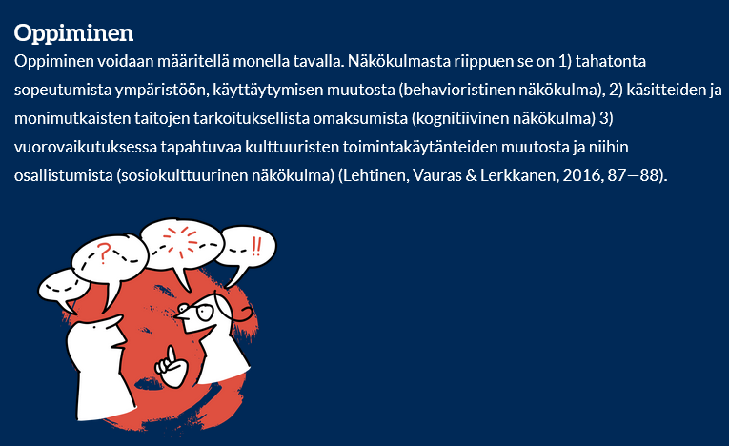
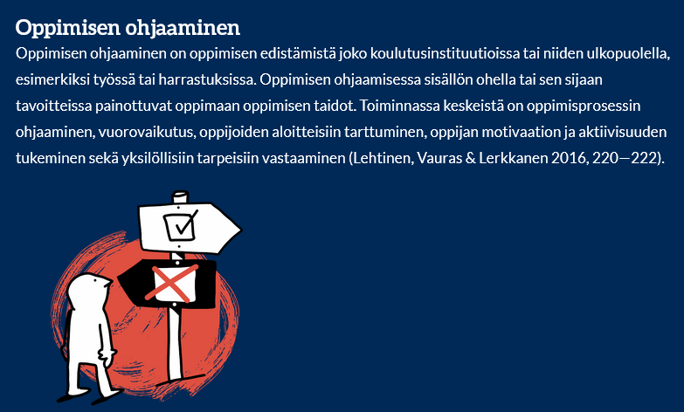
Definitions – not answers…
https://edumap.jyu.fi/oppiminenKasite.html

Slide 38
Pohdintaa yksin/pienryhmissä (n. 3 min.)
Mitä oppiminen sinun mielestäsi on? Miten määrittelisit oppimisen? What about now - how would you define learning?
Miten määrittelisit oppimisen eri teoreettisten linssien läpi?
What more do you want to know?

Slide 39
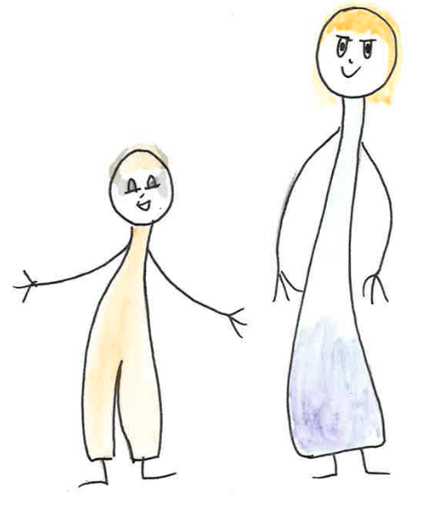
I’ll listen carefully and copy what you say.
I’ll do my best to remember.
I’ll stick with what I’m told.
I’ll tell you what you need to know.
Memorise the information.
Reproduce what you are given.
I need to know what you know and how you learn.
I am here to guide your development.
I have new ideas to share with you.
I’ll explore ideas with you.
I’ll share with you what and how I know.
I want to talk with you!
Based on Kinchin, 2004

Slide 40
Aims:
To gain a comprehensive overview of different theories of learning & different definitions of learning
What is involved in a theory of learning
Different foci and interests
Implications for teachers / counsellors
The value of theory & the limits of theory – the benefit of practice and experience in education – don’t just pay attention to your own journey, start using a pedagogical eye to pay attention to the experiences, actions and responses of others ;)
William James, 1899

Slide 41
References
Anttila, E. (2015). Embodied learning in the arts. International Yearbook for Research in Arts Education, 3(2015), 372-377.
Biesta, G. (2005). Against learning. Reclaiming a language for education in an age of learning. Nordic Studies in Education, 25(1), 54-66.
Biesta, G. (2021). World-centred education: A view for the present. Routledge.
Bruner, J. (2004). A short history of psychological theories of learning. Daedalus, 133(1), 13-20.
Illeris, K. (2018). An overview of the history of learning theory. European Journal of Education, 53(1), 86-101.
James, W. (1958). Talks to teachers (p. 106). New York: Norton.
Kinchin, I. (2004). Investigating students' beliefs about their preferred role as learners. Educational research, 46(3), 301-312.
Morris, T. H. (2020). Experiential learning–a systematic review and revision of Kolb’s model. Interactive learning environments, 28(8), 1064-1077.
Schlinger, H. D. (2022). The impact of BF Skinner's science of operant learning on early childhood research, theory, treatment, and care. In The influence of theorists and pioneers on early childhood education (pp. 101-118). Routledge.

