Slide 1
Craft
A core course of craft (3 ECTS)
POMM1041
Year 2017-18

Slide 2
Aims and contents
After completion of the course student
have experienced feelings of success and development of the abilities
understands the craft process
understands the educational role and overall significance of doing crafts for human being
conceptualizes the curriculum as a guiding document for teaching and developing teaching
Contents of the course
safe working
the principles of a whole craft process
planning and assessment of teaching in craft
tools and materials in the subject area
the multidimensionality and importance of technology in everyday life

Slide 3
POMM1041 (3 ECTS = 81 hours)
Lessons/demos 36 h:
E- and X –buildings
Independent work 45 h:
Written assignments
Planning the teachings tasks in textile work
Planning and implementing the own project
Tasks from the demos

Slide 5
Evaluation
1/3 self evaluation
1/3 peer evaluation – of the ‘Year plan in crafts’
1/3 teacher’s evaluation of the 'Lopputehtävä/Reflection essay’
+/- 1 of the final mark by teacher, based on
Making the own project
Planning and implementing the textile teaching task
Participation during the course

Slide 6
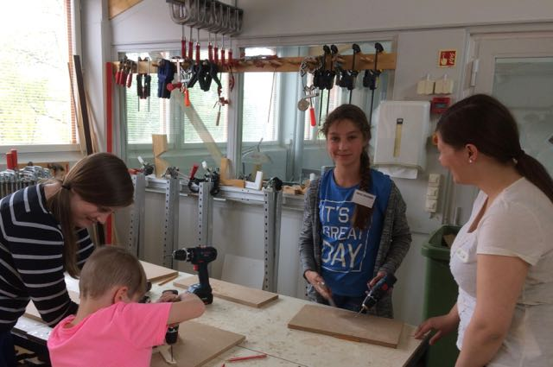
Craft and technology education in Finland
Craft education is a practical subject with hands-on activities, and pupils actively practise experimentation, investigation, invention, problem solving and designing skills. Craft education, especially technical craft, can be seen as supporting technology education.
The nature of craft and technology education provides students with a systematic approach to solving problems and a context in which students can test their own knowledge and apply it to practical problems.

Slide 7
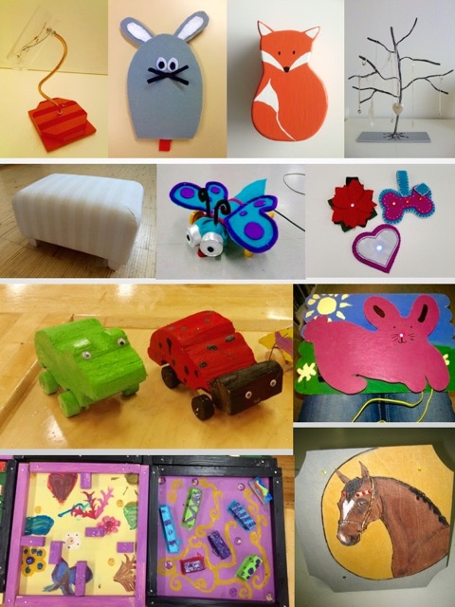

Slide 8
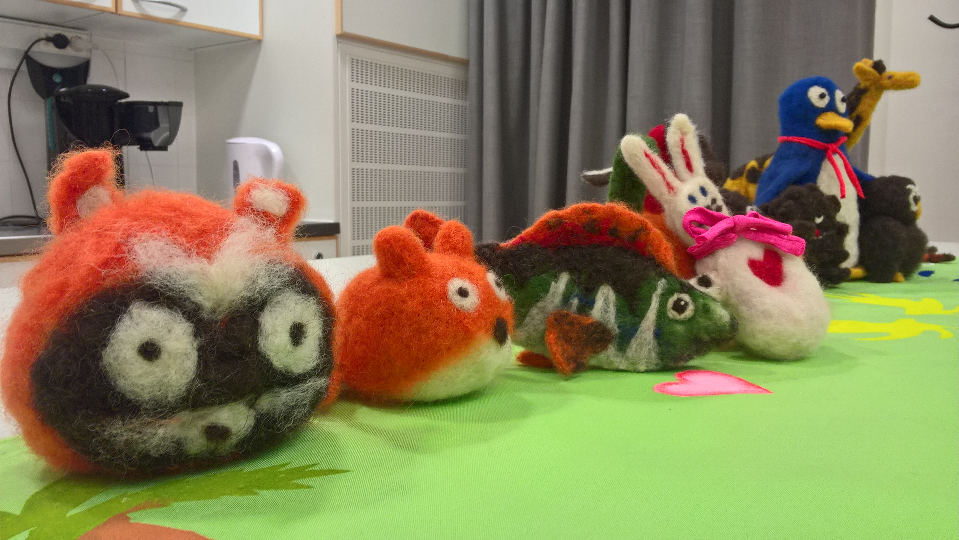
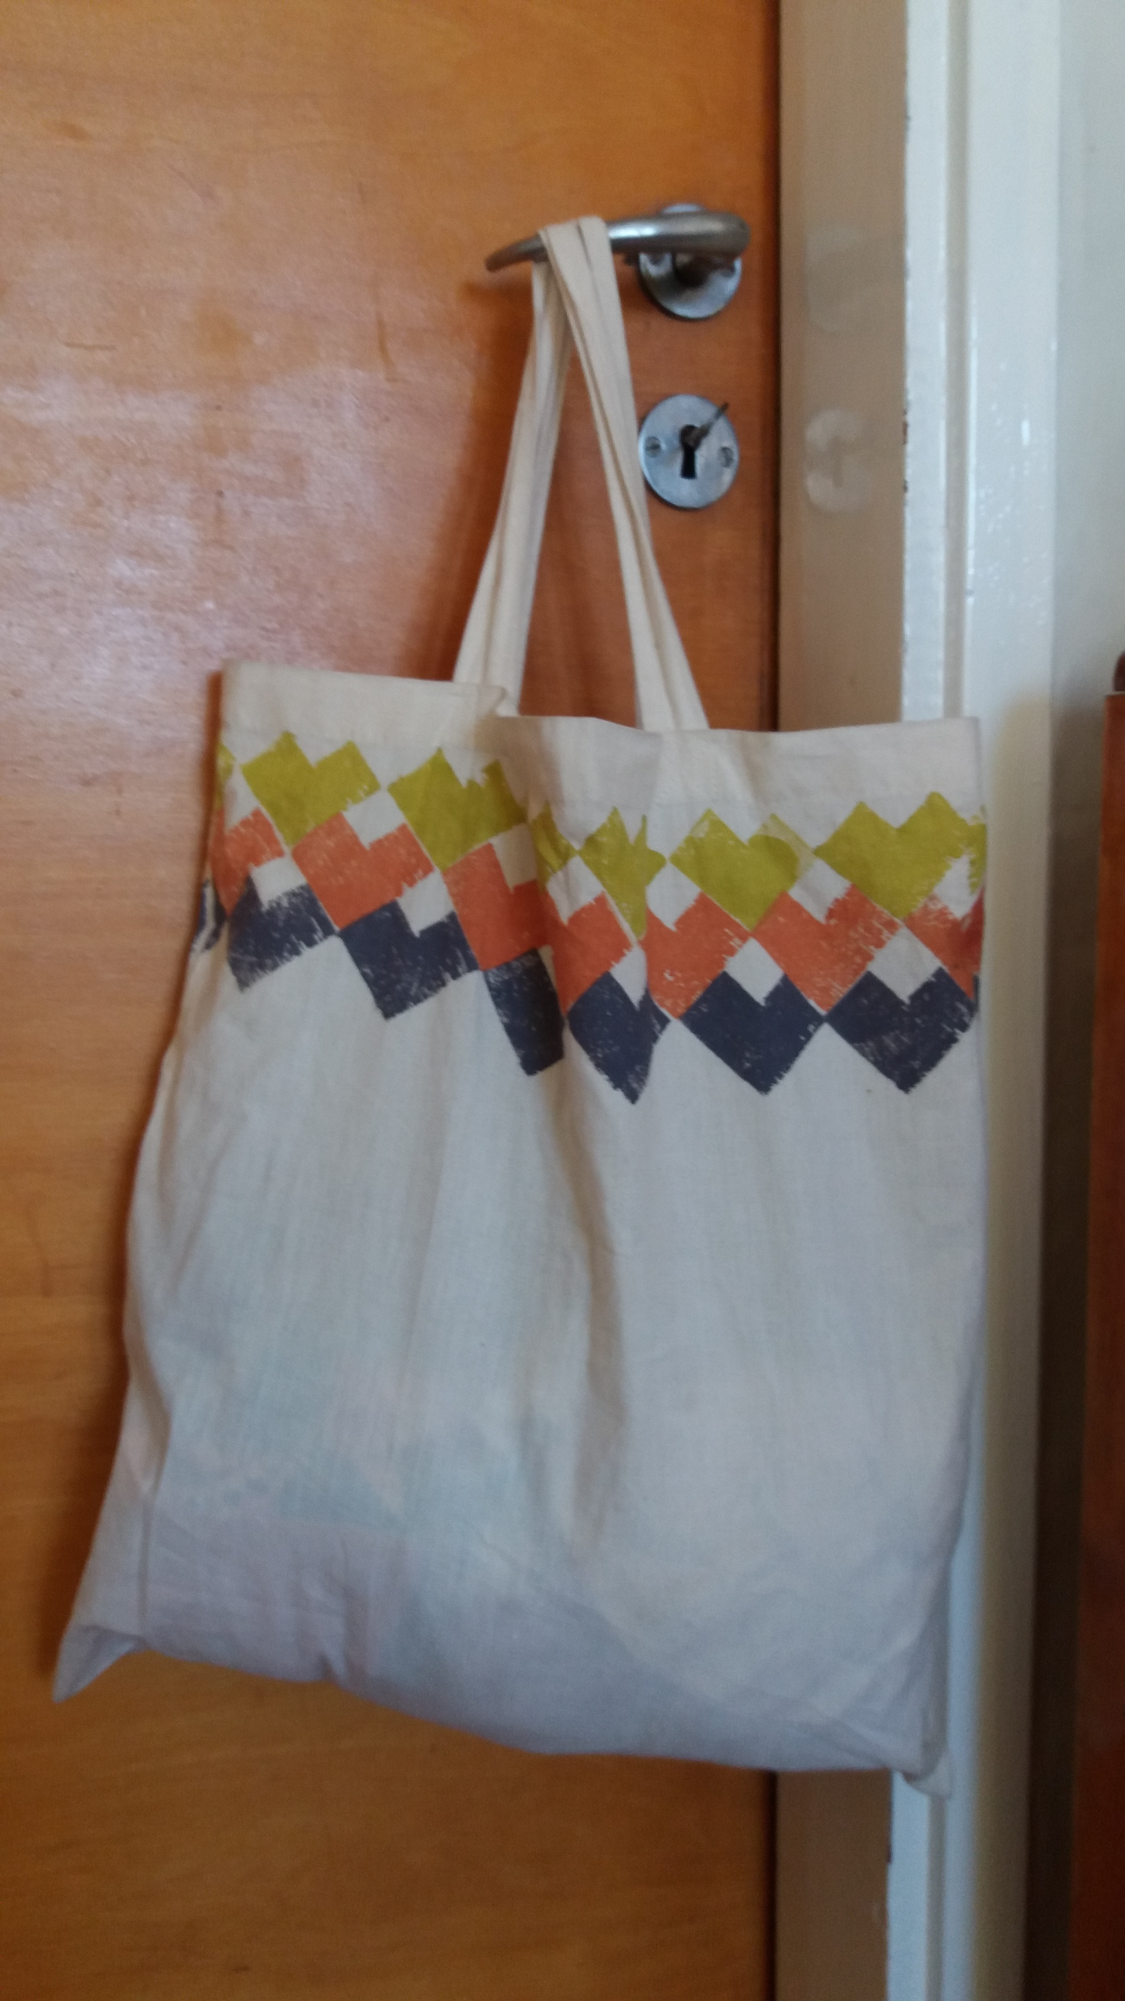
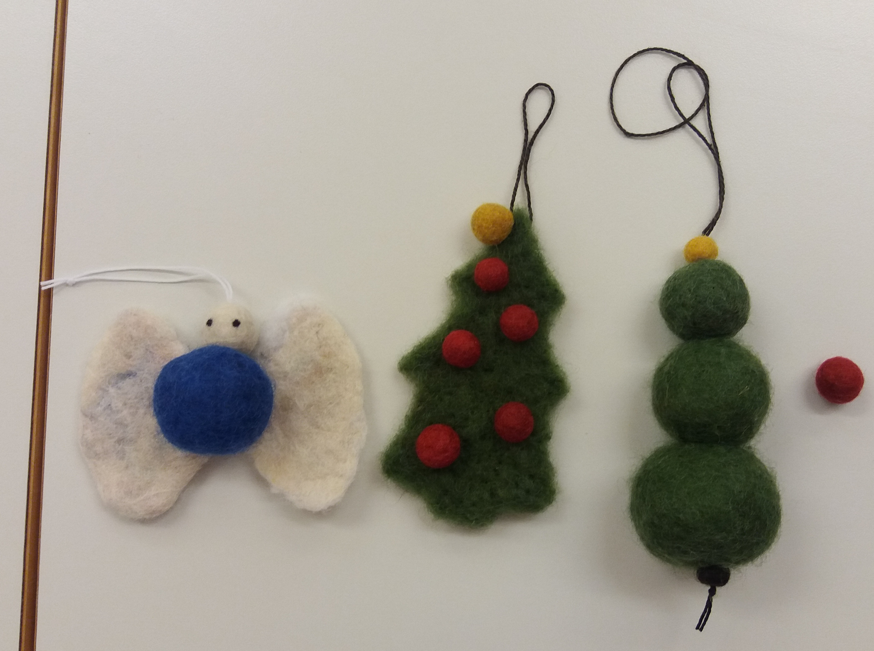
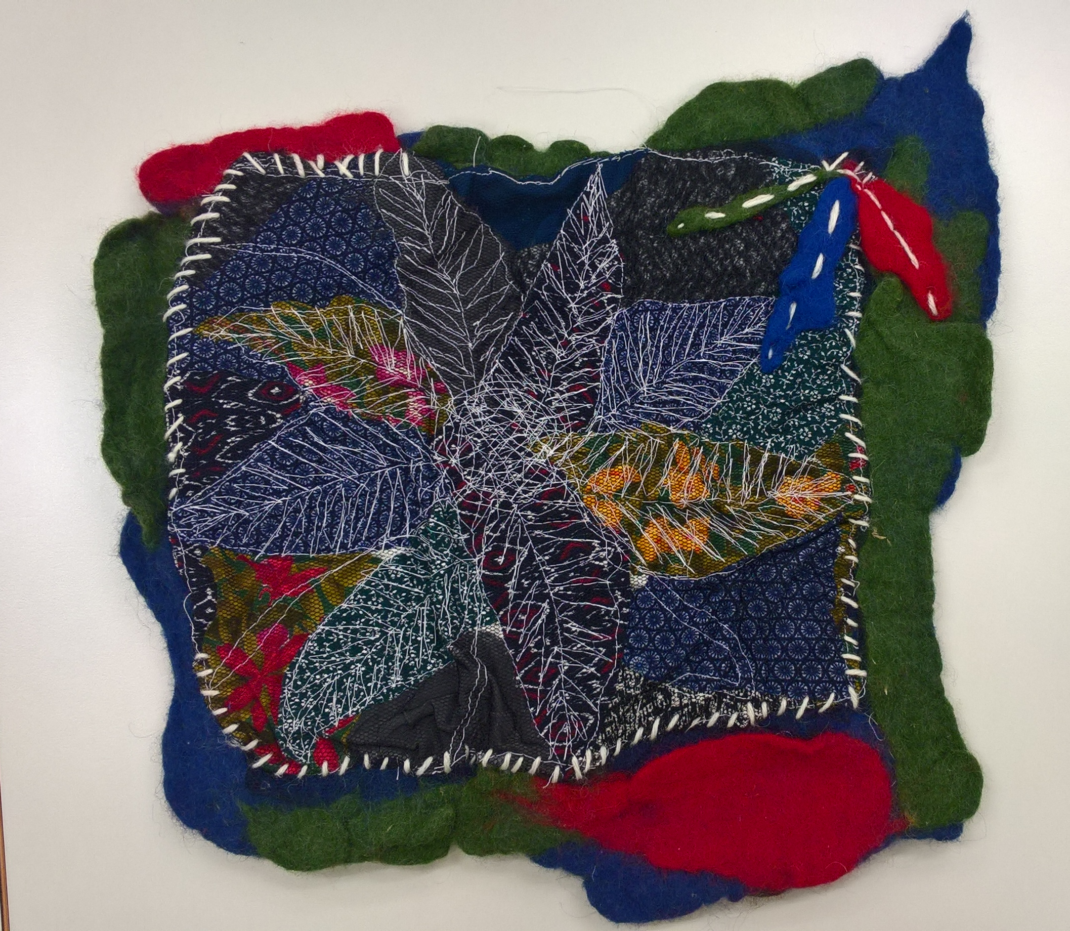
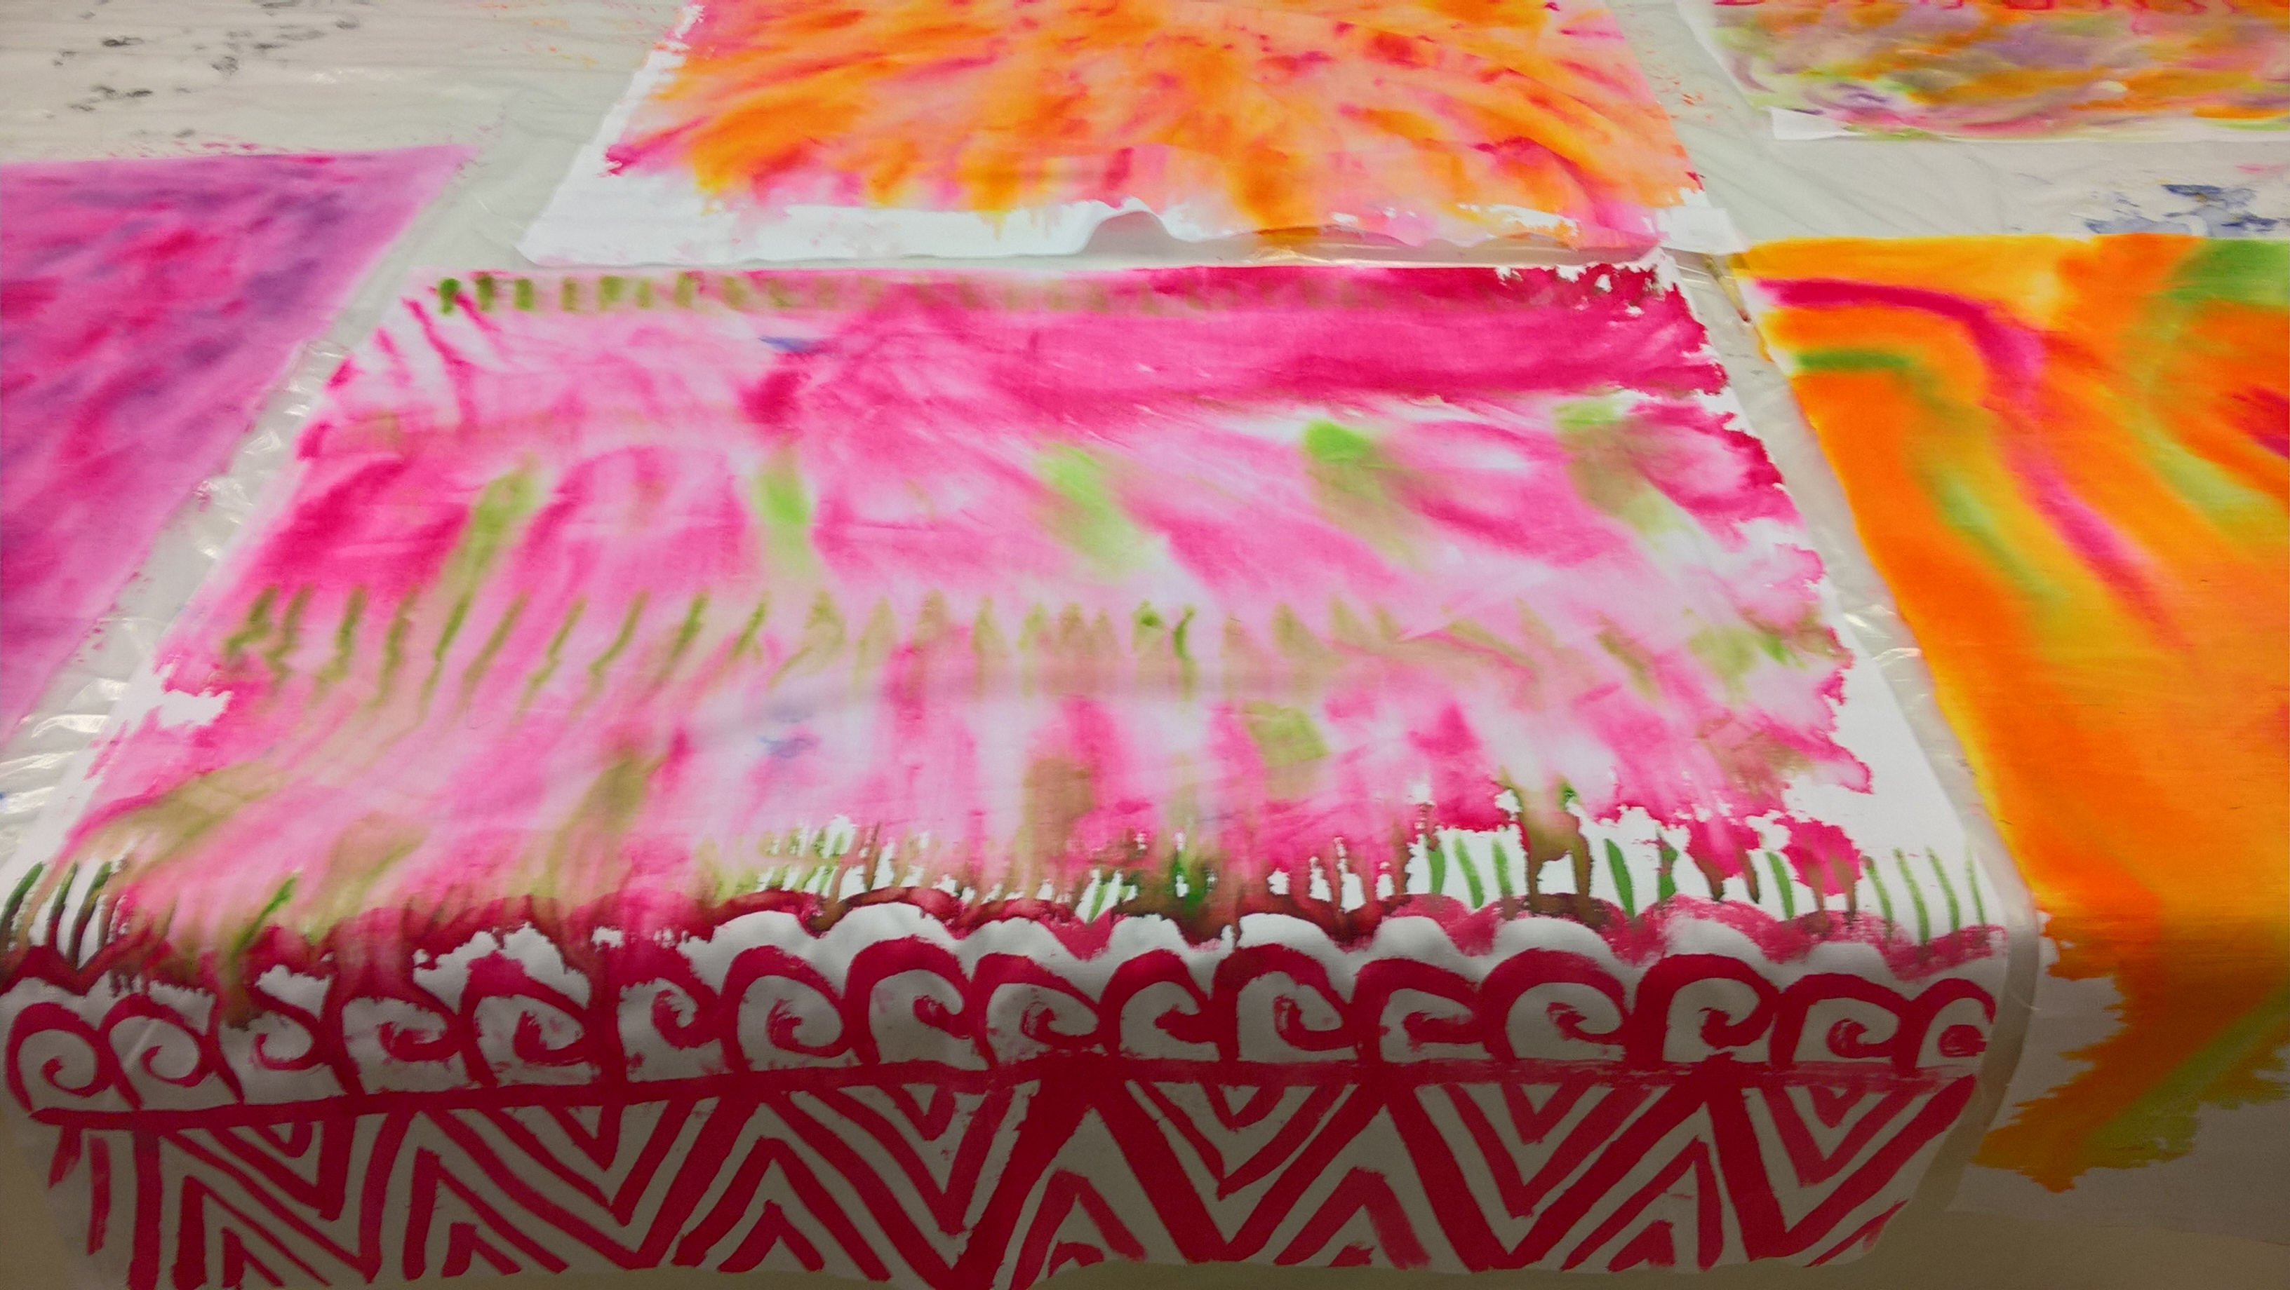

Slide 9
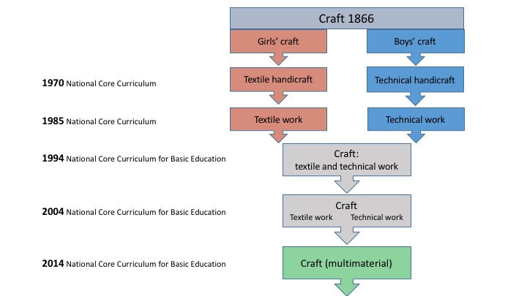
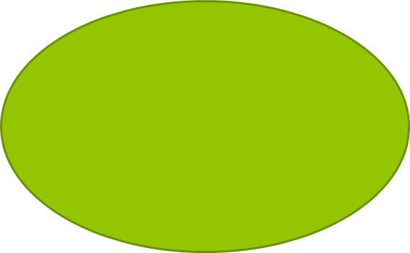

Textile work
Technical work
teknologian opetus
Craft

Slide 10
What do you think about this change?

Slide 11
Problem solving
In 15 minutes build the highest free-standing structure
Materials: one A4 paper sheet, 30 cm tape, scissors
Criteria:
It should be free standing structure
Don’t fasten it anywhere
Tape can be only used for fastening paper
15 min time

Slide 12
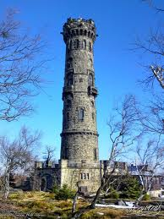
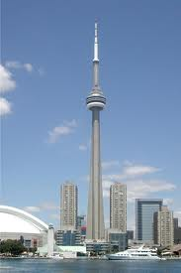
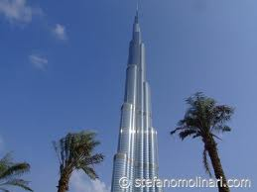
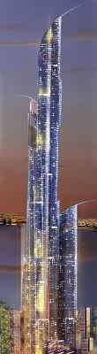
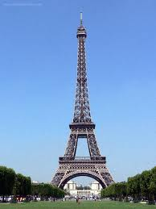
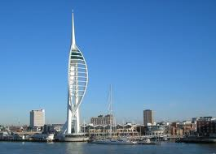

Slide 13
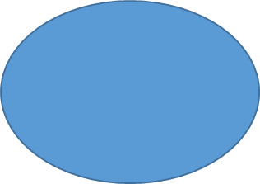
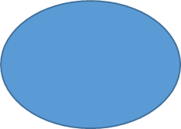
A complete crafts process
Assessment
Producing ideas
Making/ production
Design
Documentation

Slide 14
Tasks for the second meeting
Create a Pedanet account if you don’t have one yet AND
Go to Pedanet website https://peda.net/jyu/okl/ainepeda/kasityo/kp and POMM1041
Apply an access for R.1 Juliet folder!
Lue seuraavaksi kerraksi Työturvallisuusartikkeli Peda.netistä
Go through the slides of Safety in technical craft PP (in Pedanet, Juliet folder)

