Slide 1
Handbook communication and interaction teaching
Grades 5 and 6
heritage languges

Slide 2
What is the role of interaction in the curriculum?
In a school community, students develop their social skills, learn to express themselves in different ways and to perform in different situations. Teaching supports pupils' growth as multifaceted and skillful language users both in their mother tongue and in other languages.

Slide 3
What is the role of interaction in the curriculum?
Students are encouraged to interact and express themselves with little language skills. Equally important is to learn how to use mathematical symbols, images and other visual expression, drama, music and motion as tools for interaction and expression.

Slide 4
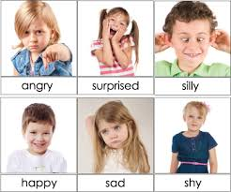
What is the role of interaction in the curriculum?
Students are guided to appreciate and master their own body and use it to express their feelings and views, thoughts and ideas. In school work, they are encouraged to use imagination and inventiveness.

Slide 5
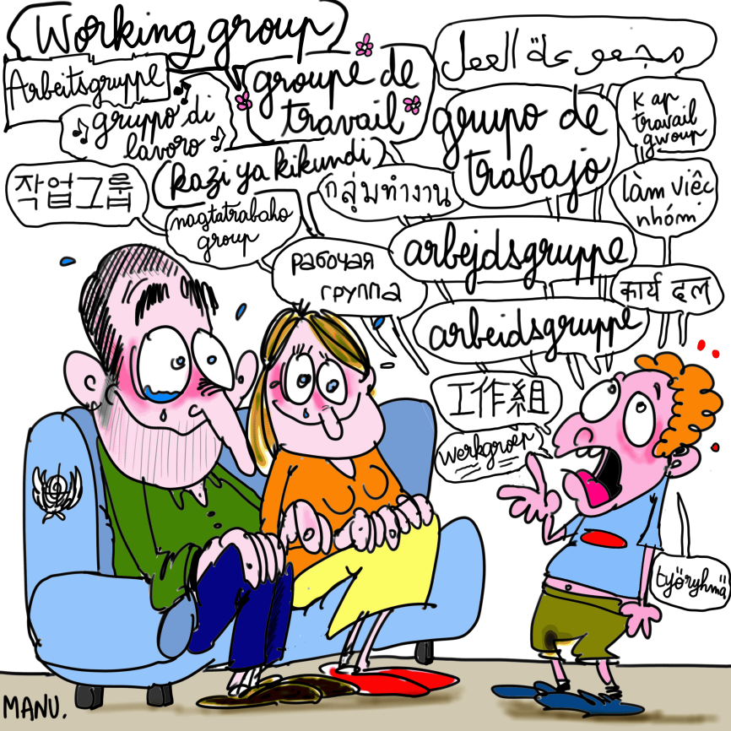
What is the role of interaction in the curriculum?
Jyväskylä's basic education takes account of different language and culture groups and encourages students to learn multilingualism.

Slide 6
Specifying the level of activity
Pupil learning objectives, content and assessment in heritage language teaching:
OPS heritage language teaching

Slide 7
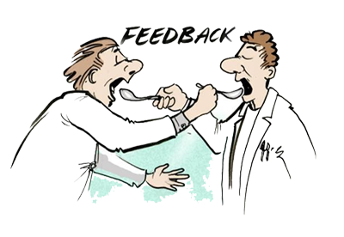
Grade 5
Pupils work in interaction situations and express their contrasting view points and opinions boldly and constructively.
They exercise in giving and receiving feedback.

Slide 8
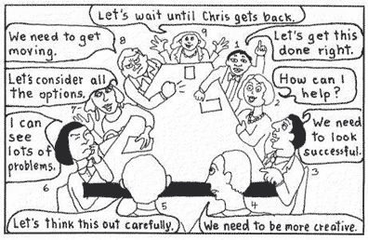
Grade 5
They partake in group-work activities, assuming different roles and responsibilities, and practice evaluating situations and results.
Their learning process is supported by active use of their heritage language.
They discuss concepts available in other subjects (interdisciplinary approach).

Slide 9
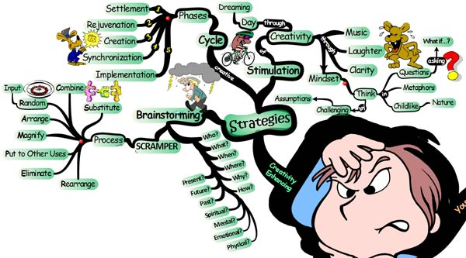
Grade 5
They are encouraged to make use of versatile vocabulary (e.g. Opetushallitus glossary).
They exercise the use of ICT, information search and knowledge evaluation.
Pupils practice different language learning strategies.

Slide 10
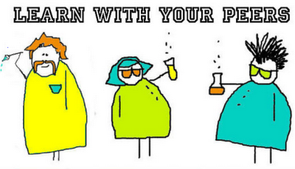
Grade 6
Pupils practice different means of expression by using their own communication and interaction skills to present things to the rest of the class.
They gain peer learning skills though interaction situations.
They are assigned different roles and responsibilities in various group activities and practice evaluating situations and interaction efficiency.

Slide 11
Grade 6
They are exposed to different subject texts and are encouraged to make use of versatile vocabulary (e.g. Opetushallitus glossary).
Active use of their heritage language skills supports pupils' learning process.
They exercise the use of ICT, information search and knowledge evaluation.
Pupils practice different language learning strategies.

Slide 12
Studying communication and interaction
Role playing games (e.g. drama, real life situations, etc.)
Different interaction scenarios (empathy vs aggression, style and tone of speech, attitudes, prejudice vs motivation and non-verbal signals)
Discussions (e.g. debates, elections)
Communication games (e.g. Alias, charades)
Presentations (e.g. book presentation, story-telling)

Slide 13
Corners
pro
against

Slide 14
Corners
Pupils are told that in two of the classroom corners there are printouts with opposite statements, e.g.“Meat consumption is healthy” versus “Meat consumption is unhealthy”.
Each pupil goes to the corner of his/her preference and while there, they discuss in pairs the reasons for their choice.

Slide 15
Corners
Afterwards, half of them move on to the opposite corner and form pairs with pupils from that corner. One pupil then agrees with the statement, while the other one is against it. They negotiate, with either pupil defending their choice and remembering the opponent’s arguments.
Finally, pupils return to their original corners and summarize the arguments quoted by pupils from the opposite corner.

Slide 16
Corners
In the ensuing classroom discussion the teacher asks the pupils why their partners chose the opposite corners.
The corner selection is a manifestation of independent thinking. The game encourages pupils to express individual opinions, it teaches negotiation techniques and collaboration skills, such as listening and summarizing.
The game duration is between 10 and 15 minutes (depending on the amount of statements used).

Slide 17
Example statments
The illegal download of music and movies needs (not) to be tackled harder.
Children may (not) have a sign with "forbidden access" on the door of their own room.
On Facebook you can/cannot write things about someone else.
Violent (computer) games should (not) be banned.
The testing of cosmetic products on animals must be prohibited/permitted.
Children may (not) occasionally lie to their parents.

