Slide 1
Student's questionnaire
Horizon-project
Joutsa high school

Slide 2
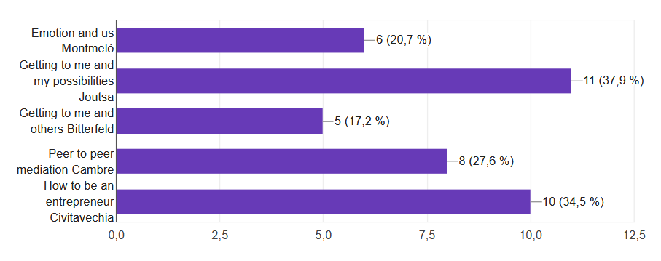
Which meeting have you participated in ? 12 male and 17 female participants

Slide 3
What did the project mean to you?
It was a great opportunity to get to know people from different countries and cultures!
It teached me many things. I overcame my slight fear of getting around lots of new people and new places.
Learning to interact with people from other countries and learning about their cultures and basic life.
New friends and social skills!
I improved my englishand got to know with other cultures and people in there
It meant much and I learnt a lot. I also got good friends and idea for my future

Slide 4
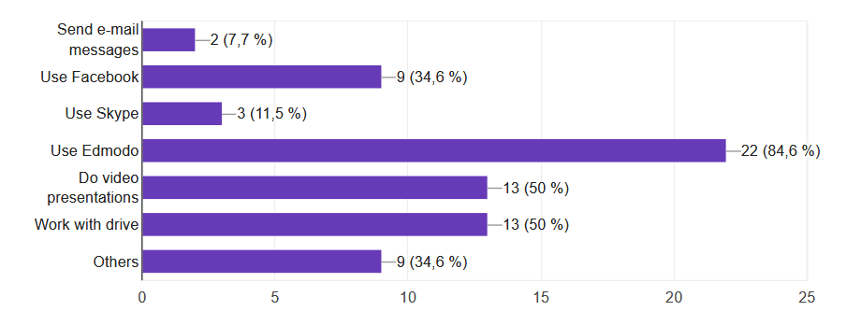
Which specific e-learnings have you acquired due to workshops that you attended?

Slide 5
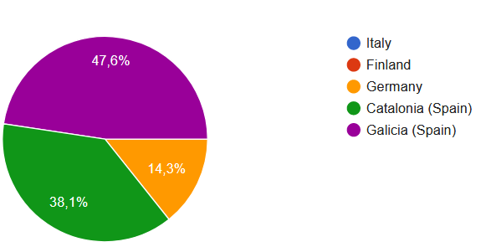
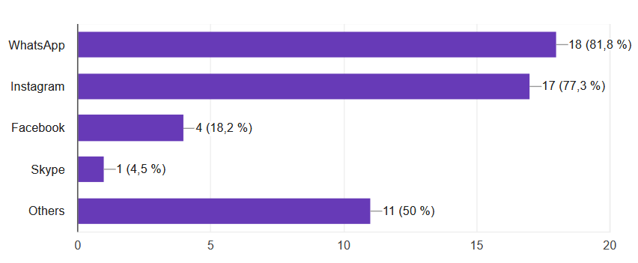
Are you keeping in touch with any of the project mates from the other countries/ regions? Yes 72,4% / No 27,6%

Slide 6
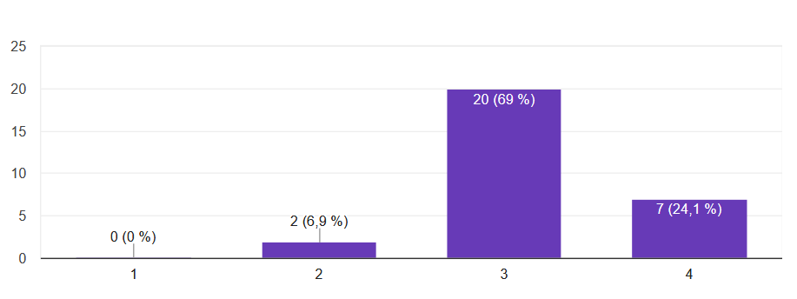
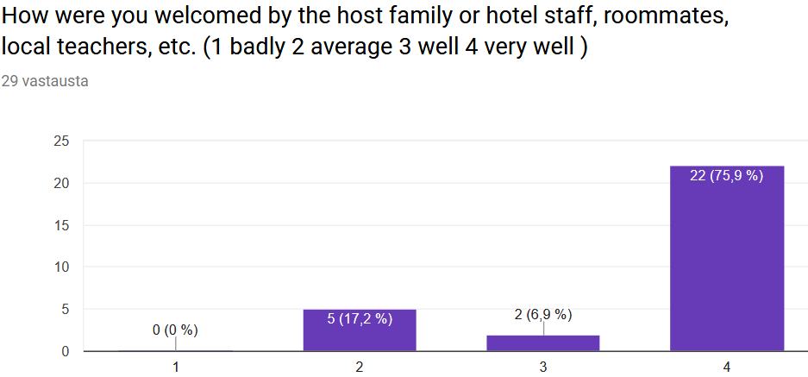
Rate the project in general. ( 1 low 2 medium 3 good 4 very good)

Slide 7
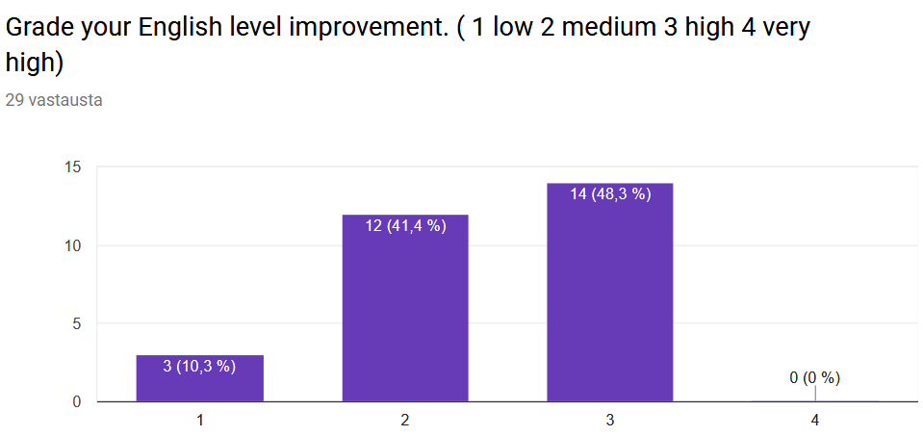
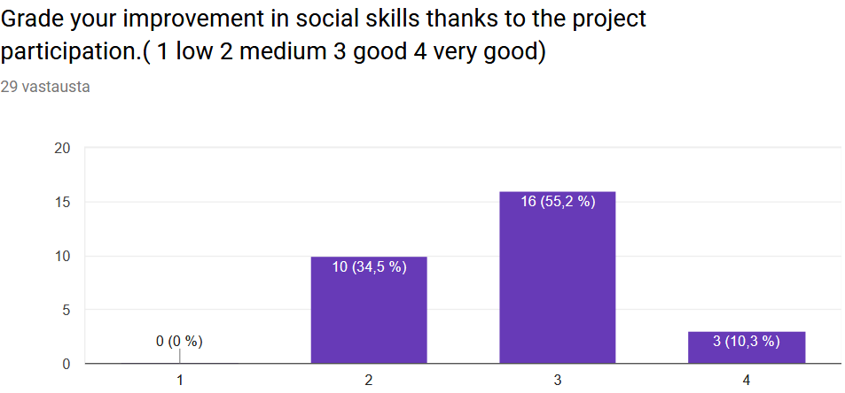
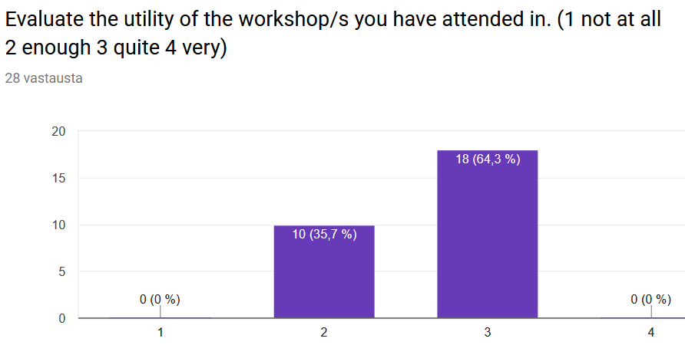
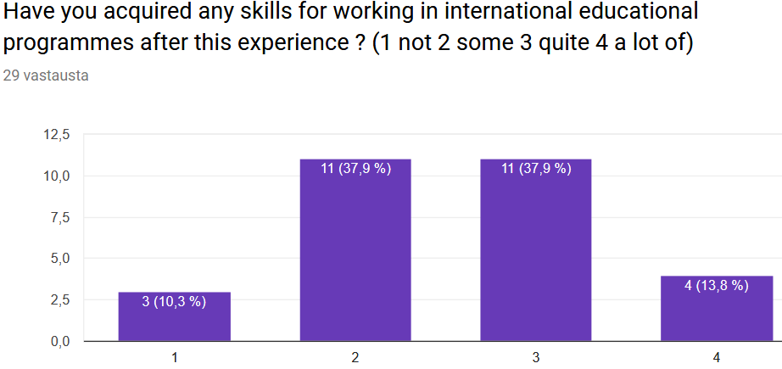

Slide 8
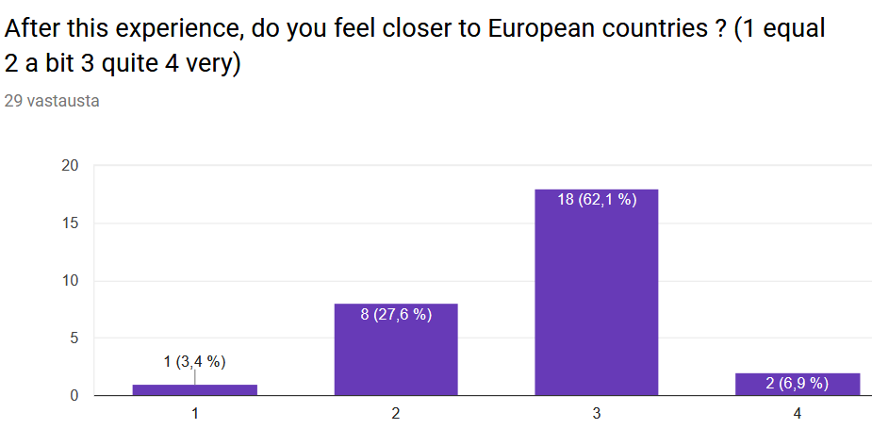
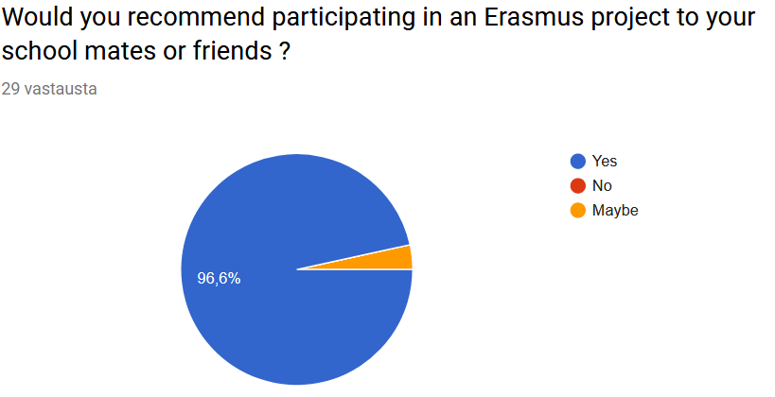
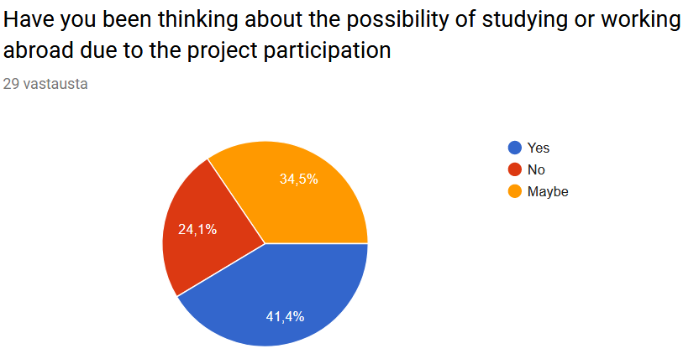

Slide 9
Positive aspects of the project
New friends, culture differences, appreciation on your own country and culture
Using English, traveling, possibly getting international acquaintances
Good experience, nice people and interesting locations
New friends, improvement of social skills and learning about new cultures
Great people, good food, interesting topics
Getting to know new people and new cultures. Now I understand better different people!
It is good that we have host families, it is good that there is students from many countries and we can see each other because there are more than one meeting.

Slide 10
Aspects to improve
Organization, punctuality and the tasks were sometimes little confusing
There were too many things in the schedule so we were busy all the time. People were often late, too. If we had more free time, we would get more familiar with the cultures and people
Too short
Schedule should plan much better, more freetime with new friends
Working in a finnish-spanish-italian group was a little difficult at times, as english wasnt always the language of choice, the students should be encouraged to use english during the meetings
Timetables, informing, more interacting between the countries

