Slide 1
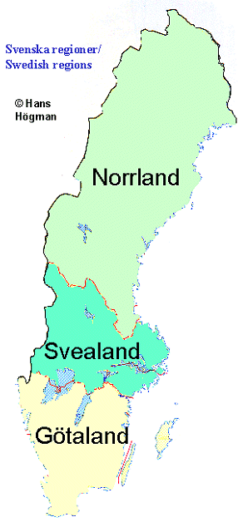
SWEDEN
QUICK FACTS
Official name | Konungariket Sverige (Kingdom of Sweden)
Form of government | Unitary Parliamentary Constitutional Mocharchy
King | Carl XVI Gustaf
Head of government | Prime Minister: Stefan Löfven
Capital city | Stockholm
Official language | Swedish
Monetary unit | Swedish Krona (SKE)
Population | (2016 est) 9.858.794
Surface | 450.295 km2

Slide 2
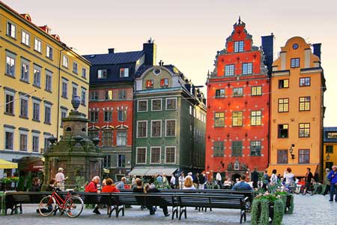
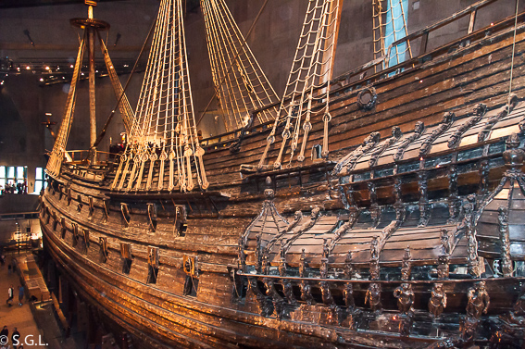
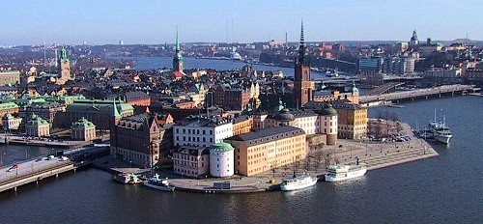
STOCKHOLM
Is the capital city of Sweden and the most populous city in the Nordic region.
The city is spread across 14 islands on the coast in the southeast of Sweden.
Stockholm is the cultural, media, political, and economic centre of Sweden. The city is home to some of Europe's top ranking universities, such as the Stockholm School of Economics.
It hosts the annual Nobel Prize ceremonies .
One of the city's most prized museums, the Vasa Museum, is the most visited non-art museum in Scandinavia.
Stockholm is the seat of the Goverment of Sweden a and the oficial residencies of the Swedish Monarch (Stockholm Palace) and the Prime Minister.

Slide 3
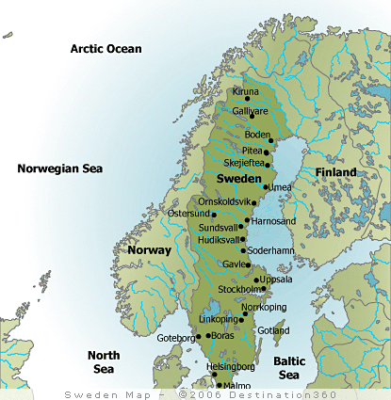

Slide 4
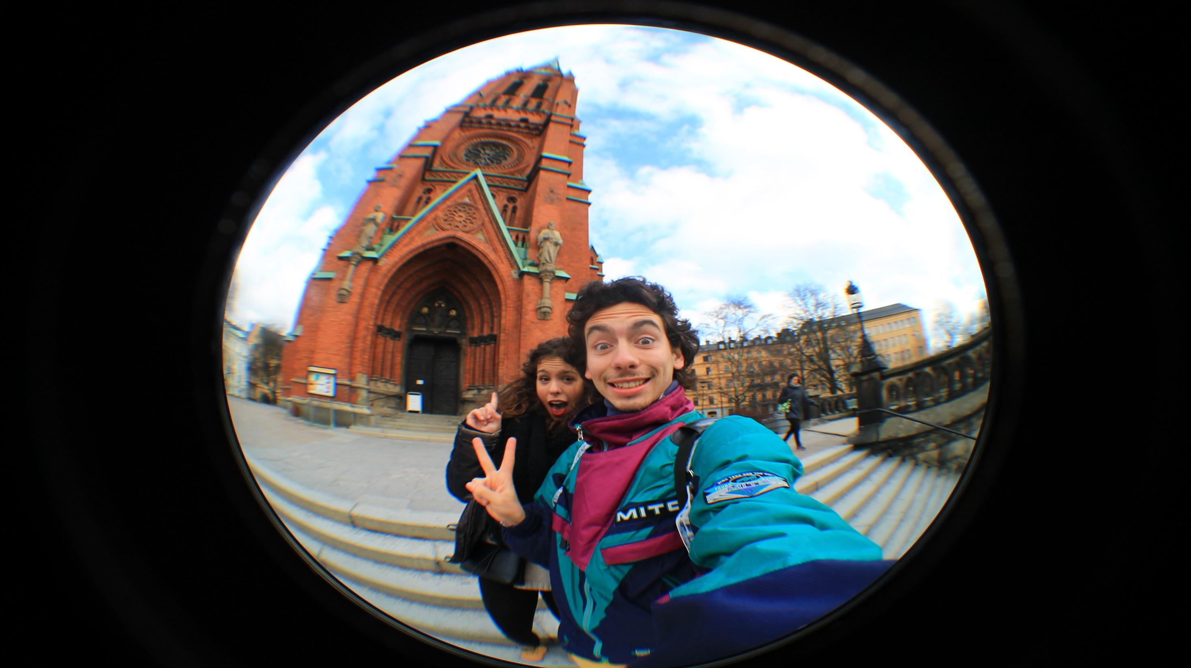
STOCKHOLM

Slide 5
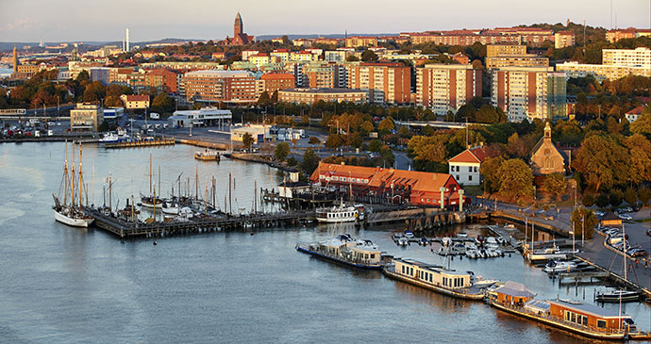
Gothenburg
Gothenburg is the second-largest city in
Sweden and the fifth-largest in the Nordic countries.
The Port of Gothenburg is the largest
port in the Nordic countries.
It is also home to many students, as it
has two universities.
Volvo was founded in Gothenburg in
1927.
The city is a major center for sports and it hosts some of the largest annual events in Scandinavia like the Gothenburg Film Festival, in summer and also a wide variety of music festivals are held in the city.

Slide 7
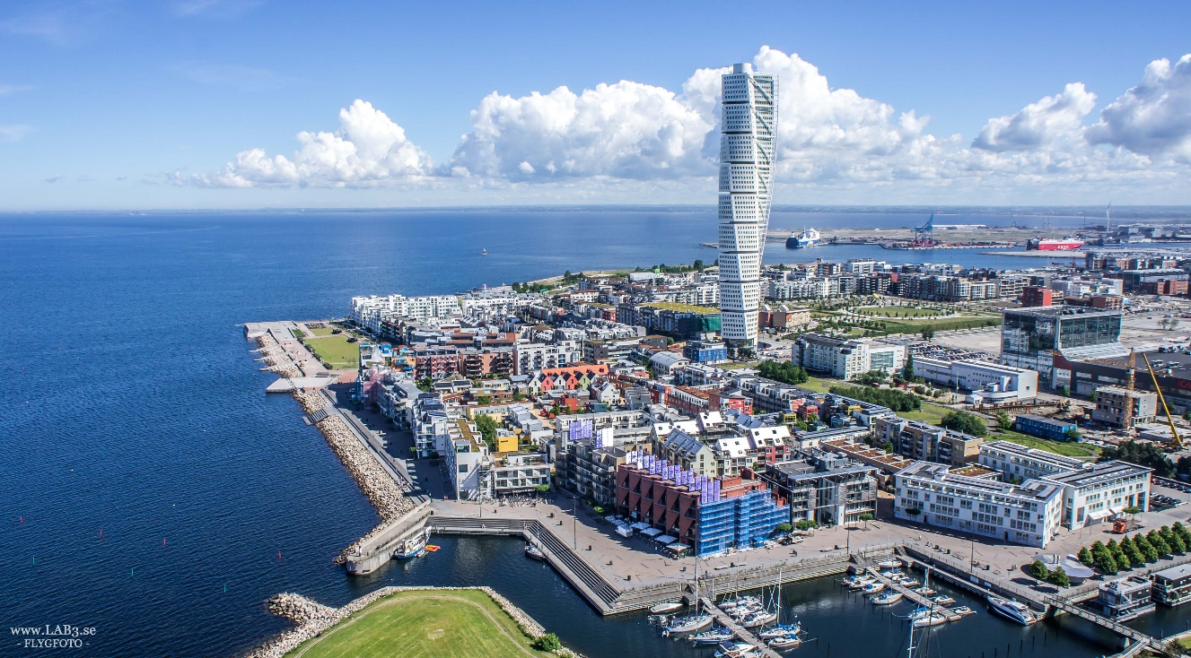
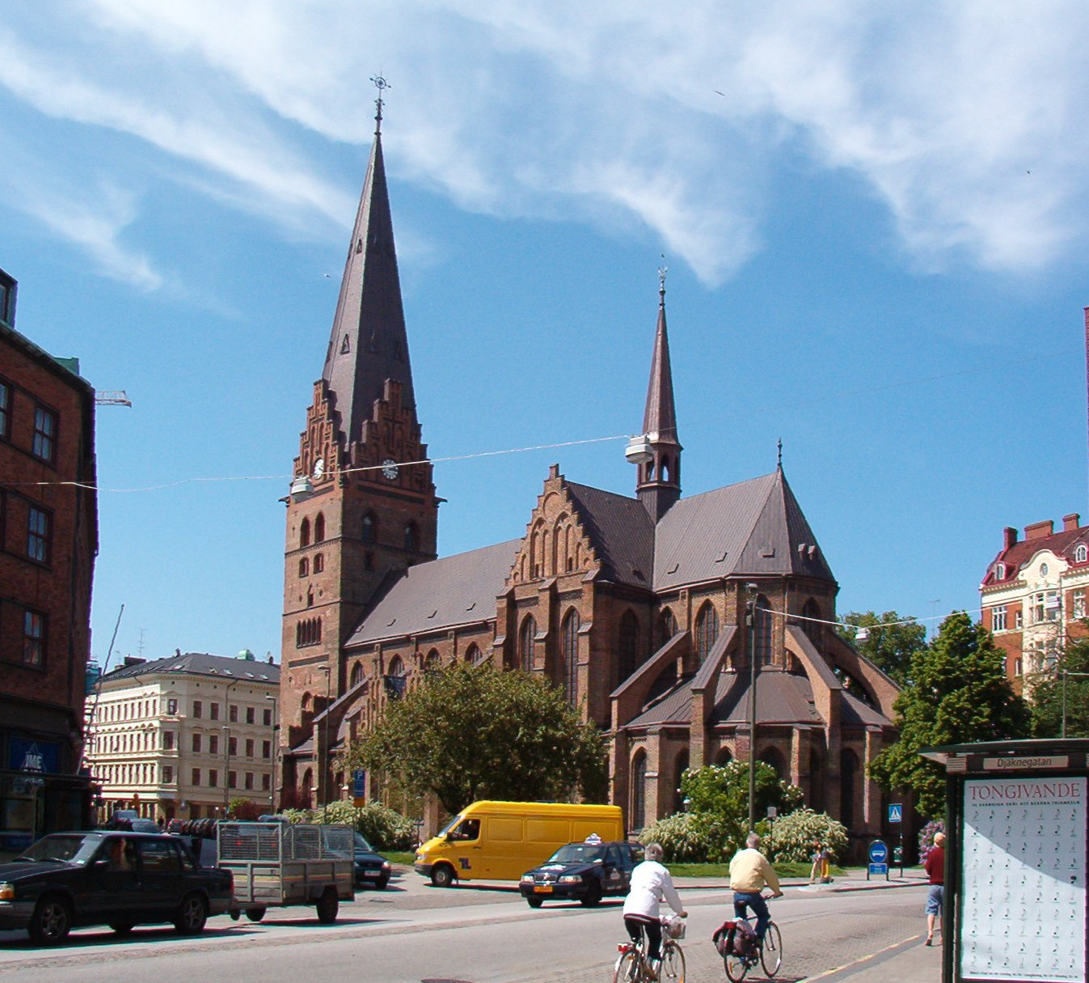
Malmö is the third largest city in Sweden and the 6th largest in the Nordic Countries.
The city is the economical and cultural centre of South Sweden. Itcontains many historic buildings and parks, and is also a commercial centre for the western part of Sweden.
Mälmo

Slide 9
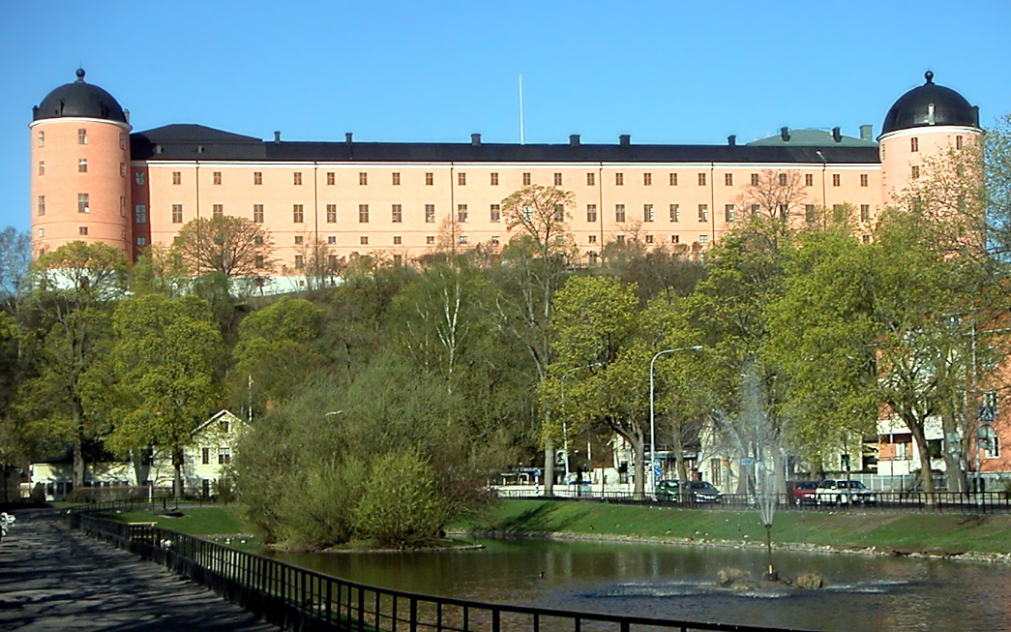
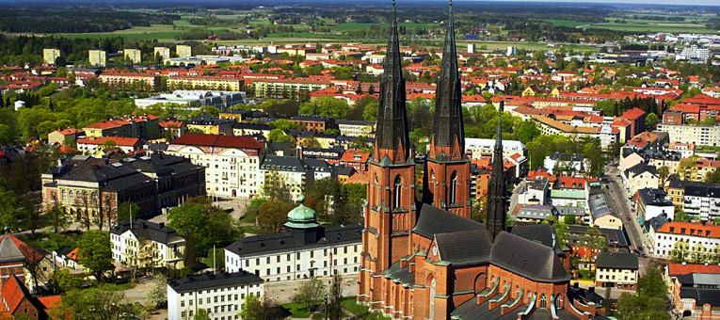
Uppsala the fourth largest city of Sweden, after Stockholm, Gothenburg and Malmö.
Since 1164, Uppsala has been the ecclesiastical center of Sweden, being the seat of the Archbishop of the Church of Sweden.
Uppsala is home to Scandinavia's largest cathedral - Uppsala Cathedral.
Founded in 1477, Uppsala University is the oldest
center of higher education in Scandinavia.
UPPSALA

Slide 11
Largest cities or towns in Sweden (est. 2010)
Rank | Name | County | Pouation.
1 | Stockholm | Stockholm | 1,372,565
2 | Gothenburg | Västra Götaland | 549,893
3 | Malmö | Skåne | 280,415
4 | Uppsala | Uppsala | 140,454
5 | Västerås | Västmanland | 110,877
6 | Örebro | Örebro | 107,038
7 | Linköping | Östergötland | 104,232
8 | Helsingborg | Skåne | 97,122
9 | Jönköping | Jönköping | 89,396
10 | Norrköping | Östergötland | 87,247

Slide 12
POPULATION:
The total population of Sweden was estimated to be 9,845,155 on
30 November 2015.
The average age is 31.4 years.
The Swedish life expectancy rate is about 81 years old.

Slide 13
Life expectancy 81
Sweden ranks in the top five countries with respect to low infant mortality. It also ranks high in life expectancy and in safe drinking water.

Slide 14
There are no official statistics on ethnicity, but according to Statistics
around 20.1% inhabitants of Sweden were of a foreign background in 2012
The most common countries of origin were Finland (2.38%), former
Yugoslavia or its successing states (2.06%), Iraq (1.74%), Poland (0.91%)

Slide 15
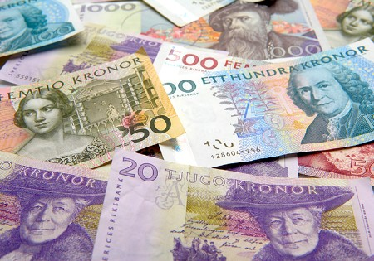
Swedish Economy is focused mainly on Importations and Exportations and on International Trade.
Wood, hydraulic energy and iron constitutes the base of the country´s economy. Moreover, the engineering sector is involved in the 50% os the exports and production.
ECONOMY:

Slide 16
Telecommunications and Automotive and Pharmaceutical industries are also of great importance.
The country invests a lot of money in researching new forms of renewable energy, for not being dependent to the fossil fuels.

Slide 17
Agriculture accounts for only 2% of the workforce.
The south of Sweden is predominantly agricultural while in the north
the forestal industry is the most important one.

Slide 18
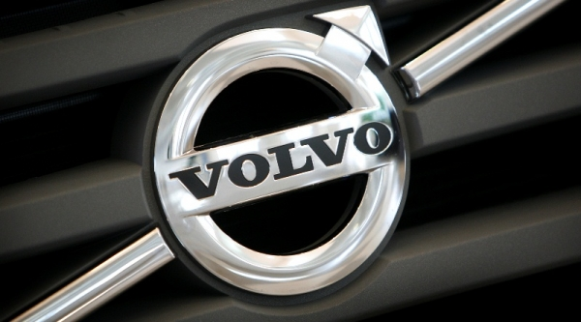
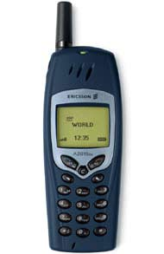
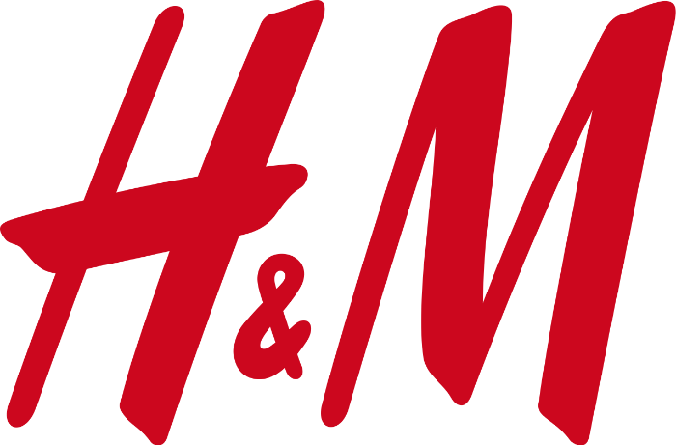
Some of the most important Swedish companies are:
AB Volvo
Electrolux
HyM
Ericcson

