Slide 1
NORWAY
NORWAY
QUICK FACTS
Official name | Kingdon of Norway
Form of government | Unitary Parliamentary Constitutional Mocharchy
King | Harald V
Head of government | Prime Minister: Erna Solberg
Capital city | Oslo
Official language | Norwegian and Sami languages (3)
Monetary unit | Norwegian krone
Population | 5.214.900 (2016 estimate)
Surface | 385.178 km2

Slide 2
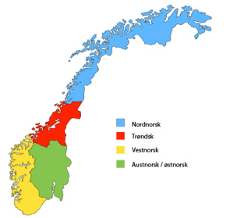
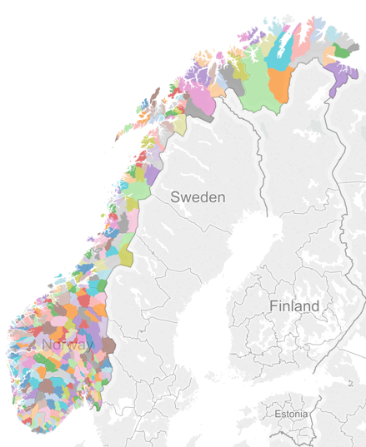
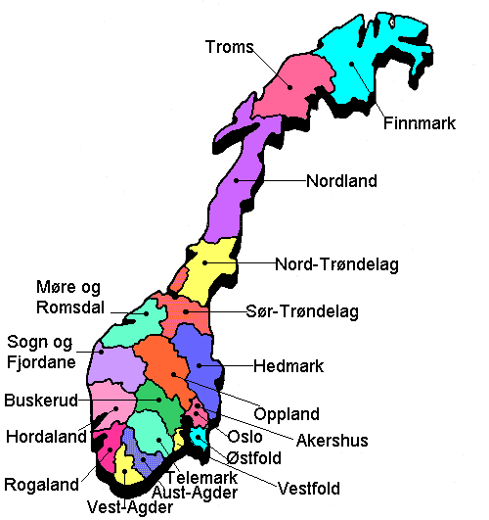
Norway is divided into 19 administrative regions, called counties, and 428 municipalities. The capital city Oslo is considered both a county and a municipality. But they also divide Norway into 5 regions, according to their situation

Slide 3
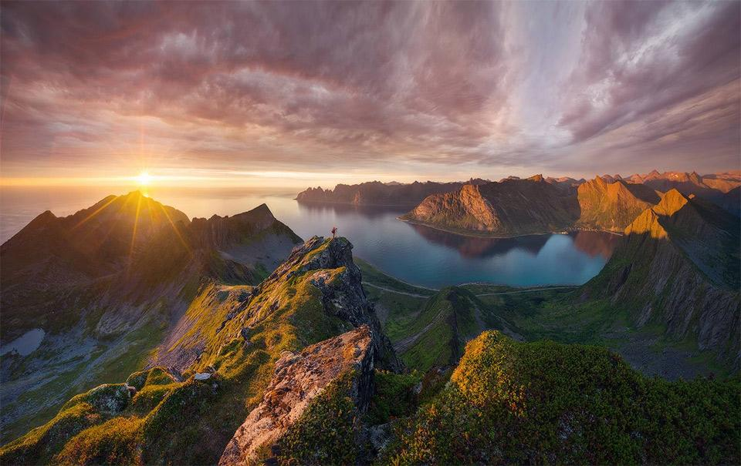
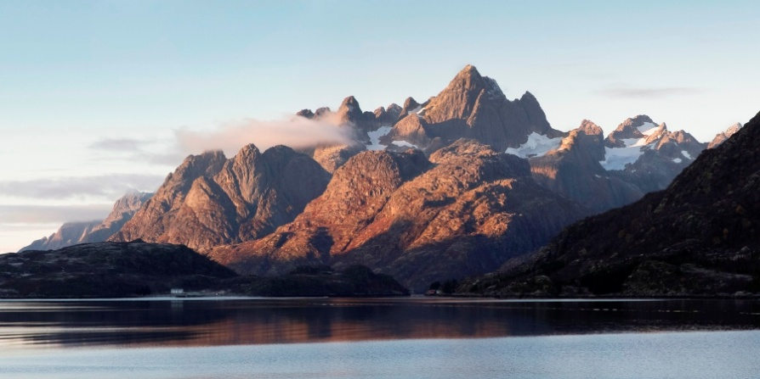
Senja
in Torms (1.586.3 km2)
Hinnøya
in Nordland, (2.204.7 km2)
Located in the western part of Scandinavia, in Northern Europe, Norway presents a rugged coastline, broken by huge fjords, and thousands of islands (more than 45.000).
In Finland 179.584, but only 789 are bigger than 1sq. Km, and 455 with inhabitants
Langøya
in Nordland (850.2 km2)

Slide 4
With a total of 385,252 km2 (338,424 km2 Finland), much of the country
is dominated by
mountains, with a great variety of natural features caused by prehistoric glaciers and varied topography.
727 km with Finland
196 km with Russia
1,619 km land border with Sweden (from which most are the Scandinavian mountains)
Skagerrak

Slide 5
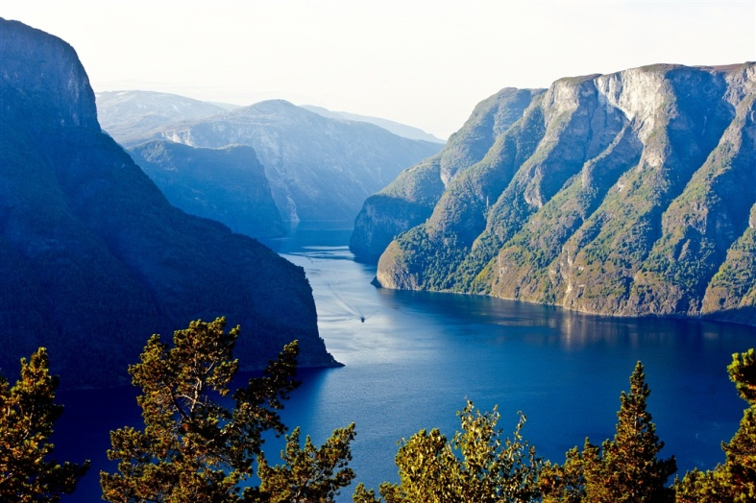
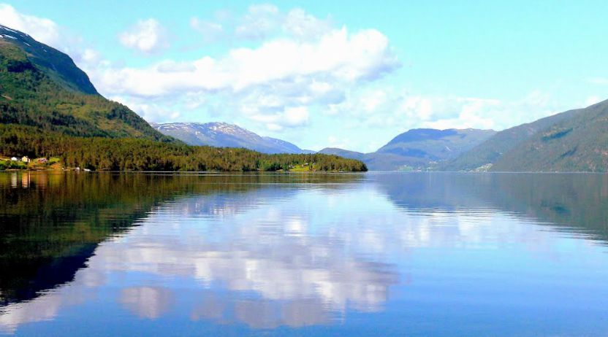
Fjords, deep grooves cut into the land flooded by the sea following the end of the Ice Age.
Permafrost can be found all year in the higher mountain areas and in the interior of Finnmark County.
Sognefjord is the world's second deepest fjord and the world's longest at 204 km
Hornindalsvatnet is the deepest lake in all Europe (514m)

Slide 6
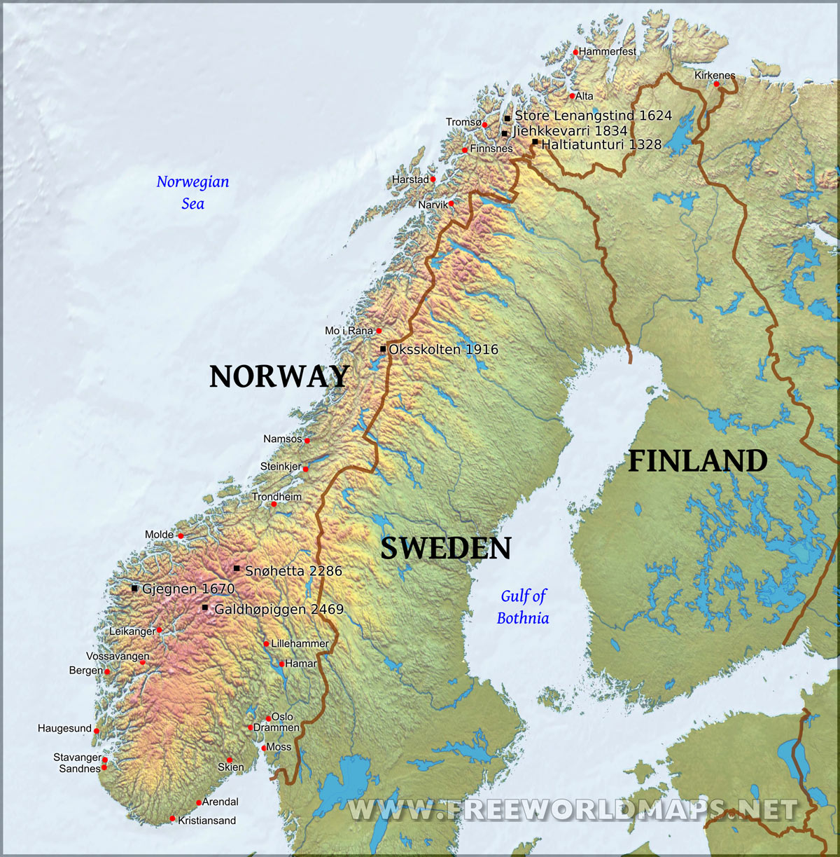
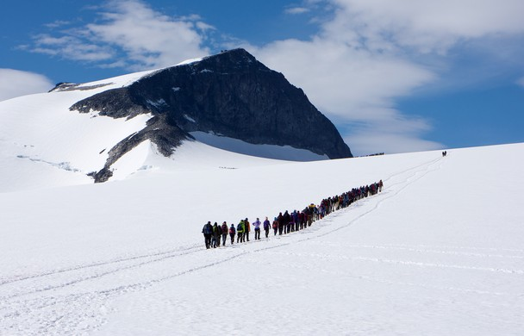
Galdhøpiggen is the highest peak in Norway and in the Northern Europe with 2.469 m above the sea level.
It is situated the Nacional Park of Jotunheimen, in the municipality of Lom, en in Oppland.

Slide 7
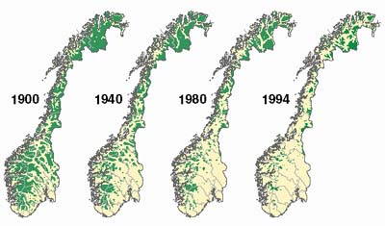
Forest area (% of land area) in Norway was last measured at 33.33 in 2011
This image shows the transition of the Norwegian forest during the last century

Slide 8
The southern and western parts of Norway, exposed to Atlantic storm fronts, experience more precipitation and have milder winters than the eastern and far northern parts.
Areas to the east of the coastal mountains are in a rain shadow, and have less rain and snow than the west.
The lowlands around Oslo have the warmest and sunniest summers, but also cold weather and snow in wintertime.

Slide 9
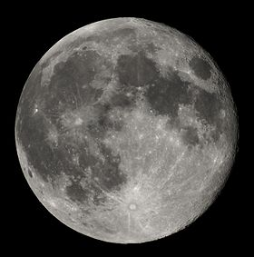
From late May to late July, the sun never completely descends beneath the horizon in areas north of the Arctic Circle, and the rest of the country has 20 hours of daylight per day.
From late November to late January, the sun never rises above the horizon in the north, and daylight hours are very short in the rest of the country.
Because of Norway's high latitude, there are large seasonal variations in daylight.

Slide 10
The coastal climate of Norway is mild compared with areas on similar latitude. The temperature anomalies found in coastal locations are exceptional, with Røst and Værøy (isles)
lacking a
meteorological
winter in spite of
being north of
the Arctic Circle.

Slide 11
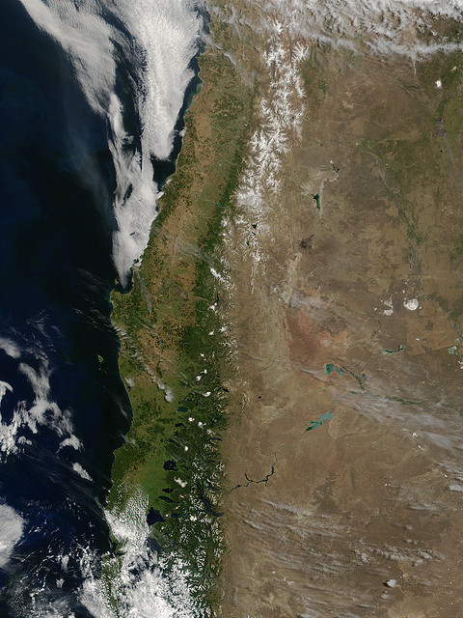
As a side-effect, the Scandinavian Mountains lock in continental winds from reaching the coastline, causing very cool summers throughout Atlantic Norway. Oslo has more of a continental climate, similar to the Swedish variety, and also very dry, being in a rain shadow

Slide 12
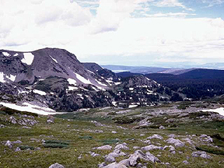
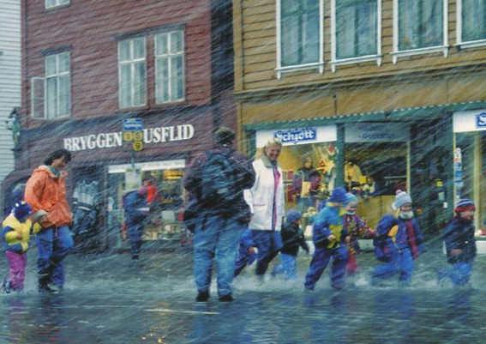
The mountain ranges have subarctic and tundra climates. There is also very high rainfall at areas exposed to the Atlantic, such as Bergen.

