Slide 1

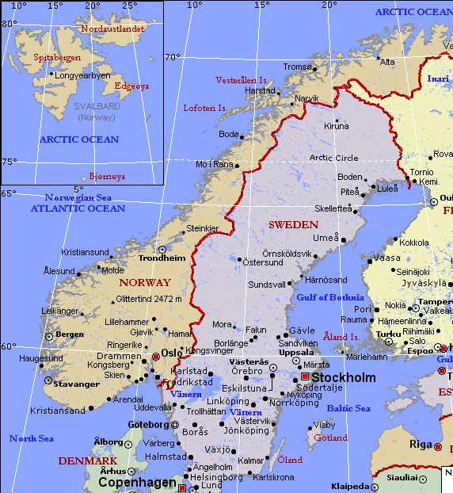

Slide 2
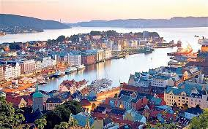
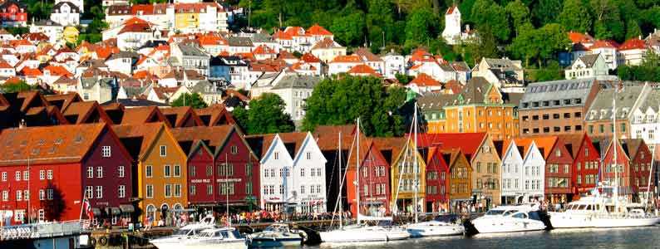

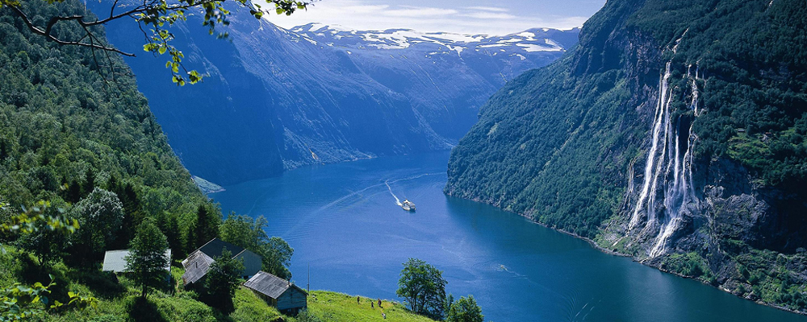
OSLO
Is the capital city and the most populous city in Norway. Its population is 647.676 inhabitants a 12% of the total Norwegian population.
It constitutes both a county and a municipality and is the governmental and economic centre of Norway.
Is the third Scandinavian city most populous below Copenhague and Stockholm.
The city is also a hub of Norwegian trade, banking, industry and shipping. It is an important centre for maritime industries and maritime trade in Europe.

Slide 4
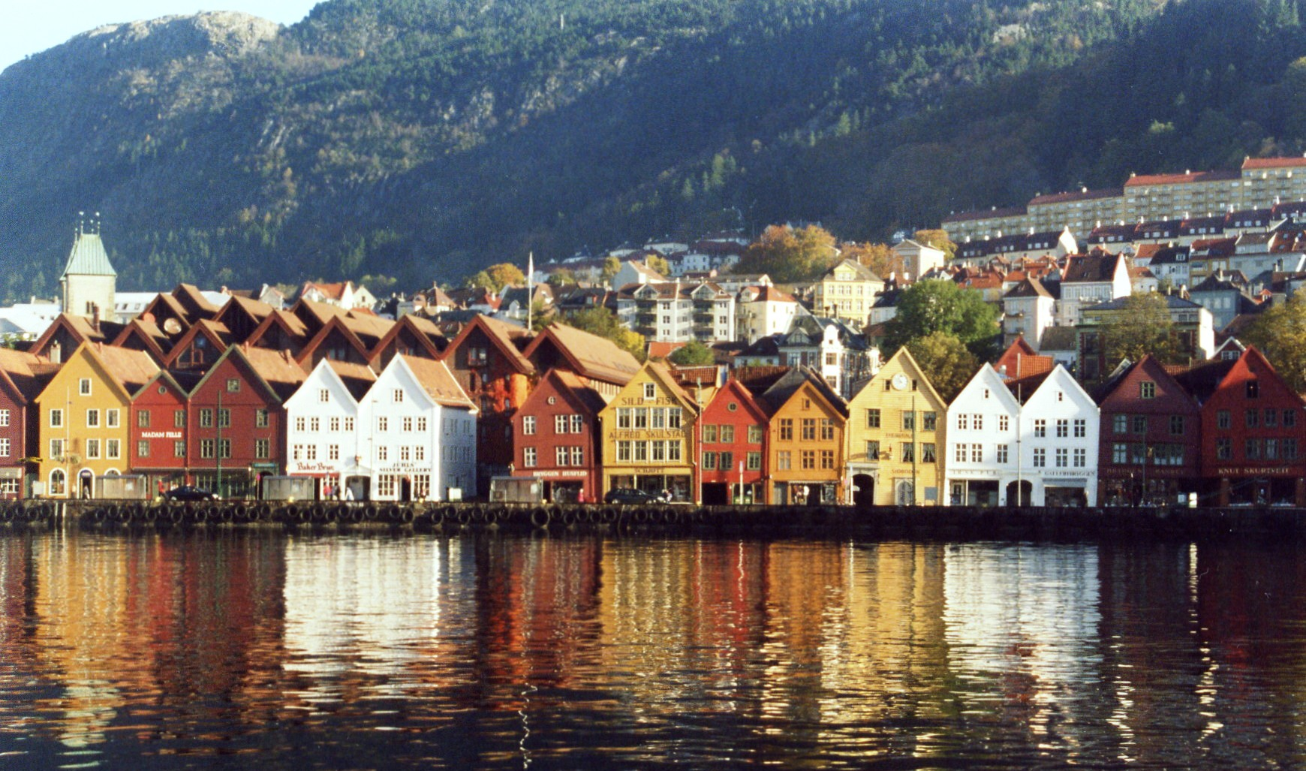
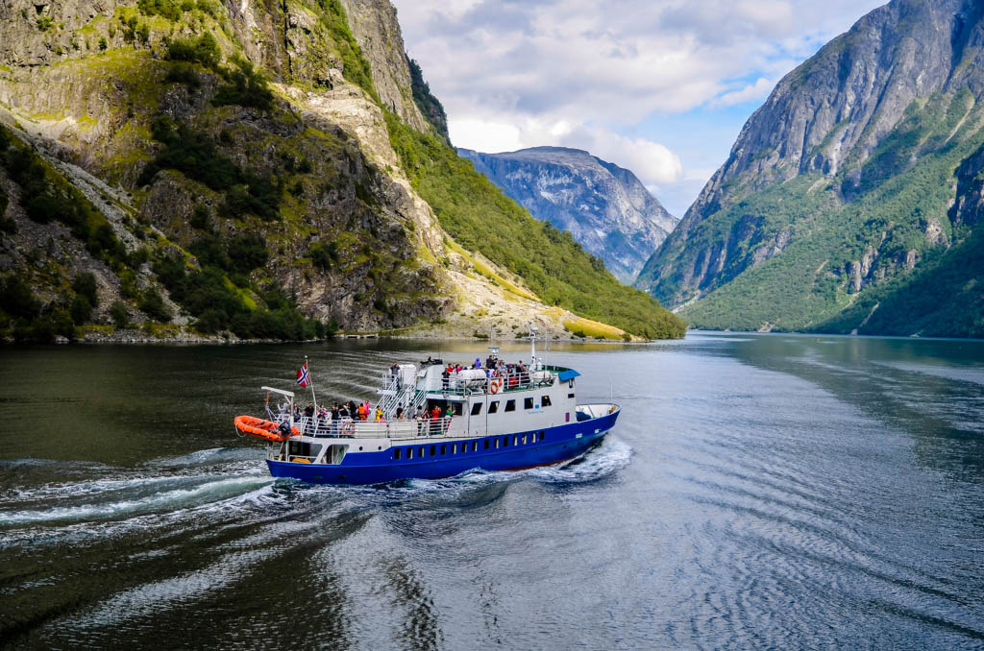
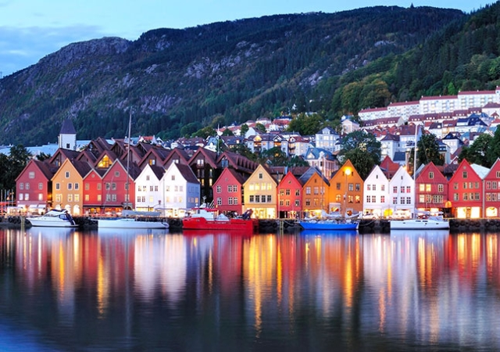
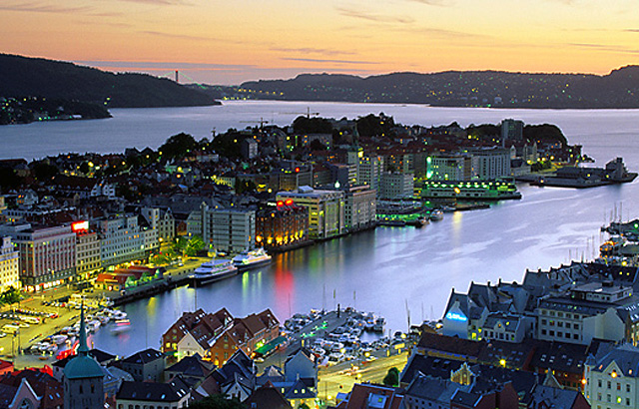
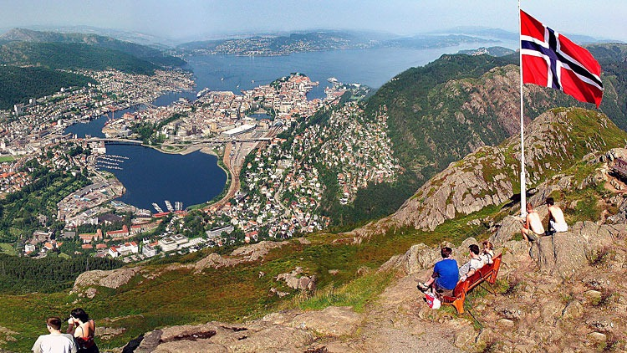
BERGEN
Bergen is the second largest city in Norway with 275,112 inhabitants according to data from Statistics Norway.
Bergen is also a municipality and the capital of the province of Hordaland.
The city is situated on the southwest coast of Norway, in a valley formed by a group of mountains known collectively as syv fjell - " the seven mountains " - . Bergen is known and touted as the gateway to the famous Norwegian fjords. Therefore it has become the largest port of tourist cruises of Norway, and one of the largest of Europe. In addition , its port is also by far the largest of Norway.

Slide 6
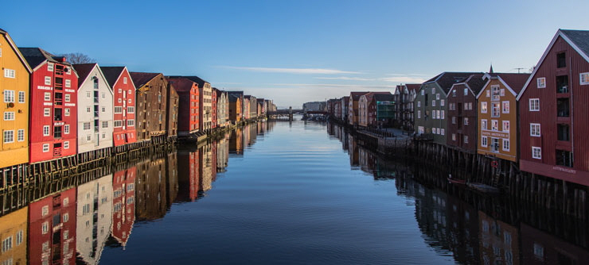
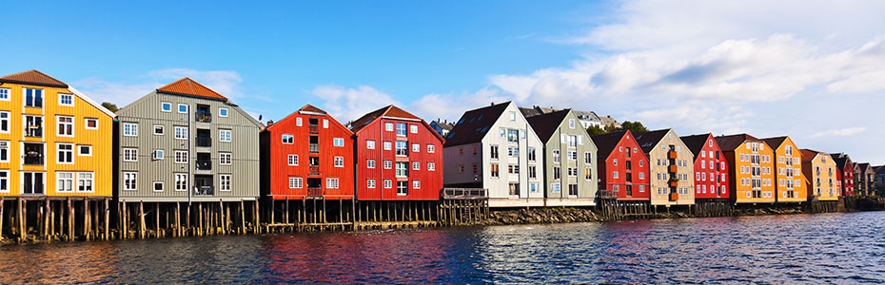
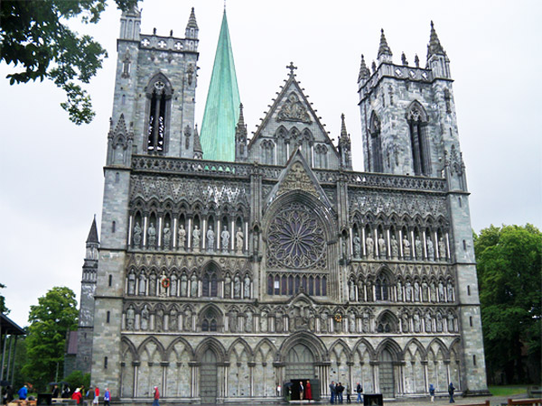
Trondheim, is both a city and a municipality. Is the capital of the province of Trondelag . With a population of 184,960 inhabitants (est. 2015 ), is the third most populous city in Norway.
It was founded in the late X century as a commercial hub. During the Middle Ages was briefly capital of Norway.
The Nidaros Cathedral is found in Trondheim, a masterpiece of Gothic architecture in the Nordic countries.
TRONDHEIM

Slide 8
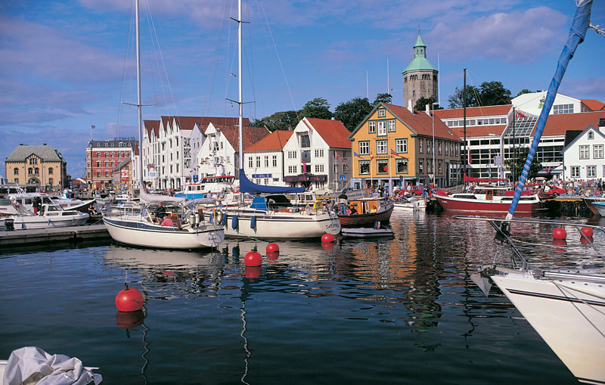
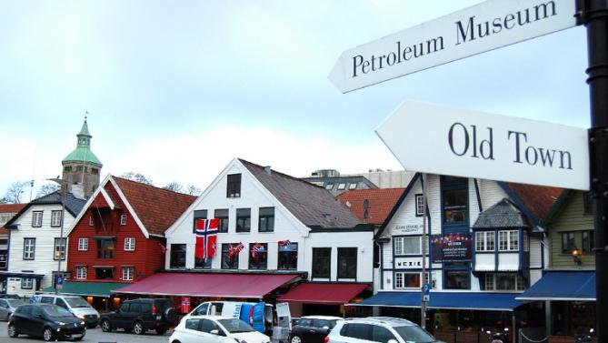
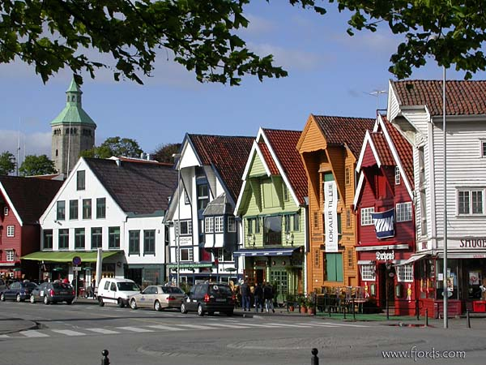
It is a port city and municipality in southwestern Norway, belonging to the province of Rogaland, the same province as Oslo.
It is the fourth largest city with 132,102 inhabitants according to the census of 2015 and the third center of Norway agglomeration.
The city is the Norwegian “oil capital”.
Stavanger traditional activities are shipping , shipbuilding and canning industry , although the latter has lost importance over the years.
STAVANGER

Slide 10

Largest cities or towns in Norway According to Statistics Norway
Rank | Name | County | Pop.
1 | Oslo | Oslo | 925,228
2 | Bergen | Hordaland | 247,731
3 | Stavanger/Sandnes | Rogaland | 203,771
4 | Trondheim | Sør-Trøndelag | 169,972
5 | Drammen | Buskerud | 110,503
6 | Fredrikstad/Sarpsborg | Østfold | 106,758
7 | Porsgrunn/Skien | Telemark | 90,621
8 | Kristiansand | Vest-Agder | 58,662
9 | Tønsberg | Vestfold | 49,735
10 | Ålesund | Møre og Romsdal | 49,528

Slide 11
POPULATION:
The total population of Norway was estimated to be 5,089,263on
30 November 2015.
The average age is 39.1 years.
The Norwegian life expectancy rate is about 80.1 years old.

Slide 12
According to Norway Statistics around the 15,6 % inhabitants of Norway were of a foreign background.
The five largest immigrant groups in Norway are: Polish, Swedish, Somali, Lithuanian and Pakistani.

Slide 13


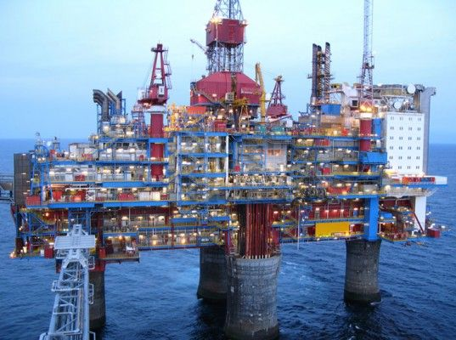

Norway is one of the world's biggest exporter of oil and gas, and Norwegian companies are in the forefront when it comes to developing new technologies in deep sea drilling.
Other main areas of export include fish, paper products and various products related to the metals industry. Tourism is also among the most important industries in Norway.
ECONOMY:

Slide 14

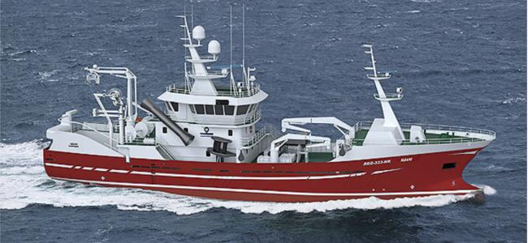

The maritime industry sustains the economy here.
Norwegian private and state owned companies are becoming more focused on research and development. The research is targeted at several areas, including natural resources and new technology like telecommunications.

Slide 15



Some of the most important Norwegian companies are:
Statoil ASA (Oil and gas multinational Company)
Norsk Hydro ASA (Aluminium and renewable energy company
Norwegian Air Shuttle ASA

