Slide 1
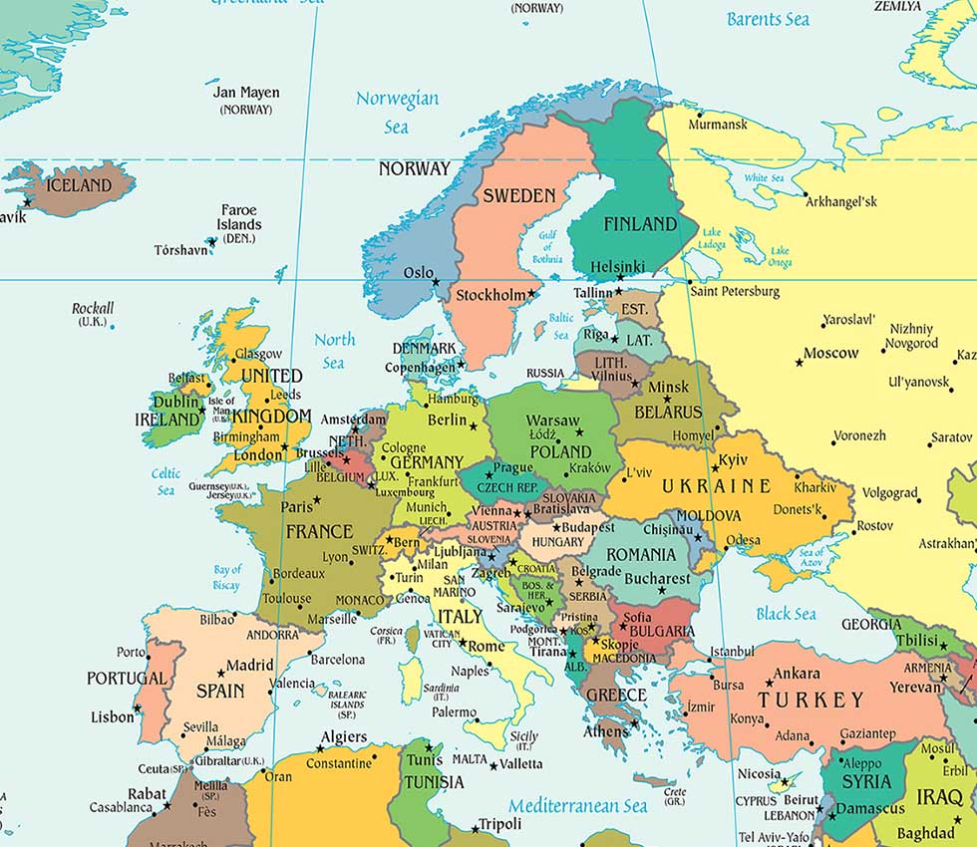
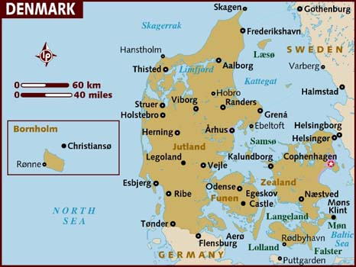
DENMARK
QUICK FACTS
Official name | Kongeriget Danmark (Kingdom of Denmark)
Form of government | Constitutional monarchy with one legislative house (Folketing)
Head of state | Danish Monarch: Queen Margrethe II
Head of government | Prime Minister: Lars Løkke Rasmussen
Capital city | Copenhagen
Official language | Danish
Official religion | Evangelical Lutheran
Monetary unit | Danish Krone (Dkk, plural kroner)
Population | (2014 est) 5.641.000
Surface | 43.090 km2

Slide 2
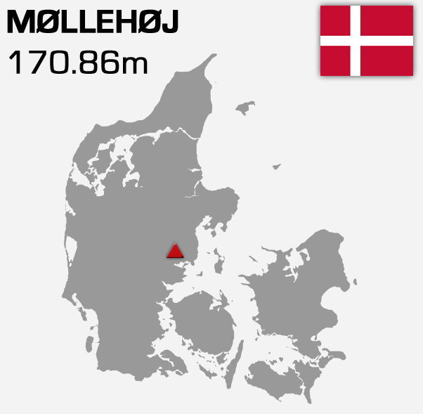
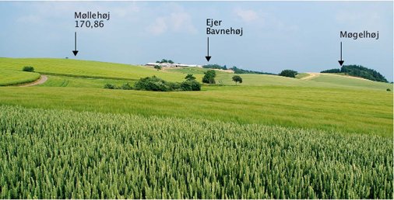
LANDSCAPE
43.094 km2 surface
Denmark ranks number 133
on the list of world countries
in terms of size
Denmark is relatively flat
with no big mountains to climb, its highest point is only 170,86 metres above sea level, called Mollehoj

Slide 3
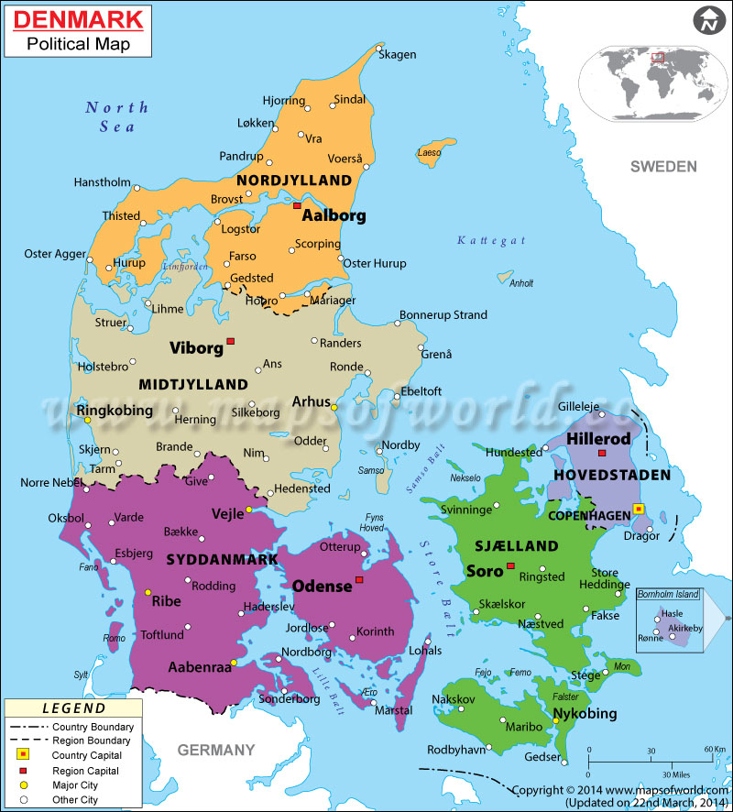
Denmark has 406 named islands
Northern sea
Baltic sea
7.314 km of coastline

Slide 4
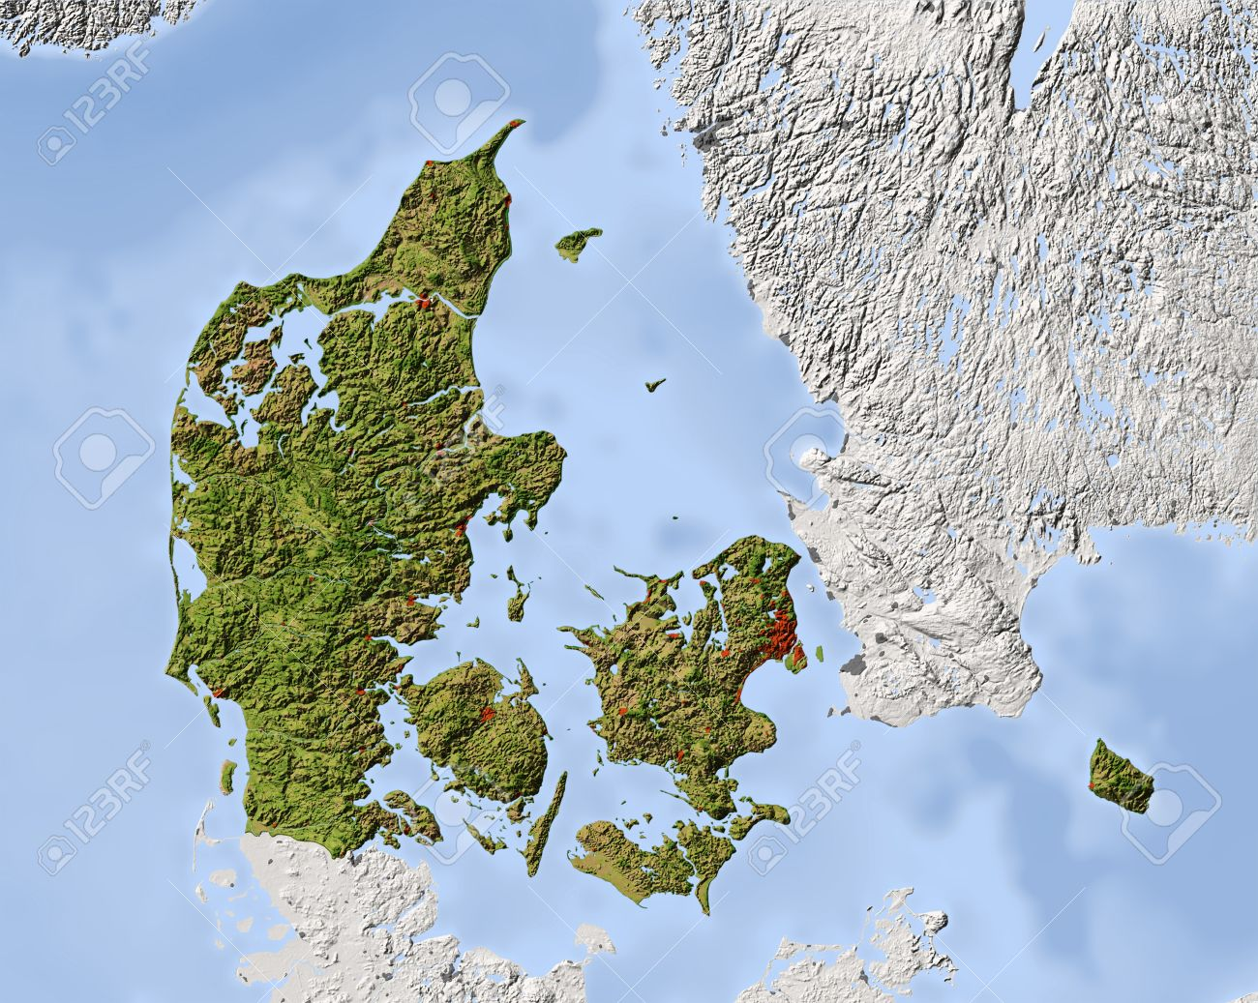
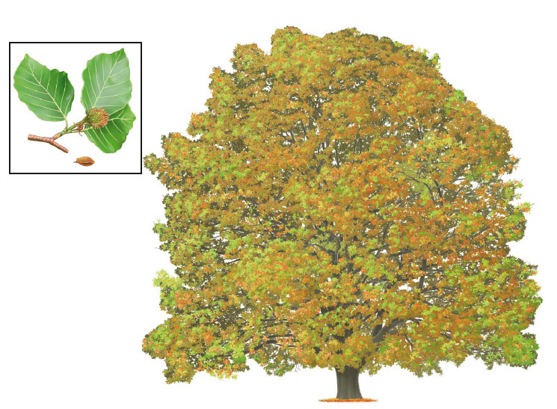
Most of its vegetation is deciduous.
The natural vegetation in most of the country is a mixed forest, with the beech as most common tree. However, almost all parts of the country are under cultivation today.
Denmark has a 12%
forest cover.

Slide 5
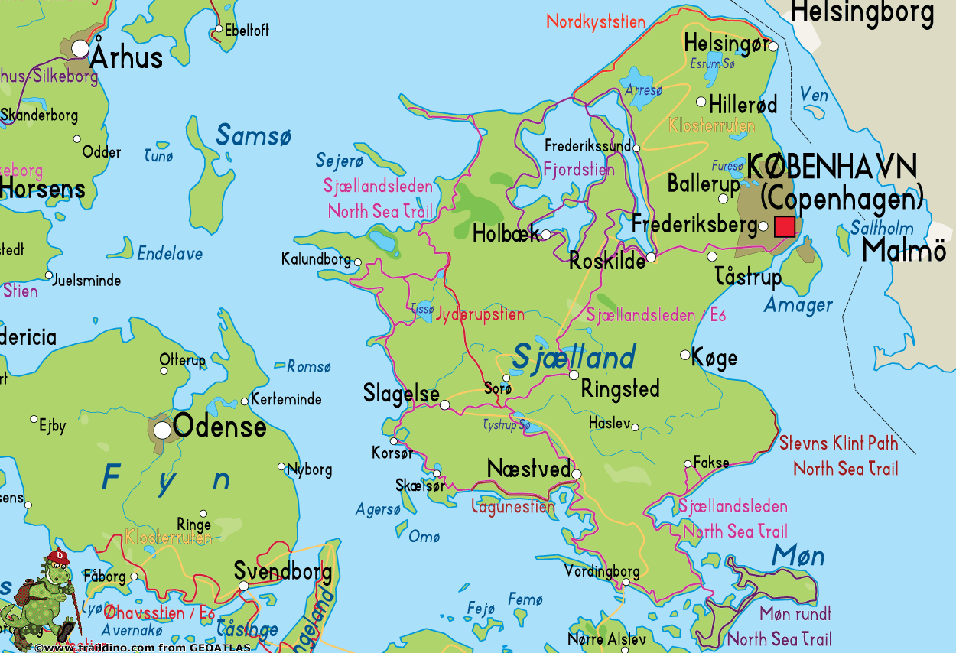
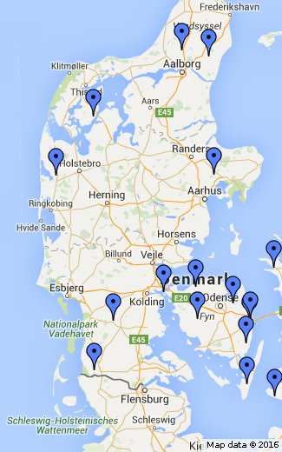
There are plenty of lakes. The total area occupied by lakes in Denmark is 435 km²
Arre (Sjaelland isle)
Stadil Fjord
(Jutland)

Slide 6
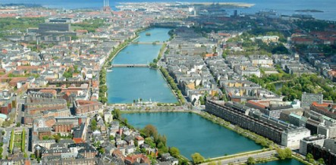
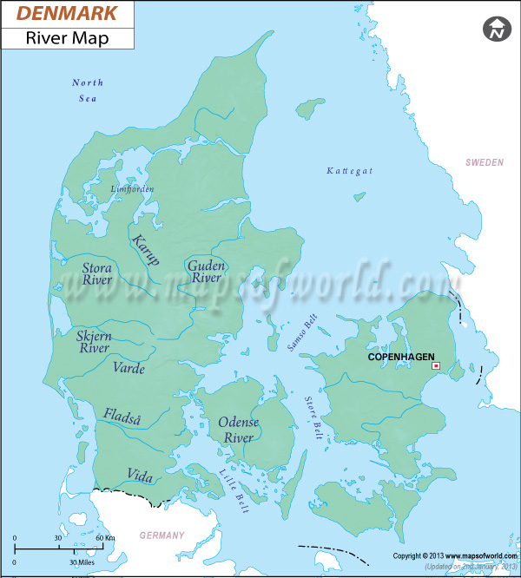
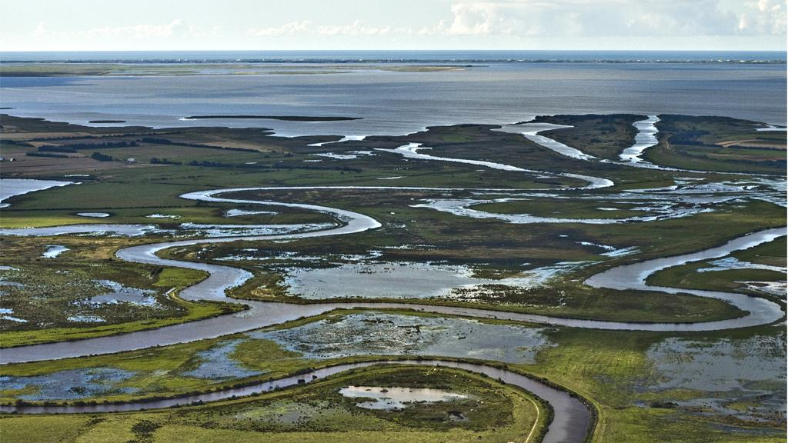
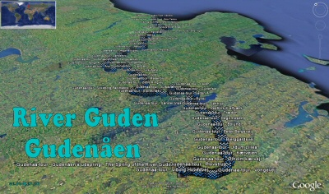
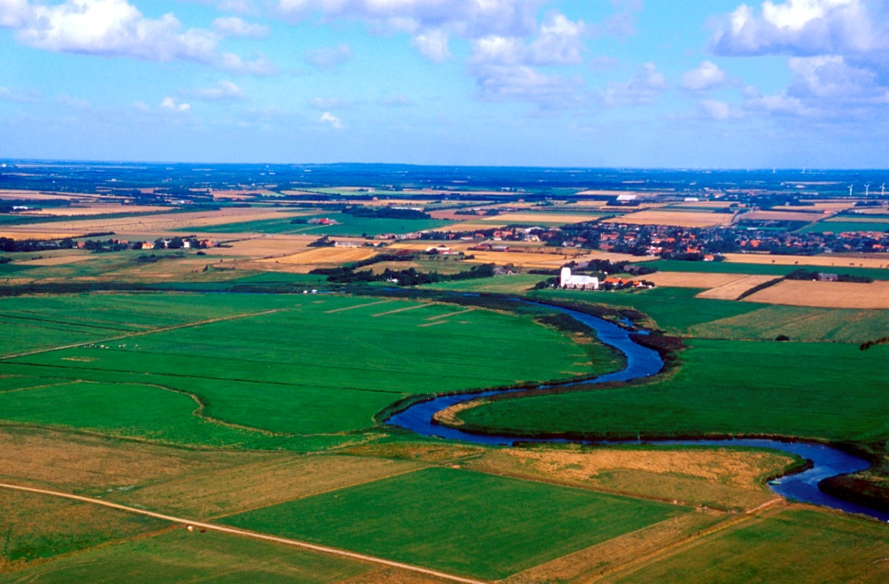
Danish rivers are short, slow, with plenty of meanders and most of them are suitable to navigate
These ones flow into the Northern sea
Skjern
Guden
longest river with 176km
Varde

Slide 7
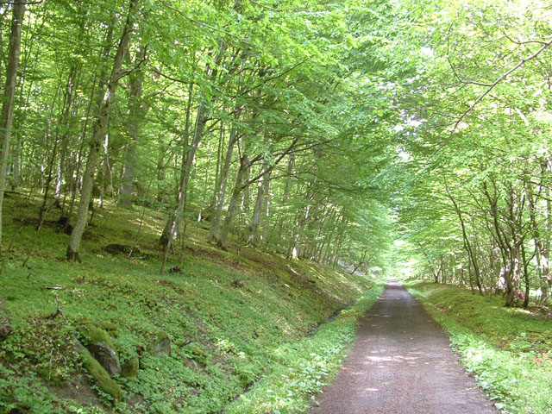
CLIMATE
Sunny, rainy, windy or snowy
Denmark has four seasons, which means warm summer days, colourful autumns, green springs and cold, snowy winters
Weather in Denmark is heavily influenced by the country’s close proximity to both sea and continent. This means that weather varies depending on
the dominant wind direction
and the season. Generally the
western parts of the country
have Atlantic climate and the
eastern parts a more
Continental influenced climate.

Slide 8
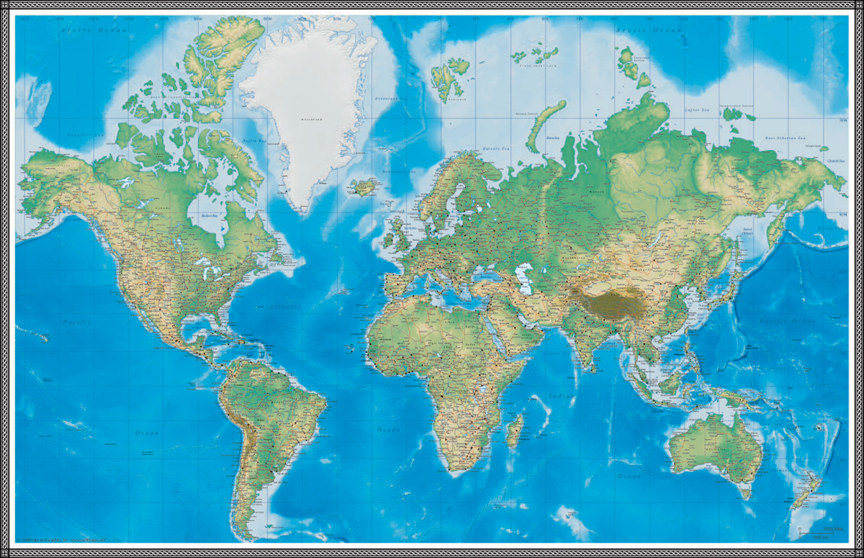
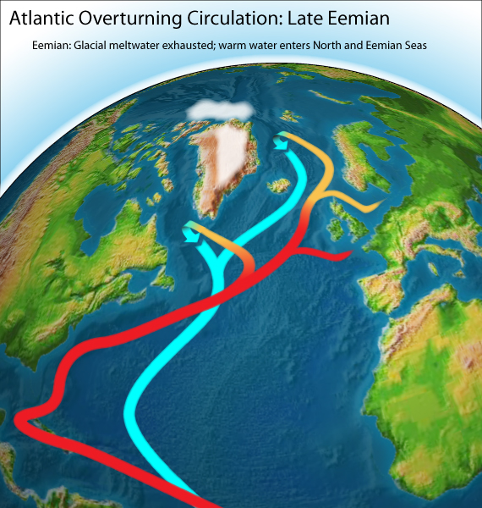
Compared to other geographic
areas at the same latitude,
the climate of Denmark is
relatively warm.
Denmark is for instance
located at the same latitude as
Hudson Bay in Canada and
Siberia in Russia - areas which
are almost uninhabitable
because of short summers and cold winters.
This is due to the warm North Atlantic Drift which originates in the tropical seas off the U.S. east coast.

Slide 9
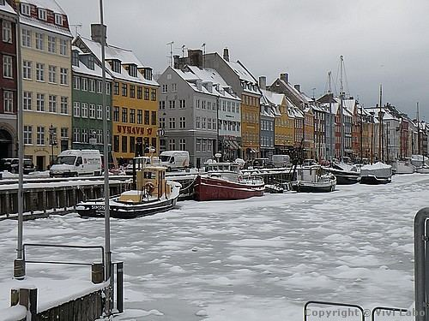
The winter is the most humid time of the year. Over the year the temperature is naturally highest, about 8’5ºC in the south, and below 7’5ºC in the northern parts of Jutland.
July is the warmest month, with a mean temperature over 20ºC, pleasant in the summertime (May-August).
January is the coldest period in Denmark, with a mean temperature of 0º C, but temperature can fall until -15 and -30°C, and the country is ruled by snow, ice and icy winds. In the wintertime the sun rises only little above the horizon and for months (October - March) the days are dark and short.

Slide 10
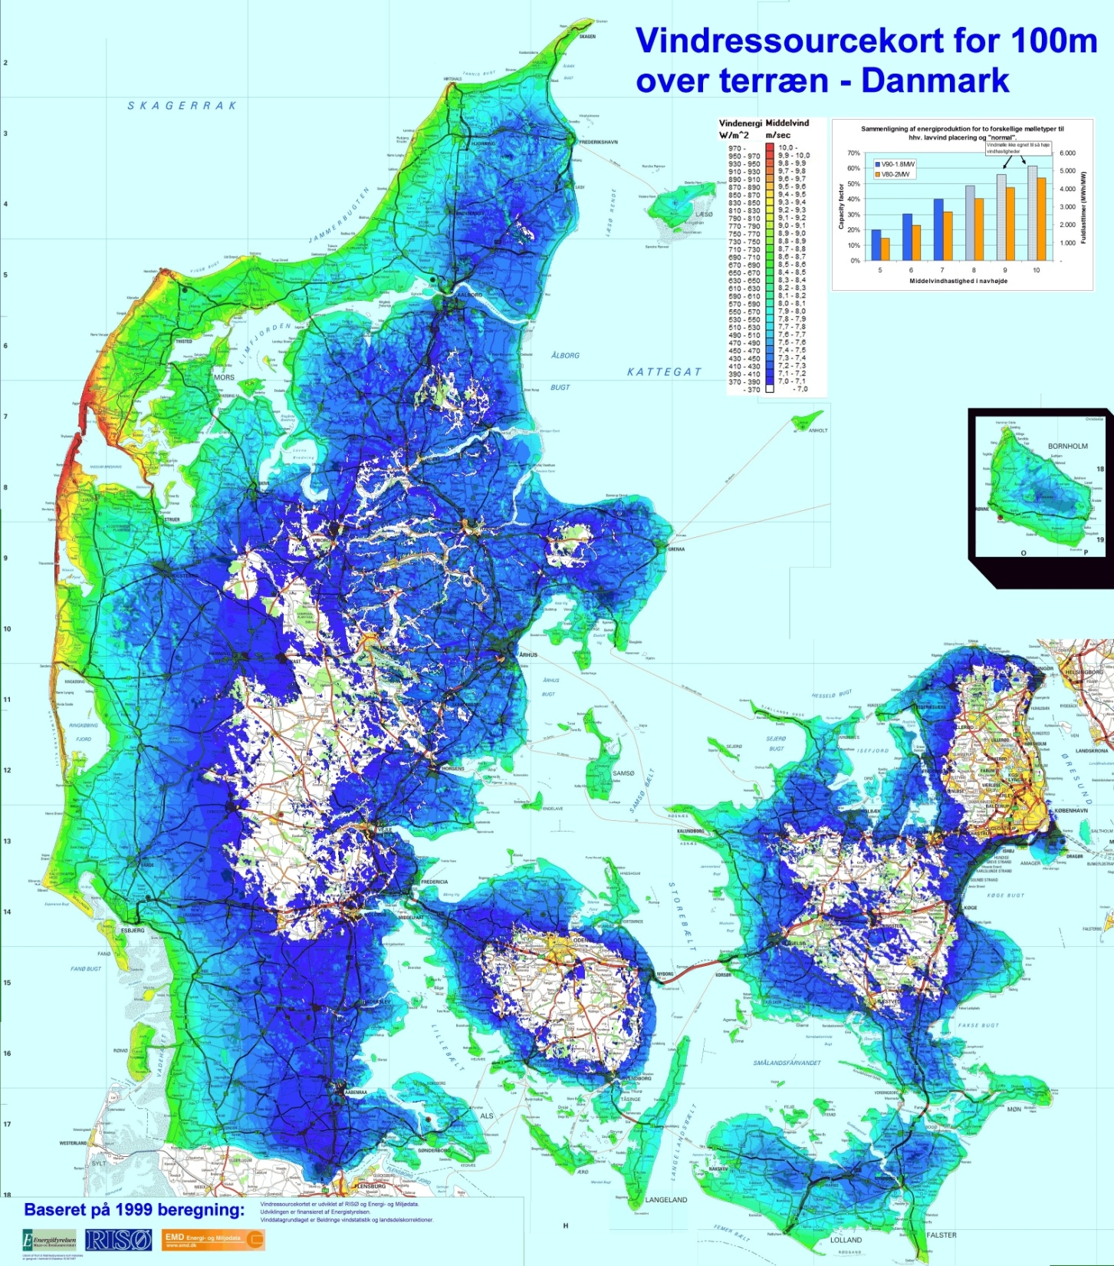
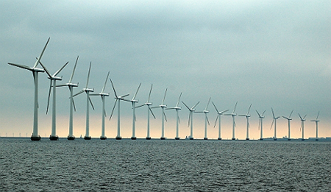
Denmark has relatively modest average wind speeds.
Onshore wind resources are highest in the western part of the country, and on the eastern islands with coastlines facing south or west.

Slide 11
REGIONS
Denmark is divided into five administrative regions, which are subdivided into 98 municipalities. The regions were created on 2007 to replace the sixteen former counties and transform smaller municipalities into larger units, reducing the number from 270

Slide 12
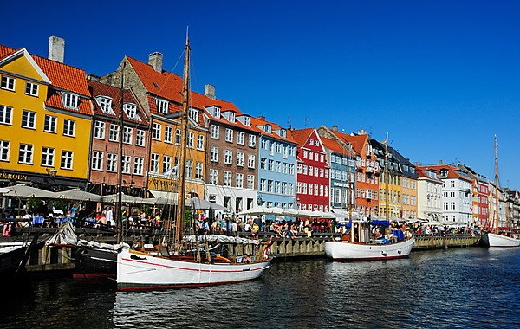
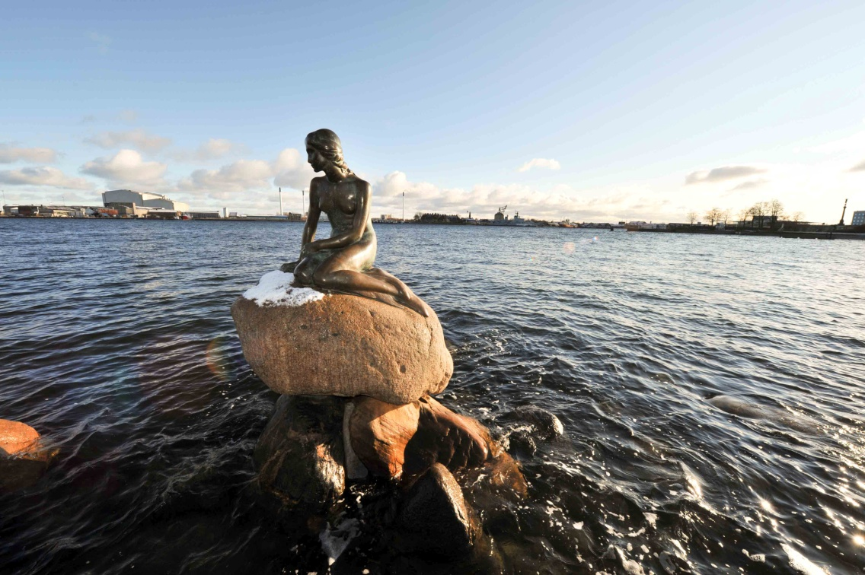
COPENHAGEN
Copenhagen, capital city, situated in the Zealand and Amager isles.
Monarchy and Parliament are situated there, and some interesting points to see are the Little Mermaid, the shore next to the Copenhagen port and the national museum

Slide 13
REGIONS

Slide 14
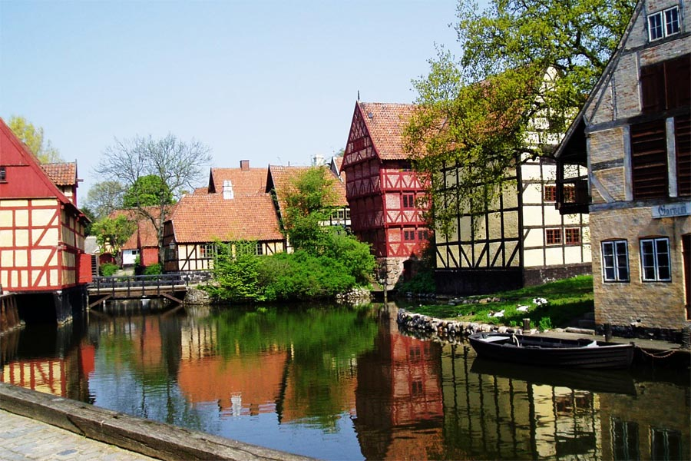
Aarhus
Second biggest city and biggest port, bishorpic seat of Denmark and students’ city
A must to see, is the Old City of Aarhus

Slide 15
REGIONS

Slide 16
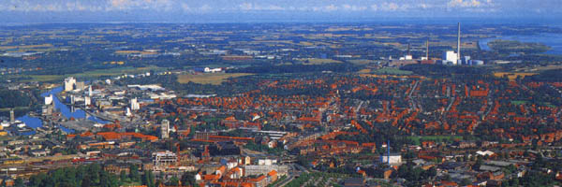
Odense
Is the third biggest city in Denmark, located at 147km away from Copenhagen, in the isle of Funen

Slide 17
REGIONS

Slide 18
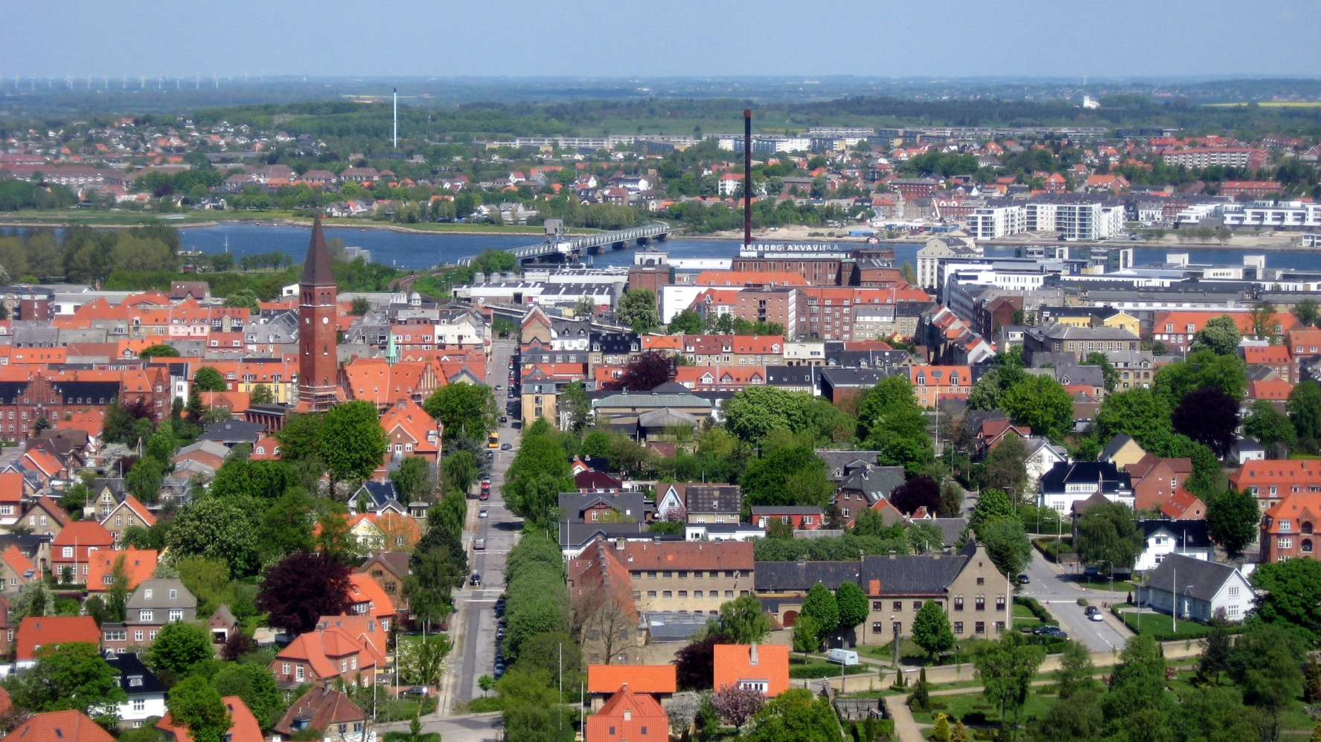
Aalborg
Important city and port of Denmark. Fourth biggest city, important aerial base, Lutheran bishop seat and great football team

Slide 19
REGIONS

Slide 20
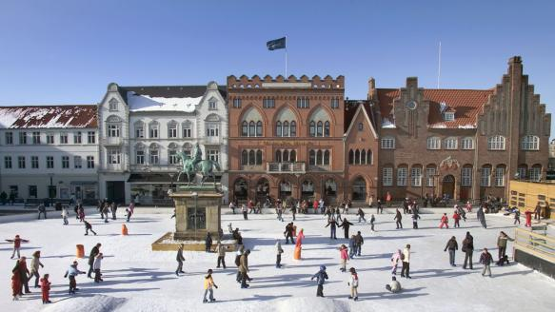
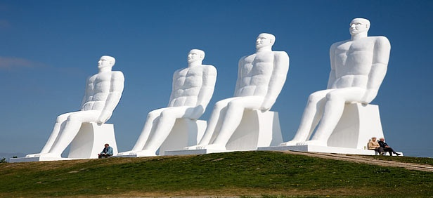
Esbjerg

