Slide 1
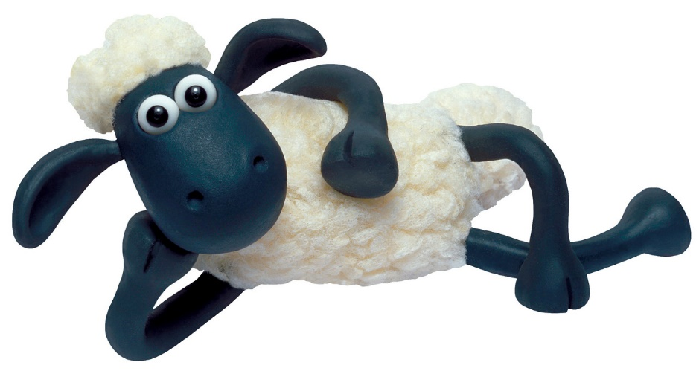
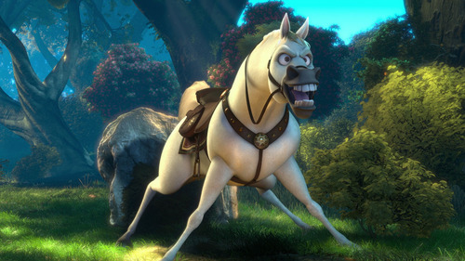
What is correct: red or green
bigger than
A sheep is
smaller than
a horse

Slide 2
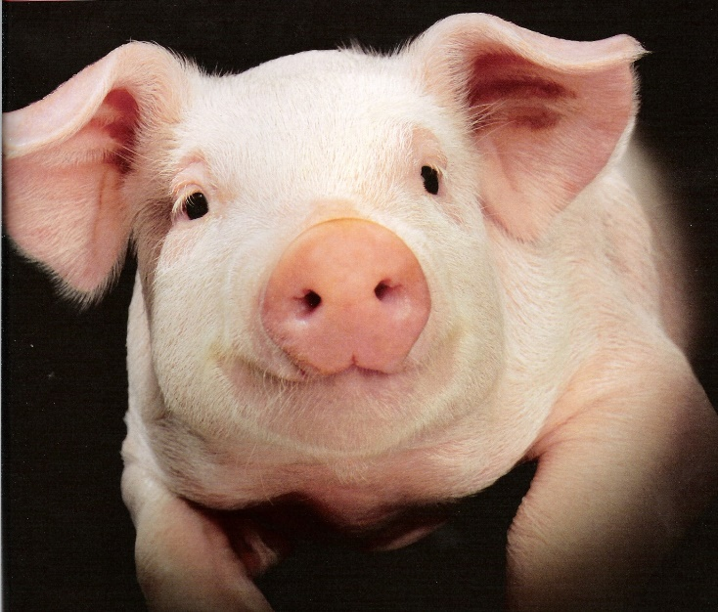
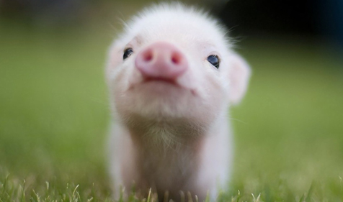
What is correct: red or green
older than
A piglet is
younger than
a pig

Slide 3
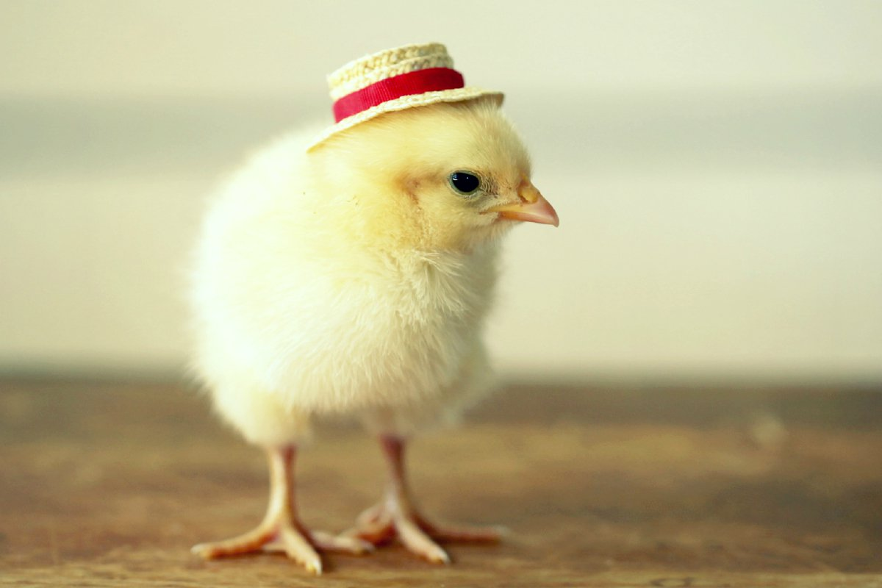
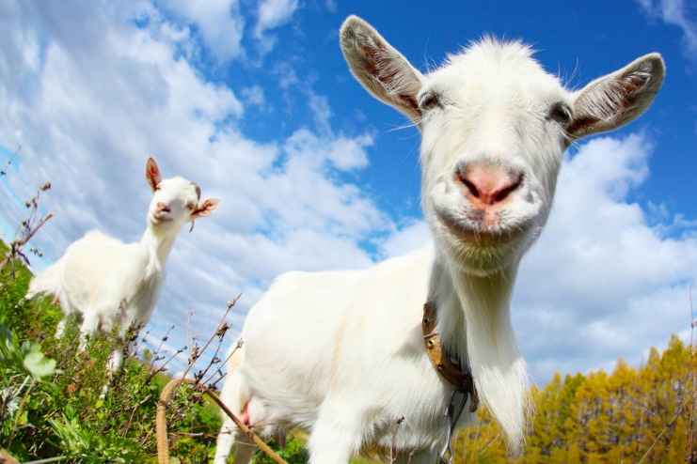
What is correct: red or green
faster than
A goat is
slower than
a chick

Slide 4
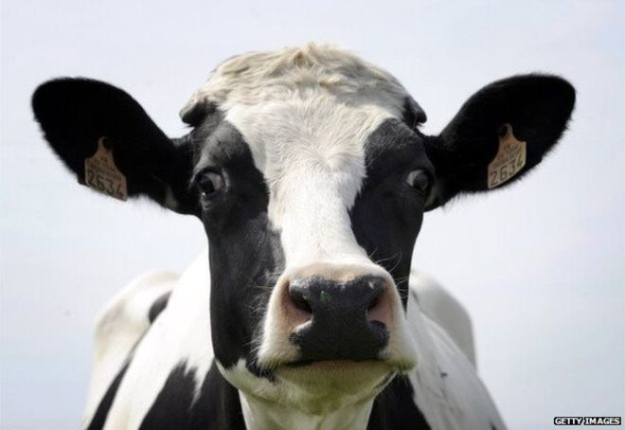
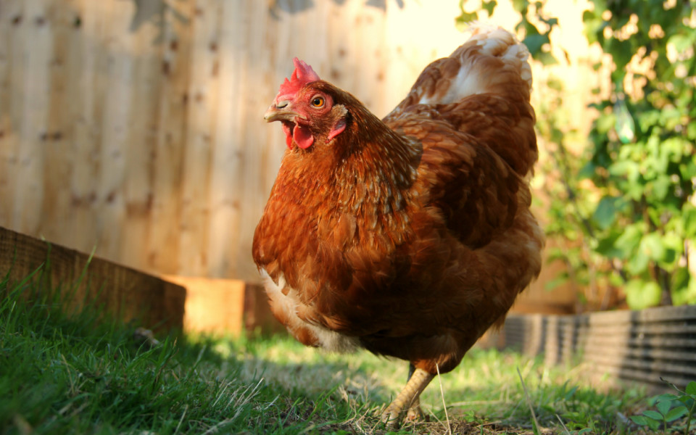
What is correct: red or green
bigger than
A cow is
bigger then
a hen

