Slide 1
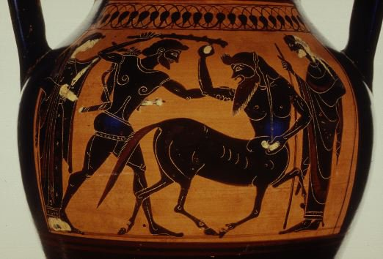
1. Work in groups 2. Discuss the following questions with your classmates 3. Acting…You have to act the myth we learned while in class

Slide 2
Questions
1. Who is Hercules?
2. Is Hercules a god?
3. Who is Hera?
4. What did she do and why?
5. Was Hercules saved? How?
6. How Zeus keep his small son safe from attack
7. Who is Eury?
8. What was Hera’s plan?
9. what did hercules do?

Slide 3

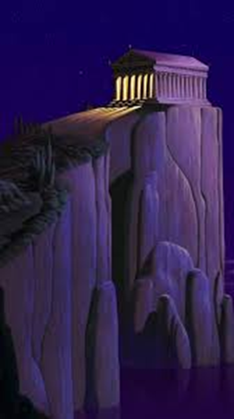
Oh! No! you have a problem… Now you must go to
You need to learn your future write down in a piece of paper your problem in English

