Slide 1
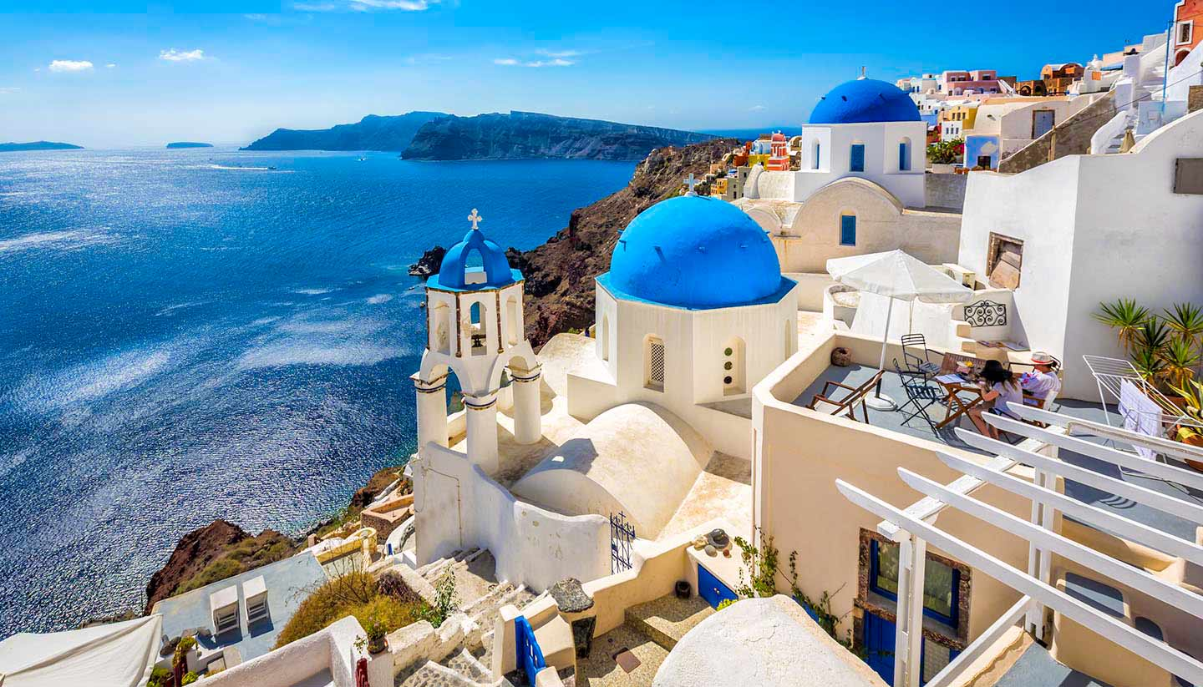
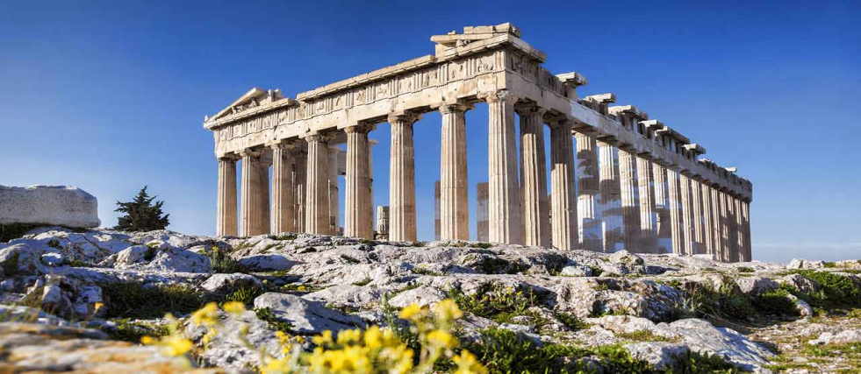
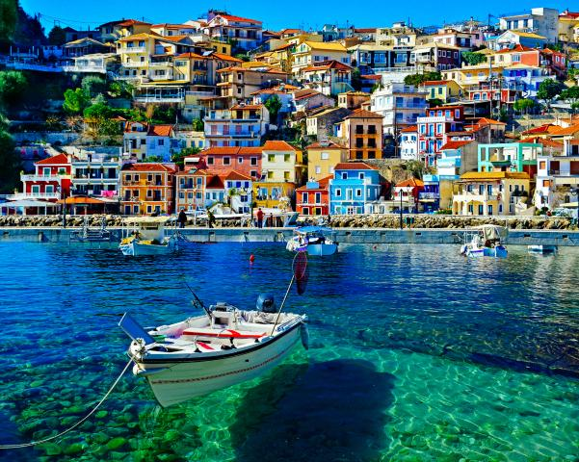
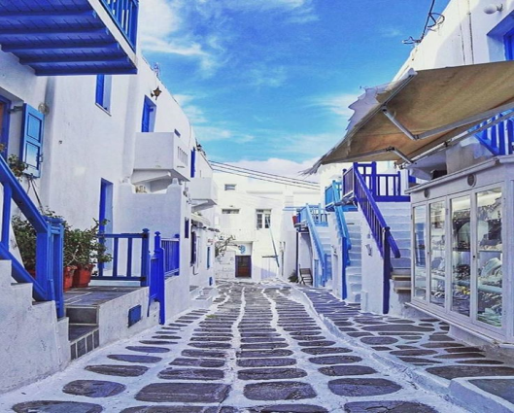
1. Have you ever been to Greece/Have you ever visited Greece?

Slide 2
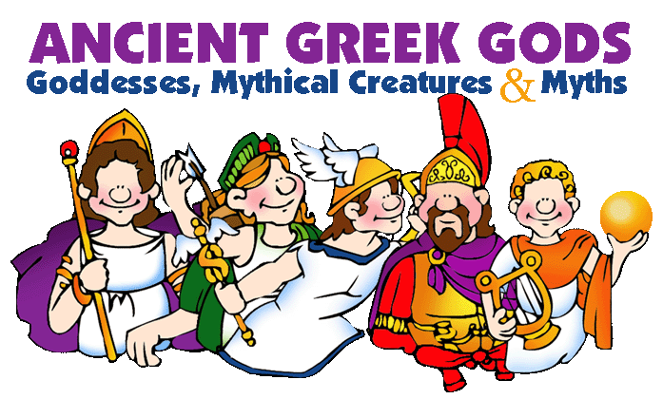
2.Do you know a god? Do you know a greek god?

Slide 3
If you ever face a greek god or godess what would you say?

Slide 4
If you were a greek god what would you do?

