Slide 1

Send me a letter
Garyttou 112 street, Agia Paraskevi 15343, Athens, Greece
Nimi : Kyriaki Korina Katsara
Whatsapp +306984188774

Slide 2
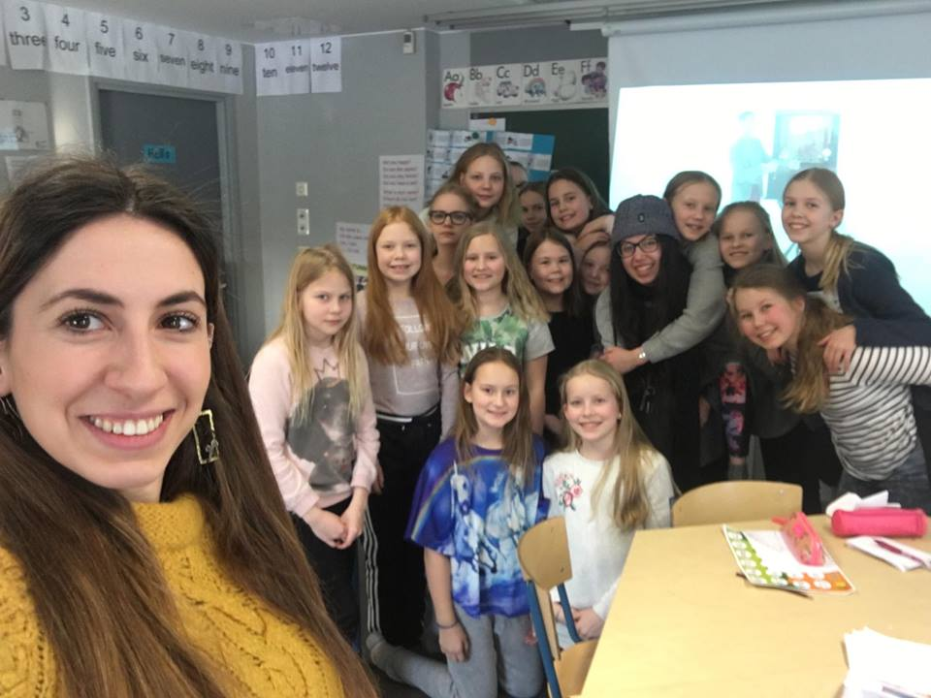
Kiitos ☺ Mutalan koulu for all these amazing moments

Slide 3
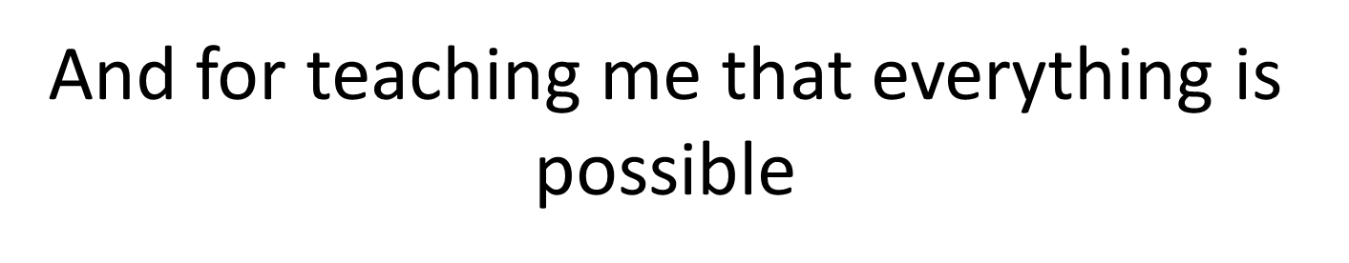
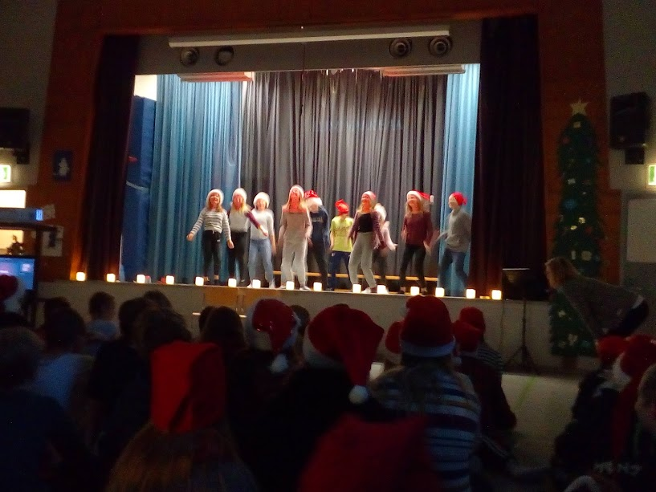
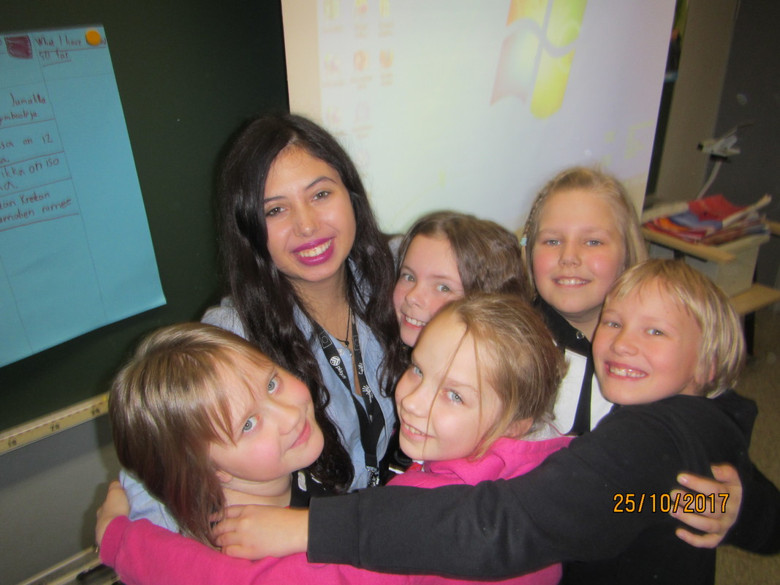
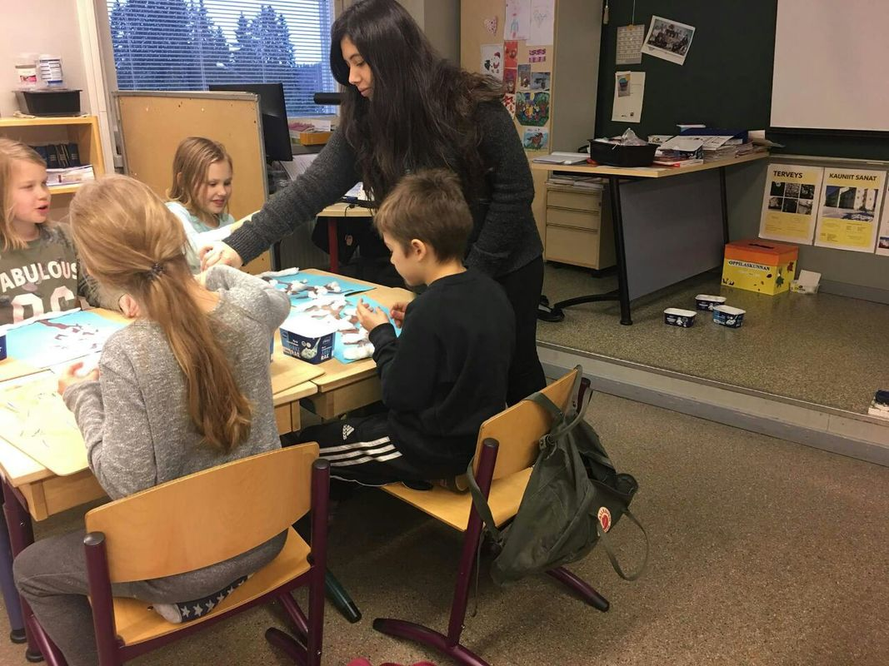
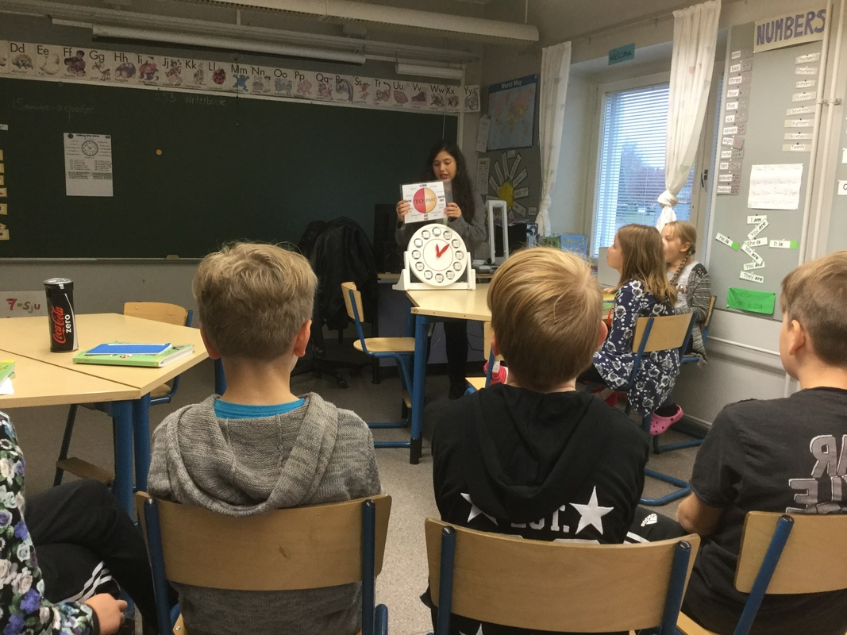
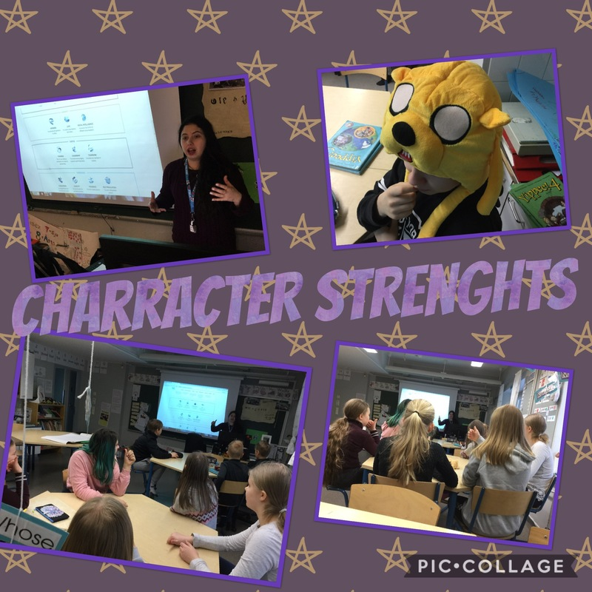
And for teaching me that everything is possible

Slide 4

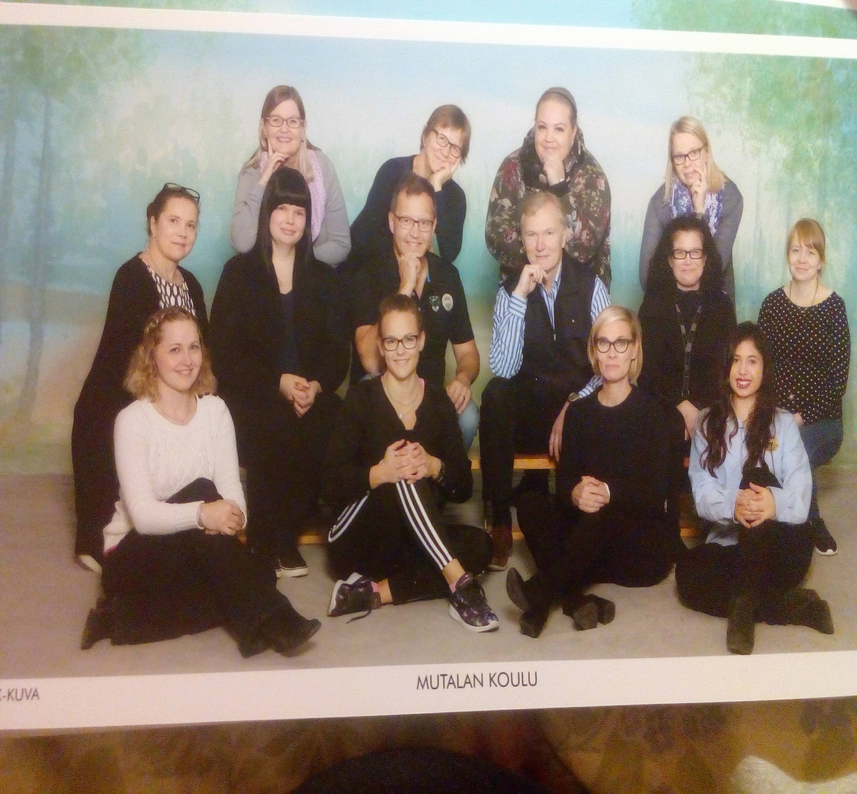
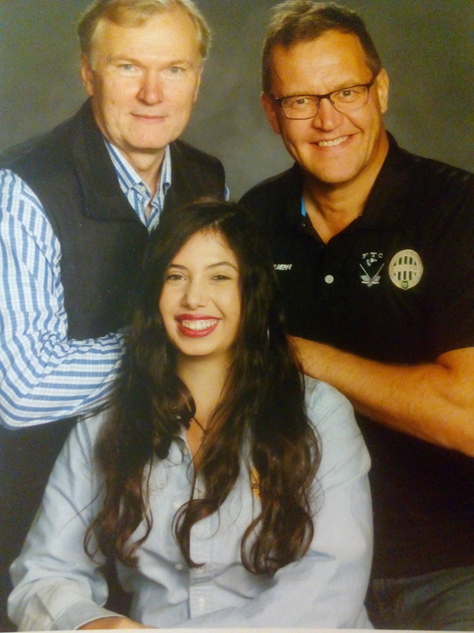
I am waiting for all of you in Greece!

