Slide 1
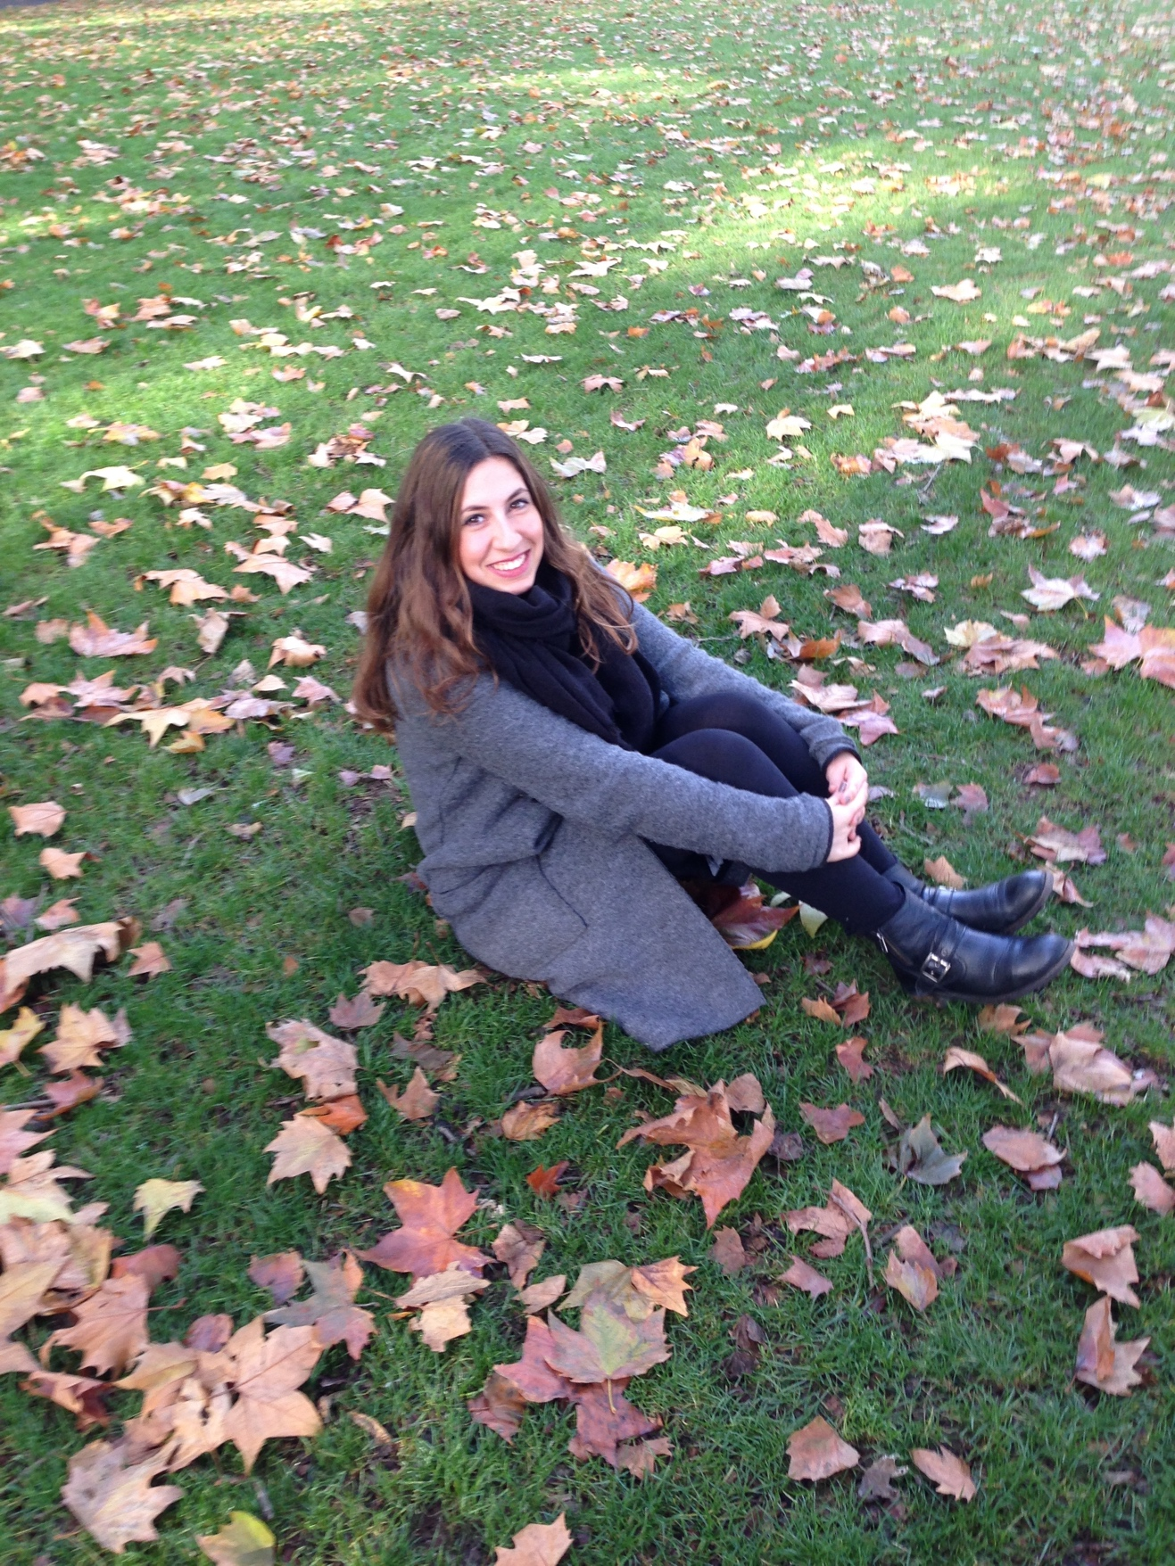
Terve! I am Katerina Eleftheriadi and I am coming from Athens Greece. I am 22 years old and I just finished my studies at the faculty of the primary education in the University of Athens.
I am Polite
Sociable
Optimistic as I try to find the positive aspect in everything

Slide 2
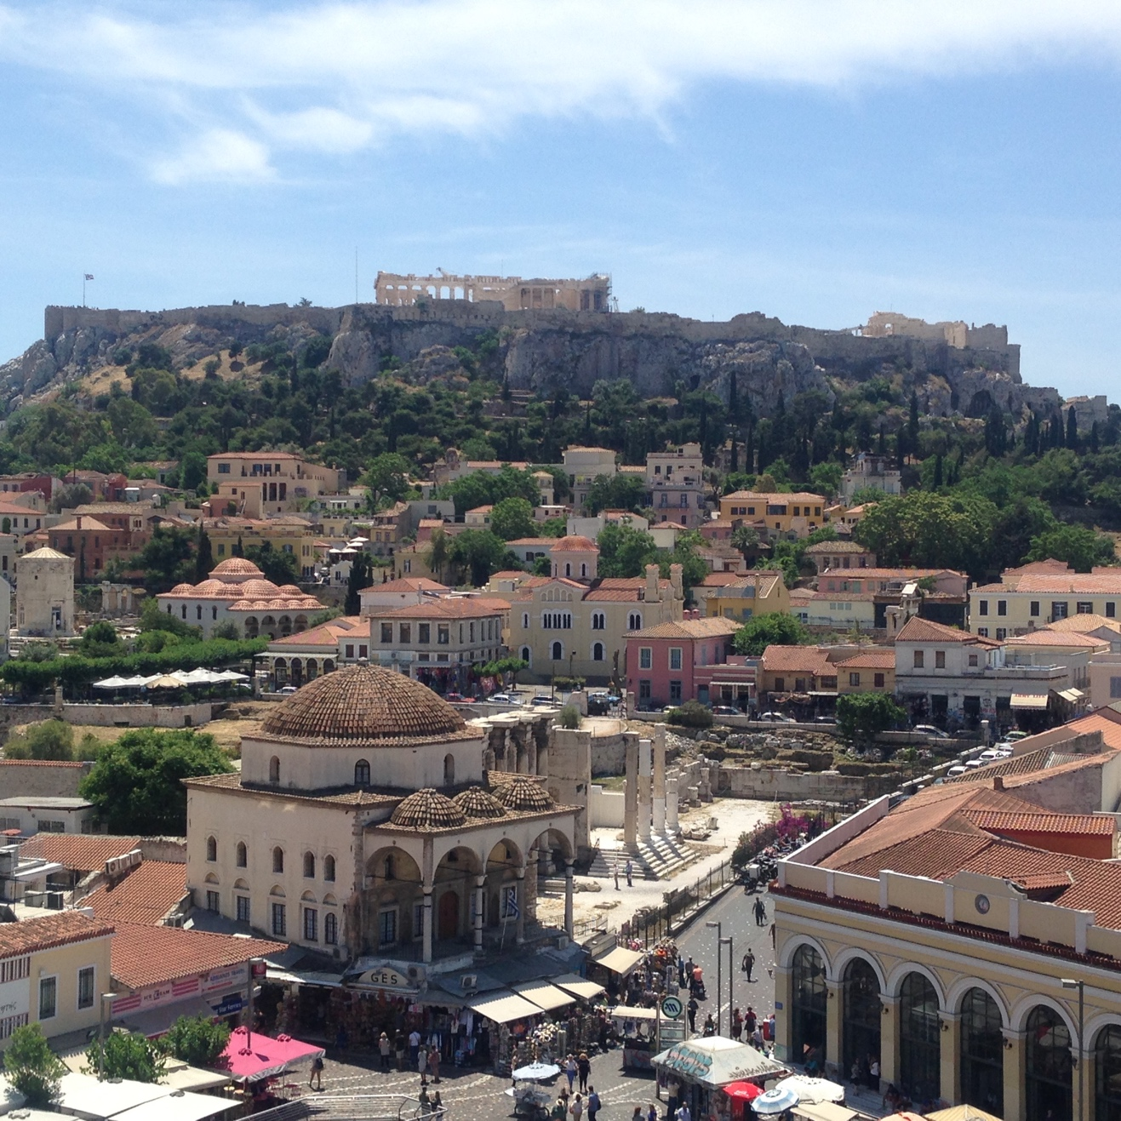
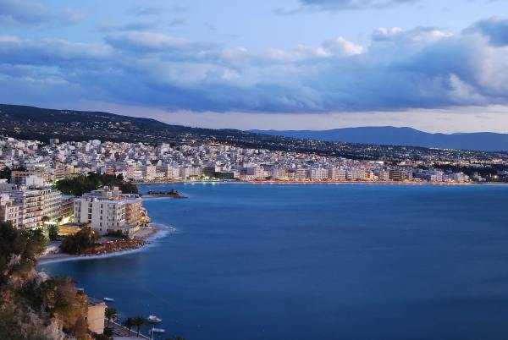
Here you can see pictures of Athens and from two other cities in Greece that my parents are coming from: Loutraki and Kastoria.

Slide 3
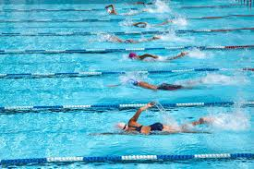
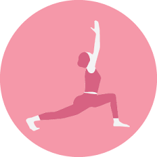
My hobbies
SWIMMING
YOGA
DANCING
PILATES

Slide 4
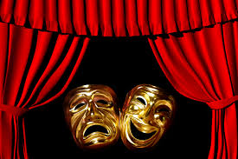
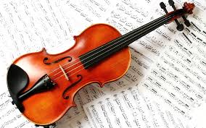
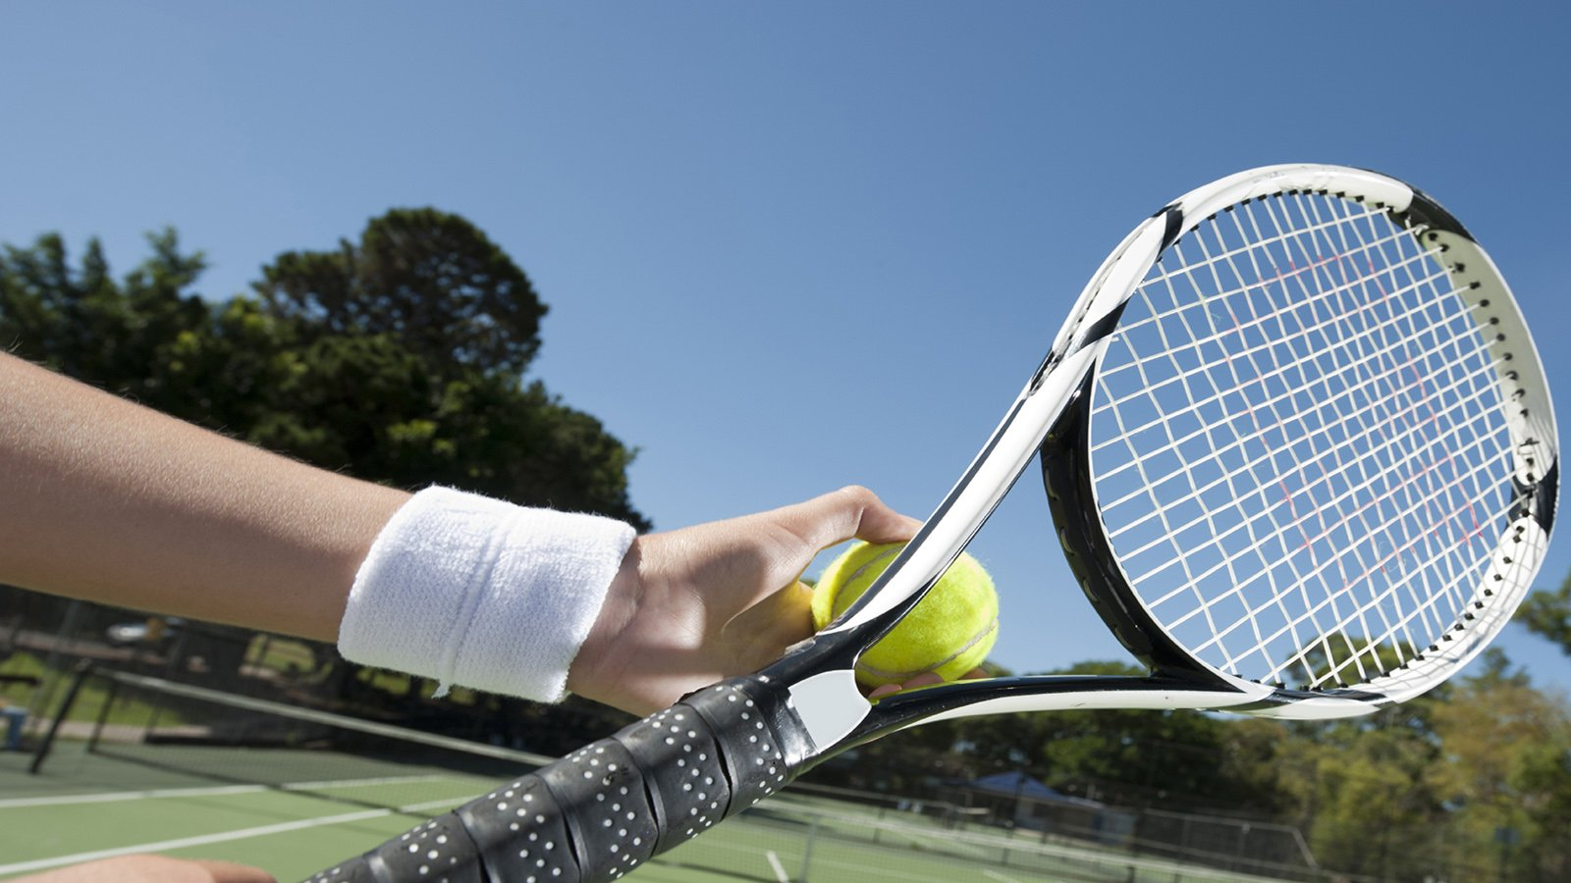
I used to play the violin and I would like to start lessons again
I watch lots of theatrical performances as I was a member at a theatrical group
Tennis which I just started to play with my sister who is 12 years old

Slide 5
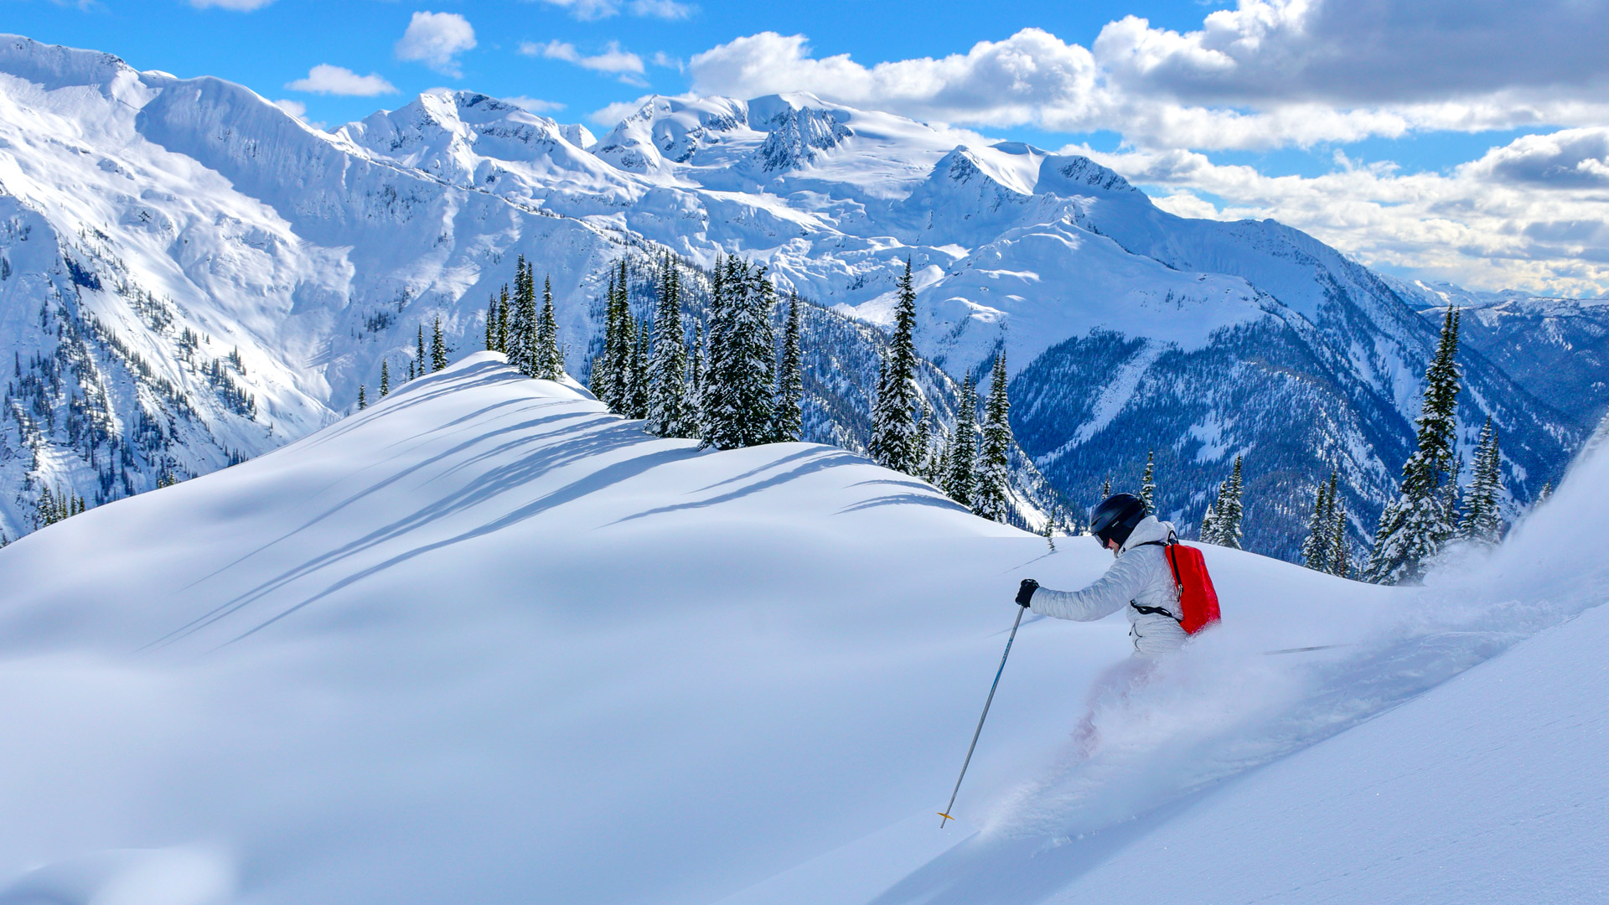
In the winter I also enjoy skiing which is something that I want to try in Finland as well.

Slide 6
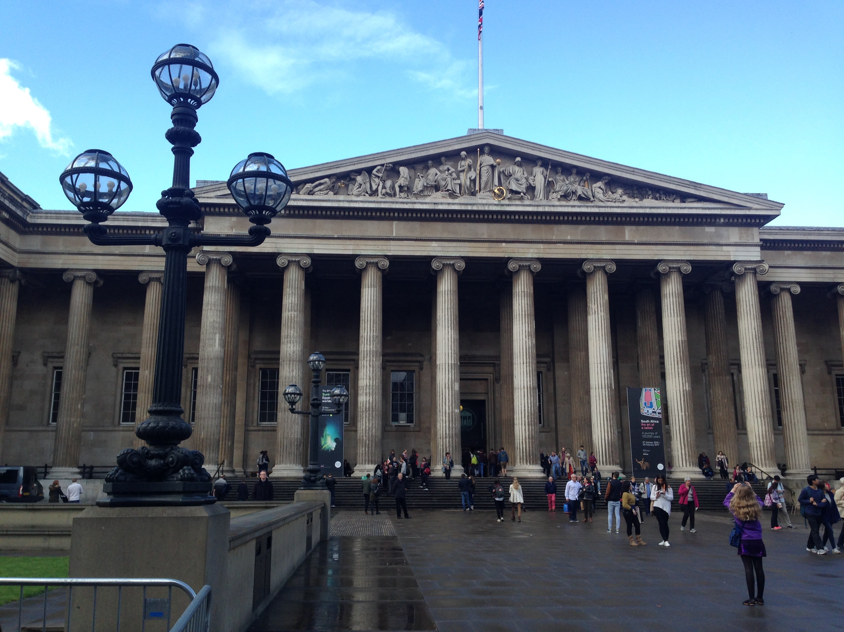
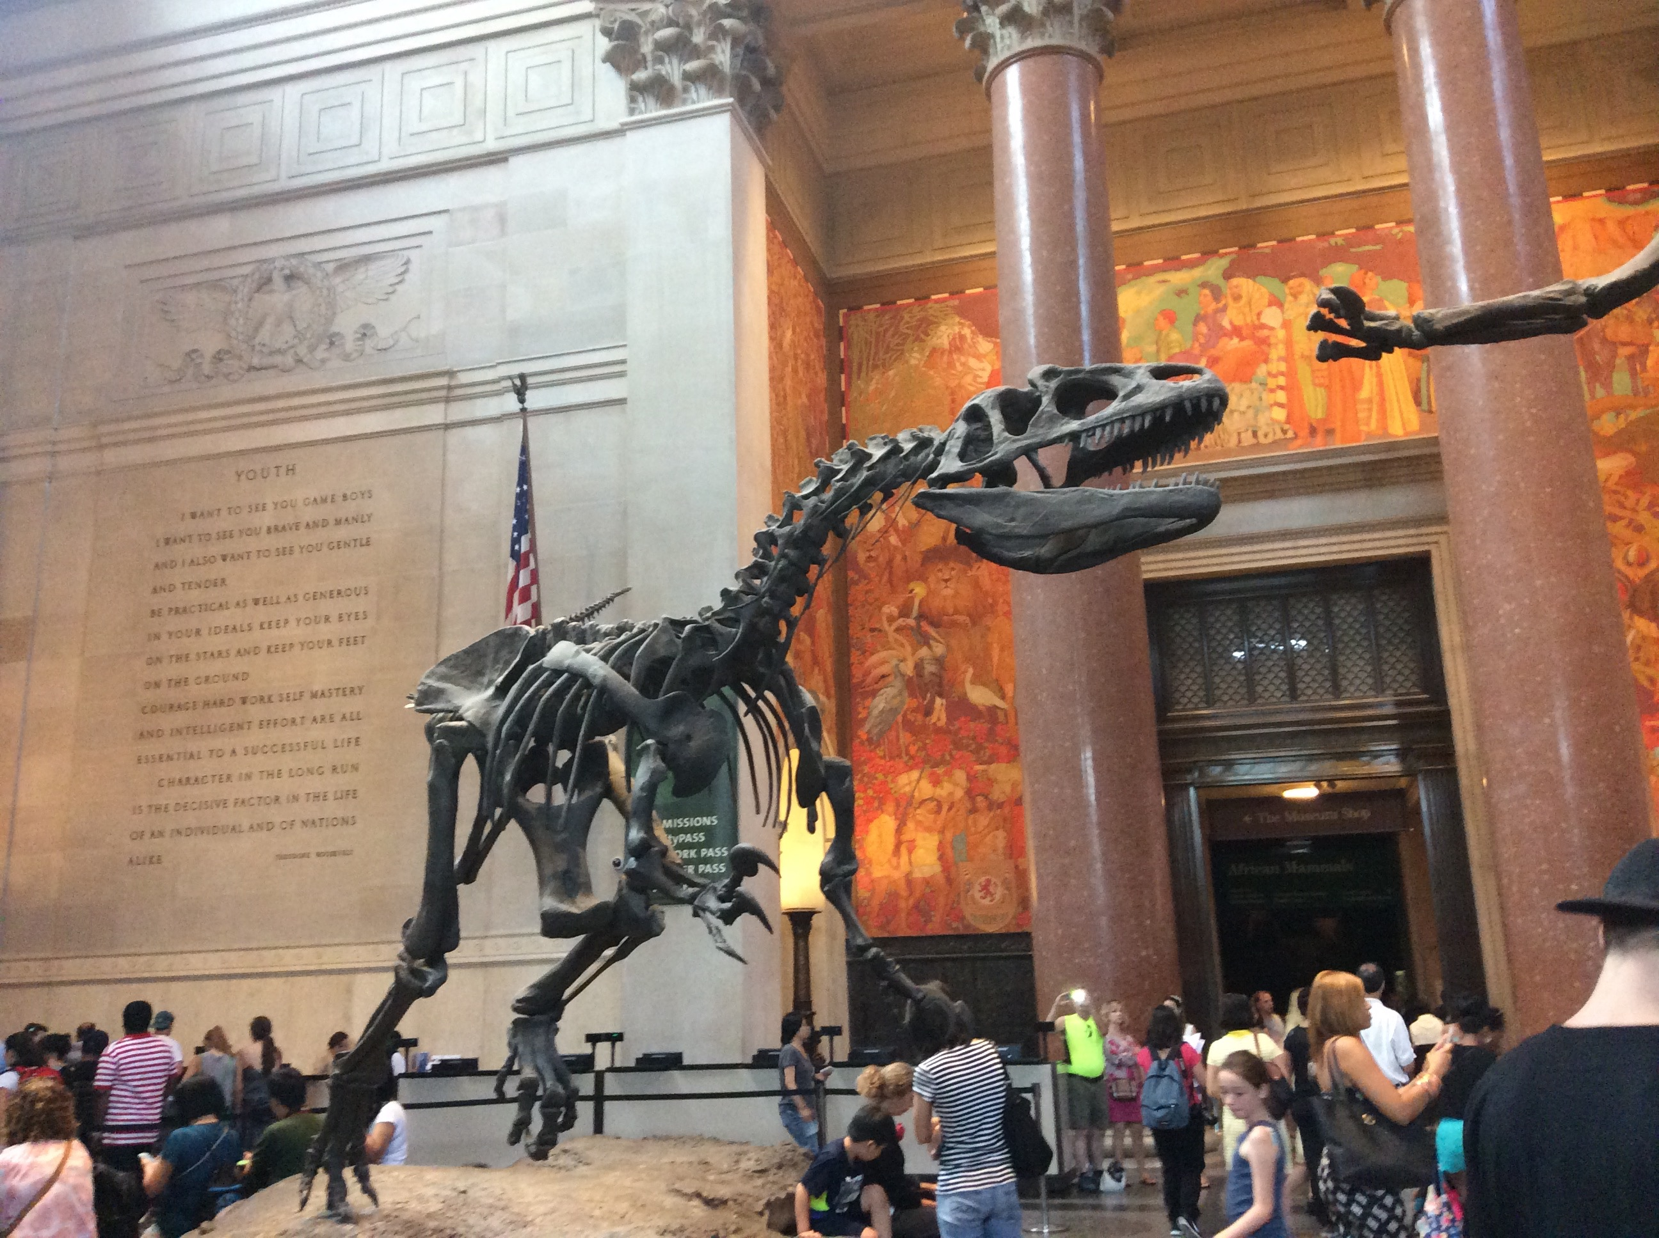
I also like to visit museums

Slide 7
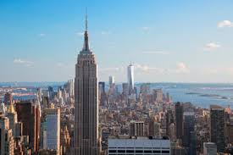
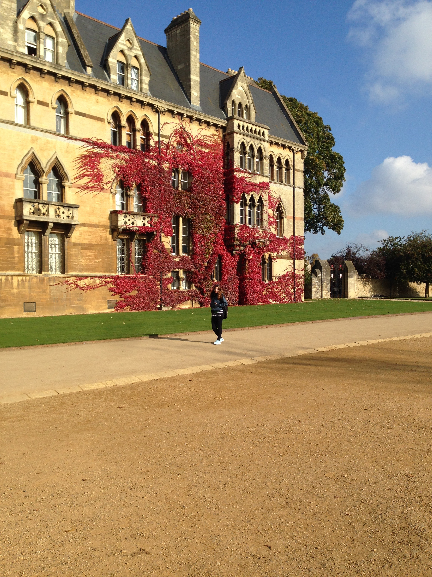
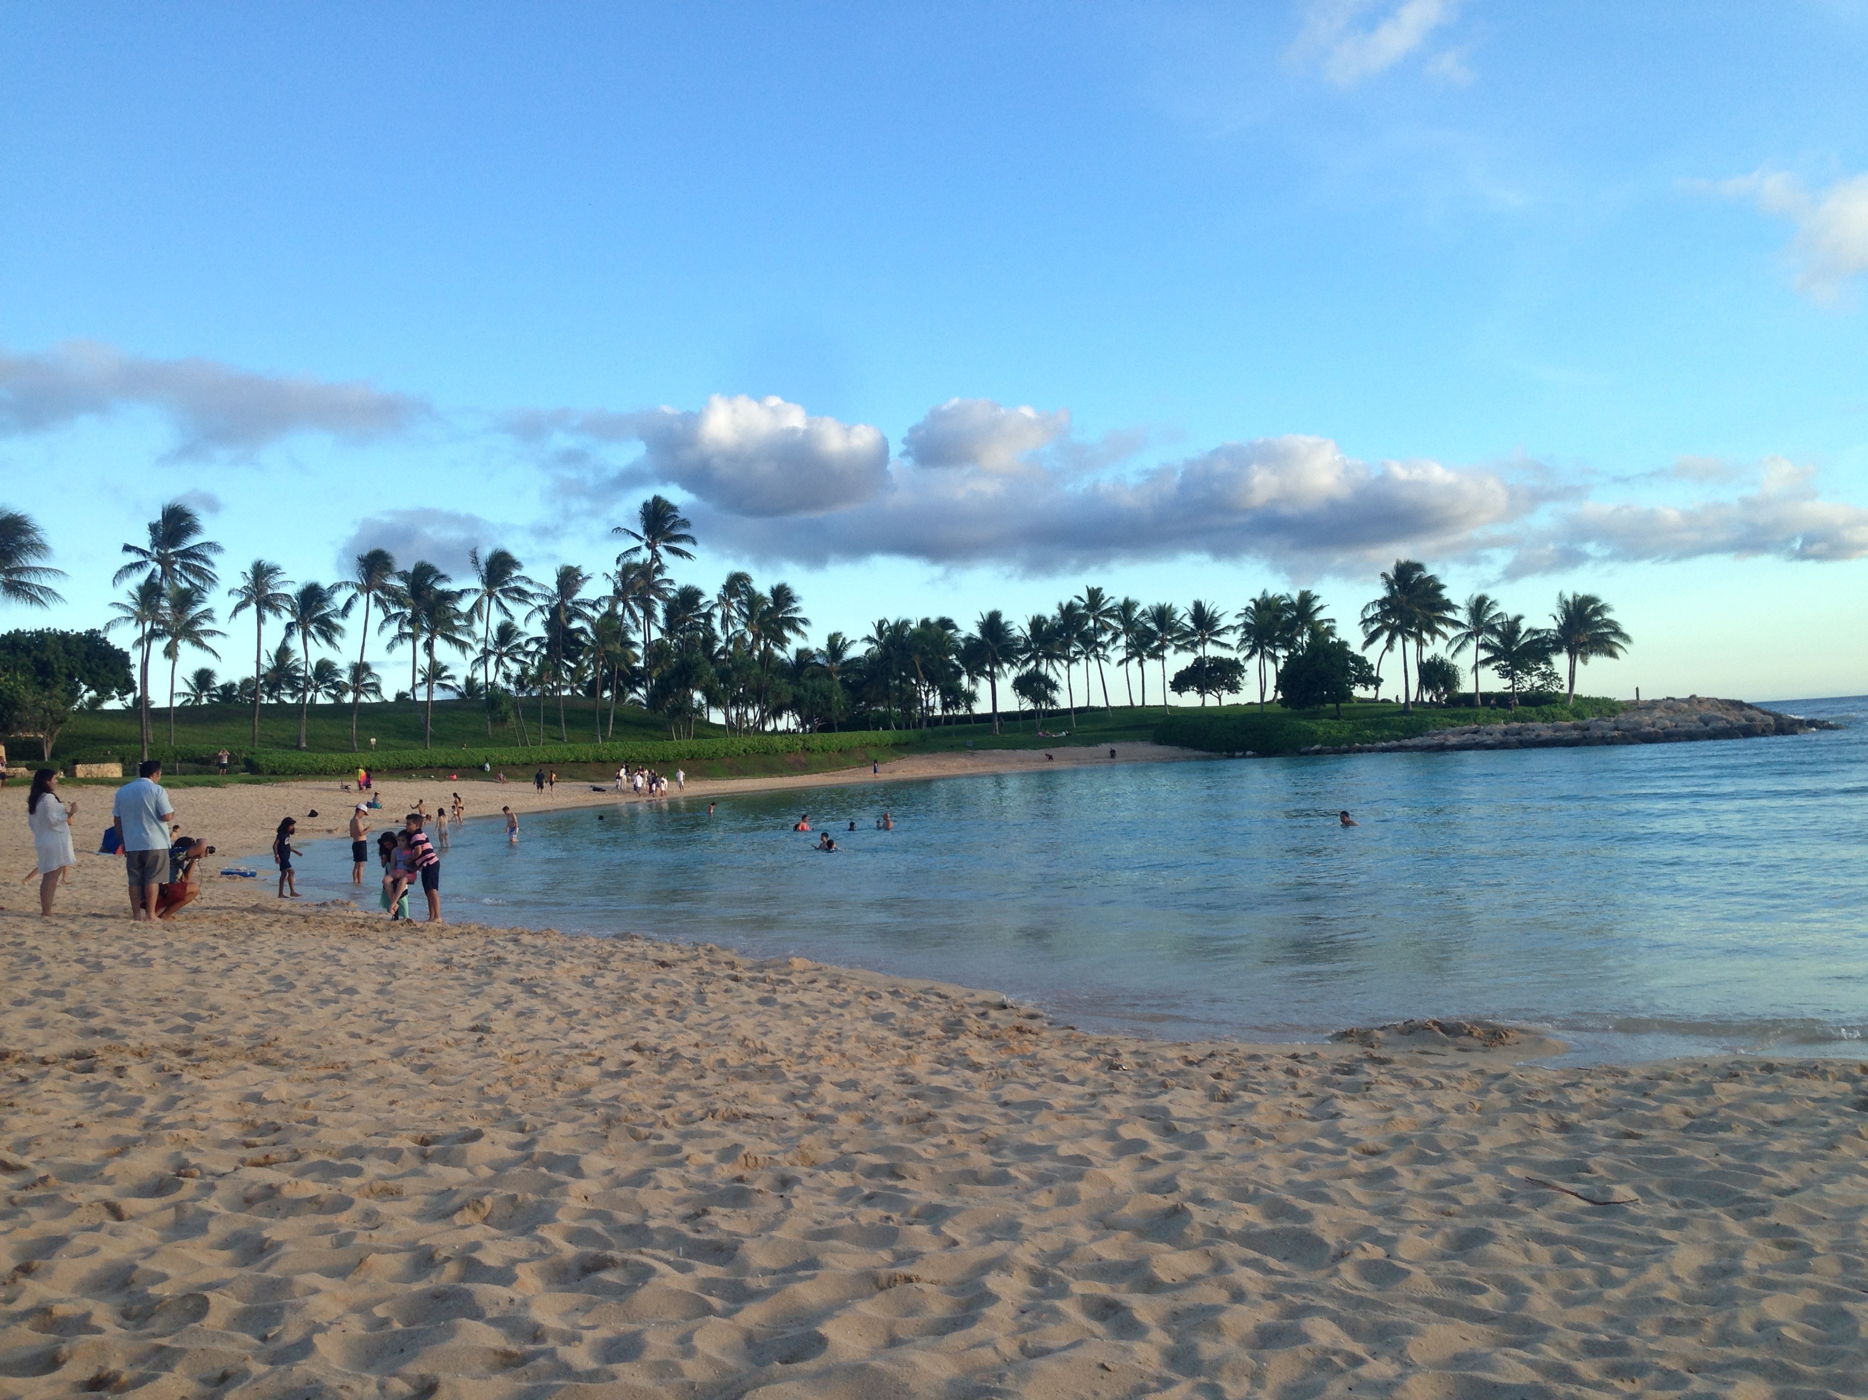
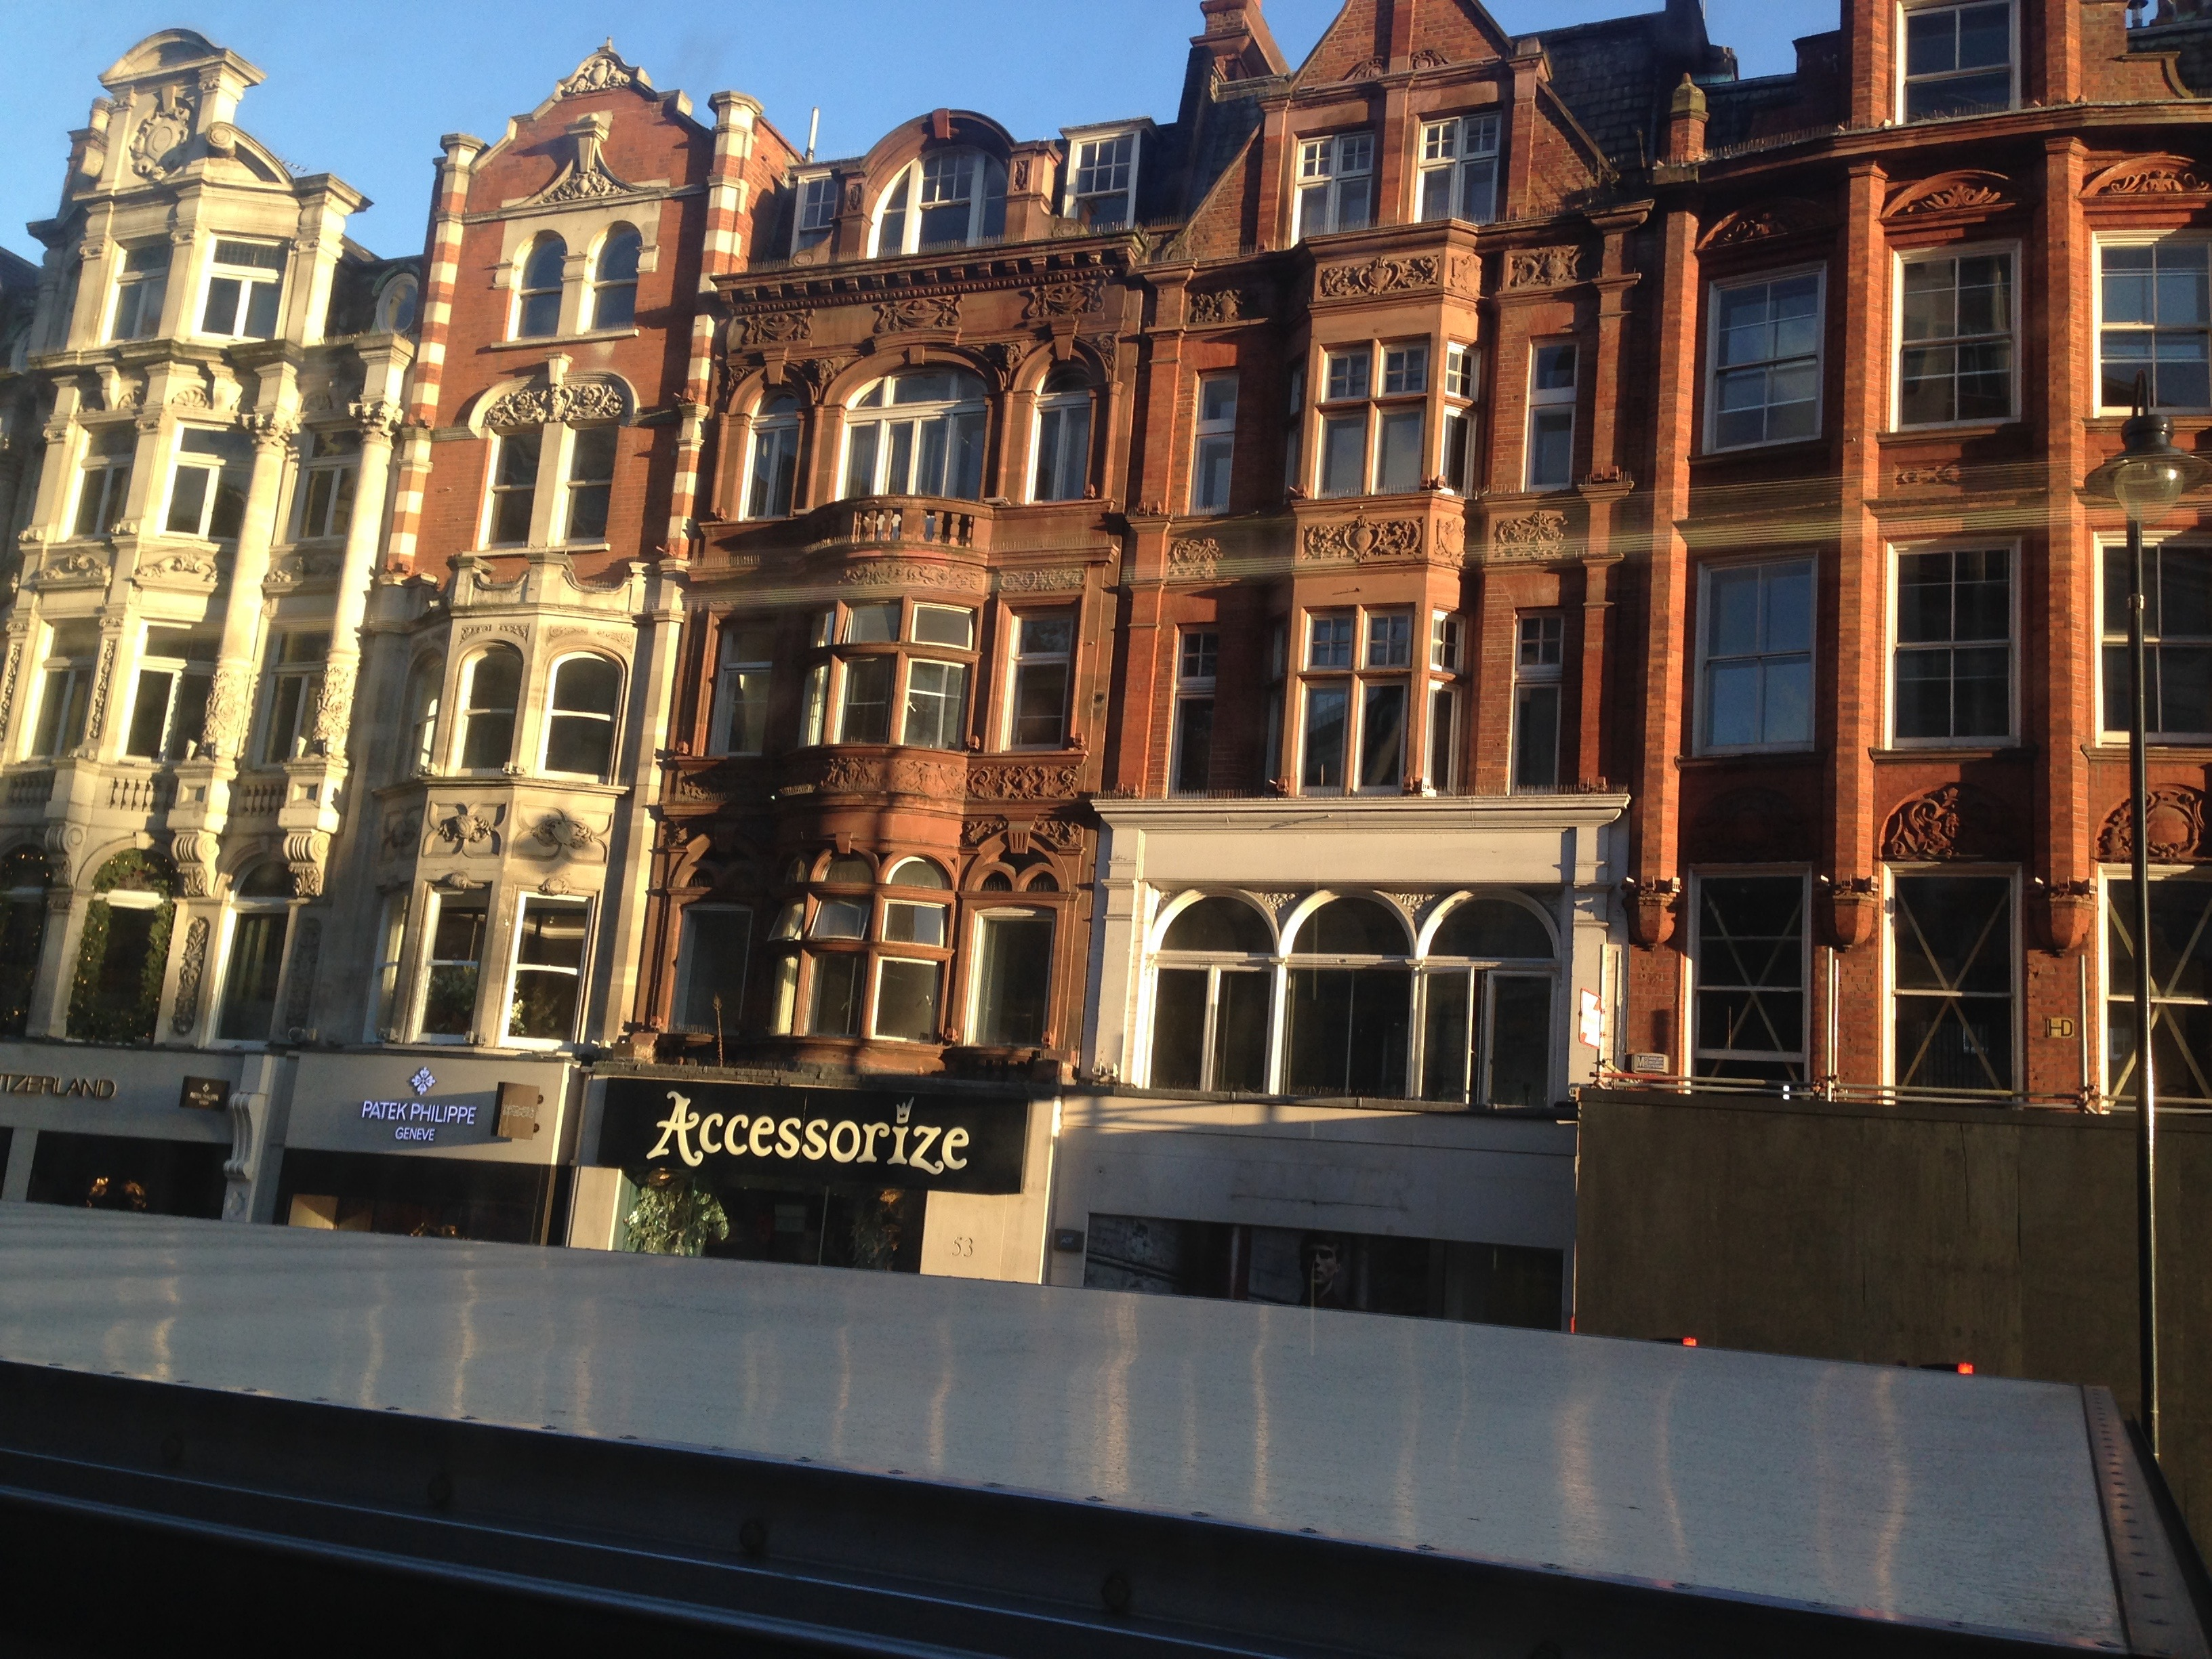
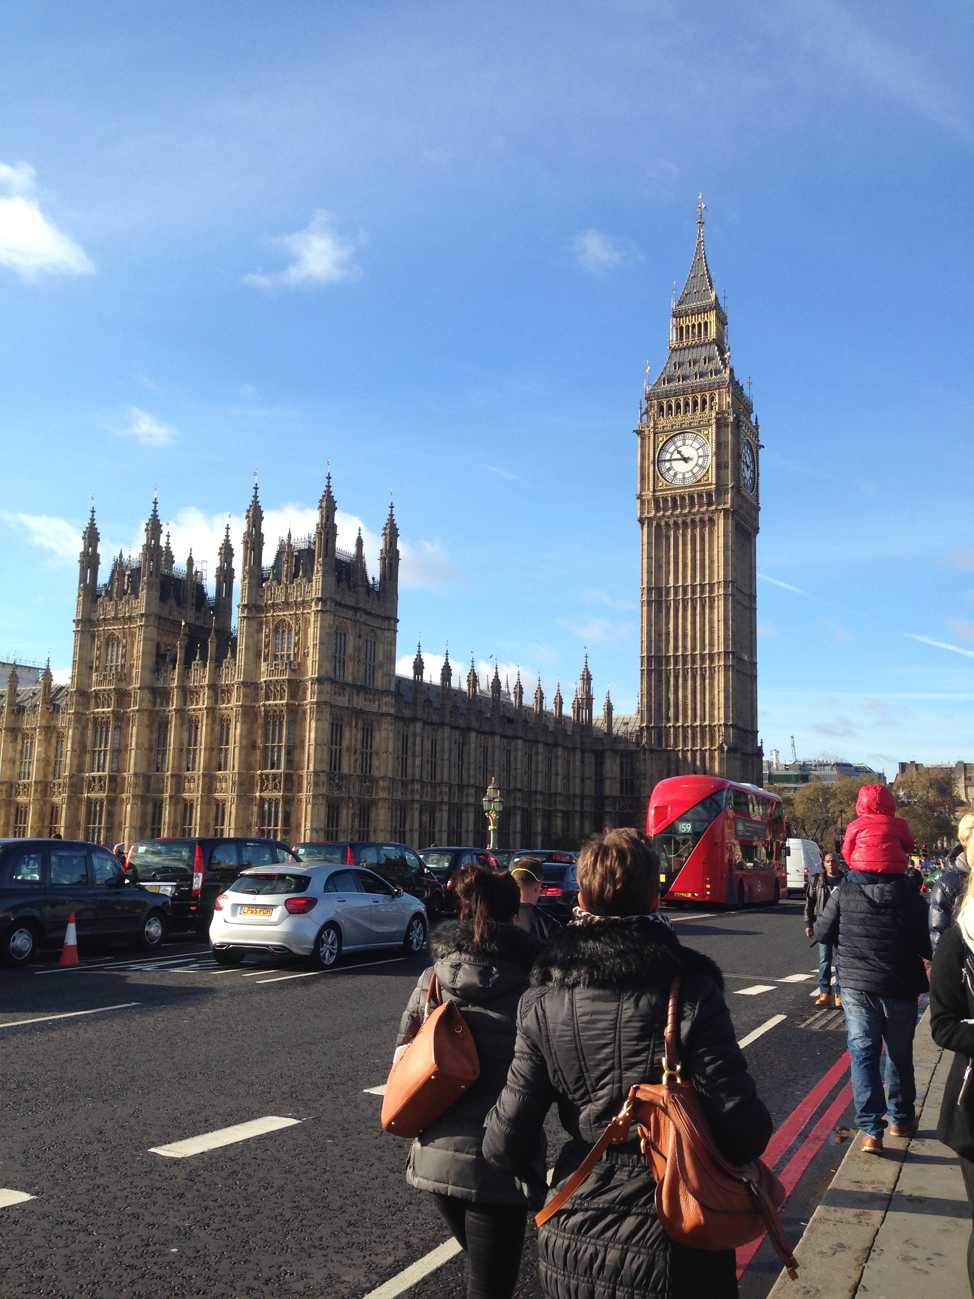
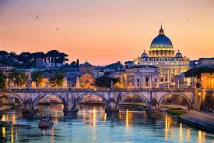
I love to travel and experience different cultures.

Slide 8
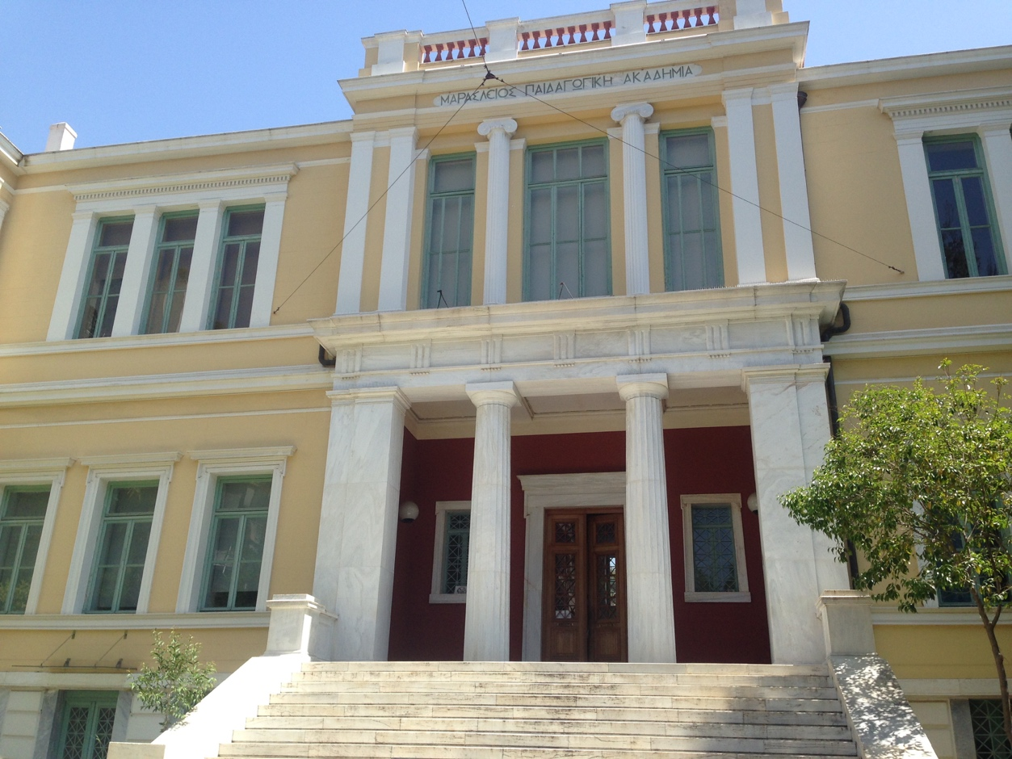
This used to be my elementary school. I came back at that school as a teacher when I had an internship at my 4th year in university. It is called Maraslio and it is placed at the center of Athens.

Slide 9
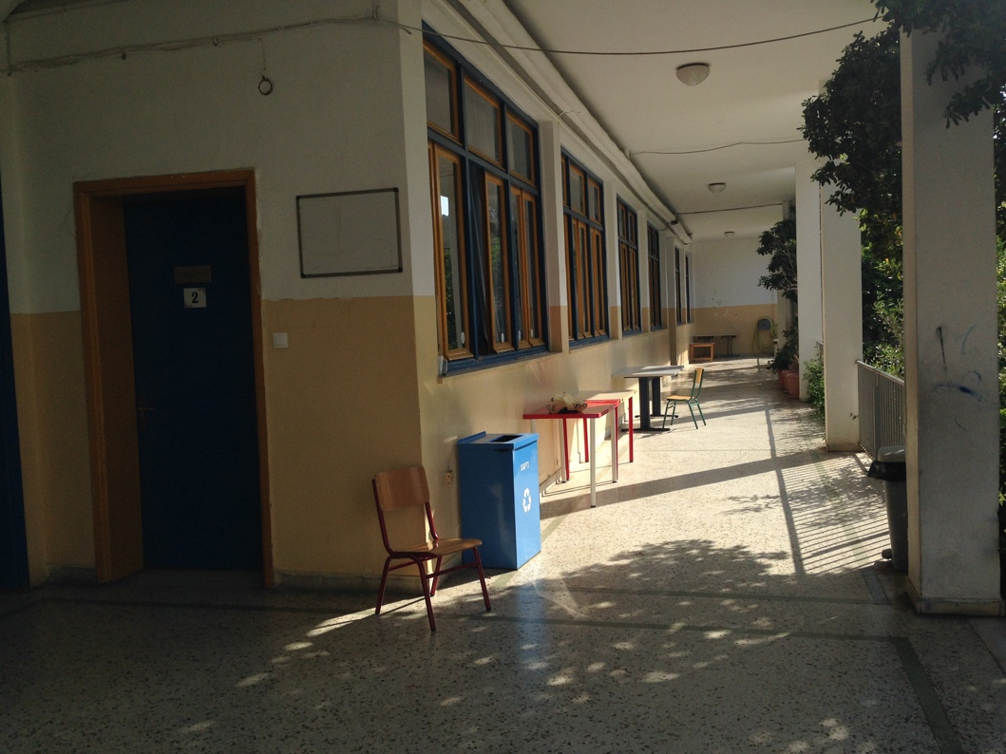
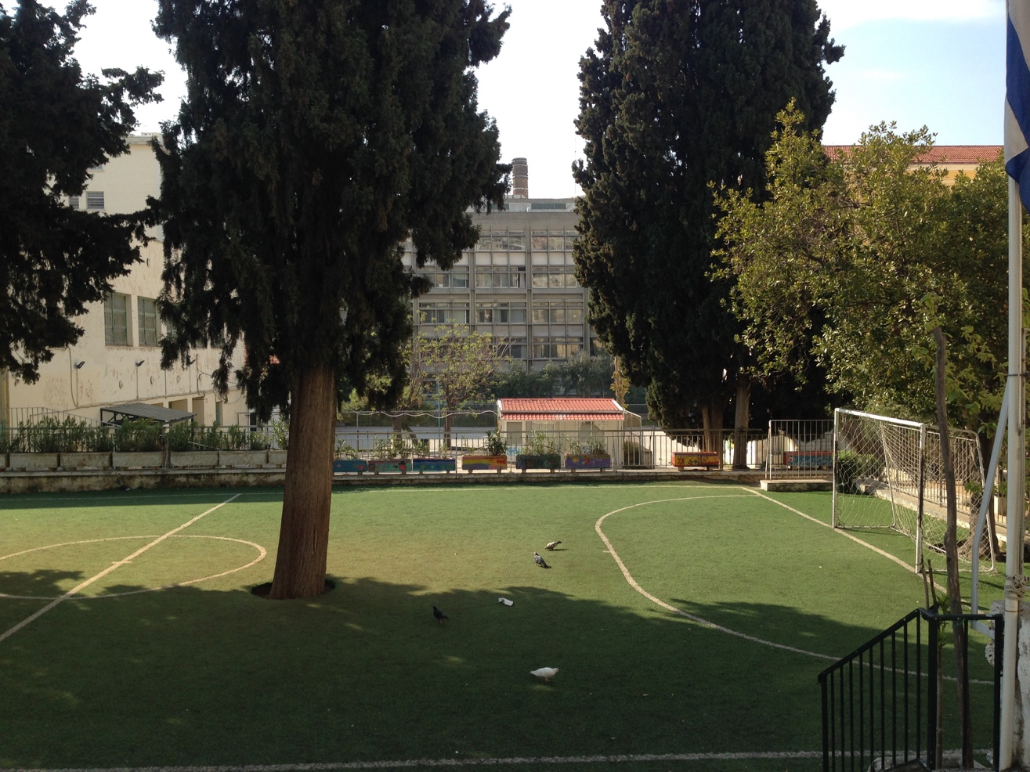
Back to school

Slide 10
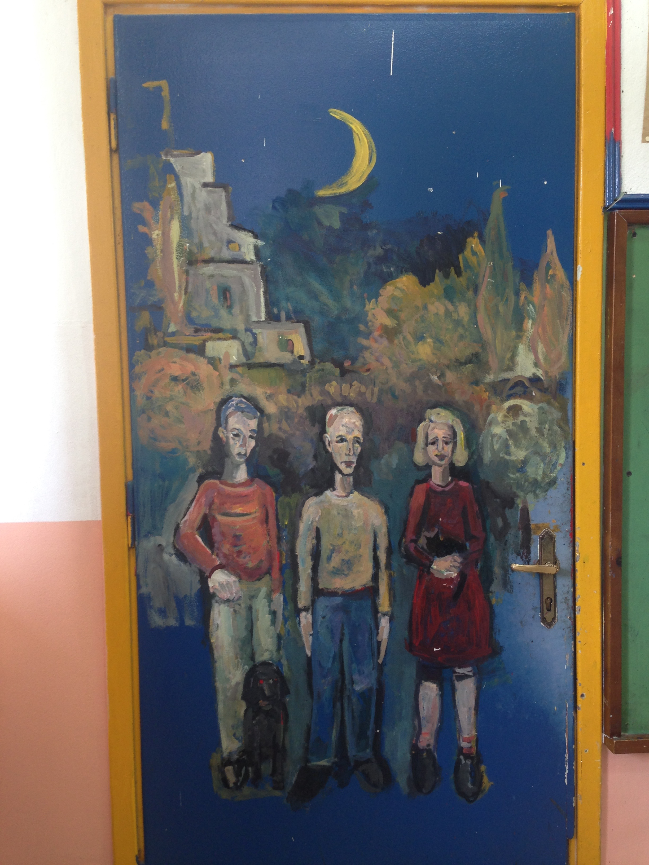
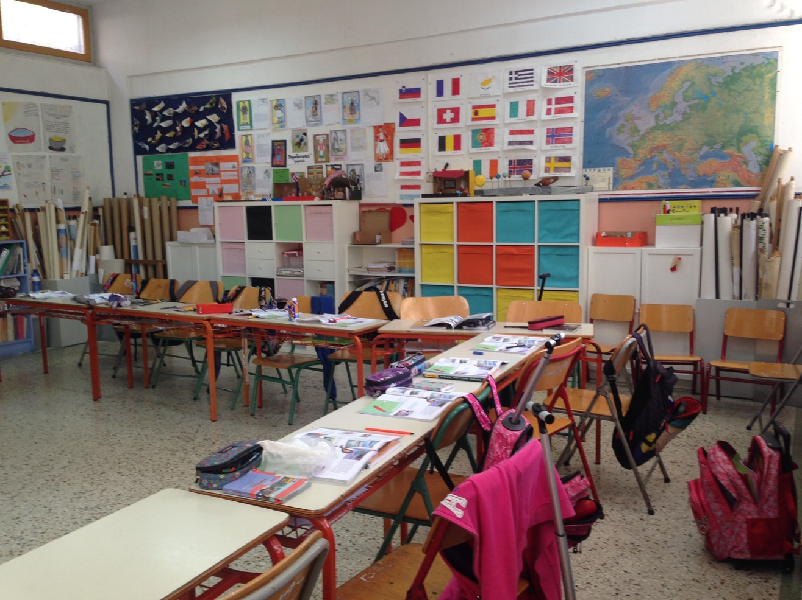
This was my classroom in the 5th and 6th grade. I came back at that classroom as a teacher and taught Physics to the pupils.

Slide 11
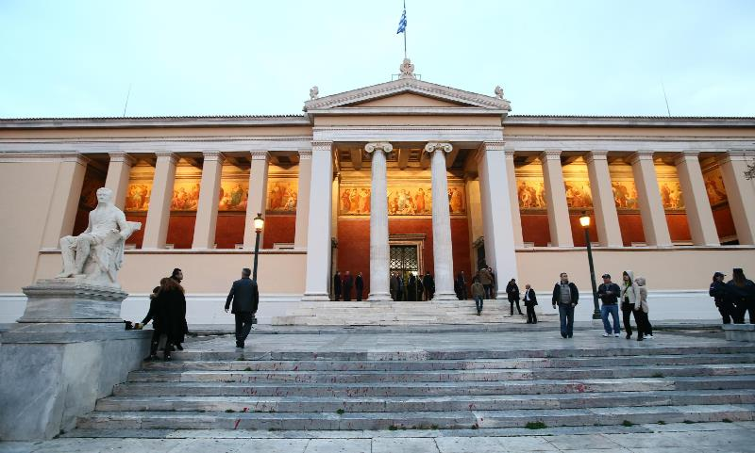
This is the central building of my university the National and Kapodistrian university of Athens. My graduation took place inside that building.

Slide 12
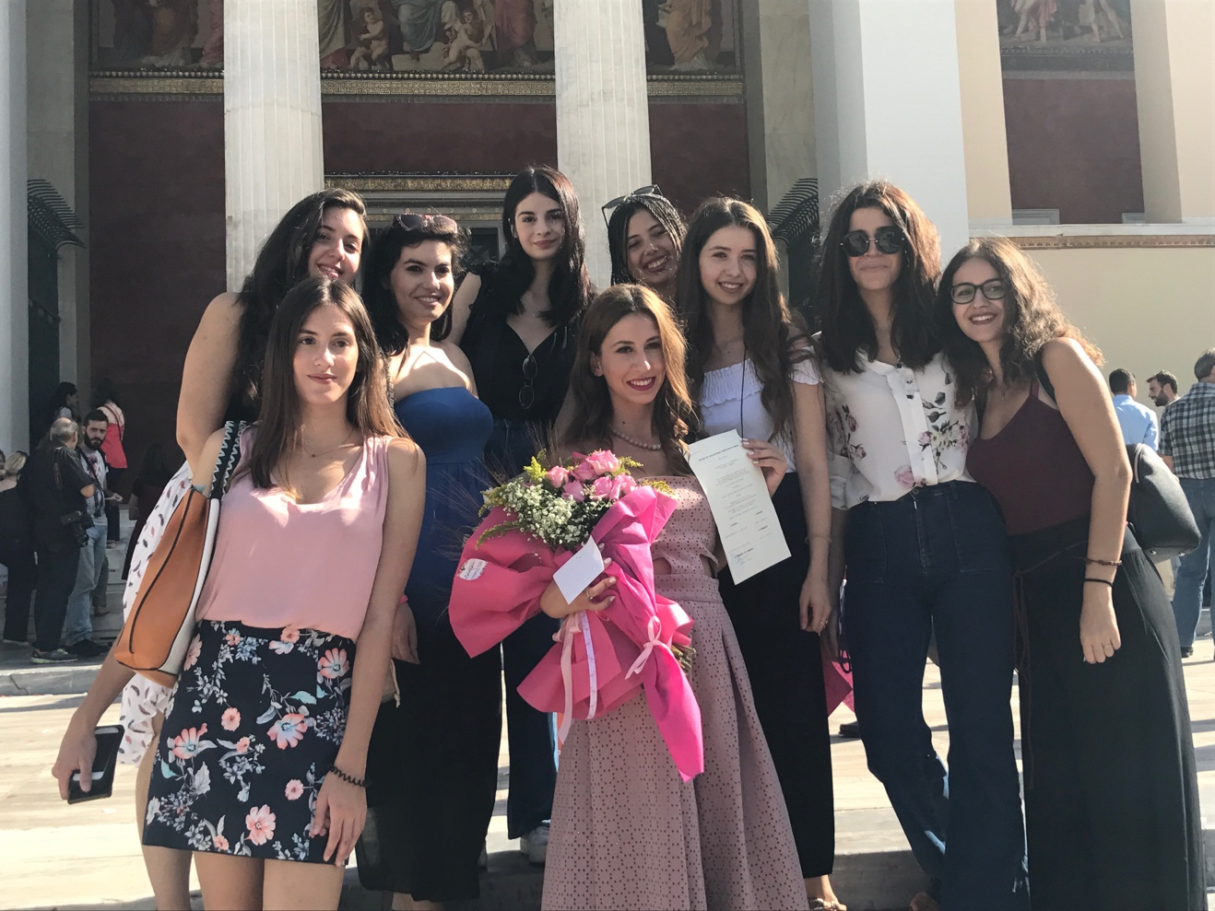
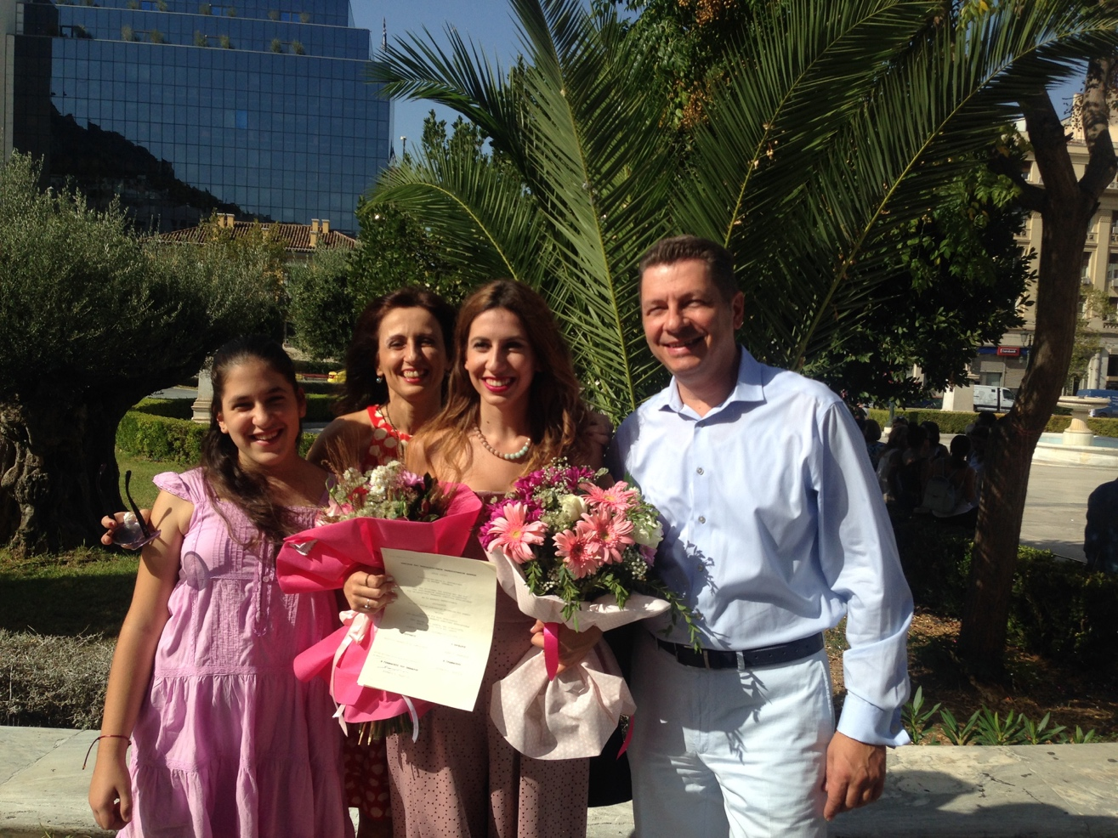
These are my friends and my family at my graduation day.

Slide 13
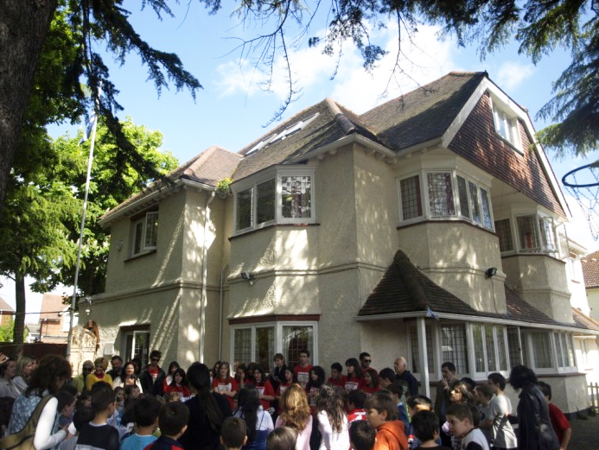
This is the school that I used to work as a teacher assistant last year for 3 months. As you can see, it looks like a house. It is not as big as Mutalan Koulu but teachers and pupils there were as friendly and kind as you are here!
Greek Primary School of London

Slide 14
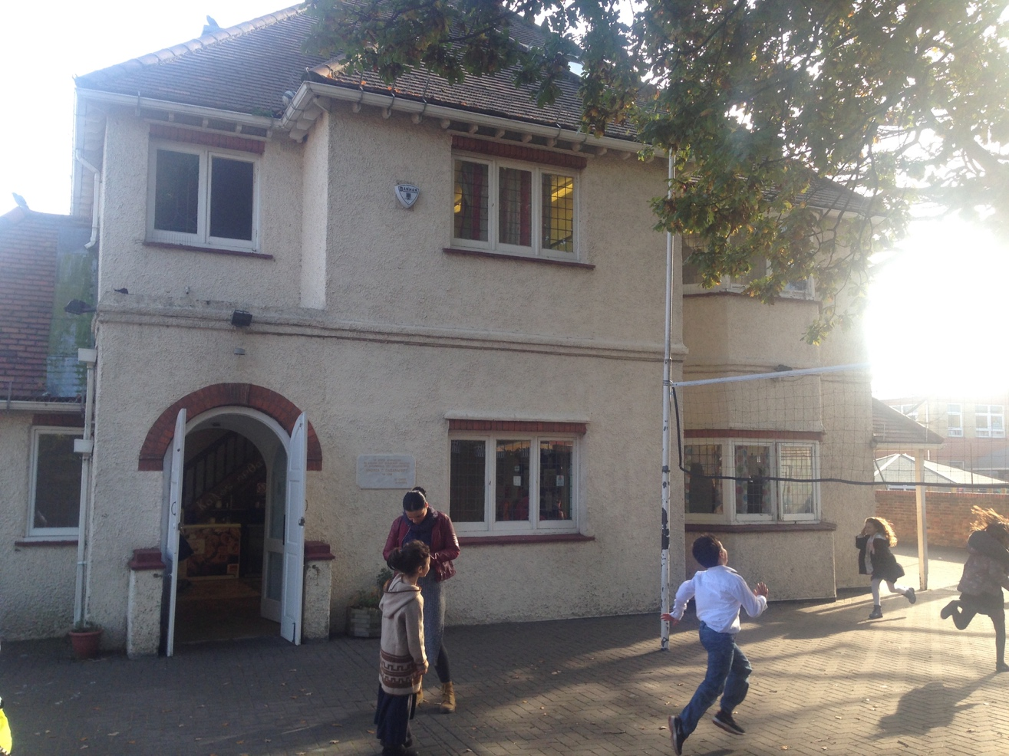
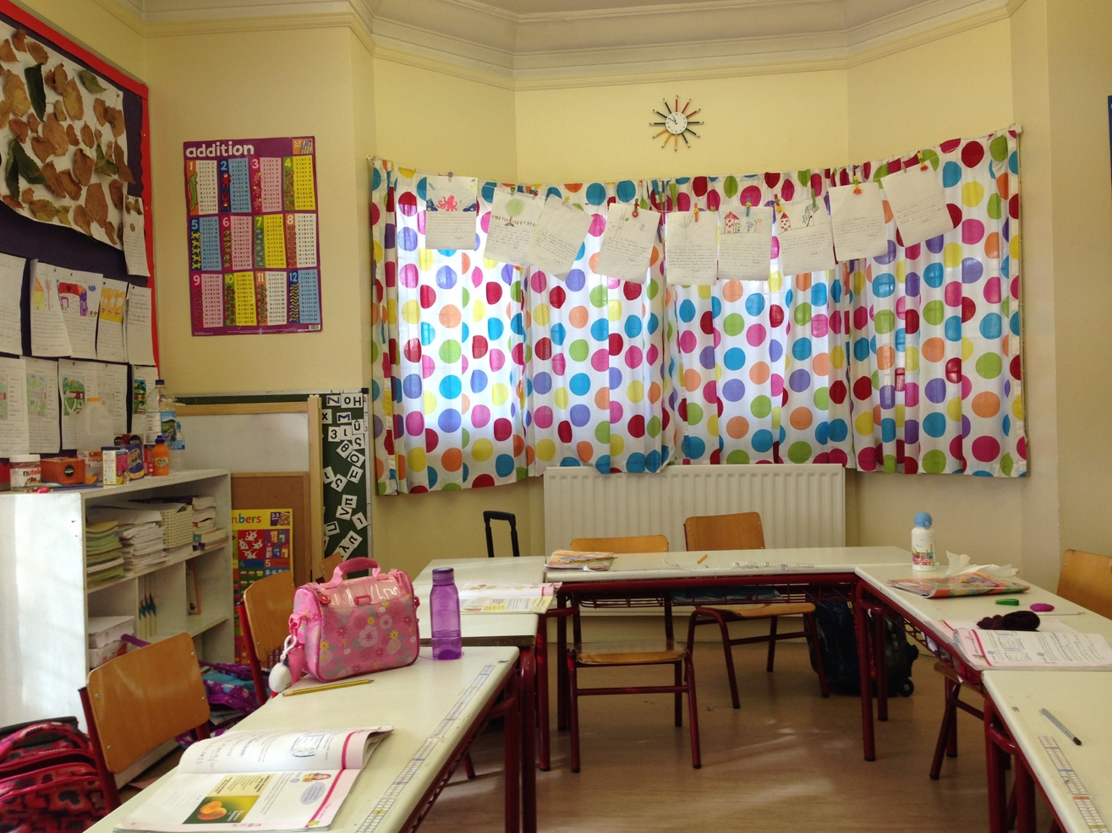

Slide 15
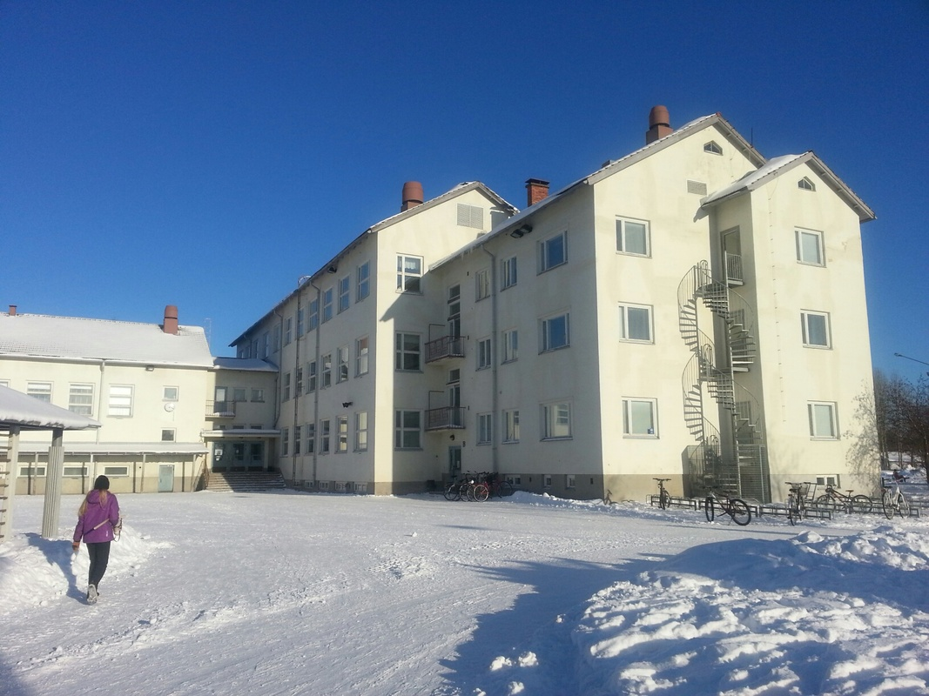
This is Mutalan Koulu and I am so happy to be here!!!
I am sure that I will gain priceless experiences which will help me to improve my skills as a teacher and as a person in general.
Kiitos

