Slide 1


Presentation
By Joep Dominicus

Slide 2
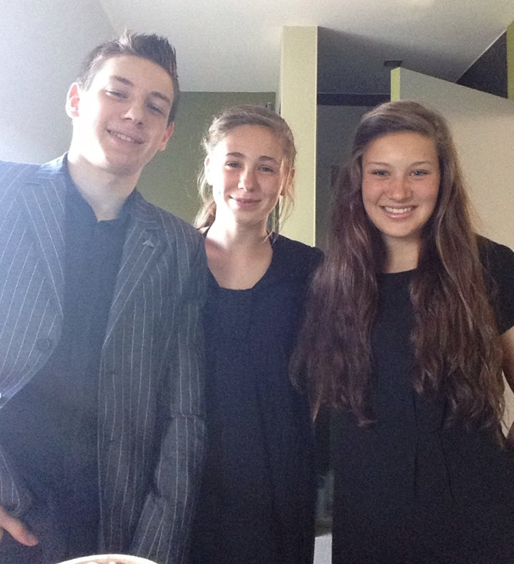
About me
Nimi: Joep Dominicus
Syntymäaika: 15 huhtikuu 1993 (olen 22)
Maa: Belgia
Village: Olen
Perhe: isa, aiti ja kaksi pikkusiskoa
Studies: opettaja historiaa ja englantia

Slide 3
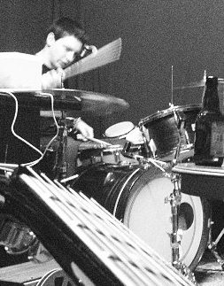
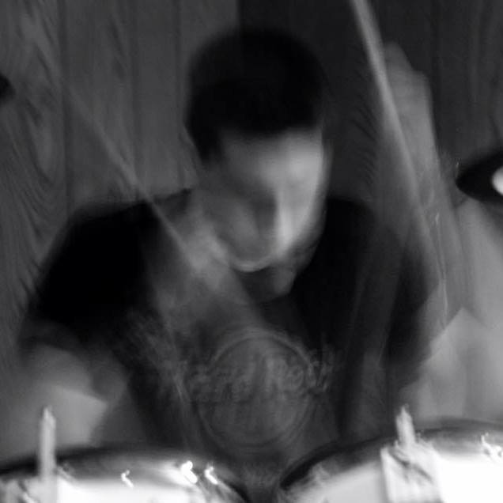
Hobbies/interests
Music
  Playing drums (alone & in a band)
  Listening to music
  Looking up info about music
Movies
  Favourites: Dead Poets Society, Amadeus, Pulp Fiction, Monsters Inc. (almost all Pixar movies), The Dark Knight, Whiplash, Star Wars, Lord Of The Rings,…

Slide 4
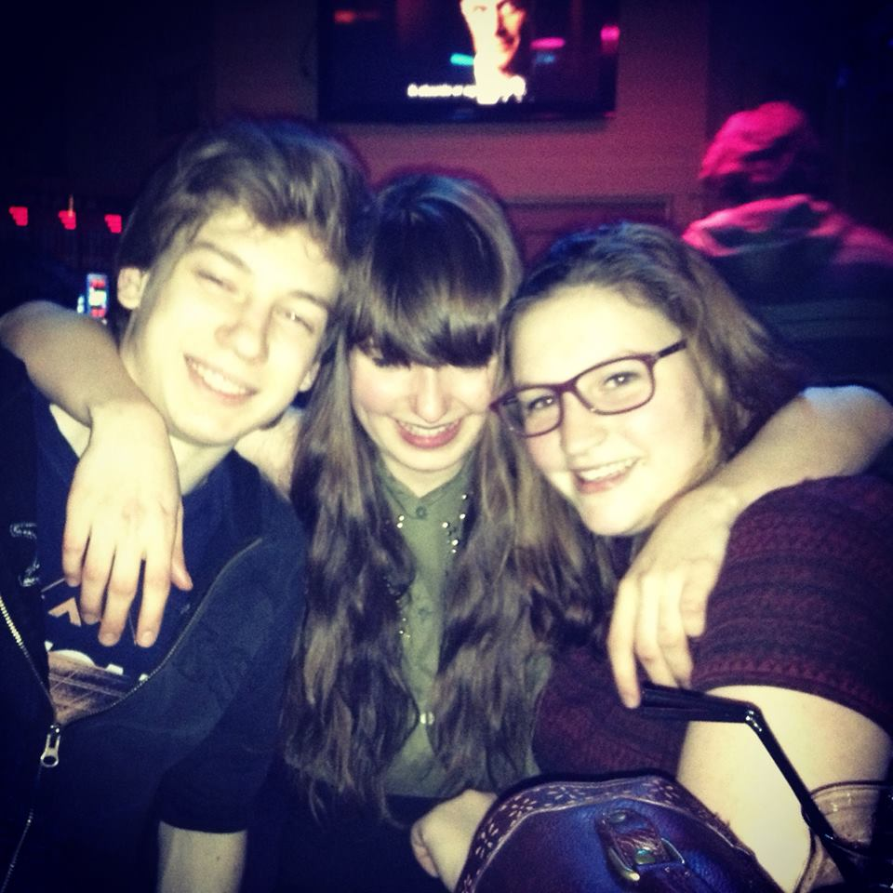
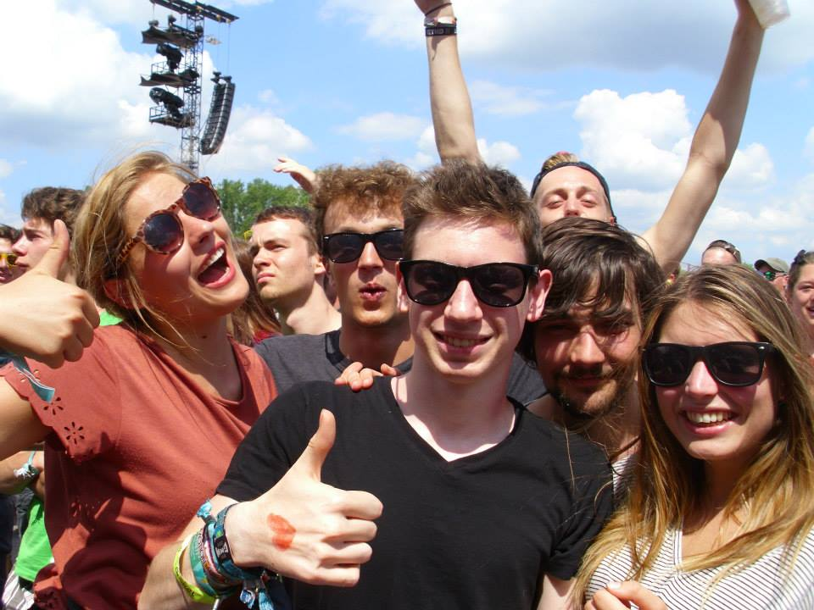
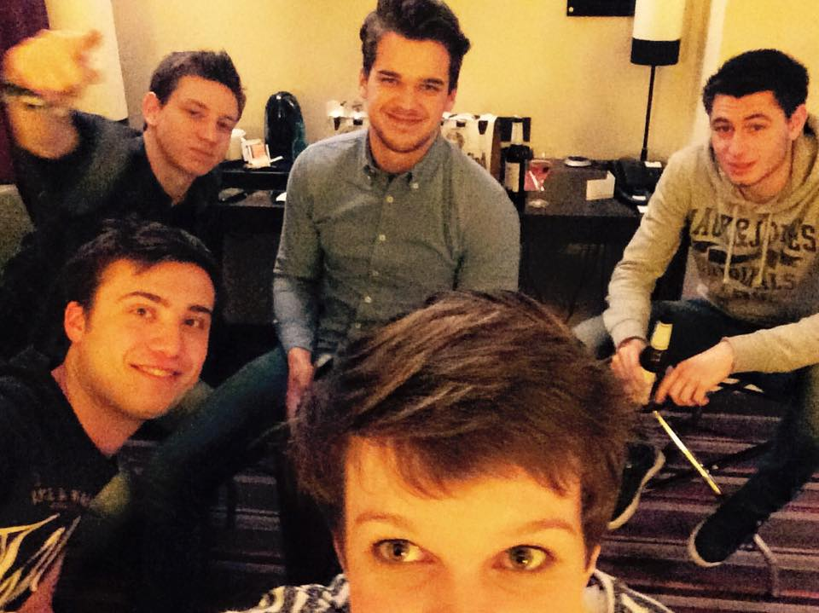
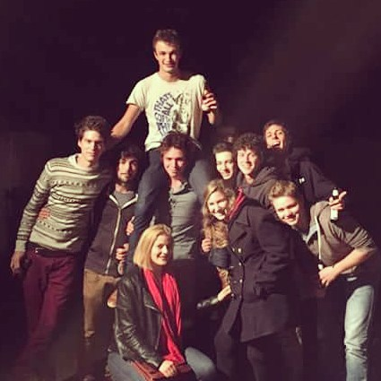
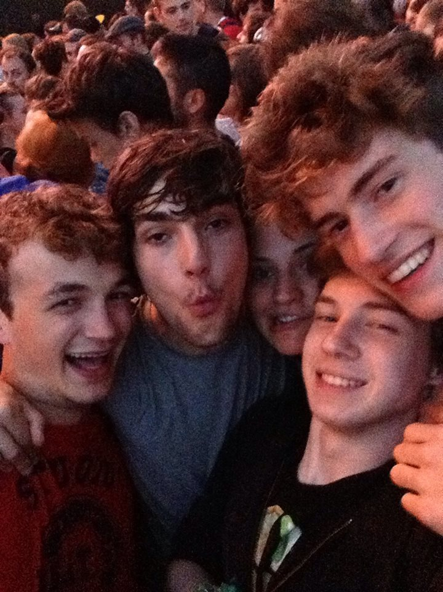
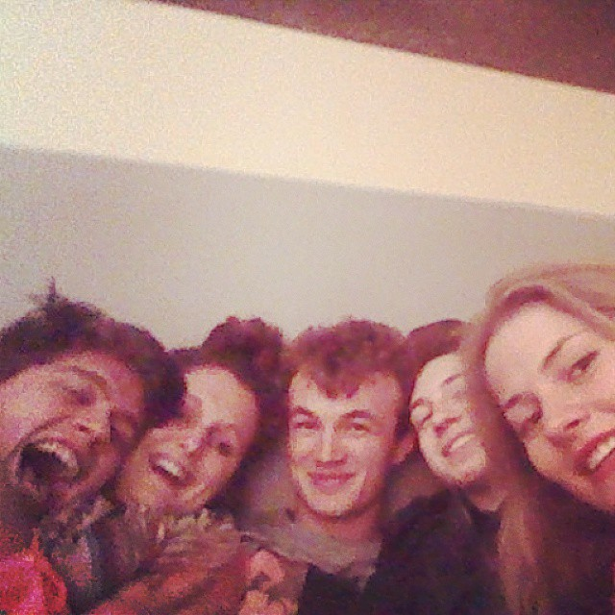
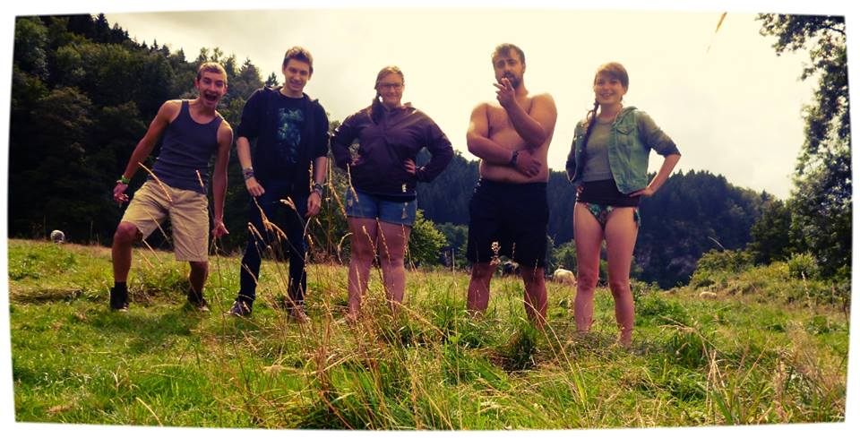
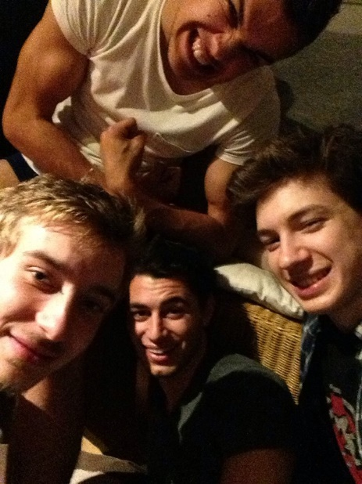
Hobbies/interests
Hanging out with friends

Slide 5
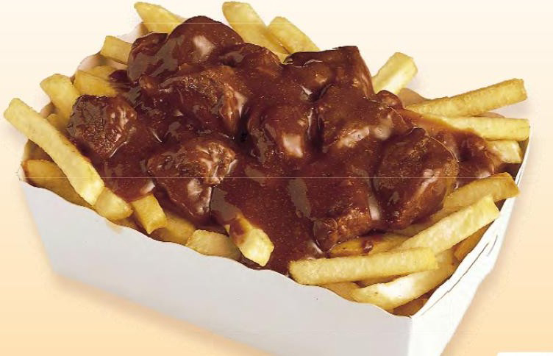
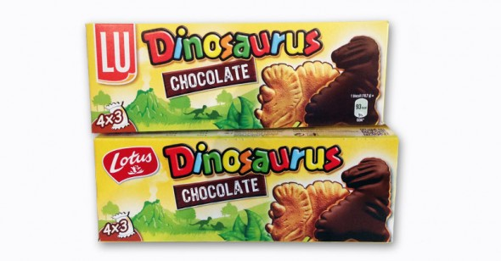
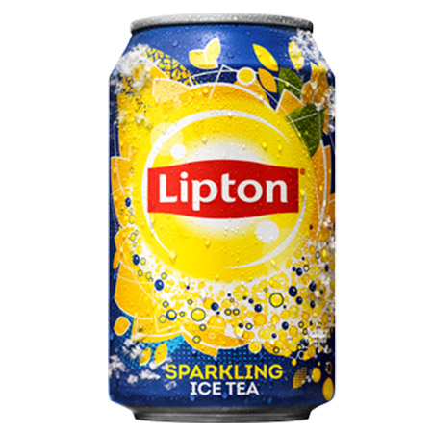
Hobbies/interests
Favourite food and drinks
  French fries with meat stew
  Dinokoeken (“dino cookies”)
  Lipton Ice Tea

Slide 6
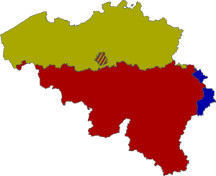
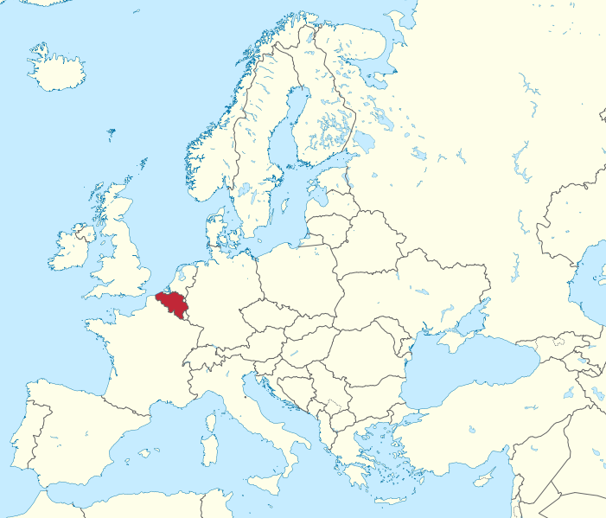
Belgia
11 million people
Three parts:
Flanderi (puhuvat hollantia) → minä
Vallonia (puhuvat ranskaa)
German (saksa) speaking part (very small)
Pääkaupunki: Bryssel (hollantia ja ranskaa)

Slide 7
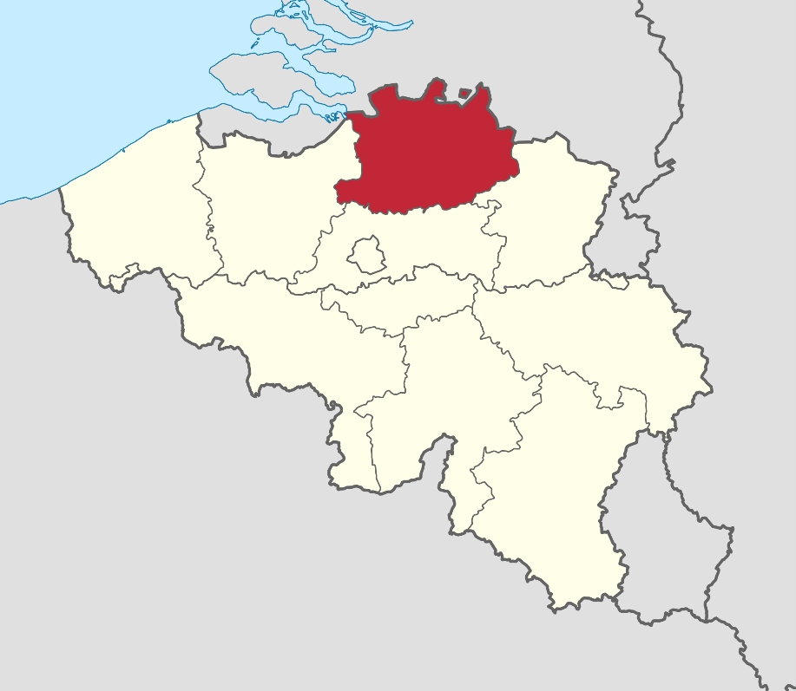
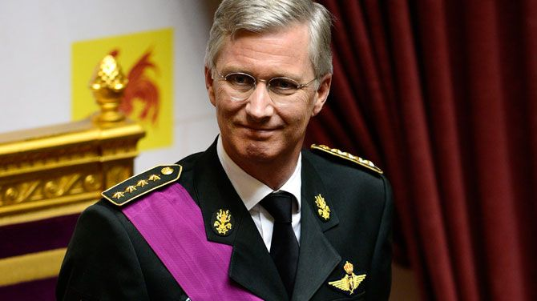
Belgium
Kymmenen provinssia: (asun Antwerpissa)
King: King Filip
Real power: ministers

Slide 8
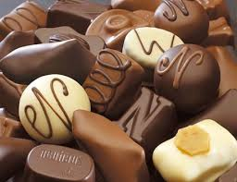

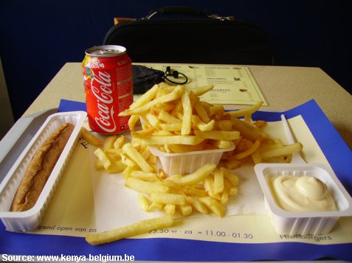
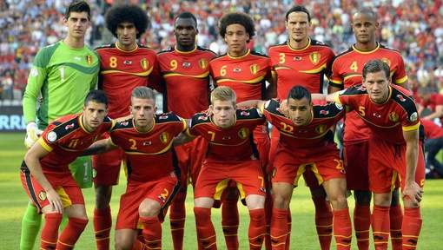
Famous Belgian things
Chocolate
Beer
French fries
Football

Slide 9
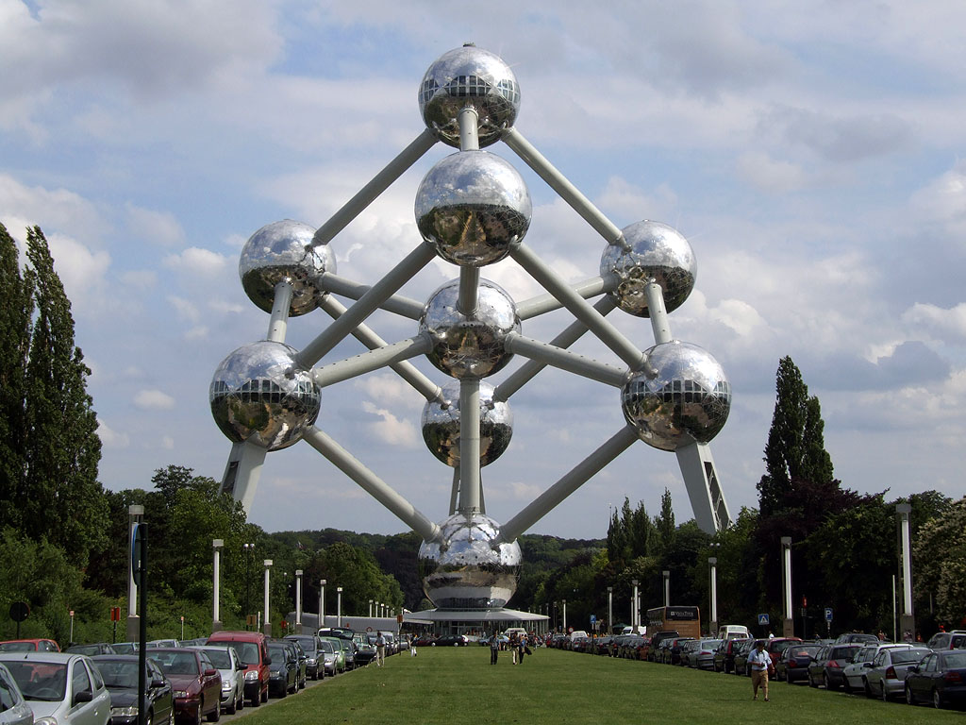
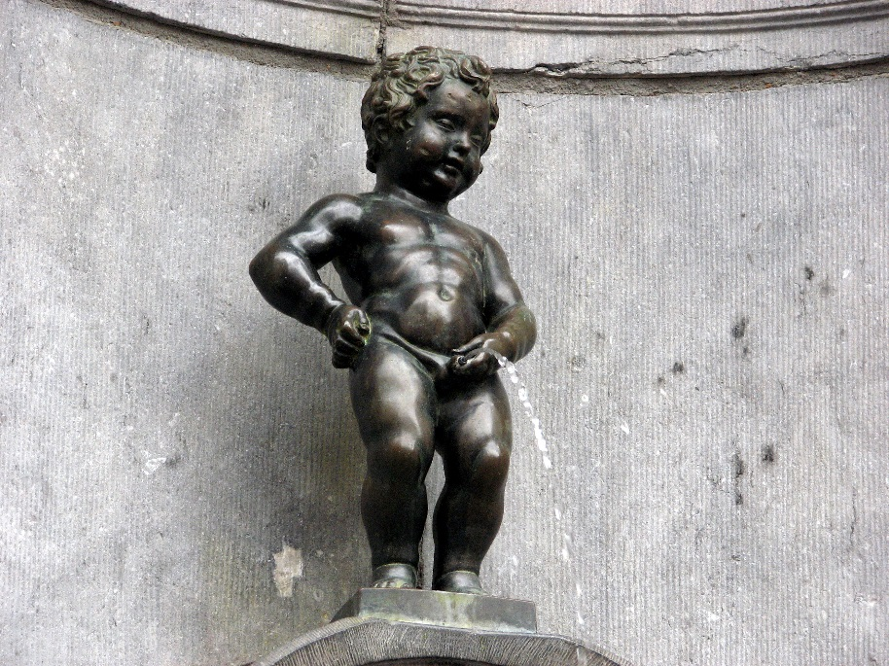
Famous Belgian things
Atomium (Bryssel)
Manneken Pis (Bryssel)

Slide 10
Miksi Suomi?
Never been here before → fascinating
Excellent education system
Beautiful nature
Kaunis kieli
Great music

Slide 11
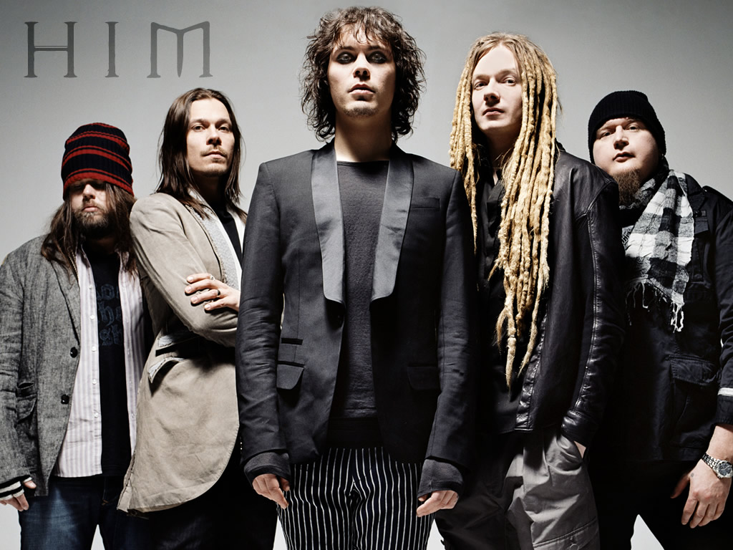
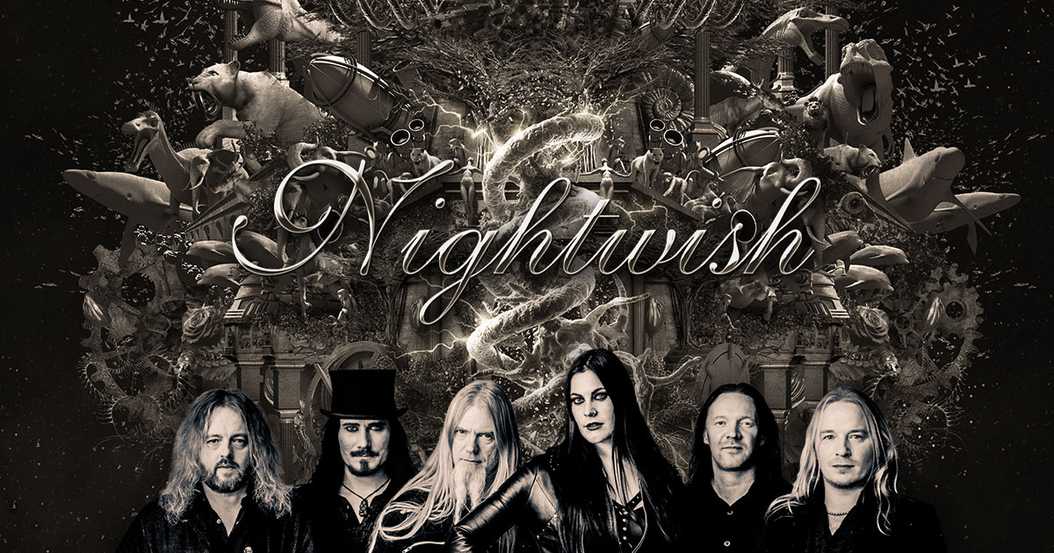
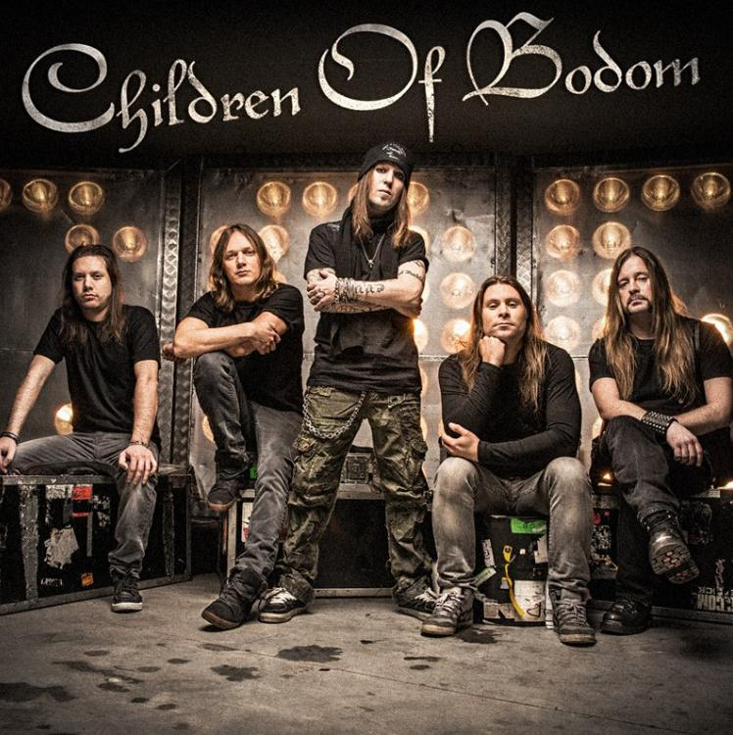
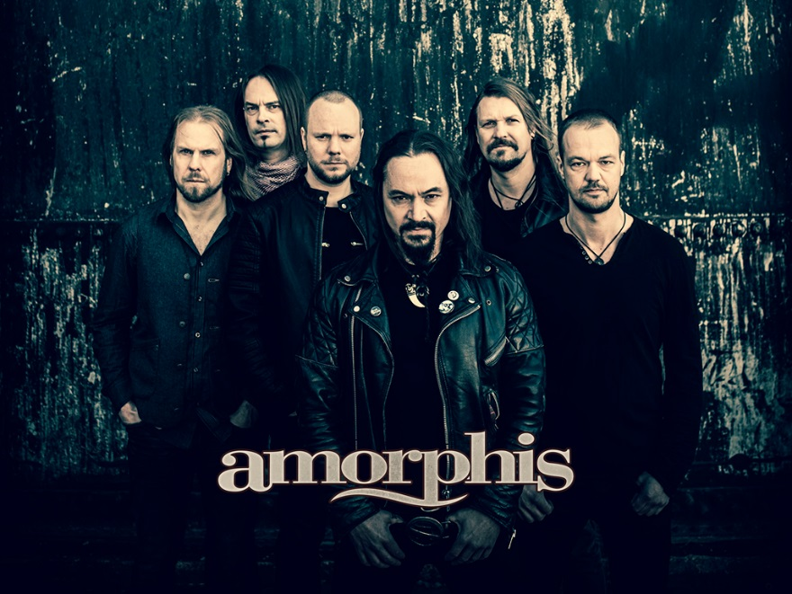

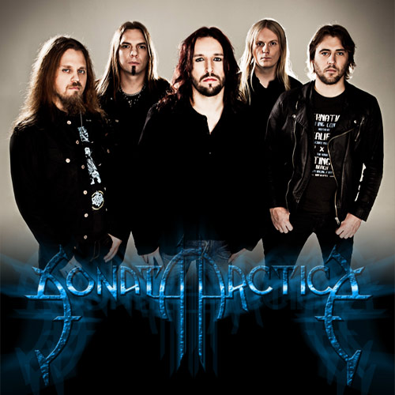
Favourite Finnish bands

Slide 12


