Slide 1







Navigating Mis- and Disinformation at an Older Age
MEDIA LITERACY
IN SOCIAL MEDIA
Towards smoother and safer information sharing

Slide 2
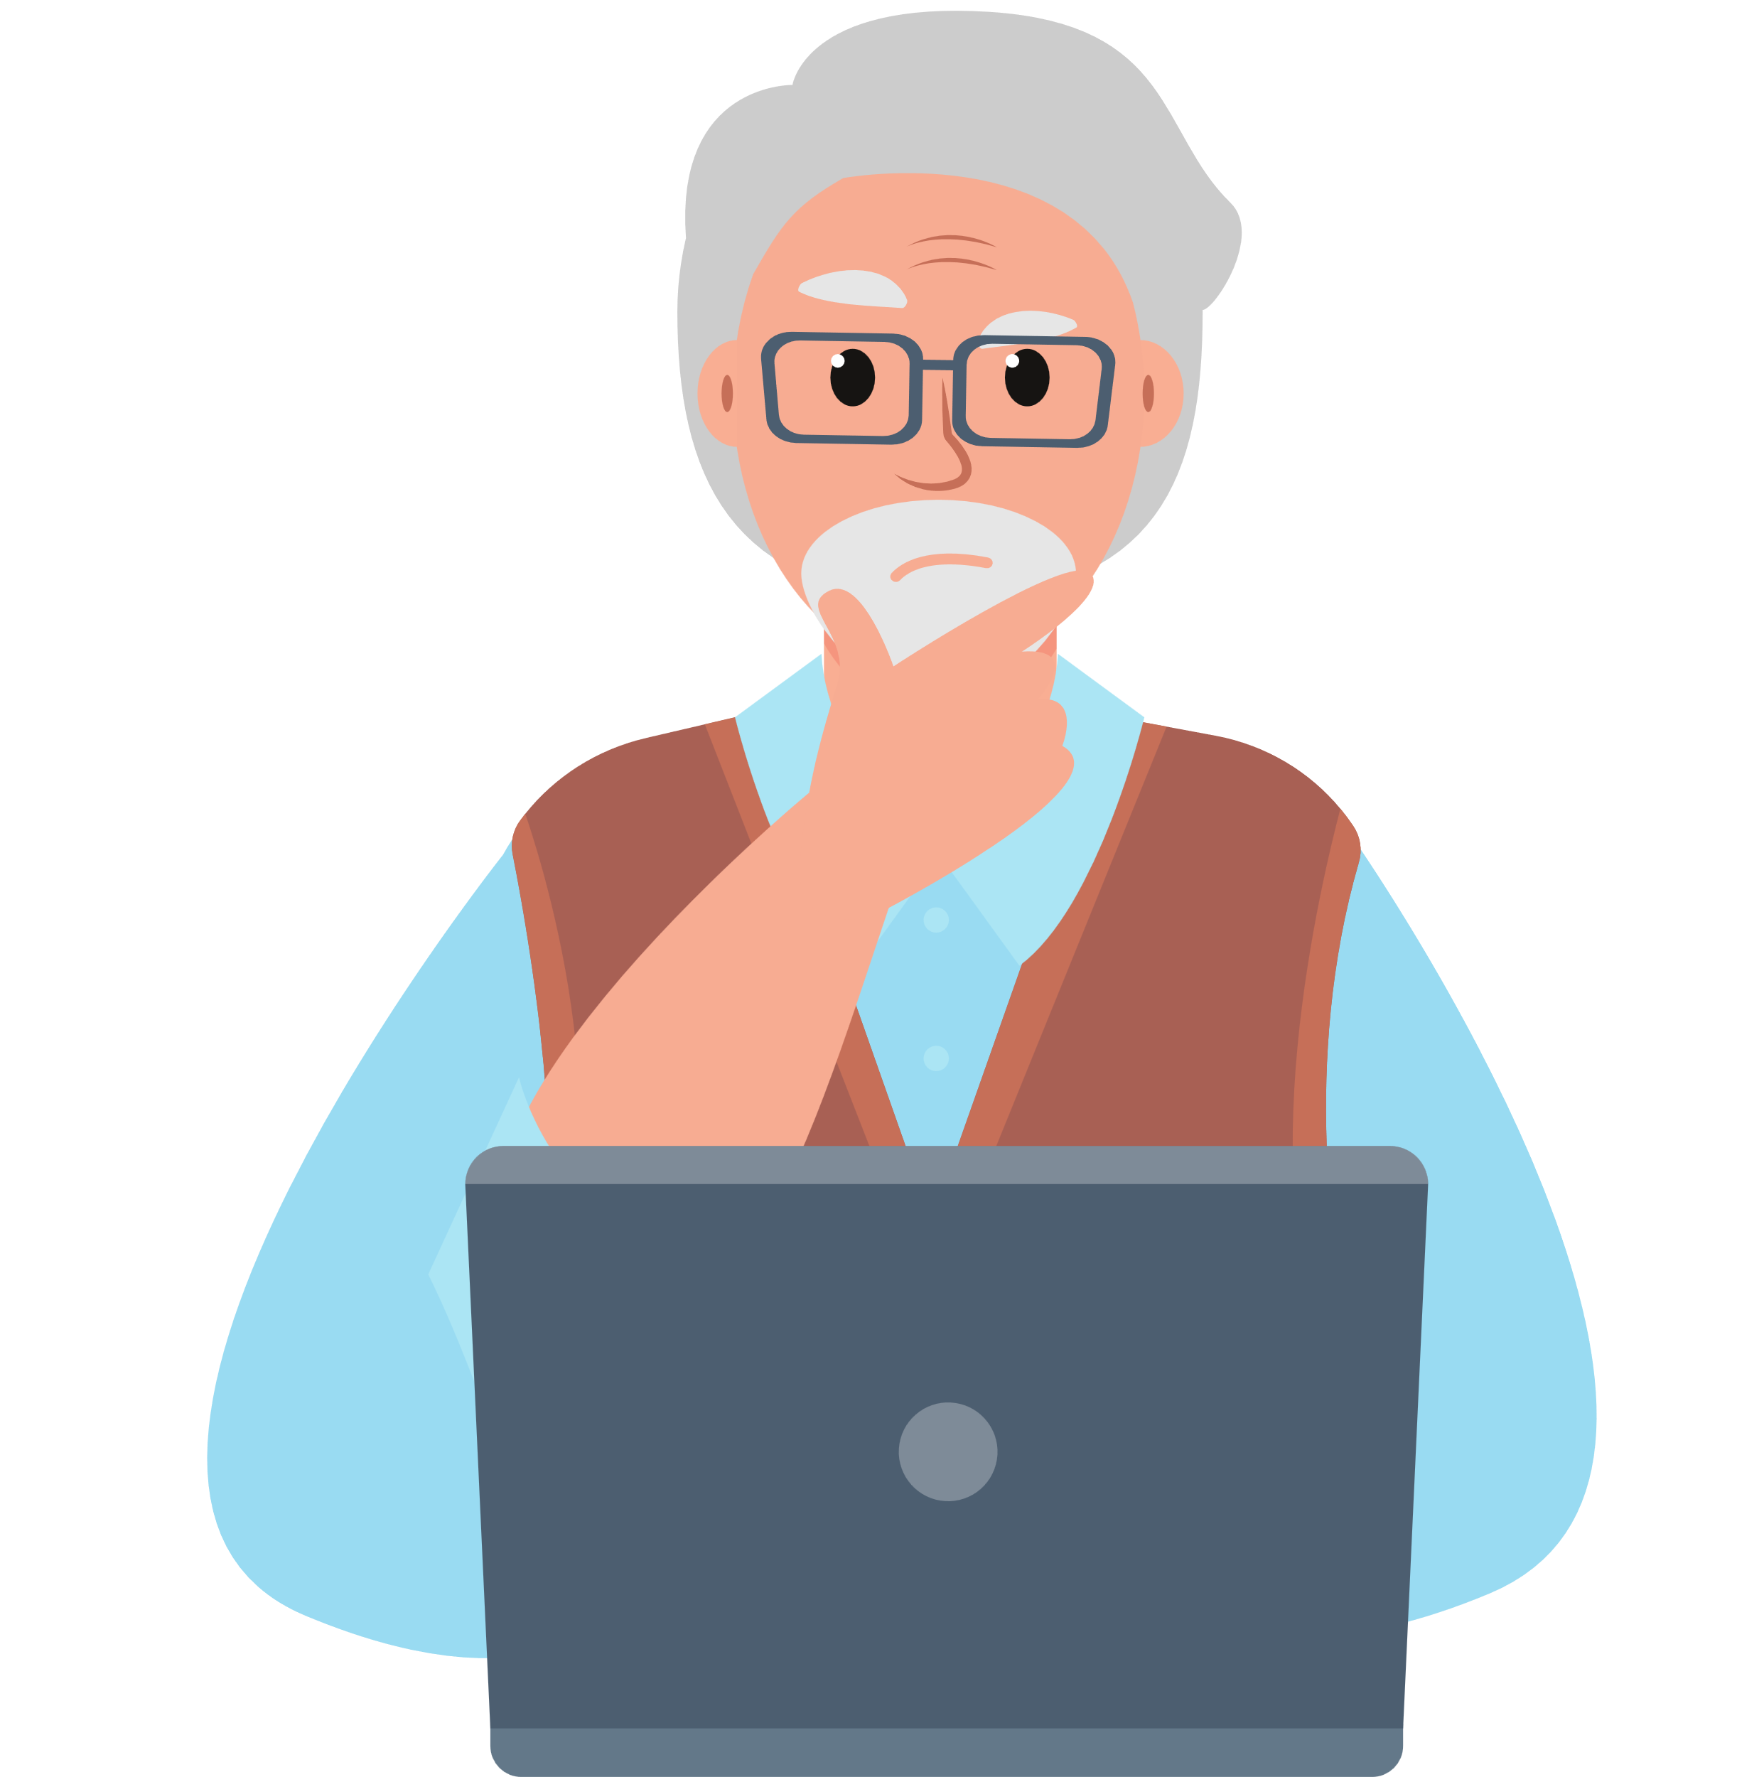
Nature of social media
A community-based media where anyone can create and share content.
It can be difficult to distinguish between information, opinions, and advertising.
Users need the ability to understand, evaluate, and create content responsibly.
Every user contributes to what kind of information spreads online.

Slide 3

Pay attention to these
Reliability of information
  Identify who created the content and for what purpose.
  Compare information from multiple sources.
Algorithms and visibility
  Your activity shapes what you see.
  The more you interact with certain types of content, the more similar content you will be shown.
Advertising and influence
  Learn to tell the difference between ads, opinions and facts.
  Always ask yourself: Who benefits if I believe this?

Slide 4

Managing safety and privacy
Think carefully about what personal information you share.
Always ask permission before posting photos or other information about others.
Learn to recognize fake profiles, scam messages and inappropriate content.
Check your privacy settings: who can see your posts, who can contact you?
Enable two-factor authentication for extra protection.

Slide 5
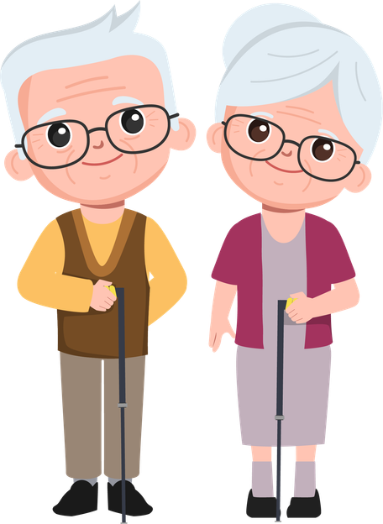
Interaction and responsibility
Information spreads quickly on social media – verify and think before you share.
You can disagree but be wise and pick your battles.
Trolls aim to provoke and stir up conflict – don’t take the bait.
Empathy, constructive dialogue and respect for others’ privacy are all part of media literacy.

