Slide 1






Navigating Mis- and Disinformation at an Older Age
Cyber Hygiene
ENAEA 2025

Slide 2
Instructions
Trainers can utilize this presentation to teach seniors how to protect their digital identity through practical, layered security measures.
The slides explain some technical concepts like Multi-Factor Authentication (MFA) and the use of password managers to handle complex, unique credentials and supports discussions on physical device safety.
By focusing on the "Top 5" summary, trainers can ensure learners leave with a prioritized checklist of essential habits to stay informed and secure.

Slide 3
Strong passwords
Use different, complex passwords for each of your accounts. A password manager can help generate and store these securely.
Passwords should contain letter in uppercase and lowercase, numbers, and special symbols.
Longer passwords are generally more secure.
Enable multi-factor authentication (MFA) whenever possible. This adds an extra layer of security, requiring a second form of verification (like a code sent to your phone) in addition to your password.

Slide 4
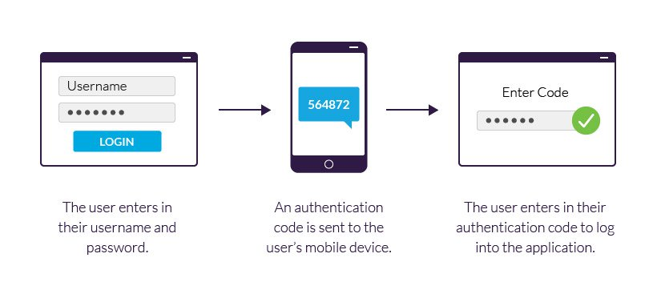
2FA example using a mobile device
Notes:
Source - https://www.imperva.com/learn/application-security/2fa-two-factor-authentication/

Slide 5
Software updates, downloads
Keep your operating system, applications, and security software (antivirus, anti-malware) up to date.
  Updates usually include crucial security patches.
Download software from trusted sources.
Don’t use free downloads from unknown websites, as they may contain malware.

Slide 6
Online behavior
Be skeptical of suspicious emails, messages, or links (phishing). Don't click on links or open attachments from unknown senders.
Use secure websites, if the URL begins with "https://" then it is safe to enter personal information. This indicates a secure connection.
Avoid using public Wi-Fi for sensitive activities like online banking or shopping, as these networks may not be secure.
Set up separate email accounts. Use your primary, protected email only for sensitive, formal communication, and dedicate a secondary email to all service sign-ups.

Slide 7
Privacy settings and data minimization
Social media privacy – check regularly and adjust the privacy settings on your social media accounts to limit who can see your information.
Share personal information only when it is necessary and with trusted entities.
Be mindful of what you post online, as it can be difficult to erase completely.

Slide 8
Devices
Lock your devices, use strong passwords or biometric locks (fingerprint, facial recognition) to secure your devices.
Enable encryption on your devices to protect your data if they are lost or stolen.
Back up your important data regularly to a secure location (external drive, cloud storage).
Backups ensure that you can recover your data in case of device failure or cyberattack.

Slide 9
Recommendations
Stay informed about cybersecurity news, keep up with the latest cybersecurity news and trends to stay informed about potential threats.
Check regularly your online accounts and notifications about suspicious activity.
Consider using a Virtual Private Network (VPN) for added security and privacy, especially when using public Wi-Fi.
When installing apps, pay attention to the permissions they request. Only grant permissions that are necessary for the app's functionality.

Slide 10
Top 5 Essential cyber hygiene recommendations
Use strong passwords, Multi-Factor Authentication (MFA)
Keep your software updated
Be wary of unexpected emails and texts (Phishing)
Set up regular backups
Lock down your devices and data

Slide 11
