Slide 1
Discourse & Literacy 16 January 2021

Slide 2
TV: Good, Bad, or Indifferent?
Just as photographs are seen as a ‘lower’ art form compared to paintings, TV has been regarded as a more common form of entertainment than films
-> the passivising effects of television (esp. on children)
-> the harmful effects of sex and violence (esp. on children)
Telling stories has been a favourite pastime since time immemorial: TV has inherited this function
-> fairy tales, ghost stories, gossip etc. can be just as gruesome

Slide 3
TV programming caters for the ideal nuclear family:
- daily and yearly cycles
- ‘unwholesome’ programmes are usually slotted after bedtime
- prime time (c. 6 pm to 10 pm) features the most popular programmes – and most advertising
However, with demographic and technological changes, TV has needed to diversify its programming and rethink its formats

Slide 4
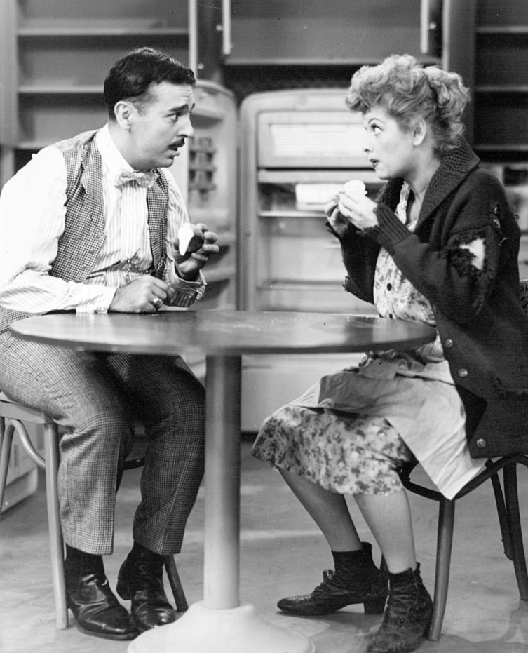
Narration on the Small Screen
“Television, in essence, becomes a collection of different segments that are brought together into a whole larger than any individual segment --” - Elizabeth Evans
Narration for television relies on serialisation – on stories that do not necessarily reach a conclusion (e.g. soap operas)
Smaller screen size (at least until recent times) has made TV less effective than film
-> talking heads, ‘everydayness’
-> less intensive viewing (more prone to interruptions – both outward and inward)
Early programming (1940s and 50s) was largely modelled on radio:
- comedy and game shows were adapted for the visual medium

Slide 5
Serialisation
- Based on our thirst of knowledge (“What’s happened in the world / in Westeros / in Emmerdale?”)
1) Serial
- Long-running programmes with a continuous storyline (Days of Our Lives has been running continuously since 1965, Coronation Street since 1960)
- Rely on cliff-hangers to keep the viewer hooked
- Soap operas, miniseries
2) Series
- Long-running programmes with independent storylines
- ‘Closed’ endings: the winner is rewarded, the bad guys end up in prison, all is well in the world
- News, game shows, Law & Order, The Simpsons

Slide 6
3) Reality shows
invented in 1996 in the UK (a show which later became Survivor)
‘storylines’ that imitate life – because they are life
however, in shows such as Big Brother live cutting and editing still goes on
TV aims to create a ‘common reality’ with the viewer
Unlike film, which relies on spectacle, TV strives for realism and ‘real-time’ representation
→ everydayness, spontaneity, and equality between media and viewer
However, not everything we see is ‘real’
-> ‘hyperreality’
https://youtu.be/BBwepkVurCI?t=91

Slide 7
The Future of TV
With the introduction on streaming sites, our relationship with televisual content has begun to change
Bingeing entire series/seasons in one go, at any time, is now possible
-> a logical follower of the DVD box set
TV has changed from a domestic medium to an ever-present one due to its portability on different devices
The philosophy of production has also changed:
- people give money directly to the production company
- or they seek alternative content on sites such as YouTube
Thus, major broadcasting networks such as CBS have to invest in web-based programming along with more traditional TV

Slide 8
Activity: Memorable Ads
Make a list of all the ads you can remember
1) from last week
2) from your childhood/adolescence
Discuss
- what makes these ads so memorable?
- which is more effective, print or TV advertising?
What about ads on the Internet?
- do you often buy things just because you’ve seen the commercial?

Slide 9
Advertising
When children aged 4-6 were asked in a survey, “Which do you like better, TV or your daddy?,” 54% said, “TV.”
Studies show that 9 out of 10 people cannot remember the product or the company featured in the last commercial they watched, even if it was less than five minutes ago.
Research also indicates that two thirds of all consumers buy only well- known brands
-> advertising does play a role in consumer buying decisions
Silverblatt: Media Literacy. 1995.

Slide 10
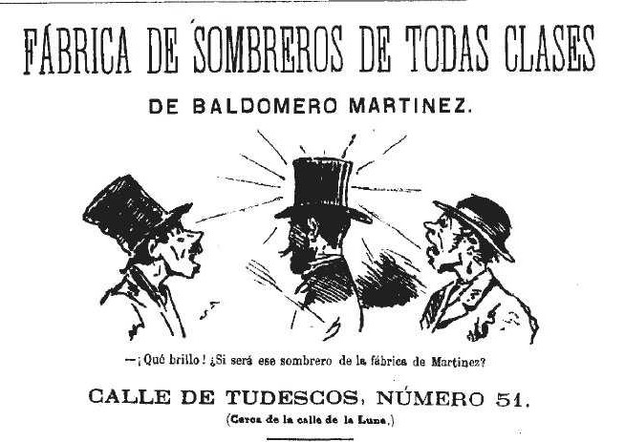
Like many other types of media, advertising has been around for a long time.
In the 16th century, printed books included listings of the printers’ other products, informing the readers of available titles.
In London around 1650, a newspaper would carry about six ads; by 1750, it would carry about fifty.
“Among the goods and services advertised in the 18th century, there were plays, race meetings, quack doctors and ‘Holman’s Ink Powder’, perhaps the first brand name.”
Briggs and Burke: 2009. The Social History of the Media

Slide 11
Functions of advertising
Manifest functions:
Informing the public about a product
Attracting the attention of customer to the product
Motivating the consumer to action
Stimulating markets and supporting the business community
Establishing and maintaining a relationship between the consumer and a company

Slide 12
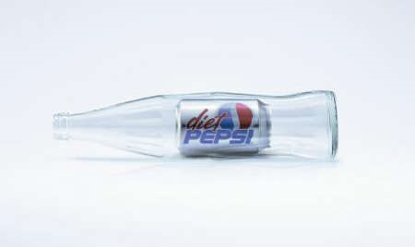
In addition, advertising serves a number of latent functions:
Persuasion
- Advertisers try to convince us that we do not merely want a product, but in fact need it.
-> ’impulse displays’ at check-out counters
-> the use of imperatives (“Buy it today!”)
Shaping attitudes
- Some ad campaigns are designed to create a positive image for the company rather than sell a particular product

Slide 13
Fostering consumer culture
- Advertisers encourage the audience to think of themselves in terms of their consumer behaviour
-> by wearing designer labels or sweatshirts with commercial logos, or displaying mobile phones, laptops or tablets, consumers have been transformed into living advertisements for products
- Hyping consumer events like Black Friday

Slide 14
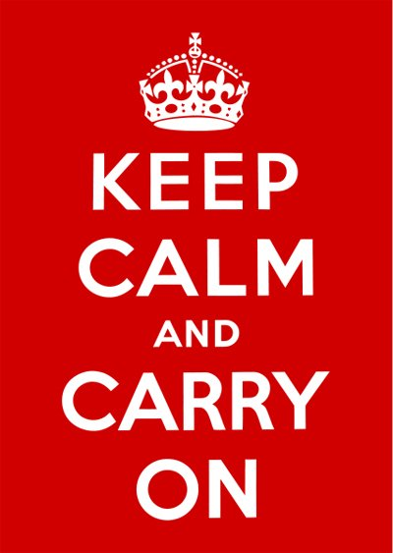
Establishing standards of behaviour and lifestyle
- Advertising influences how consumers spend their time and money
-> new ‘look’ for each season; end-of- season sales to boost sales
-> Ad slogans entering everyday speech (‘Elämä on’)
Entertainment
As principal message
- Instead of simply supporting programming/magazine content, in some cases advertising has emerged as the predominant message.

Slide 15
Online advertising relies on pop-ups and targeted sidebar ads (f.ex. Facebook)
Yet, most browsers enable the skipping and blocking of ads
-> advertisers find other ways of reaching their audience
- direct sponsorship of programmes and events
- product placement
Tom Scott on how cookies/
online advertising works:
https://youtu.be/OFRjZtYs3wY

Slide 16
The appeal of appellation
Who is the subject of this ad? Why, you are, of course. Guess what - I've just ‘appellated’ you. Exactly like this ad does. Ads hail us - they call out “hey you.” - Rae French
Appellare (Lat.) = to accost, address, call upon
We have been trained to accept being appellated by people we have never met – and to changing the ‘you’ to ‘I’ in our minds
“These characters are all young, beautiful, and physically fit – there is not a beer belly in the crowd. The main figures are always in the middle of the frame, the centre of attention. Everyone is watching (and admiring) them. And because the use of the personal pronoun you projects the audience into the advertisement, we are by extension watching people adoring us.” (Silverblatt 1995:194)

Slide 17
Appellation

Slide 18
The Art of Copy
The ‘claim’ is the verbal or print part of an ad that makes some claim of superiority for the product being advertised. A few of these claims are downright lies, some are honest statements about a truly superior product, but most fit into the category of neither bold lies nor helpful consumer information. They balance on the narrow line between truth and falsehood by a careful choice of words.
Jeffrey Schrank at
http://sunset.backbone.olemiss.edu/~egjbp/comp/ad-claims. html

Slide 19
Parity products and pseudo-information
Many ad claims fall into the category of pseudo-information because they are applied to parity products
-> products in which all or most of the brands available are nearly identical.
Since no one superior product exists, advertising is used to create the illusion of superiority.
The largest advertising budgets are devoted to parity products such as petrol, cigarettes, beer and soft drinks, soaps, and various headache and cold remedies.

Slide 21
Information and Persuasion
Different types of advertising have different proportions of informative and persuasive content
“Advertisers know better. Although few people admit to being greatly influenced by ads, surveys and sales figures show that a well-designed advertising campaign has dramatic effects. A logical conclusion is that advertising works below the level of conscious awareness and it works even on those who claim immunity to its message. Ads are designed to have an effect while being laughed at, belittled, and all but ignored.” - Jeffrey Schrank
To create the necessary illusion of superiority, advertisers usually resort to one or more of the following ten basic techniques

Slide 22
1) The weasel claim
A weasel word is a modifier that practically negates the claim that follows:
“Helps control dandruff symptoms with regular use.”
“Leaves dishes virtually spotless.”
2) The unfinished claim
The ad claims the product is better, but does not finish the comparison:
“Magnavox gives you more.”
“Supergloss does it with more colour, shine, more sizzle, more!”
3) The ‘We’re different and unique” claim
Tries to persuade us that there’s nothing quite like the product being advertised
“There’s no mascara like it.”
“Only Doral has this unique filter system.”
“Cougar is like nobody else’s car.”

Slide 23
4) The ‘Water is wet’ claim
The claim says something about the product that applies to any brand in that product category:
“Great Lash greatly increases the diameter of every lash.”
“Rheingold, the natural beer”
5) The ‘So what’ claim
A claim is made which is true but which gives no real advantage to the product.
“Geritol has more than twice the iron of ordinary supplements.”
“Strong enough for a man but made for a woman.”

Slide 24
6) The Vague claim
Uses words that are colourful but meaningless, and subjective and emotional opinions that defy verification.
“Lips have never looked so luscious.”
“For skin like peaches and cream.”
7) The endorsement or testimonial
A celebrity or authority appears in an ad to lend their stellar qualities to the product.

Slide 25
8) The Scientific or Statistical claim
uses some kind of scientific proof or experiment, very specific numbers, or an impressive sounding mystery ingredient
“Easy-Off has 33% more cleaning power than another popular brand”
“Certs contains a sparkling drop of Retsyn.”
9) The ‘Compliment the consumer’ claim
butters up the consumer by some form of flattery
“We think a cigar smoker is someone special”
“You pride yourself on your good home cooking…”
10) The Rhetorical question
Demands a response from the audience
“Plymouth – isn’t that the kind of car America wants?”
“Shouldn’t your family be drinking Hawaiian Punch?”
https://youtu.be/ZN27wC6pj_o

Slide 26
The post-modern ad

Slide 27
Assignment 2: Advertising
Choose an advert (print media, TV, or Internet) and analyse it, using the tools you have been provided with so far. In the course of your analysis consider the following questions in particular:
What is the denotative meaning of the ad (colours, composition, expressions used, etc.)?
What is the connotative meaning of the ad: what does it want to say to the consumer indirectly, and how is this effect achieved?
You can also discuss the different persuasive ploys included in the ad, along with the ideologies it contains/helps to reinforce.
Write your answers in essay form (c. 1500 words); include also the ad you have analysed (or link to it); email to karppinen.anne.m@gmail.com
Deadline 15 February (flexible)

Slide 28
Audience Segmentation FTW
“Audience segmentation is the process of dividing a broad target audience into more homogeneous subgroups, called audience segments. The purpose of dividing up an audience into segments is to make your program more effective and to use your resources wisely.” Social Marketing
http://www.cdc.gov/nccdphp/dnpa/socialmarketing/training/basics/audience_segmentation.htm
Marketing along gender lines is one of the most obvious of these divisions:
- making ‘for him’ and ‘for her’ versions of the same product expands the market
- often the ‘pinkified’ version costs more than the ‘regular’ one
- men tend to shun products they consider feminine
https://www.adforum.com/creative-work/ad/player/34472583

Slide 29
Men and women in the media
Men act and women appear. Men look at women. Women watch themselves being looked at. This determines not only most relations between men and women but also the relation of women to themselves. The surveyor of woman in herself is male: the surveyed, female. Thus she turns herself into an object - and most particularly an object of vision: a sight. John Berger 1972
You are a man inside a woman looking at a woman. - Margaret Atwood

Slide 30
The Male Gaze
“Traditionally, the woman displayed has functioned on two levels: as erotic object for the characters within the screen story, and as erotic object for the spectator within the auditorium, with a shifting tension between the looks on either side of the screen.” Laura Mulvey: “Visual Pleasure and Narrative Cinema”

Slide 31
The persons gazed at are objectified; their sole value is to be enjoyed or possessed by the voyeur.
-> the denial of agency/humanity
The worldview presented through media does not merely reflect culture, but shapes thinking by promoting the dominant ideologies of the culture
The cumulative media messages about female sexuality cause young girls “to absorb the dominant culture’s fantasies as their own”. - Naomi Wolf
Women are not naturally more susceptible to media messages – only constantly bombarded by them
“The beauty myth tells a story: The quality called ‘beauty’ objectively and universally exists. Women must want to embody it and men must want to possess women who embody it”

Slide 32
The Beauty Myth
How did women’s appearance become the target of advertising?
In the 1950s, housewives boosted commercialism (‘buying things for the house’ to keep themselves occupied and fulfilled)
As women began to work outside the home, a new strategy was needed
-> “There is no other way for a woman to be a heroine than to keep on being beautiful”.
A woman’s appearance is a reflection of her self-control
-> advertising builds an ideal image most people can never attain
Naomi Wolf: The Beauty Myth. How Images of Beauty Are Used Against Women.

Slide 33
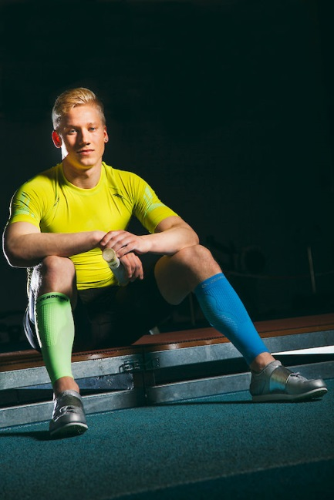
The role of women in society has changed, and women have made great achievements since the 1960s.
“Yet not everything has changed. She may be the professional success story rather than a domestic goddess -- but two elements identified by earlier theorists remain; the need to look good and the need to get male attention.” Paul Hodkinson, 2011
-> looking good and doing so by consuming

Slide 34
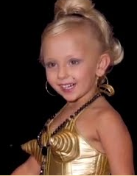
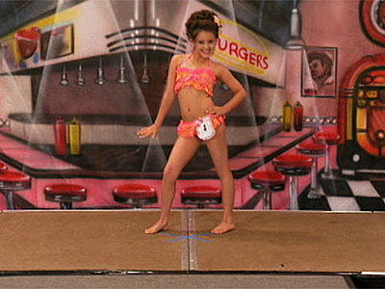
Advertisers and the ‘beauty industry’ create problems for women to fix: ‘problematic’ skin and hair, cellulite, wrong body shape
-> can lead to the use of toxic chemicals, skin bleaching and eating disorders
“Of course, the consequences of such procedures are considered women’s personal ills, a result of vanity and the futility of pursuing a perfected image that nature did not bestow upon them. The larger entendre, of course, lies in the fact that in order to meet the standards of the cultural beauty ideal most women must physically change themselves, yet they are simultaneously scrutinised for doing so.”
Vanessa Reimer & Rukshana Ahmed: “Feeling Good Never Looked Better” 2012
https://youtu.be/jWKXit_3rpQ

Slide 35
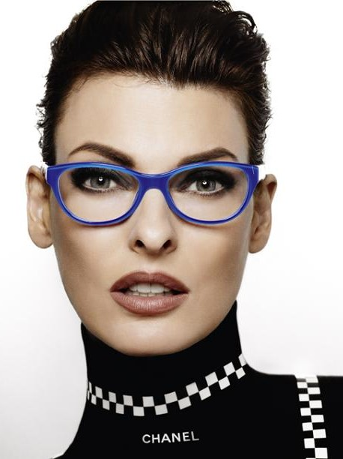
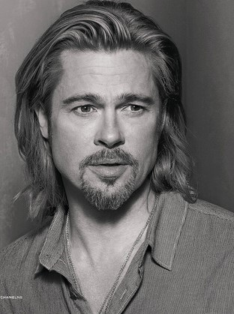
Double standards: Men do not age any better physically. They age better only in terms of social status. Our eyes are trained to see time as a flaw on women’s faces and a mark of character in men’s.
There’s still an officially enforced double standard for men’s and women’s nakedness in mainstream culture that bolsters power inequalities.
Yet, men too are increasingly sold “body problematisation which can be soothed through continual purchases.”
https://youtu.be/M957dACQyfU

Slide 36
Anti-aging or pro-aging?

Slide 37
Society really does not care about women’s appearance per se. What genuinely matters is that women remain willing to let others tell them what they can and cannot have.

Slide 38
What can we do?
Becoming media literate helps to unravel harmful stereotypes
-> understanding that self-worth can’t be bought
Following media that exposes (and makes fun of) harmful images and tropes
Using our power as consumers, and deciding what (not) to buy
Changing legislation:
- In the UK, ‘harmful gender stereotypes’ have been banned in advertising since July 2019.
https://www.bbc.com/news/business-46558944

Slide 39
Now and then: gender roles in advertising
Cheer http://www.youtube.com/watch?v=wPrSpihatgM
Goodyear
https://youtu.be/rC5aGCOT6bs
Wilkinson razors:
https://youtu.be/Kk2xPIsdF4c

Slide 40
Activity: Car commercials
https://youtu.be/bNKqhUlqPq4
https://youtu.be/HcZP4Y7Pk9A
Discuss the way women and men are portrayed in these ads: who has agency (who does/sees/invents things, and who is there just to be seen)?
What kinds of ideologies do these ads recycle / reinforce? What kinds of roles are offered for men and women in the world of these ads?

Slide 41
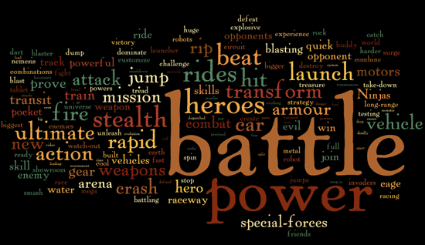
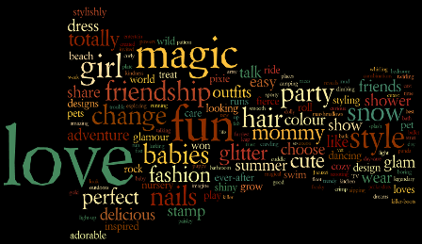
Children and Advertising
The media lives of children and young people have diversified over the past couple of decades
“A 2015 study showed that most 2-year-olds [in the US] used mobile devices on a daily basis, and 92.2% of 1-year-olds had already used a mobile device. Furthermore, three-quarters of teenagers own a smartphone, 24% of adolescents describe themselves as “constantly connected” to the internet and 50% report feeling “addicted” to their phones, according to a 2016 survey.”
http://www.aappublications.org/news/2016/10/21/DigitalMedia102116

Slide 42
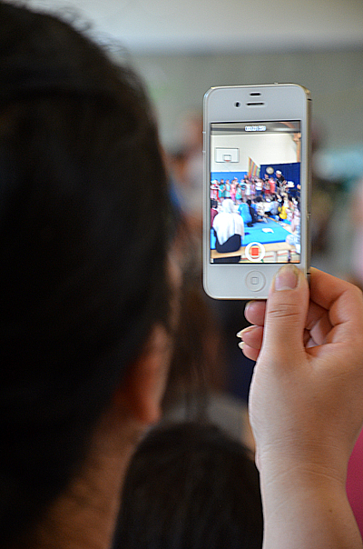
While young people in the US spend more than 7 hours a day consuming media, they manage to pack 11 hours of media content into that time
-> young people live in an increasingly complex media world & communication environment
-> the educational system and parents’ attitudes often lag behind these developments

Slide 43
Branding for Babies (in the US)
Brand marketing for children has existed since the 1930s
However, the rise of neoliberalism in the 1980s contributed to the explosion in children’s advertising
-> the thought that markets are best able to provide for the wellbeing, development and happiness of all
-> government deregulation of media industries that play a central role in children’s and youth’s lives
-> the development of new branding and marketing strategies for young people
As a result, brands have become more prevalent, influential and common features across kids’ experiences
(Hoechsmann and Poyntz: Media Literacies: A Critical Introduction 2012)

Slide 44
Why Does it Matter?
Brands articulate and reference complicated psychological
needs (e.g. love, self-esteem, a sense of freedom) as a way of
ensuring that certain products are bought - regardless of their real value
New branding strategies have changed the experience of childhood
-> massive franchises such as that around Star Wars have changed the context of children’s play
-> the creation of TV programmes (Teenage Mutant Ninja Turtles, Transformers) specifically designed to market toys, comics, cups, sweets etc.
-> websites and apps that tie in with the franchises
-> brands become intertwined with children’s lives

Slide 45
What to do?
Many countries have banned or restricted advertising to children
The EU gives some general guidelines, but their implementation depends on each member country:
http://www.globalchildforum.org/wp-content/uploads/2016/06/GlobalChildForum_Regulating_Marketing_2015.pdf
Finnish legislation is also somewhat elusive:
https://www.kkv.fi/Tietoa-ja-ohjeita/markkinointi-ja-menettely-asiakassuhteessa/mainonnan-tunnistettavuus/
Anita Sarkeesian’s take on children’s gendered advertising:
http://www.feministfrequency.com/2010/11/toy-ads-and-learning-gender/

Slide 46
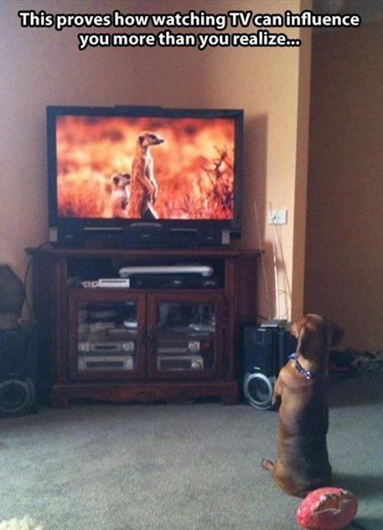
Finally
http://www.youtube.com/watch?v=85HT4Om6JT4

Slide 47
Sources and Links
Campbell, Jane and Theresa Carilli. 2012. Challenging Images of Women in the Media : Reinventing Women’s Lives. Lanham : Lexington Books.
Dworkin, Shari and Faye Wachs. 2009. Body Panic: Gender, Health, and the Selling of Fitness. New York: New York University Press.
Freeman, Matthew and Renira Rampazzo Gambarato (eds.). 2019. The Routledge Companion to Transmedia Studies. London: Routledge.
Hoechsmann and Poyntz.2012. Media Literacies: A Critical Introduction. Chichester: Blackwell Publishing.
Lothe, Jakob. 2000. Narrative in Fiction and Film. An Introduction.
Potter, James W. 1998. Media Literacy.
Silverblatt, Art. 1995. Media Literacy: Keys to Interpreting Media Messages.
Storey, John. 2001. Cultural Theory and Popular Culture.
Wolf, Naomi. 1990. The Beauty Myth. How Images of Beauty Are Used against Women.

Slide 48
http://www.aef.com/on_campus/classroom/speaker_pres/data/3005
http://www.globalchildforum.org/wp-content/uploads/2016/06/GlobalChildForum_Regulating_Marketing_2015.pdf
http://www.lclark.edu/~soan370/appellation.rae.html
http://library.duke.edu/digitalcollections/eaa
http://www.achilleseffect.com/2011/03/word-cloud-how-toy-ad-vocabulary-reinforces-gender-stereotypes/#
http://thesocietypages.org/socimages/2012/07/10/sexual-objectification-part-3-daily-rituals-to-stop/
http://www.slate.com/articles/double_x/doublex/2013/08/gender_contamination_when_women_buy_a_product_men_flee.html
http://youtu.be/3JDmb_f3E2c
Jean Kilbourne’s Ted Talk: https://youtu.be/Uy8yLaoWybk
http://www.megalon.fi/kompressioasut/kompressiosaarystimet/zero-point-compression-performance-calf-sleeves-ox-p-1458.html#prettyPhoto
Least Weasel By Keven Law - originally posted to Flickr as On the lookout..., CC BY-SA 2.0, https://commons.wikimedia.org/w/index.php?curid=4580080
VW logo cupcake By Clever Cupcakes from Montreal, Canada, CC BY 2.0, https://commons.wikimedia.org/w/index.php?curid=32568159
Taro opening Netflix package by Taro the Shiba Inu Uploaded by JohnnyMrNinja, CC BY 2.0, https://commons.wikimedia.org/w/index.php?curid=15677815
Smartphone By Bernd Schwabe in Hannover - Own work, CC BY-SA 4.0, https://commons.wikimedia.org/w/index.php?curid=41389465

