Slide 1
Discourse and Literacy 28 November 2020
karppinen.anne.m@gmail.com

Slide 2
COURSE OUTLINE
Six lectures
Exercises and group discussions (active participation encouraged)
Two written assignments
Absences
Material:
- Discourse and Literacy booklet
- various Internet sources
- lecture slides (on Pedanet)

Slide 3
Exercise: Types of text
Read the text extracts and discuss them, paying particular attention to the following questions:
What type of text is it?
Can you tell who has written the text? Who might/is supposed to read it?
What is it aiming at? What is its purpose?
How can you tell, i.e. what specific features of the text contributed to your decision?
Is this the original format of the text, or do you think something has been left out? Does that matter?
Summarise your answers in the Docs

Slide 4
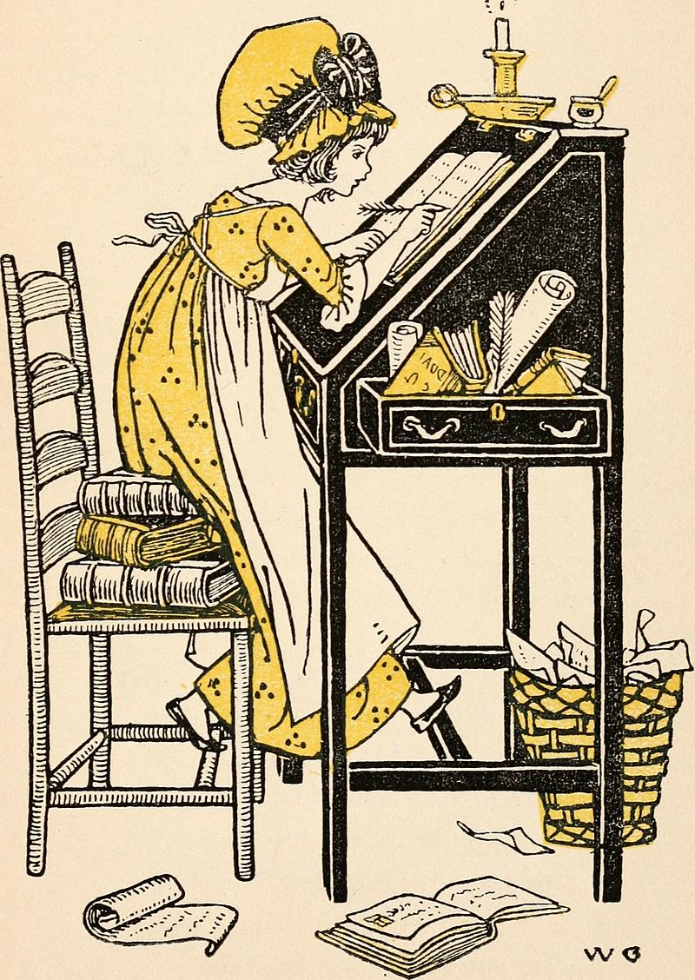
CENTRAL CONCEPTS: LITERACY (p. 12)
A term used extensively in English (early literacy, literacy skills, computer literacy)
Generally refers to a person’s ability to read and write, but also
- an ability to understand and produce texts
- how people make sense of texts and how they use them in their everyday lives
- multimodality
- language awareness

Slide 5
MULTIMODALITY
Meanings are not mediated simply by words, but in various other ways as well:
- text
- image
- sound
- movement and gesture
- space
-> esp. useful when looking at Internet texts (hypertext)
Yet, multimodality is an old concept: f.ex. religious rituals have always made use of all the features mentioned above

Slide 6
TRANSMEDIA
= a model where narratives and fictional worlds, not just characters, extend across media platforms
Sometimes called ‘convergence culture’
Using multiple media technologies to present information and entertainment has become the norm rather than exception in the 21st century
Media conglomerates such as Disney and Warner have learned to make the most of transmediality
Old media (f.ex. films) have got a new lease of life through streaming services and YouTube

Slide 7
MEDIA LITERACY
The traditional definition of literacy refers only to print. Yet, nowadays the principal channels of mass media include print, photography, film, radio, television – and the Internet.
“The ability to choose, to understand – within the context of content, form/style, impact, industry and production – to question, to evaluate, to create and/or produce and to respond thoughtfully to the media we consume. It is mindful viewing, reflective judgement.”
(the definition of media literacy by The National Telemedia Council)

Slide 8
MODERN MEDIA LITERACY
1. An awareness of the impact of the media on the individual and society
-> critical thinking skills that empower people to make independent judgements in response to information conveyed through the channels of mass communications.
2. An understanding of the processes of mass communication
-> an ability to understand the production, transmission, and context of interpretation involved
-> also the VALUES behind these (who produces what for whom and why)

Slide 9
3. The development of strategies with which to analyse and discuss media messages
-> very much what this course is all about
4. An awareness of media content as a “text” that provides insight into our contemporary culture and ourselves
-> media presentations can provide insights into the attitudes, values, behaviours, preoccupations, patterns of thought, and myths that define a culture

Slide 10
5. The cultivation of an enhanced enjoyment, understanding, and appreciation of media content
-> Media literacy shouldn’t detract from your enjoyment of texts – conversely, it should enhance it
-> However, it can also teach us why some texts make us feel uncomfortable – and to accept the fact that not everything is acceptable

Slide 11
Why Study Mass Media?
• Media stories shape our culture, serving both as a mirror of existing cultural practices and traditions and as a creator of new cultural traditions for audiences.
• Media stories give us the perspectives and information needed to make good decisions about the paths we’ll choose in life.
• Media stories transport us into other worlds and give us a richer understanding of other people, places, and ways of thinking.
• Media stories can hypnotise us, immersing us in a fantasy more exciting or preferable to our real lives.

Slide 12
Media stories inspire us to imagine a better way of living in our worlds and act on our vision.
Media stories help us form ideas that we carry into our real lives.
Pike, Deidre. Media Literacy : Seeking Honesty, Independence, and Productivity in Today's Mass Messages

Slide 13
Literacy is the ability to express oneself in an effective way through the text of the moment, the prevailing mode of expression in a particular society. Literacy follows language. To be literate, in other words, is to be conversant in the dominant expressive language and form of the age.
Stephen Apkon: The Age of the Image. Redefining Literacy in a World of Screens. 2013.
Yet, in order to assess the social and cultural consequences of [an] invention and [its] development, it is necessary to look at the media as a whole, to view all the different means of communication as interdependent, treating them as a package, a repertoire, a system, or what the French call a ‘regime’, whether authoritarian, democratic, bureaucratic or capitalist.
Briggs and Burke: A Social History of the Media. 2009.

Slide 14
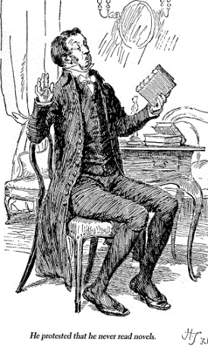
CENTRAL CONCEPTS: TEXT (p.7)
Spoken and written texts:
Spoken language tends to have
- low lexical density
- informal words
- simple structures
- involved style
Written language tends to have
- high lexical density
- formal words
- complex structures
- detached style
-> Not necessarily the case with f.ex. social media texts

Slide 15
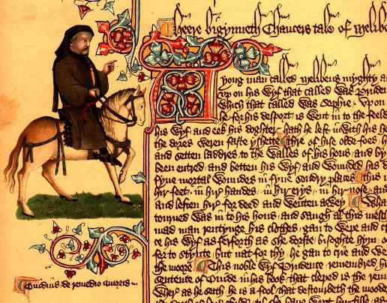
Changes in society lead to changes in texts: information society, globalisation, technological advances
Technology enables access to different forms of production and consumption -> changing concepts of writer and reader
Moving from “the world told to the world shown”

Slide 16
LANGUAGE AND IDEOLOGY
Our knowledge and beliefs -- are discursively produced, that is, they are not universal and unchanging but are historically and culturally shaped. As far as interpretations of texts are concerned -- language does not mediate reality in any simple, commonsense or transparent way. Instead language is a site through which ideologies are produced. It is not a neutral medium.
Carter, R. Investigating English Discourse : Language, Literacy, Literature.

Slide 17
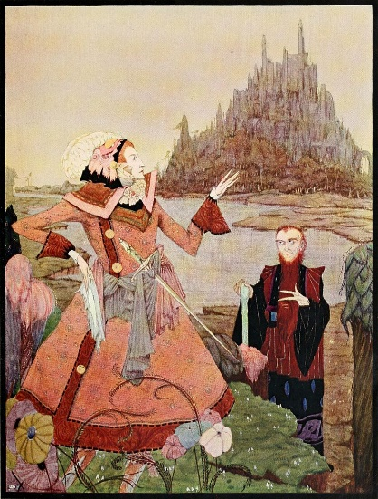
GENRE (p. 4)
= Conventional ways of expressing meanings
Culturally constructed: e.g. we have a ‘scheme’ for a ‘proper’ ending for a fairy tale
Definition difficult – categories overlap and subgenres abound
Literary genres: detective story, historical fiction, autobiography, diary
Genres of popular culture: science fiction, romance, soap opera, music video, reality TV etc.
Genres of everyday uses: joke, story, chat, gossip, song, sermon, argument, debate

Slide 18
Activity: Genre
Think about the most important characteristics of the following genres (i.e. what makes them stand out from other genres). Give examples.
- News item (in a newspaper and on television)
- a joke
- a detective story (a novel and/or on TV)
- an advertisement (give examples from different mediums)
- a superhero film

Slide 19
MEANING (p.10)
Where is meaning constructed? How do we make sense of texts? Where does the meaning of the text lie?
- Inside the text?
- Inside the writer’s / reader’s mind?
- In the community (= consensus meaning?)
- In all the above?
Is meaning stable?

Slide 20
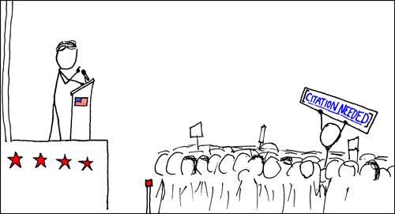
CITATION NEEDED (xkcd)

Slide 21
LEVELS OF MEANING
Manifest messages:
- direct and clear to the audience
- many advertisers rely on these
- however, the fact that they are ‘direct’ does not mean that they are true

Slide 22
Latent messages
- indirect, “beneath the surface”
-> escape immediate attention
- may reinforce manifest messages or may suggest entirely different meanings
- conveyed through different strategies
1. Affective strategies
- appealing to emotions (guilt, need of acceptance)
- the visual and aural media are especially suited for this
2. Embedded values
- Media content may reflect the value system of the media communicator as well as widely held cultural values and attitudes
- Editing decisions, point of view (who is shown; who gets to talk), and connotative words and images

Slide 23
Cumulative messages
- occur with such frequency over time that they form new meanings, independent of any individual production
- gender roles, racial and cultural stereotypes, presentations of success or desirability etc.

Slide 25
MESSAGES AND INTERPRETATIONS
All media messages are interpretations. Journalists tell us their interpretation of what is important and who is important. Entertainment storytellers show us their interpretation of what it means to be human --. Advertisers try to convince us that we have problems and that their products can help us quickly overcome those problems. Also, as audience members we can construct our own interpretations of those messages.
W. James Potter. 1998. Media Literacy.
-> the reader / viewer does not need to be passive or powerless

Slide 26
DIFFERENT APPROACHES TO ANALYSING AND INTERPRETING TEXTS (*)
1. Linguistic Discourse Analysis / Text Analysis (p. 36)
- focus on the structural properties of text
A. cohesion:
different kinds of ties and connections between parts of text
unity created by links among the surface elements of texts
- reference: is created when an item in one sentence refers to an item in another sentence (f.ex. pronouns)
- substitution: replacing a grammatical slot with another word/phrase (“He is rich. He is unhappy.”)

Slide 27
- ellipsis: creates cohesion by omission (= leaving out some grammatical elements, f.ex. verbs)
- conjunction: ‘however’, ‘because’, ‘so’ etc.
- lexical cohesion: repetition of words; using words to point to one another in various ways (synonyms, metonyms…). Also using words referring to the same field.
B. coherence:
- semantic / thematic links between ideas throughout the text
- shows how we are able to make sense of texts without apparent cohesive links

Slide 28
The human mind tends towards connections – trying to make sense even of random sequences of words and images.
BAKER: Afternoons! Phew-cycle racks hardly butter fag ends.
CHARLIE: (Agreeing with him) Fag ends likely butter consequential.
Tom Stoppard: Dogg’s Hamlet (1979)
-> Language is an arbitrary system; as representation it is always fictional
-> There are no ‘natural’ relationship between things and words

Slide 29
2. Content analysis (p. 39):
Quantifying
- calculating and turning into numbers different aspects of texts
(e.g. word frequencies)
Predetermined categories
- looking for a certain word or sets of words and phrases
Concerned more with WHAT is said than HOW something is said in the text

Slide 30
3. Genre analysis
Genres can differ in terms of their topic/theme, structure, layout, expected audience etc.
These features are related to purposes – different texts aim at communicating or achieving different things
‘Genre’ refers not only to a particular text type, but also to particular processes of producing and consuming texts (cf. a newspaper article and a poem)
Communicative acts are interpreted in terms of the genre and its purposes (cf. the forms and functions of questions in a classroom, casual conversation, and police interrogation)

Slide 31
What to ask?
What expectations do we have about texts in a genre?
Which conventions of the genre are recognised in a text?
To what extent does the text stretch the conventions of its genre?
Which conventions seem more like those of a different genre?
What purposes does the genre serve?
What ideological assumptions and values seem to be embedded in the text?
Do we feel ‘critical or accepting, resisting or validating, casual or concentrated, apathetic or motivated (and why)’ while reading the text?
What sort of audience is the text aimed at? What assumptions does it make about the reader’s age, gender, class and ethnicity?
What relevance does the text have for its readers?

Slide 32
HOME ASSIGNMENT 1: Genre analysis
Emma Donoghue’s The Tale of the Shoe (a fairy tale)
- Read the text (on Pedanet), and think about the questions laid out in the previous slide.
Write a short essay (1500-2000 words) on your findings. Note that you don’t have to answer all of the questions - only the ones you find relevant for your analysis.
Deadline 18 January (email to karppinen.anne.m@gmail.com)

Slide 33
HOW TO CONSTRUCT AN ESSAY
Introduction
Section 1
Section 2
Section 3
Conclusion

Slide 34
ANALYSING PRIMARY SOURCES
You should analyse what the source has to say and the way in which it is said. When doing so, it is best to consider:
- Why was it produced?
- Who produced it?
- What is being said/shown?
- Who was it intended for?
Most sources are biased and produced for a particular purpose. This does not necessarily invalidate the document. Try to think about what ‘biases’ themselves can tell you.
Think about the particular kind of information you would expect from a newspaper account, a novel, or a medical text etc.. Sometimes, what a source doesn’t say may be as significant as what it does. Does the source give you the kind of information you would expect from it?

Slide 35
4. Critical discourse analysis
“The controlling idea behind CDA is that discourse is one of the principal activities through which ideology is circulated and reproduced. Ways of talking produce ways of thinking and ways of thinking can be manipulated via choices of grammar, style, wording, and every other aspect of language.” (Johnstone 2002)
Draws on social theory and the Systemic-functional grammar of M. A. K. Halliday
Examines both spoken and written texts
How language shapes and is shaped by social, cultural and situational context?
Focus on power relations in society
The goal often explicitly political (e.g. Marxist, post-colonial, and feminist theories)

Slide 36
Calling what we do “discourse analysis” rather than “language analysis” underscores the fact that we are not centrally focused on language as an abstract system. We tend instead to be interested in what happens when people draw on the knowledge they have about language, based on their memories of things they have said, heard, seen, or written before, to do things in the world: exchange information, express feelings, make things happen, create beauty, entertain themselves and others, and so on.
Barbara Johnstone: Discourse Analysis, 2002

Slide 37
5. New Literacy / Literacies Studies
“Literacy comes already loaded with ideological and policy presuppositions that make it hard to do ethnographic studies of the variety of literacies across contexts.”
= literacy as a social practice that varies across cultures and contexts
Use of ethnographic methods in studying literacy (observing, interviewing, collecting and analysing different kinds of data)
Digital literacies see the internet as a “global streetscape” in which people create online communities
-> the importance of the local and the global
“literacy as something people don’t just do inside their heads but inside society”
http://www.csun.edu/sites/default/files/James-Gee-sociotech.pdf

Slide 38
ACTIVITY: COHESION AND COHERENCE
Read the two texts in your Docs, and look at the way each one employs cohesion/coherence:
- Identify different cohesive structures (reference, ellipsis, etc.) as introduced in the course booklet p. 36
- Discuss how cohesion/coherence affects the readability and enjoyability of the text, and how genre (news item / prose text) affects your interpretation.
- summarise your findings in your Docs

Slide 39
Bibliography
Apkon, Stephen. 2013. The Age of the Image. Redefining Literacy in a World of Screens. New York: Farrar, Strauss and Giroux.
Pahl, Kate and Jennifer Rowsell (eds.). 2006. Travel Notes from the New Literacy Studies: Instances of Practice. Channel View Publications. ProQuest Ebook Central, https://ebookcentral.proquest.com/lib/jyvaskyla-ebooks/detail.action?docID=255752.
Pike, Deidre. 2013. Media Literacy : Seeking Honesty, Independence, and Productivity in Today’s Mass Messages, International Debate Educational Association. http://ebookcentral.proquest.com/lib/jyvaskylaebooks/detail.action?docID=3433193
Potter, W. James. 1998. Media Literacy. London: Sage Publications.
Silverblatt, Art. 1995. Media Literacy. Keys to Interpreting Media Messages. London: Praeger.
https://www.dawsonera.com/readonline/9781410618894
http://thesocietypages.org/socimages/2010/07/20/metaphorical-merri-go-round-likening-animals-to-women-and-women-to-animals/

Slide 40
New earrings by Claus Tom Christensen CC BY 3.0, https://commons.wikimedia.org/w/index.php?curid=71783428
Ghost writer by hobvias sudoneighm - https://www.flickr.com/photos/striatic/1629269/, CC BY 2.0, https://commons.wikimedia.org/w/index.php?curid=45476043
Thor by Anandu Sugathan - Own work, CC BY-SA 4.0, https://commons.wikimedia.org/w/index.php?curid=38654450

