Slide 1
Cultural history: 18th century
15 February 2020

Slide 2
The Era of Revolutions
The sense of the term ‘revolution’ changes dramatically between the first shots of American Revolution in the spring of 1775 through to the year of European revolutions in 1848. It changes in three ways: in the growing sense that revolutionary change might be progressive, rather than merely restoring a political system or constitution to some historically prior and uncorrupt state; in broadening its scope to move from a restoration of the political domain to encapsulate a sense of social and economic, as well as political, restructuring; and in the independent role which the common people come to play in the dynamics of the revolutionary process.
Iain McCalman: An Oxford Companion to the Romantic Age: British Culture, 1776- 1832

Slide 3
Look what we found!
“In 1770 -- Britain was in a buoyantly expansive mood.”
Australia has a long history of habitation (at least 40 000 years)
New Zealand, on the other hand, is one of the last major landmasses to be inhabited by humans (The Maori arrived in the 13th century)
The Aboriginal peoples of Australia led a nomadic life
A very sophisticated oral culture; some 300 different languages spoken on the continent
In Aboriginal tribal lore, the deep past melded into a dreamtime of supernatural ancestors creating the indigenous society and its customs; celebrated religiously with ceremonies of dance and song, their culture blended into the land, surrounding natural world and unseen spirits. Robert Murray: Making of Australia: A Concise History.

Slide 4
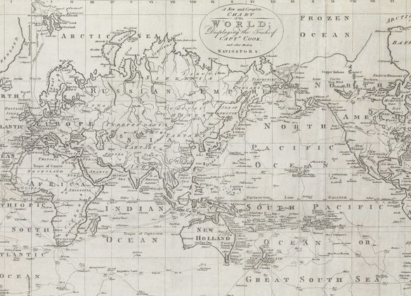
The first documented outsiders to visit Australia were the Dutch who arrived in the 17th century
As in America, contact with new peoples led to widespread epidemics (f.ex. smallpox), with devastating effects on the local populations
In 1767 the Royal Society planned to observe the transit of the planet Venus across the face of the sun in June 1769
One of the voyages was commanded by James Cook, a lieutenant in the Royal Navy
A skilled mapper and explorer, Cook was given instructions to take a look at the mainly uncharted area of the Pacific Ocean

Slide 5
At first, the inhospitable nature of the continent’s environment discouraged settlers
Australia served as a penal colony (after America was no longer an option)
The First Fleet (carrying 568 male and 191 female convicts - and 13 children) reached Botany Bay in January 1788
The first few years were trying: many the convicts weren’t used to farm work, and the area around Sydney was inhospitable to both domestic animals and crops
A lack of tools: no one had thought to bring a single plough

Slide 6
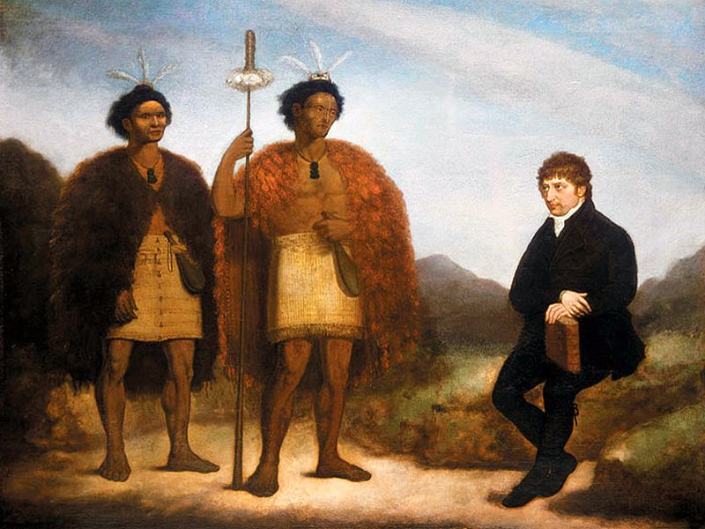
The Maori of New Zealand managed to establish their authority from the first (mainly by a show of violence)
They were more eager to adopt new technology (f.ex. firearms) than their Australian counterparts
The chiefs negotiated with the British more or less on equal terms, and f.ex. visited Australia and England
Yet, British sovereignty over New Zealand was declared in 1840

Slide 8
The first of the treaty’s three articles extended the Crown’s authority over the territory of New Zealand, though there is a question mark over whether chiefs ceded sovereignty, because of the differences between the English and Maori texts. Under article 1 , in the English version, the chiefs ceded the Queen ‘all the rights and powers of sovereignty’ over their land. In the Maori version, however, the chiefs gave the Queen ‘te kawanatanga katoa’, that is, ‘government of all their lands’. -- The implication is that the Maori text was translated in such a way as to enhance the advantages of signing.
-> a systematic colonisation effort led by the New Zealand Company
Philippa Mein Smith: A Concise History of New Zealand

Slide 9
The American Revolution
The cause of American independence was advanced not only by pamphlets but also by newspapers. There were already 42 different newspapers in the American colonies in 1775 and some of them -- advanced the revolutionary cause by describing atrocities committed by the British army. Briggs and Burke
From the 17th century on, British war expenditure rose sharply
-> new taxes and increased mercantile regulations
In British America, these new measures caused an uproar, particularly as the new payments weren’t met with increased representation in the Parliament

Slide 10
The Destruction of Tea at Boston Harbor
Nathaniel Currier, 1846

Slide 11
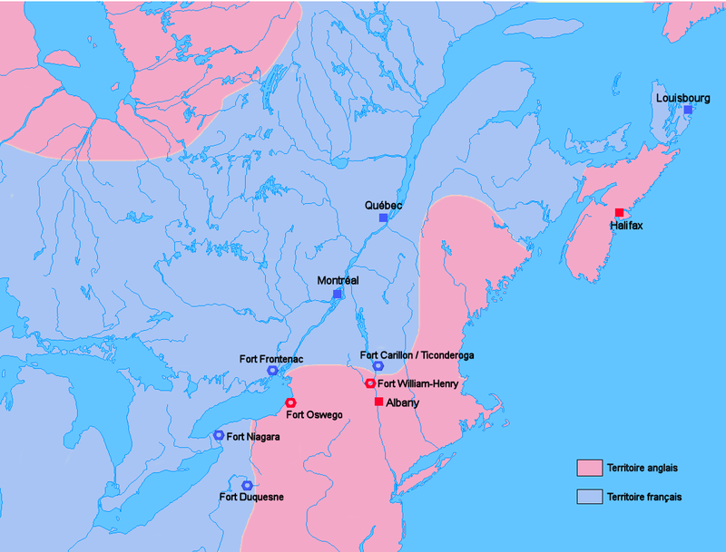
Canada, eh?
Newfoundland had been claimed by the British in 1583
Between 1661 and 1763, France laid claim to large swathes of North America
During the Seven Years’ War (1756-63), the French allied with the First Nations’ people
Yet, the British were victorious, and won the possession of all French holdings in North America

Slide 12
After the American war of Independence, some 20,000 Loyalists moved to Canada - yet, the population was heterogenous
In Quebec, Britain faced the novel problem of creating political forms to accommodate the needs of some 80,000 European but non-British settlers. [I]t was naturally feared that the erection of representative institutions might provide the forum for continuing frustration of British rule or even for revolt — revolt that might infect the increasingly tense relations between Britain and the nearby Thirteen Colonies.
The result was the Quebec Act of 1774 , which placed power firmly in the hands of the Crown or, in practice, the royally appointed governor. An elected assembly was rejected in favour of a council drawn from both the French and British settlers and nominated by the Crown in consultation with the governor. Iain McCAlman
In the aftermath of European and American revolutions, the British were extremely reluctant to grant their colonies any significant powers

Slide 13
The Short-Lived Unity
Almost as soon as the United States had got its independence, its initial unity began to fracture
Most early Congressmen were strongly opposed to party politics, believing them to be the source of discord and dissention
One of the dividing issues was that of slavery
“-- seeds of two contending factions appear to be plentifully sown. The names Federalist and Antifederalist are no longer expressive of the sentiments which they were so lately supposed to contain --. The people are evidently dividing into these two parties.” - John Quincy Adams, 1790

Slide 14
What are we fighting for?
It was not just cold weather that triggered homesickness. Another part of the problem was that soldiers’ sense of home was still quite geographically bounded. Home was not yet the new nation; it was the local neighborhood or, at best, the colony. The historian Charles Royster notes, “In June 1775, eighteen men from Captain Winthrop Rowe’s New Hampshire company deserted outside Boston, saying ‘that they didn’t intend when they enlisted to join the Army, but to be station’d at Hampton’ on the New Hampshire coast.”
Susan Matt: Homesickness: An American History

Slide 15
Discussion: study questions
In your groups (min. 4 people) discuss the questions (and the answers you’ve prepared at home)
Write down your answers (in a clear & concise form)
- make sure to include your names
If you have any questions to do with the themes/time periods/ etc., you’re more than welcome to ask!

Slide 16
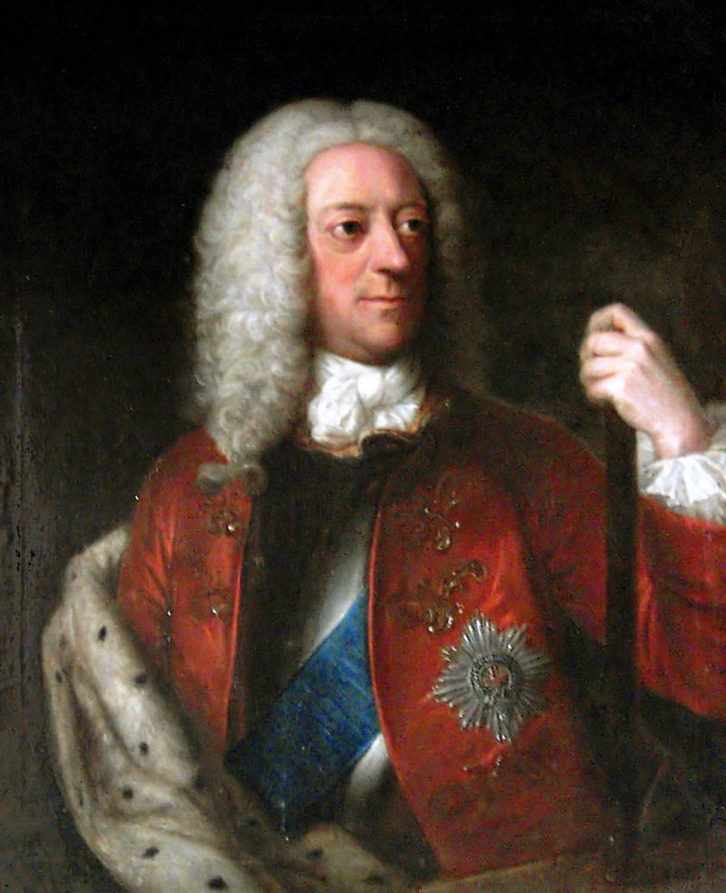
The Hanoverians: George I and II

Slide 17
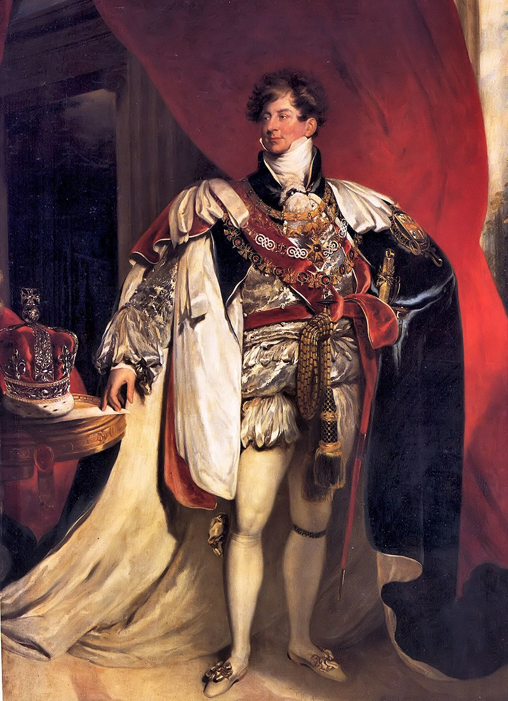
George III and George IV (the Prince Regent)

Slide 18
The Industrial Revolution begins
The socio-politico-economic factors behind the Revolution are manifold and go back at least a century
-> not so much “revolution as evolution” (Jeremy Black)
The Enclosure Act
Urbanisation
Population growth: growing domestic markets
The union with Scotland (1707), as well as aggressive foreign policy also widened the markets (esp. in North America and the Caribbean)
Political stability after the Restoration

Slide 19
The manufacture of weapons: unlike on the Continent, where weapons were made in small workshops, in Britain arms were made in ‘yards’ which could turn out complete weapon systems
-> mass-produced, standardised, interchangeable parts
-> the idea was soon taken up and refined in the United States
The percentage of the male labour force employed in industry rose from c. 19% in 1700 to about 30% in 1800
-> a significant number, taking into account the rapid population growth
-> at the same time, the number of men working in agriculture fell steeply (60% to 40%) so that by 1750 there were more people employed in manufacturing than in agriculture

Slide 20
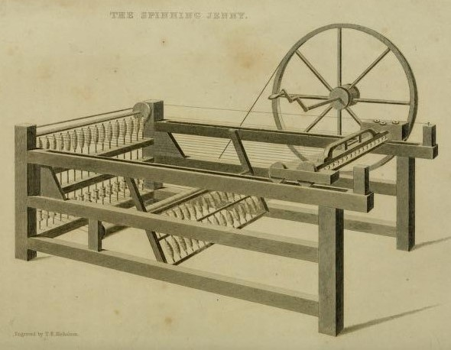
The Textile Industry
Here, too, changes in the 18th century were slow, but they gradually laid the foundation for greater innovations in the future
John Kay’s flying shuttle (1733) and James Hargreaves’s spinning jenny (1764) increased productivity in textile manufacturing
-> workers often saw the new inventions as a threat, and sought to destroy them
-> the Blackburn riots 1768-9
-> the Lancashire riots in 1776, which destroyed over 100 spinning machines

Slide 21
First water-powered cotton mills in 1771; followed by a coal-powered one in 1790
In 1772, a Nottingham mill employed over 300 people, some of whom were children from the parish workhouses
A readily transportable and controllable fuel, certainly in comparison with wood --, coal was useful even in the preparatory stages of traditional manufacturing processes, such as soap-boiling, let alone in factories. -- Coal could be mined throughout the year, whereas water mills were affected by ice, flooding and summertime drops in water flow. Jeremy Black

Slide 22
The Age of Steam
Coal was also used to power steam engines
The first prototype was developed by Thomas Savery in 1698, but it was Thomas Watt’s much improved model in 1769 which changed the game for good
The production of iron and coal went hand in hand, each boosting the other
How a steam engine works:
https://youtu.be/fsXpaPSVasQ?t=34

Slide 23
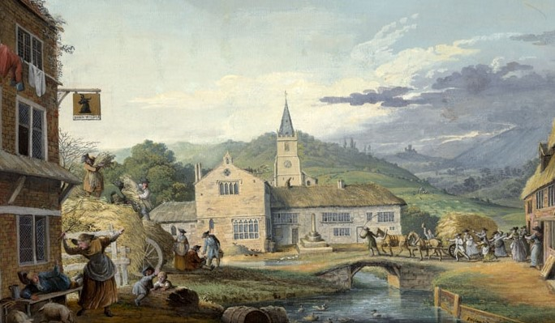
Yet, the pace of industrialisation was still slow
Production was very much based on trial and error; products were often of poor quality
There was very little specialisation or skilled labour
The artisanal tradition didn’t encourage innovations, and people were slow to change their ways
Flax spinning and linen weaving were still cottage-based
Steam didn’t become the major source of energy in manufacturing until the 1870s

Slide 24
Slavery as Fuel for Industrialisation
African communities on the Gold/Slave Coast became increasingly dependent on British goods
The English city of Bristol in particular flourished
-> metal goods were exchanged for slaves
The same ships that carried brass pots to Africa could be used to transport slaves to America - and sugar back to England
-> the birth of the triangular trade
The money made from the slave trade could be used to fund new industrial inventions
http://humanities.uwe.ac.uk/bhr/Main/intro/hotspots/thorn.htm

Slide 25
Modern capitalism needs to maintain growth, and after the industrial revolution began in eighteenth-century Britain, the search for resources and markets increased. Overseas operations were financed by metropolitan capital, accelerating modern colonialism’s shift away from older notions of imperial tribute-gathering. Modern empires regarded their subjects very differently as a result of this shift. Colonised peoples had once been valuable in their own right, but modern imperial powers sometimes replaced them by others who provided a better return on investment, as in the replacement of indigenous labour by African slaves in the Americas, or the large-scale importation of Asian workers to colonies in Africa or the Pacific.
Jane Samson: Race and Empire

Slide 26
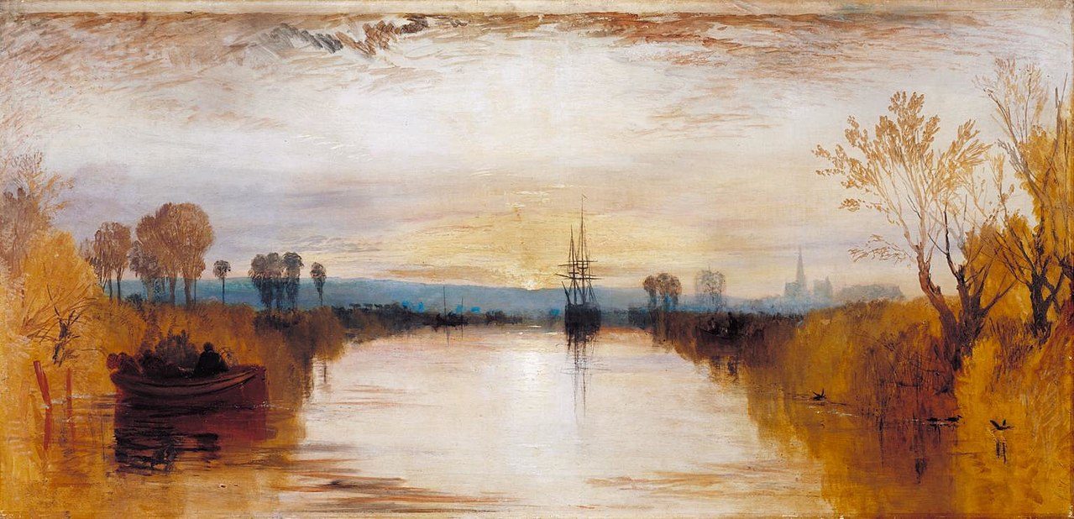
Now we’re getting somewhere!
Although the greatest breakthroughs in transportation would take place during the following century, there were many things underway in 18th century Britain, too.
Road mileage increased 5-fold between 1750 and 1790
The first iron bridges appeared
The first ‘canal craze’ was already transforming the economic life of the English Midlands and the North

Slide 27
The transportation of coal called for a more sophisticated system:
-> wagonways with cast-iron wheels (from the 1780s on)
-> the wagonways connected local coalmines to waterways and to ironworks in the North of England
For rapid industrial growth, the essentials were capital, transport, markets and coal. - Jeremy Black
Yet, travelling long distances for pleasure was still rare
‘The road from Greenwich to London was actually busier than the most popular streets in Berlin,’ judged the Prussian Pastor Moritz, ‘so many people were to be encountered riding, driving or walking. Already we saw houses on all sides, and all along the road at suitable distances lamp-posts were provided.’ Iain McCalman

Slide 28
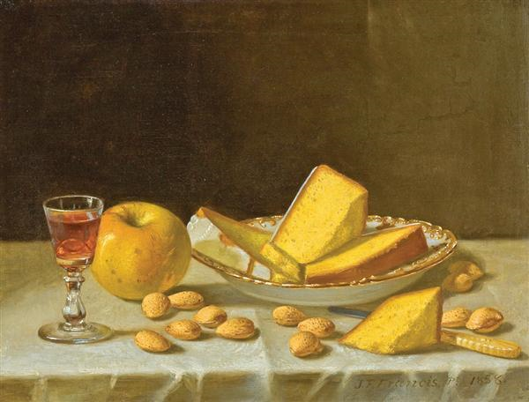
The pace of life was increasing - which didn’t go unnoticed by contemporaries:
‘I happened to go into a pastrycook’s shop one morning,’ observed Robert Southey, ‘and inquired of the mistress why she kept her window open during this severe weather—which I observed most of the trade did. She told me, that were she to close it, her receipts would be lessened forty or fifty shillings a day so many were the persons who took up buns or biscuits as they passed by and threw their pence in, not allowing themselves time to enter. Was there ever so indefatigable a people!’

Slide 29
The Social Order
The dominant ethos was patriarchal, hierarchical, conservative, religious and male-dominated, although each involved both tensions and a variety of means of expression. Jeremy Black
Domestic service was a common form of work for unmarried men and women
-> service was rarely a career; it was poorly paid and notoriously unregulated, leaving servants at the mercy of their masters
Agricultural service was even more precarious, due to the cyclical nature of the work

Slide 30
Mariage à la mode
William Hogarth
1743

Slide 31
The middle classes buy stuff
The rapid industrial growth fed into the consuming habits of the middle classes
People could buy goods instead of making them
The term “consumer revolution” encompasses two ideas. One is that the expansion of goods, in quantity and in variety, was truly revolutionary. The other is that it was consumers who drove this revolution. Their interests, their tastes, their desire for goods, and ultimately their purchasing power created and gave cultural meaning to this economic phenomenon. This transformation in the habits and expectations of consumption in British America was fueled by England’s ability to produce and provide through trade more goods, and a wider variety of goods over the eighteenth century. Halttunen et al.

Slide 32
New kinds of material possessions, such as pottery and furniture
-> Josiah Wedgwood, Thomas Chippendale
The intensified trade relations between Britain and the colonies meant that the people of the colonies, too, could enjoy the new goods
But discerning customers were expected to understand more than the distinctions among “German serges,” “Devonshire kersey,” “India satins,” and “Genoa velvets.” They would or should know that, at least in 1765, broadcloth could be had in many colors, “of the newest fashion, and . . . suitable for the summer season.” They should care that a retailer had his goods “upon the best terms and from the best house in London,” and that anyone was welcome to “see the sterling cost” to appreciate the fair price of these fine offerings. Pennsylvania Gazette , 1765.

Slide 33
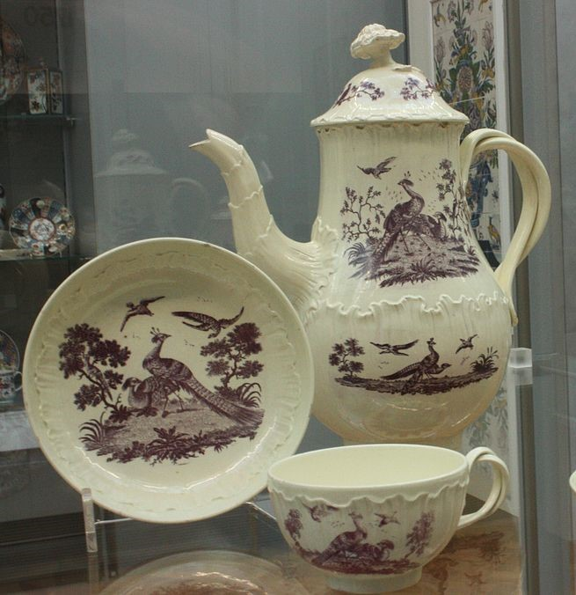
Works by Wedgwood
Transfer printed creamware 1775; a medallion opposing slavery 1786

Slide 34
The Consumer Revolution Continues
[Ordinary people had] possessions like curtains and carpets; upholstered chairs; tablecloths; glass and china-ware; tea services; fancy pottery; looking-glasses; clocks; cases of books other than just the Bible, supplied by circulating libraries --; prints or ornaments to put on the wall or the mantelshelf; and all manner of bric-à-brac and decorations. Shop-bought toys, games, and jigsaw puzzles for children had become common. Not least, diet was more varied, with a greater range of fruit and vegetables. People owned more changes of clothes, particularly with the growing availability of cheaper calicoes and cottons. Efficient oil-lamps dispelled the age-old stygian gloom; gas lighting arrived with the new century, soon to be followed by railway travel and the electric telegraph. Iain McCalman

Slide 35
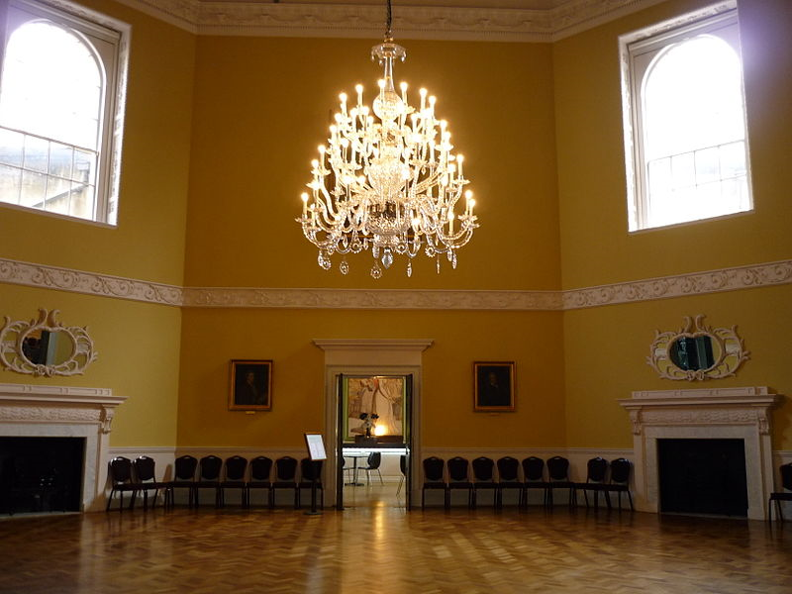
English examples of the commercialisation of leisure at this period included horse-racing at Newmarket, concerts in London (from the 1670s onwards) and some provincial cities, operas at the Royal Academy of Music (founded in 1718), lectures on science in the coffee-houses, and balls and masquerades in newly constructed public assembly rooms in London, Bath and elsewhere. -- [T]hese events were open to anyone who could afford the price of a ticket. Briggs and Burke: A Social History of the Media

Slide 36
The Gin Craze
At the start of the eighteenth century gin stood for modernity, free trade and economic security. By 1750 gin stood for urban decay, social disin- tegration and economic collapse. James Nicholls
Gin wasn’t the first distilled drink available in Britain, but it was the first to gain widespread popularity
After 1688, William III encouraged the use of his native Dutch ‘geneva’ (instead of French brandy)
Being made from native corn, gin boosted the British economy as well as agriculture
Anyone who wished could set up shop as a producer or retailer of gin - without a licence

Slide 37
18th century ‘gin’ is a shorthand for any corn-based distilled (and often flavoured and sweetened) spirits
By the 1720s, an average Londoner consumed an estimated pint of gin a week
-> there were said to be over 8500 ‘dram shops’ in London
Having been barred from clubs and alehouses, women could also partake of the new drink as liberally as men
Along with the gin craze, a moral panic began to spread
-> worry about the health and morals of the working classes
The 1736 Gin Act sought to limit the sale of gin by imposing a yearly £50 licence on anyone wanting to sell it
Roderick Phillips Alcohol: A History

Slide 38
Gin Lane
William Hogarth 1751

Slide 39
Beer Street
William Hogarth
1751/ 1759

Slide 40
Finally, the Enlightenment!
“A tendency towards critical enquiry and the application of reason” - Jeremy Black
A central part was played by French thinkers Voltaire, Rousseau, Diderot and D’Alembert
Thanks to the rise of translation and the rising popularity of international travel, it was easier to spread these new ideas in the English-speaking word (and vice versa)
John Locke and Isaac Newton in England; Adam Smith in Scotland
Thomas Paine vs. Edmund Burke
https://youtu.be/OPT7WsRZneU

Slide 41
The 18th century was a time of what has been called an ‘explosion’ of printed matter in Britain [--]. In England, there was a rise of small cheap books or ‘pocket-books’ in the 1770s [--]. The marketing of these books became increasingly sophisticated. The publisher John Newbery, for instance, offered a ball for boys and a pincushion for girls at twopence extra if they bought one of his children’s books [--].
The annual production of works of fiction in Britain -- rose at least threefold between 1740 and 1770 and more than doubled again between 1770 and 1800.
-> the rise of the novel

Slide 42
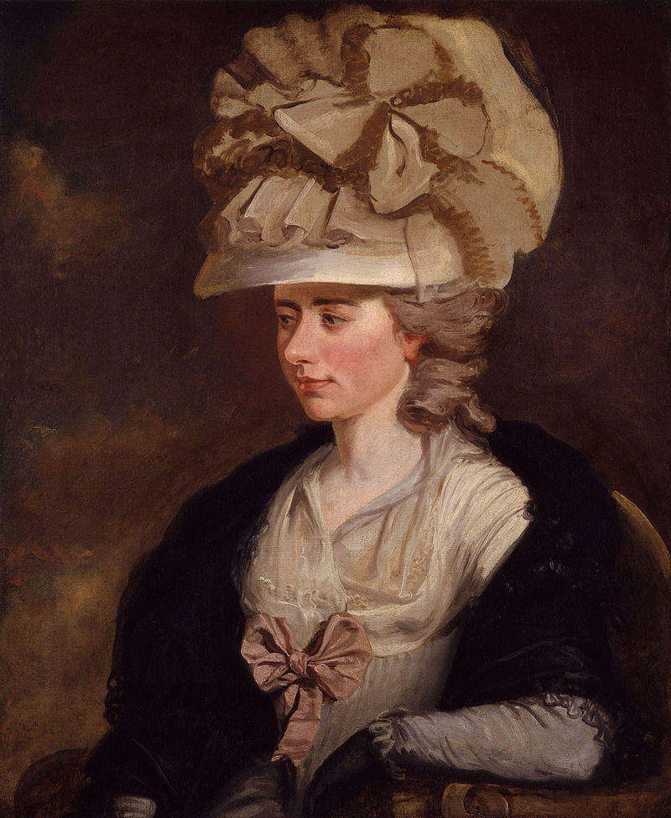
New Reading Materials
The introduction of the library system made new kinds of reading materials available to a wider public
-> the first circulating library in 1725
Samuel Richardson, Laurence Sterne
Fanny Burney: Evelina
Jonathan Swift: Gulliver’s Travels; A Modest Proposal
Samuel Johnson: A Dictionary of the English Language (1755)
Edward Gibbon: Decline and Fall of the Roman Empire (1776-88)
James McPherson’s Ossian cycle

Slide 43
[T]he English periodical The Spectator, which began publication in 1711 -- prided itself on its independence. The point of the journal’s title was to emphasise its detachment from party politics [--]. Its coverage ranged from deep moral and aesthetic questions to the latest fashion in gloves.
[I]ts editors… encouraged their readers to participate in the journal, placing an advertisement in the first issue advising ‘those who have a mind to correspond with me,’ to direct their letters to the printer. Many people did so, and some letters were published.
Briggs and Burke: A Social History of The Media

Slide 44
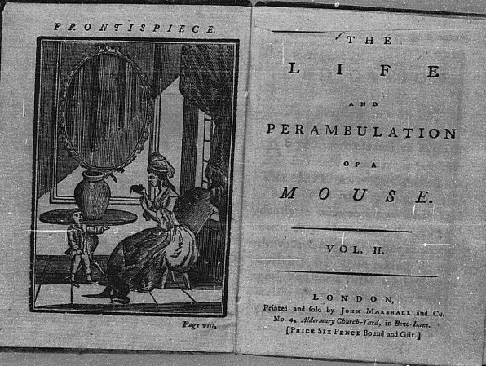
Dorothy Kilner
The Life and Perambulation of a Mouse (1784)
http://www.gutenberg.org/files/1904/1904-h/1904-h.htm

Slide 45
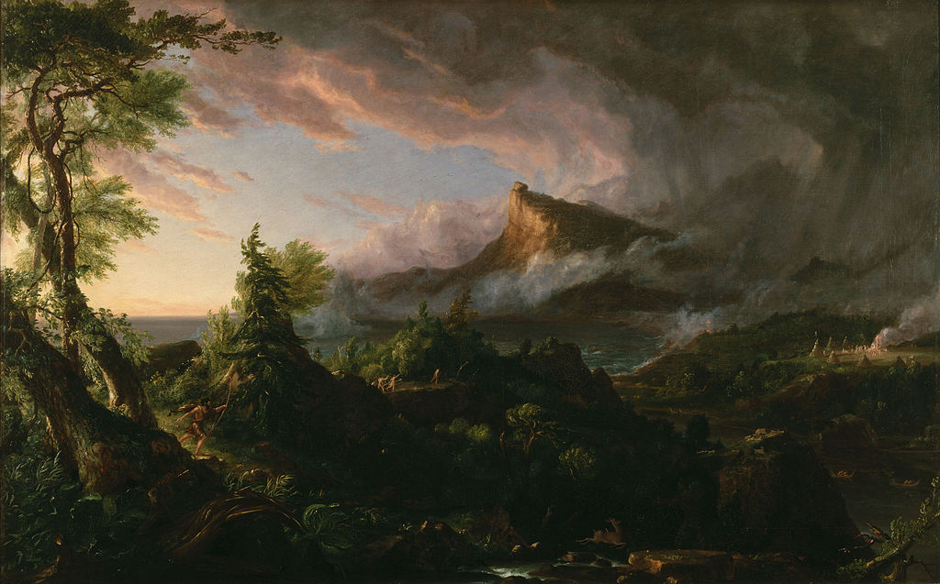
Romanticism
Began in Germany as a counterstrike against French classicism
Against the formal, mimetic style of French classicism, Schlegel and his comrades extolled the expressive, imaginative role of the artist; against the mechanistic Enlightenment materialism of the French philosophes, the German Romantics revered religion and feeling; against the universalist abstractions of French rationalism, they valued the organic, the particular, and the historical.
Iain McCalman: An Oxford Companion to the Romantic Age: British Culture, 1776-1832

Slide 46
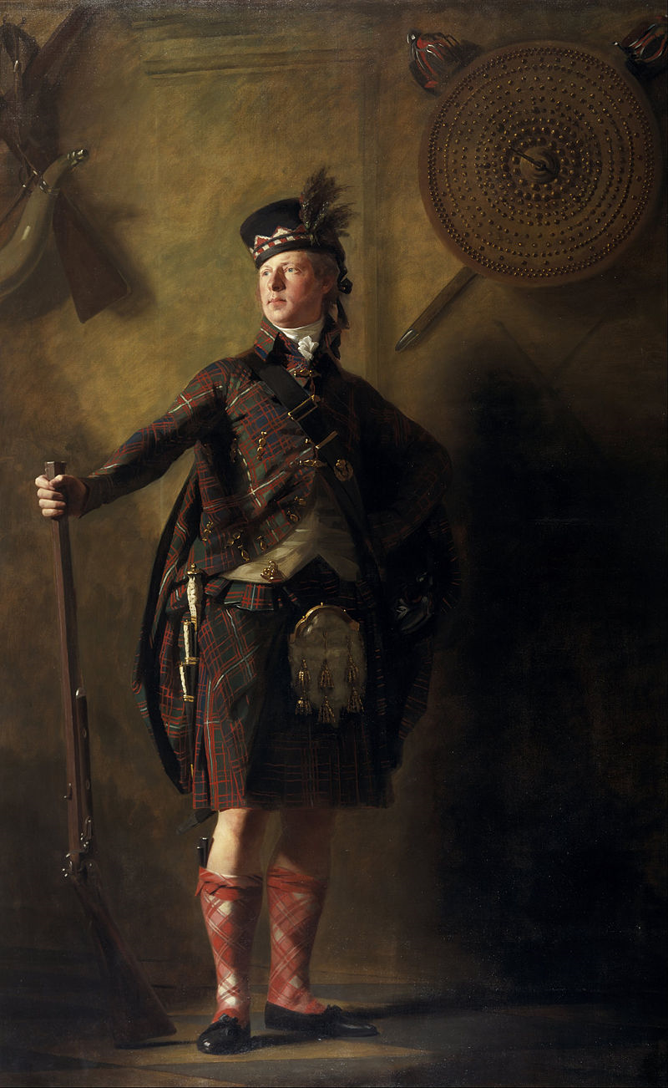
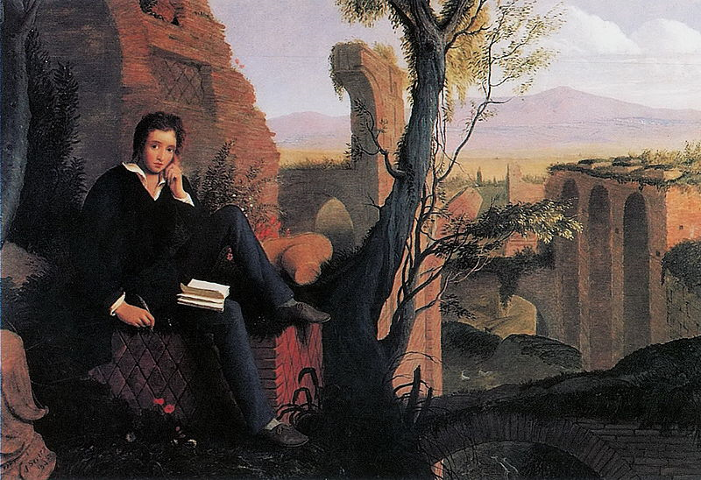
Yet, British Romantics had their own way of interpreting the movement
William Wordsworth & S.T. Coleridge: The Lyrical Ballads
William Blake: Songs of Innocence and Experience
Lord Byron & Percy Shelley
Walter Scott & Robert Burns

Slide 47
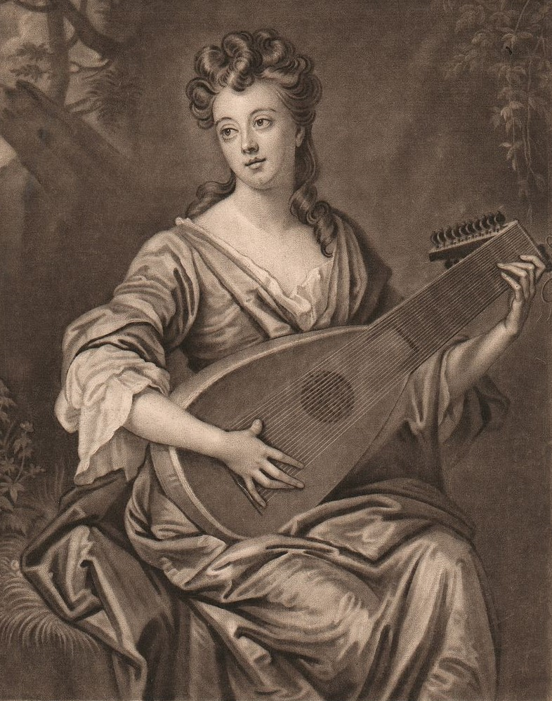
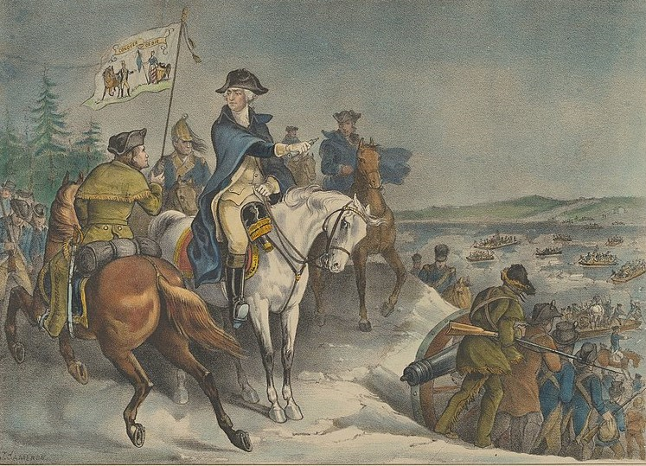
Fine Arts
By the 18th century artistic identities were diversely mediated --: an artist might be patronised, employed, commissioned, exhibited, engraved, acquired by museums, promoted by critics and dealers and celebrated as a life in print. - Gordon Fyfe
Mezzotinting and lithograph images made art more accessible

Slide 48
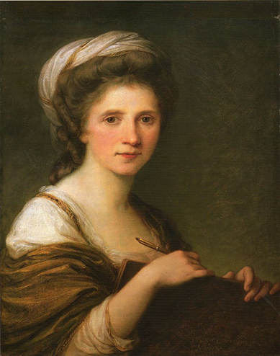
The Royal Academy was founded in 1768
-> 40 founding members, out of which 2 were women (Mary Moser and Angelika Kauffman) - after which no female members were elected until 1936
The landed elite had a greater role in patronage than the monarchy: taste came from outside the court
The era of the portraitist:
- Thomas Gainsborough
- Sir Joshua Reynolds

Slide 49
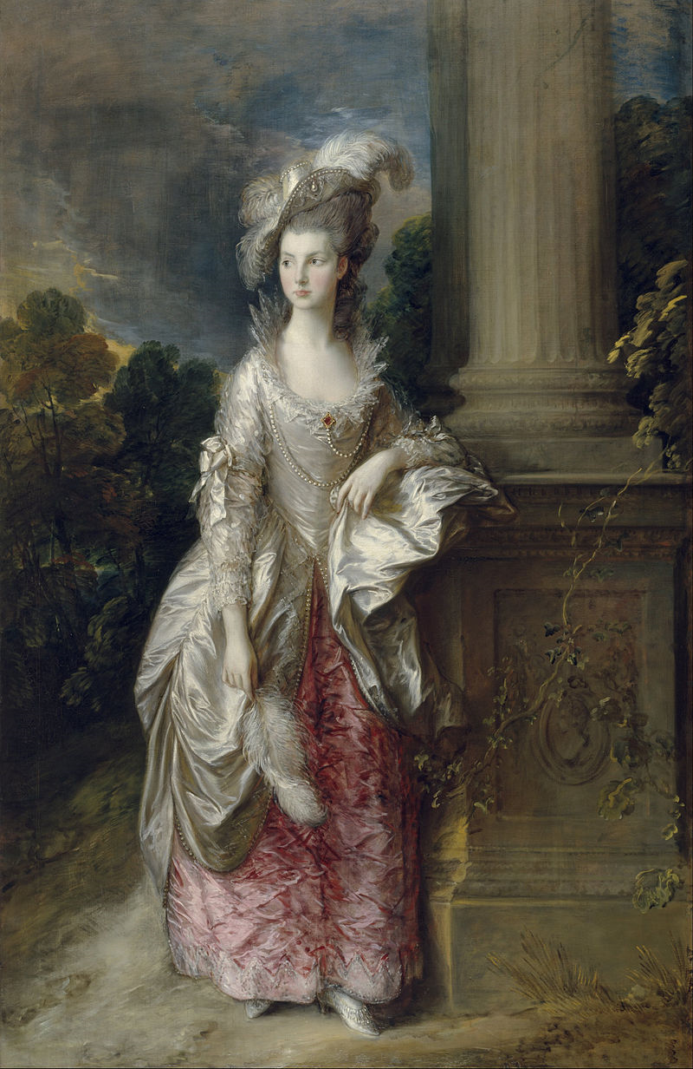
Thomas Gainsborough
Her Grace, Georgiana Cavendish, Duchess of Devonshire, 1787
The Honourable Mrs Graham, 1777

Slide 50
George Clive and his family with an Indian maid, 1765
Sir Joshua Reynolds

Slide 51
Music in America
Music making prior to the American Revolution was largely an amateur activity. The first known concert in the American colonies took place in Boston in 1729, but the city did have a dedicated concert hall until 1754. It wasn’t until 1730 that the first known advertisement for music lessons appeared in Philadelphia and not until 1757 that the first public concert took place in that city. The first music store in the colonies opened in Philadelphia in 1759.
Despite having arrived as slaves, and having had little or no cultural prestige, African-Americans managed to create musical styles that had both immediate popularity and longevity
http://www.digitalhistory.uh.edu/era.cfm?eraID=2&smtID=6

Slide 52
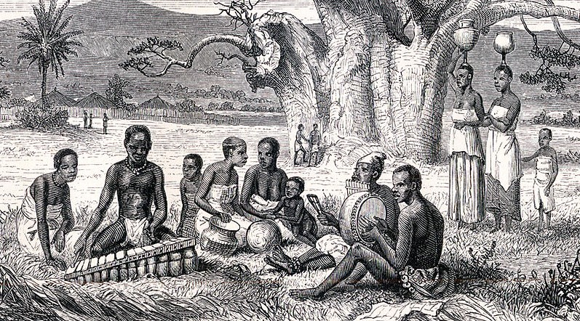
The (forced) multiculturality was at least partly responsible
-> The need to create music that had wide appeal
Africans brought at least the design of some musical instruments with them (the banjo, the marimba, the berimbau)
In (British) North America, musically talented slaves could expect better treatment from their masters
In Charleston, a remarkable number of African (slave and free) violinists are recorded - often employed by dancing masters

Slide 53
The Madness of King George
The medical science was still in its infancy
Most ‘cures’ were ineffective at best, painful and/or lethal at worst
Mental institutions were mainly for keeping troublesome patients in control and out of sight
-> such institutions were also popular ‘tourist attractions’
https://youtu.be/4-hhNHmUd_A?t=3300

Slide 54
KEW LODGE, WED 28th [1789] The excellent Dr. Willis gave me a most reviving account of our beloved King this morning, and with a glee so genuine, that I think that even the opposition must have sympathised in it.
KEW PALACE, MON, FEB 2nd When they were within a few yards of me, the King called out, ‘Why did you run away?’. -- Think, however, of my surprise, to feel him put both his hands round my two shoulders, and then kiss my cheek!
What a conversation followed! When he saw me fearless, he grew more and more alive, and made me walk close by his side --. Everything that came uppermost in his mind he mentioned; he seemed to have just such remains of his flightiness as heated his imagination without deranging his reason, and robbed him of all control over his speech --. What did he not say! He opened his whole heart to me. The Diary of Fanny Burney https://archive.org/details/diaryandletters09burngoog/page/n118/mode/2up

Slide 55
The Woman Who Gave Birth to Rabbits
https://www.historyextra.com/period/georgian/mary-toft-gave-birth-rabbits-hoax-karen-harvey-podcast/

Slide 56
The Worst Jobs in History:
https://youtu.be/V7ktD66YvJ0

Slide 57
Sources
Black, Jeremy. 2008. Eighteenth-Century Britain 1688-1783. Basingstoke: Palgrave Macmillan.
Clarke, Frank G. 2002. History of Australia. Greenwood Publishing Group, Incorporated. ProQuest Ebook Central, https://ebookcentral.proquest.com/lib/jyvaskyla- ebooks/detail.action?docID=3000902.
Conrad, Margaret. 2012. A Concise History of Canada. Cambridge University Press. ProQuest Ebook Central, https://ebookcentral.proquest.com/lib/jyvaskyla-ebooks/detail. action?docID=880647.
Fyfe, Gordon. 2000. Art, Power and Modernity : English Art Institutions, 1750-1950. Leicester University Press.
McCalman, Ian. 2001. An Oxford Companion to the Romantic Age : British Culture, 1776-1832. Oxford: OUP Oxford.
Mein Smith, Philippa. 2011. A Concise History of New Zealand, Cambridge University Press. ProQuest Ebook Central, http://ebookcentral.proquest.com/lib/jyvaskyla-ebooks/ detail.action?docID=1543715.

Slide 58
Murray, Robert. 2013. Making of Australia : A Concise History. Rosenberg Publishing. http://ebookcentral.proquest.com/lib/jyvaskyla-ebooks/detail.action?docID=3440931
Nicholls, James. 2009. The Politics of Alcohol: A History of the Drink Question in England. Manchester University Press.
Phillips, Roderick. 2014. Alcohol: A History. The University of North Carolina Press.
http://www.gutenberg.org/files/1080/1080-h/1080-h.htm
http://britishcirculatinglibraries.weebly.com/overview.html
https://www.scotsman.com/200voices/cultural-icons/sir-walter-scott-man-invented-scotland/
https://www.fff.org/explore-freedom/article/enclosure-acts-industrial-revolution/
Octagon room by Glitzy queen00 at English Wikipedia, CC BY-SA 3.0, https://commons.wikimedia.org/w/index.php?curid=32886652

