Slide 1
Where do we come from?
The origin of Finns and Sami people

Slide 2
Finns
During the last Ice Age people were in southern Europe
One group lived in northern Spain and southern France
Another group lived in Ukraine
When the Ice Age ended these two groups migrated through Europe to Finland
These two groups mixed together and became Finns

Slide 3
Sami people
Sami people remind genetically the Basques the most, who are an indigenous ethnic group from the area of north-central Spain and south-western France.
They presumably arrived in Finland along the Norwegian coast and it’s possible that they have always lived in the north.
It can also be possible that they came from the east from Russia.

Slide 4
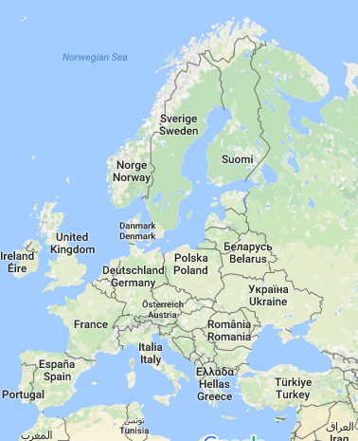
Map: Google Maps (2016)

Slide 5
Sources
http://www.tiede.fi/artikkeli/jutut/artikkelit/suomalaisten_alkupera_hahmottuu_pirullisen_hitaast
http://www.tiede.fi/artikkeli/jutut/artikkelit/suomalaisten_uudet_juuret
http://www.nytimes.com/2008/08/13/science/13visual.html
https://en.wikipedia.org/wiki/Basques

