Slide 1
GHANA
Motto: FREEDOM & JUCTICE

Slide 2
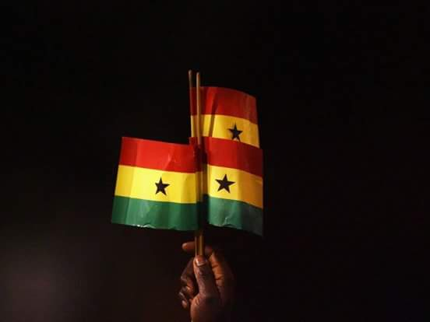
BASIC FACTS
Founded in 6th March, 1956
English as Official Language
Formally Known as Gold Coast
Current Population of about 29.46 million
Colonised by the British and became republic 1st July, 1960

Slide 3
GHANA BEYOND AID
POSITIVES
SETBACKS
Political stable
Largest man – made lake globally (Lake Volta)
2nd Largest producer of Cocoa next after Ivory Coast
Excessively in natural minerals (gold, timber, bauxite etc.)
Value our culture
Basically, all is not okay as a citizen point of view.
Every sector seems to be deficient (from transportation, education, agriculture ect.)

Slide 4
WAYS FORWARD
Innovative thoughts
Value addition to natural resources
Effective systems
Right things to be done
Implemenation of right policies

Slide 5
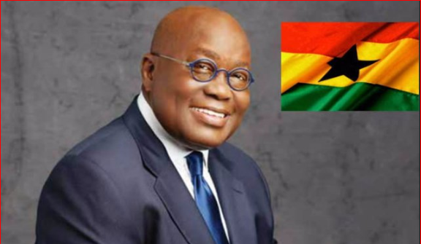
H.E. Nana Addo Dankwah Akuffo Addo
Current President of Ghana

Slide 6
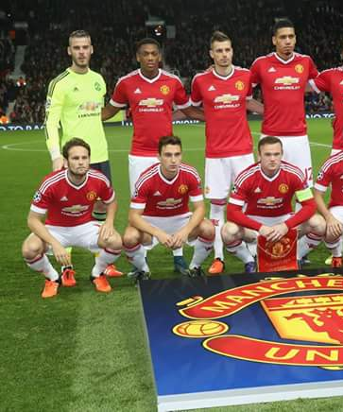
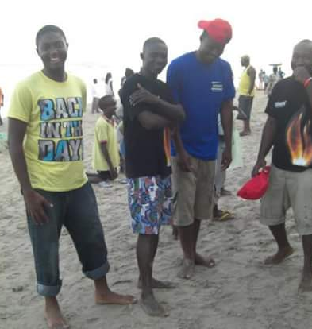
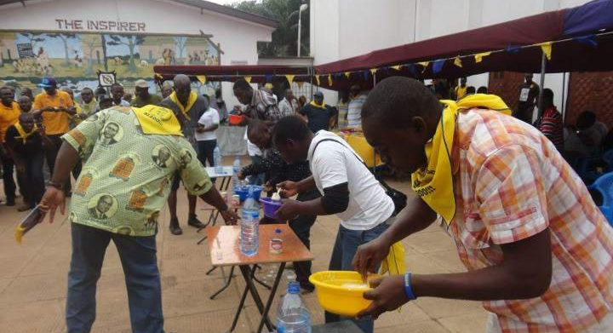
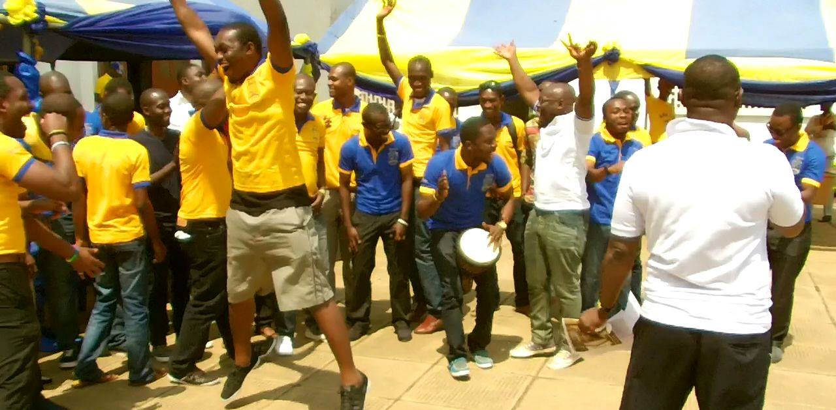
WHO IS ISAAC?
34 years
Nick name (Orgah Walley)
Study IB in Xamk (Kouvola)
Entrepreneur
Critical Thinker
Good Communicator
Fun to be with
Love sports, music, movies
Love good foods & Very Religious
Understand French a bit & little Finnish

Slide 7
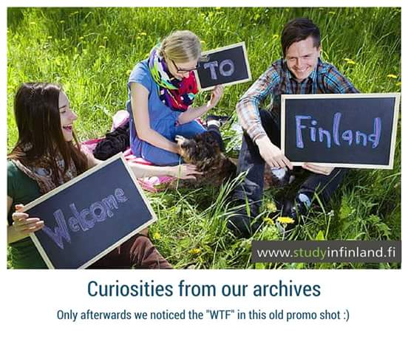
MIKSI SUOMEA?
CURIOSITY

Slide 8
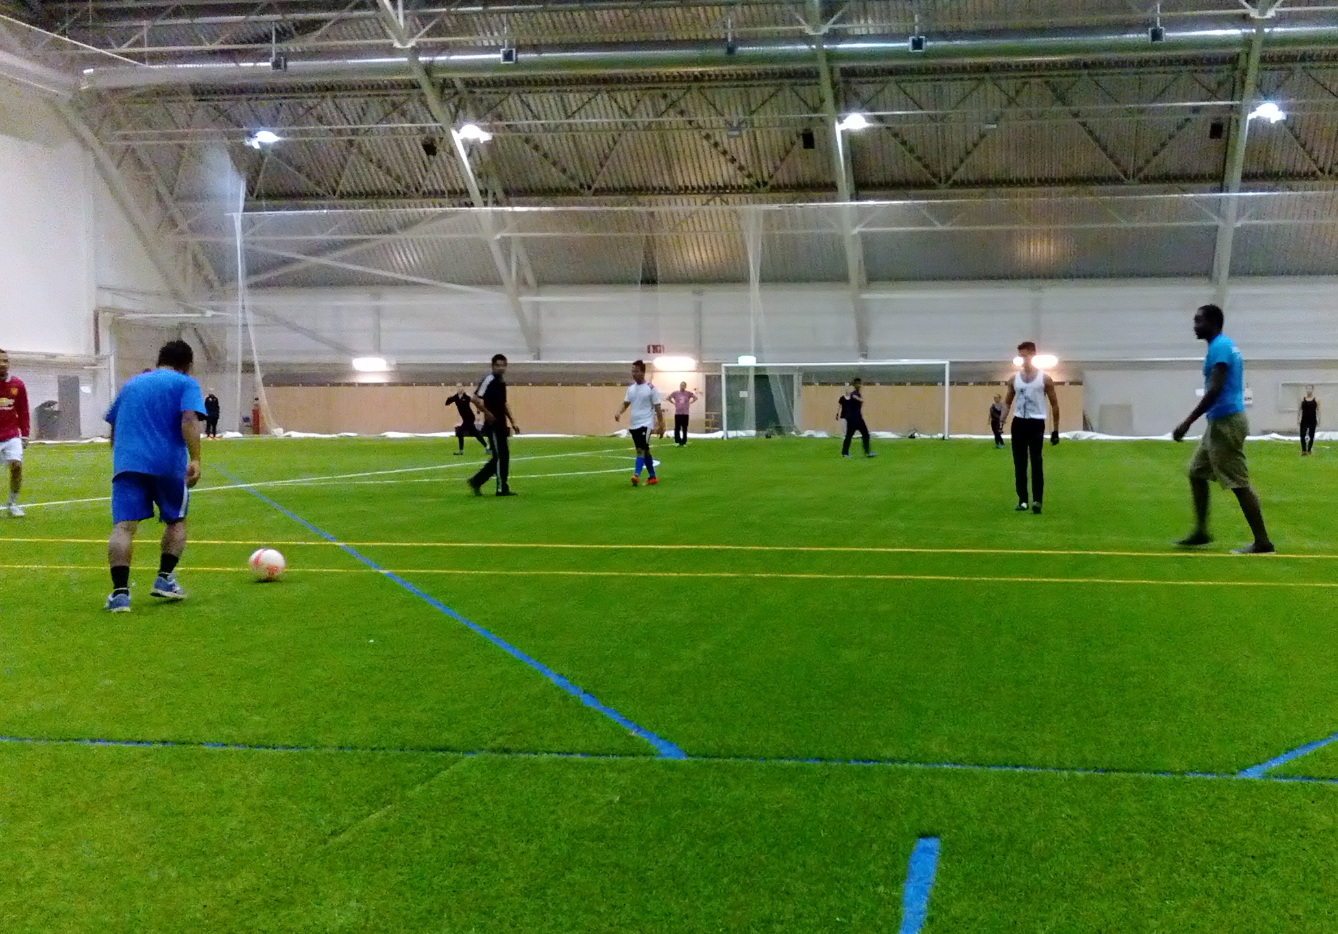
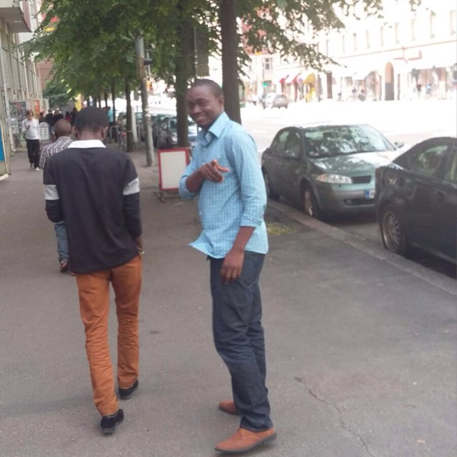
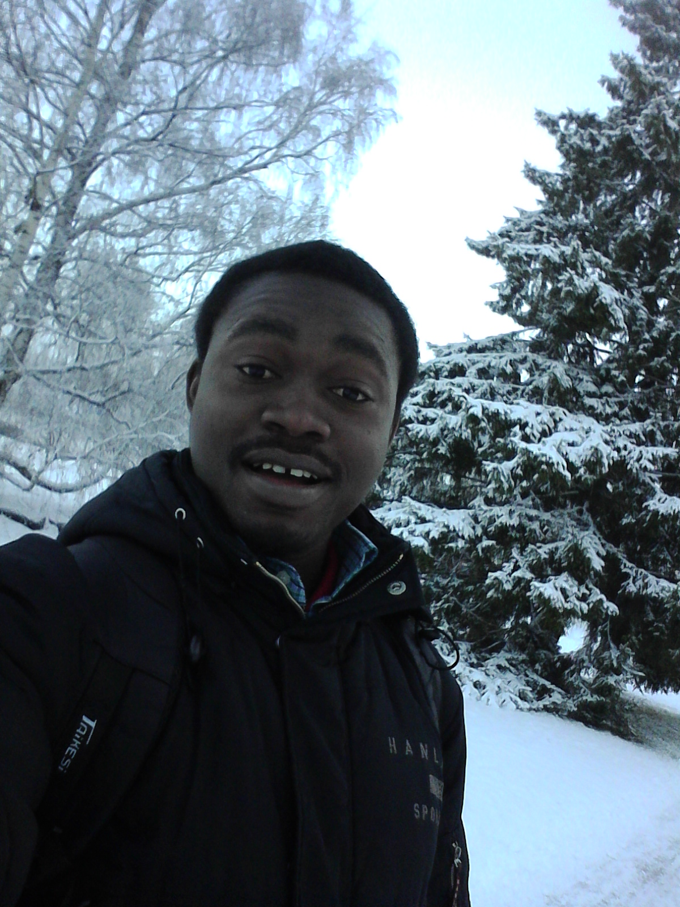
MOMENTS IN FINLAND

Slide 9
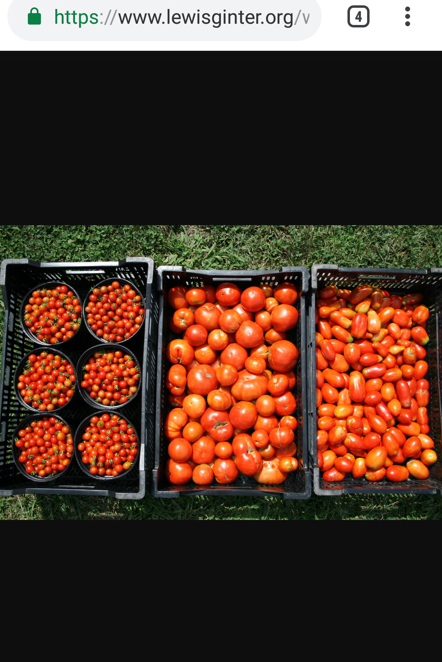
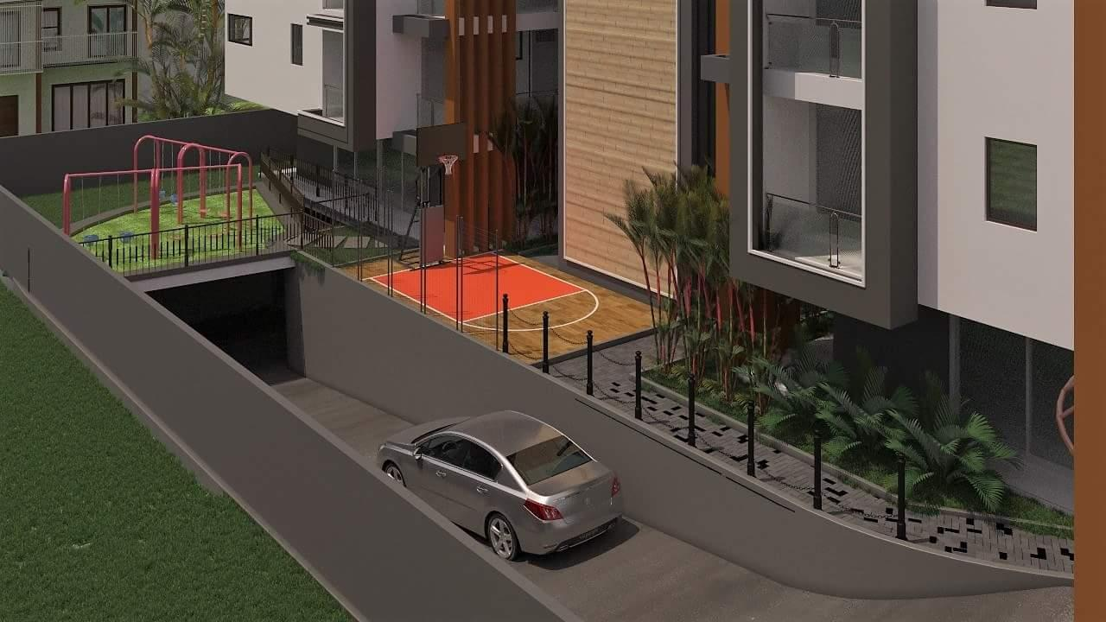
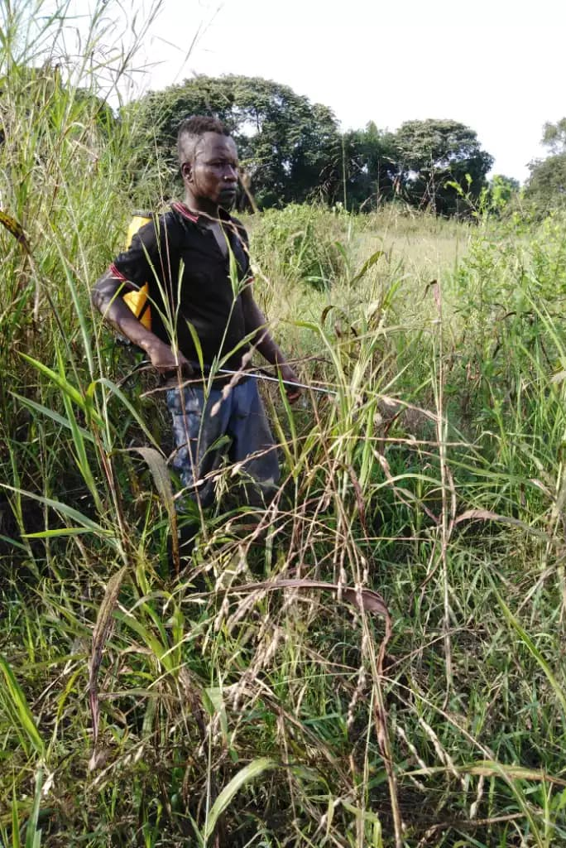
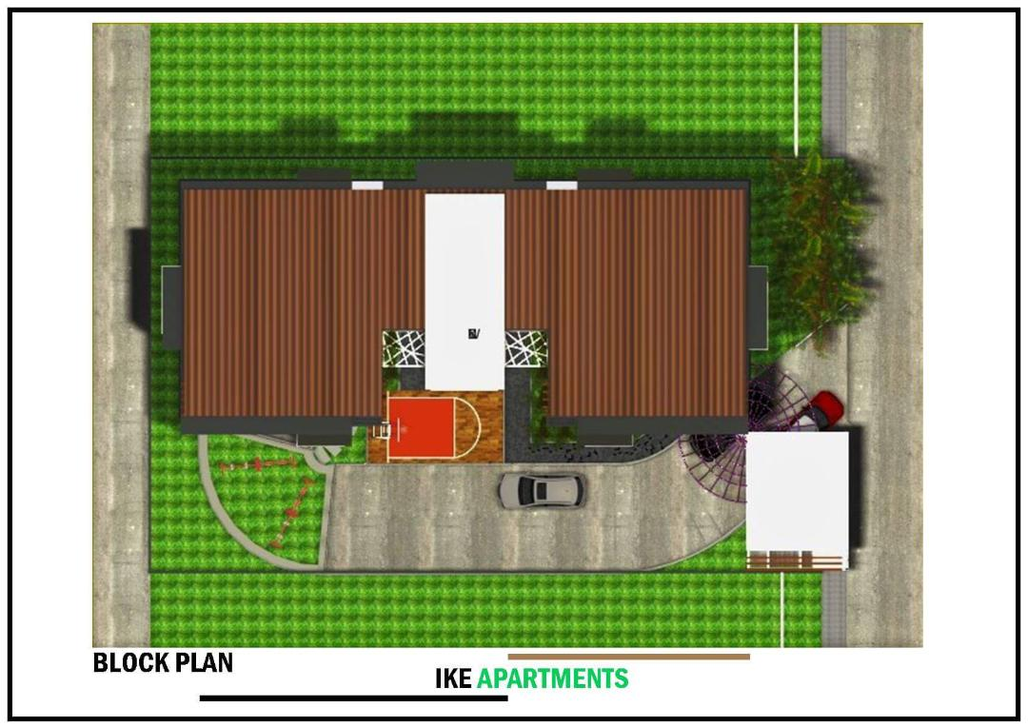
FUTURE GOALS & ASPIRATIONS
3K GROUP NETWORK

Slide 10

FAVORITE QUOTE
OUR PRIMARY PURPOSE IN LIFE IS TO HELP OTHERS
AT LEAST IF YOU CAN NOT HELP THEM
DO NOT HURT THEM

Slide 11
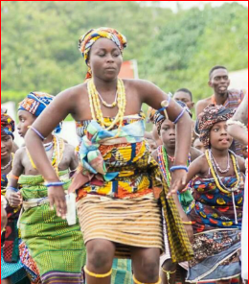
APK3
MEDAASE
MERCI
KIITOS

