Slide 1
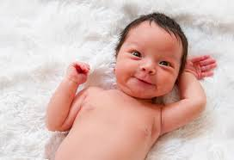
What is your name? Who chose the name? Why?

Slide 2
What is your home village like?

Slide 3
How many languages do you speak? Which level?

Slide 4
How and where do you study the best?

Slide 5
Who is your favourite relative? Why?

Slide 6
What are you interested in?

Slide 7
Do you like travelling?

Slide 8
What is your favourite colour? Why? How does it show?

Slide 9
You and animals?

Slide 10
What kind of food do you like?

Slide 11
Are you hungry now? Why?

Slide 12
Do you like garlic?

Slide 13
What have you done so far today?

Slide 14
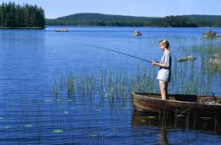
Talk about the Finnish weather!

Slide 15
What makes you happy?

Slide 16
What makes you angry?

Slide 17
What kind of music do you like?

Slide 18
What are your bad habits?

Slide 19
What motivates you?

Slide 20
How do you use the social media?

Slide 21
What have you made for yourself?

Slide 22
What are you afraid of?

Slide 23
What is your favourite place?

Slide 24
Do you have good manners?

Slide 25
What will you remember most about 2017?

Slide 26
How is your future going to be?

