Slide 1
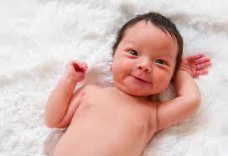
Wie heißt du? -What is your name? - Who chose the name?

Slide 2
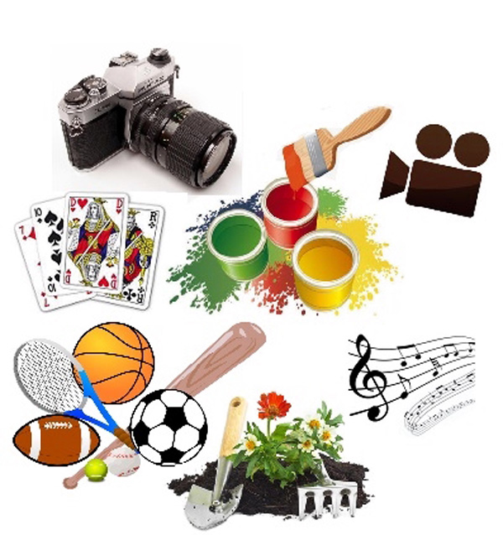
Welche Hobbys hast du? - What are you interested in?

Slide 3

What is your home village like?

Slide 4
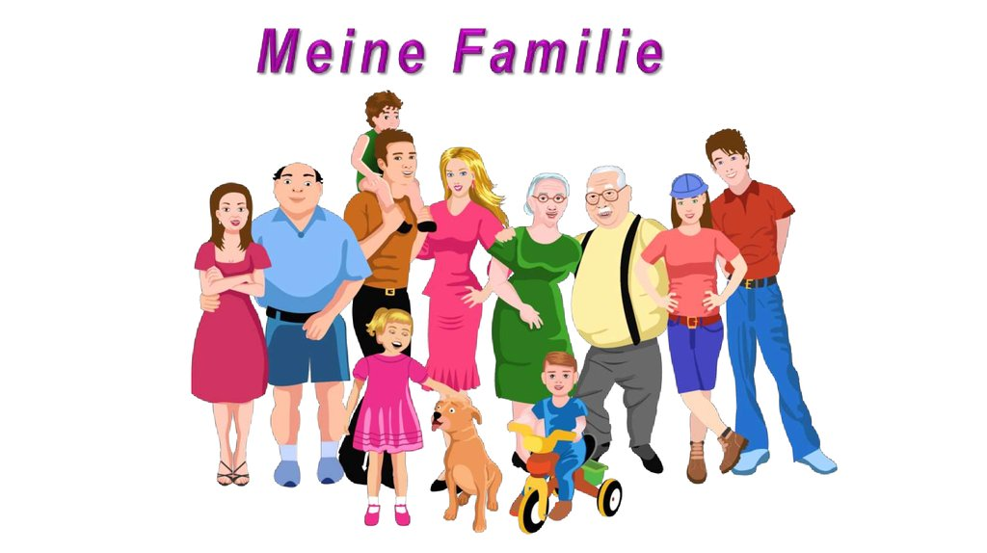
Wie ist deine Familie?

Slide 5
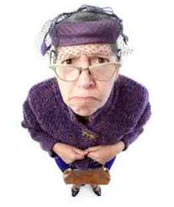
Who is your favourite relative? Why?

Slide 6

Welche Sprachen sprichst du? - How many languages do you speak? - Which level?

Slide 7

Was ist deine Lieblingsfarbe? - What is your favourite colour? - Why? How does it show?

Slide 8
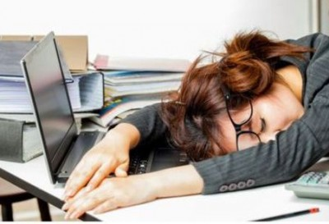
How and where do you study the best?

Slide 9
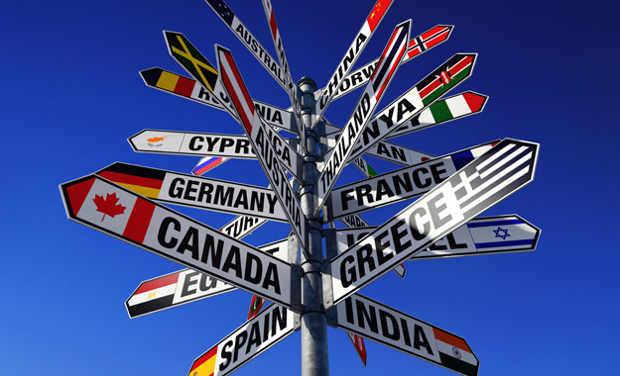
Do you like travelling?

Slide 10
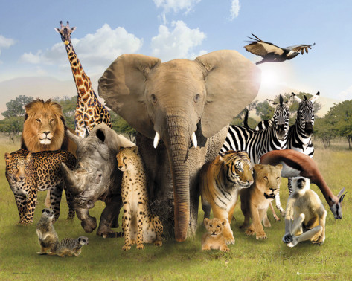
Du und Tiere? - You and animals?

Slide 11
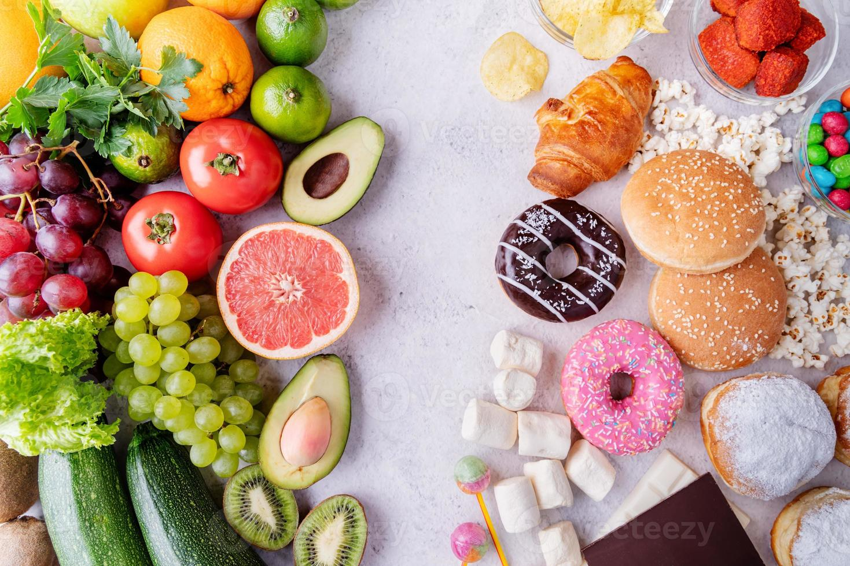
What kind of food do you like? - Was ist dein Lieblingsessen?

Slide 12

Bist du jetzt hungrig? Warum? - Are you hungry now? Why?

Slide 13

What have you done so far today?

Slide 14
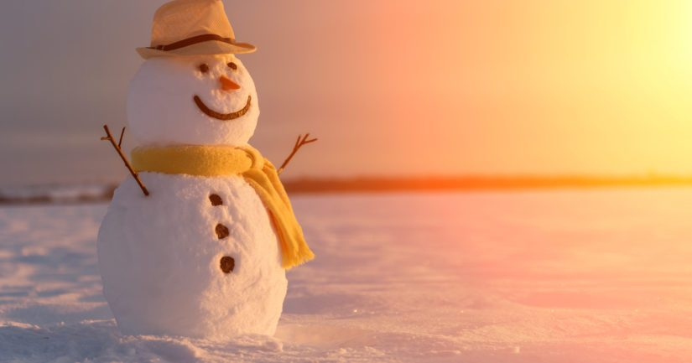
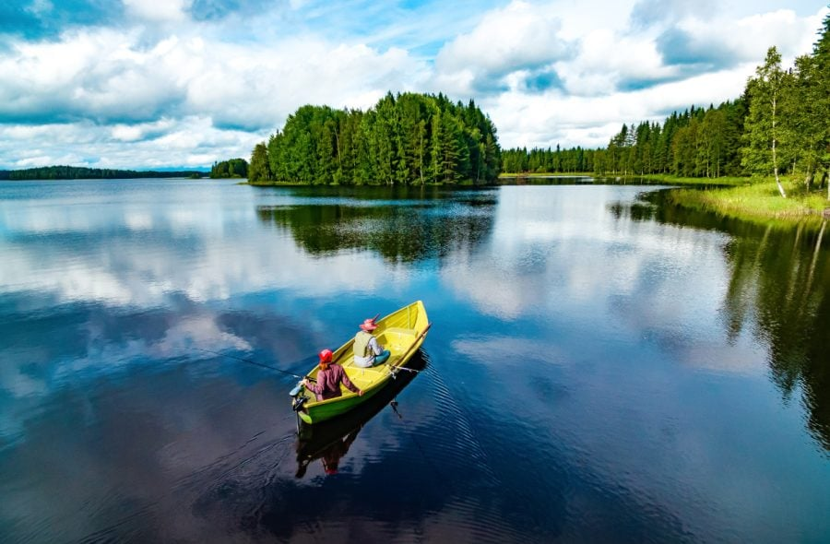
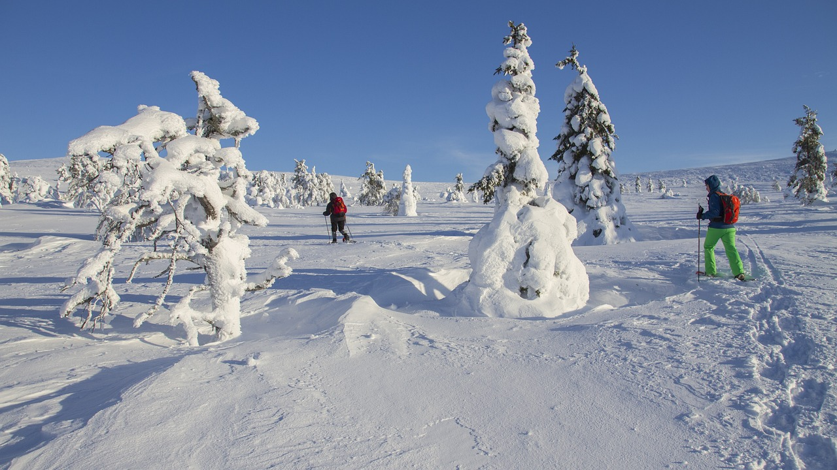
Talk about the Finnish weather!

Slide 15

What makes you happy?

Slide 16
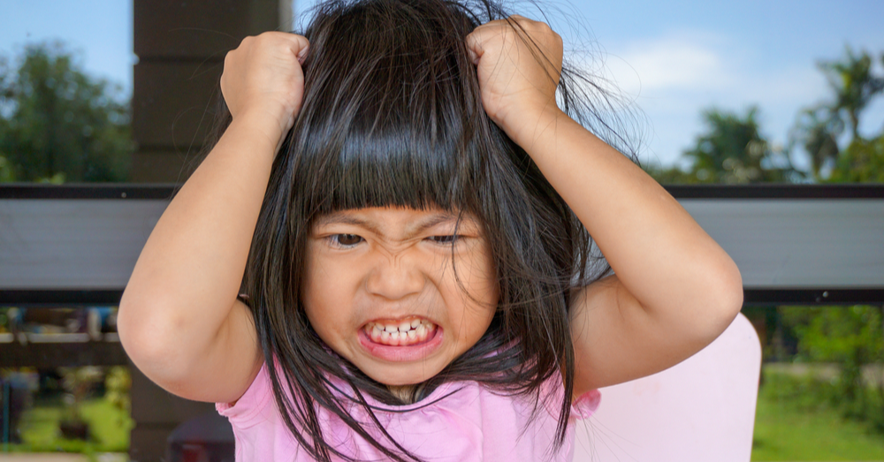
What makes you angry?

Slide 17

What kind of music do you like?

Slide 18
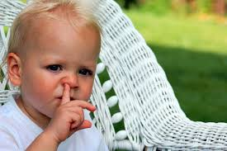
What are your bad habits?

Slide 19
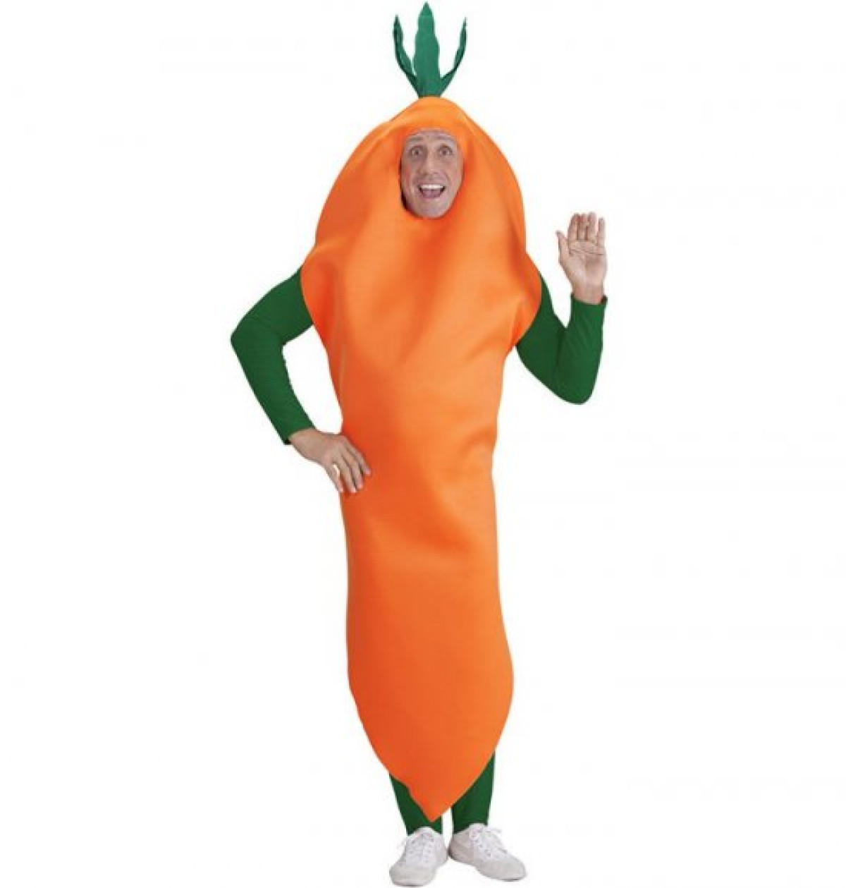
What motivates you?

Slide 20

How do you use the social media?

Slide 21

What have you made for yourself?

Slide 22
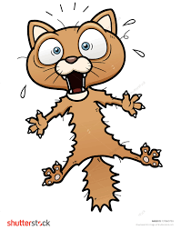
What are you afraid of?

Slide 23
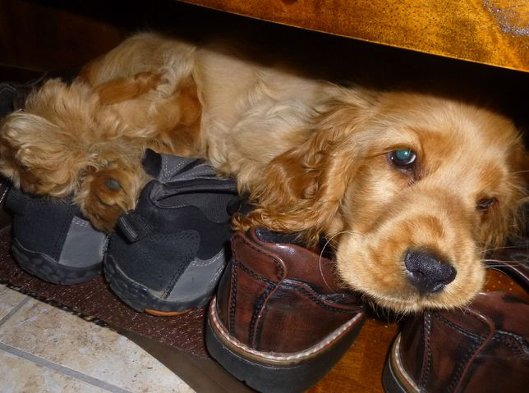
What is your favourite place?

Slide 24

Do you have good manners?

Slide 25

What will you remember most about 2024?

Slide 26

How is your future going to be?

