Slide 1
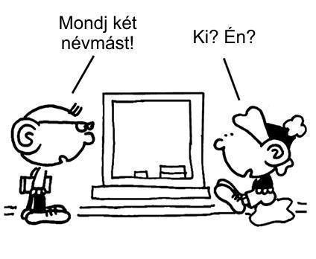
Developing Reading Comprehension in the mother language

Slide 2
Reading comprehension in primary and secondary education
*Developing reading comprehension is one of the main parts of Hungarian primary education from grade 1
Textbooks are written according to this principal. (Reading and comprehension)
*Reading comprehension tasks are important parts of the secondary school entrance exam tests as well as that of the two-level school-leaving examination in secondary education
Entrance exam
Matura exam

Slide 3
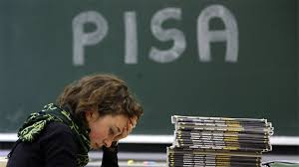
PISA (Programme for International Student Assessments) results
The results of the assessments reveal that 4 graders perform well in reading comprehension, however, students at the age of 15 perform below the average concerning the process , the application of the information and its adoptation in situations different from the learned ones.

Slide 4
The position of reading comprehension in teaching Hungarian
In Hungary the first (basic) period of developing reading comprehension lasts up to grade 4
The development of reading ends by the end of the first (basic) period
Instead of teaching reading students have to process new content using their previous knowledge
In Hungarian Literature lessons students deals with analysing the content, the genres and the forms of fictions from grade 5 to grade 8 and in secondary education.In Hungarian grammar lessons they learn grammar.
Teachers can employ reading comprehension tasks besides the material mentioned above. Teachers are provided only few opportunities for developing reading comprehension by the curriculum
The methods and tasks applied for developing reading comprehension in the first (basic) period are pushed into the background.

Slide 5
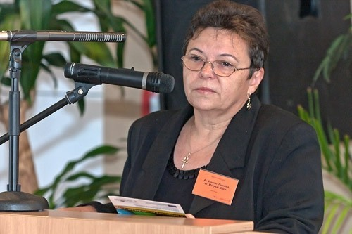
What kind of reading methods are pushed in the background in the upper grades?
According to Józsefné dr.Zsolnai and dr. Mária dr.Mátyási six different ways of reading can be distinguished. These are the following:
Silent reading – processing texts;
Silent reading – search for data;
Meditative reading – e.g.reading a poem
Loud, expressive reading;
Reading after preparation – after silent reading;
Reading for audience

Slide 6
How to develop reading comprehension skills in the upper grades?
Using practice and supplementary exercises books besides the coursebook
Using the tasks of the previous National Student Assessment of Linguistic Competences and that of the school leaving examination and the entrance examination for practice. These tasks are available on the Internet.
Using of the relavant parts of the Hungarian Grammar books mainly in grade 10.

Slide 7
The most common types of exercises applied for developing reading comprehension
Matching exercise.
Finishing sentences with words from a certain text.
Find out the meaning of the word from the context.
True or false exercises.
Putting the sentences into the correct chronological order.
Answering questions using the information in the text.
Completing a chart with the missing information.
Summarizing the content with the help of keywords.

Slide 8
How to make reading comprehension skills in the mother tongue more effective?
Available textbooks similar to the ones used in the first (basic) period
More practice books.
Devoting more time for developing reading comprehension in the curriculum.
Fewer students in classes and groups.
Time for loud and meditative reading.
Practising basic, loud reading in the upper grades as well.

Slide 9
