Slide 1


Fit for lifelong Learning – Using Innovative And Digital Utilities And Methods
FLUIDUM 2017-2020

Slide 2

TEACHING FOREIGN AND NATIVE LANGUAGES
WITH THE USE OF NEW INNOVATIVE TECHNOLOGIES
IV Liceum Ogólnokształcące im. Komisji Edukacji Narodowej w Poznaniu
Iv high school in poznan

Slide 3

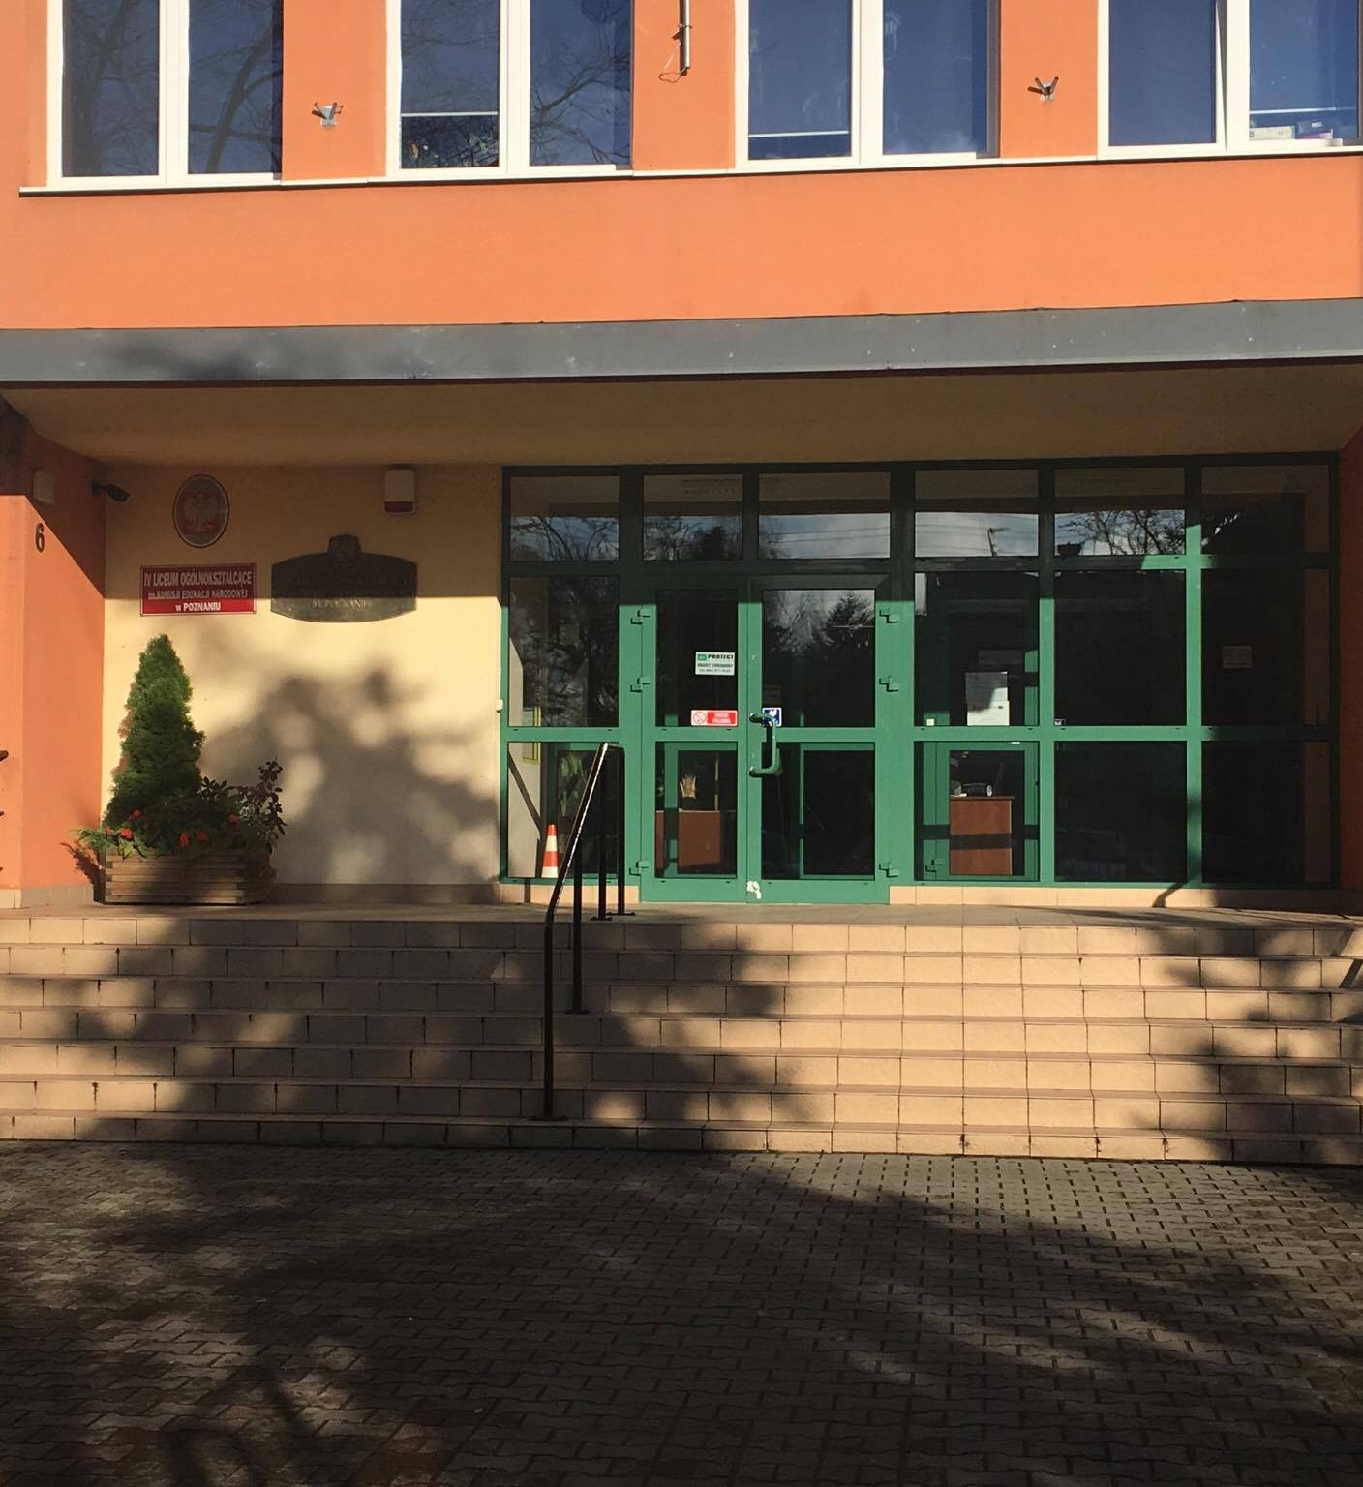
OUR SCHOOL- MAIN INFORMATION
SECONDARY SCHOOL
STUDENT’S AGE 16-19
EDUCATION PERIOD: 3 YEARS
(NEW REFORM: 4 YEARS)
PREPARES FOR FINAL EXAMS
FINAL EXAM IS THE EXTERNAL EXAM WHICH ALLOWS FOR UNIVERSITY EDUCATION (NO EXTRA EXAMS)

Slide 4

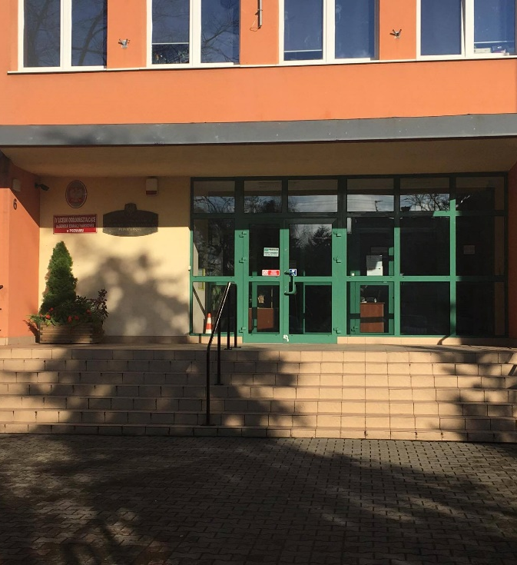
ENGLISH LANGUAGE
THE FIRST LANGUAGE TAUGHT AS CONTINUATION (610 STUDENTS), THE OTHER ONE FROM THE BASICS (497 STUDENTS) OR AS CONTINUATION 113 STUDENTS)
A STUDENT CHOOSES THE LEVEL AND THE LANGUAGE
FOREIGN LANGUAGE – OBLIGATORY SUBJECT AT FINAL EXAMS
INTERCLASS EDUCATION

Slide 6

OTHER FOREIGN LANGUAGES
GERMAN, FRENCH, SPANISH, RUSSIAN
(THE NUMBER OF STUDENTS IN CLASSES 1-3)

Slide 7


LANGUAGE LESSONS PER WEEK
ENGLISH LANGUAGE – 3-6 HOURS DEPENDING ON THE CLASS PROFILE (I.E. BILOGY-CHEMISTRY, LAW AND PSYCHOLOGY, ECONOMY, INFORMATION TECHNOLOGY ETC.)
OTHER LANGUAGES (GERMAN, SPANISH, FRENCH, RUSSIAN) 2 HOURS

Slide 8


TRADITIONAL METHODS

Slide 9

TEACHING A FOREIGN LANGUAGE
TRADITIONAL METHODS
COURSEBOOK
WORKBOOK
LANGUAGE GAMES
INDIVIDUAL/ GROUP WORK
ROLE PLAYING DRAMA GAMES
PROJECT WORK
SONGS
LISTENING COMPREHENSION: RECORDINGS FROM THE COURSEBOOK, AUTHENTIC MATERIALS (TV, RADIO, NEWSPAPERS)

Slide 10

WORKING WITH A TEXT ON FOREIGN LANGUAGE LESSONS
FORMULATING MAIN IDEAS/MAIN PROBLEM OF THE TEXT – WORKING WITH FINAL EXAM TASKS
DIFFERING BETWEEN INFORMATION AND OPINION
TRUE/ FALSE EXERCISES
SOLVING CROSSWORDS ON THE BASIS OF THE TEXT
GAP- FILLING
PUTTING INFORMATION IN CHRONOLOGICAL/ LOGICAL ORDER
ASKING QUESTIONS/ THESIS FOR PARAGRAPHS OF A TEXT
WORD ASSOCIATIONS GAMES
DIDACTIC STORIES

Slide 11

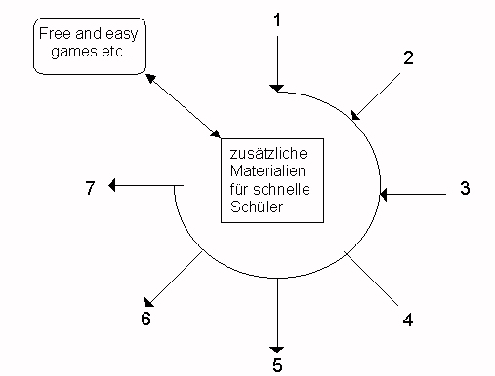
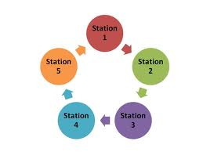
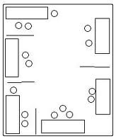

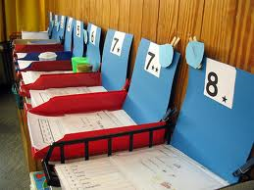
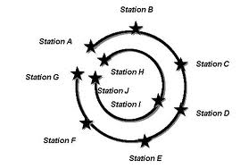
TASK BASED LANGUAGE LEARNING

Slide 12

Introducing new technologies to language lessons

Slide 13
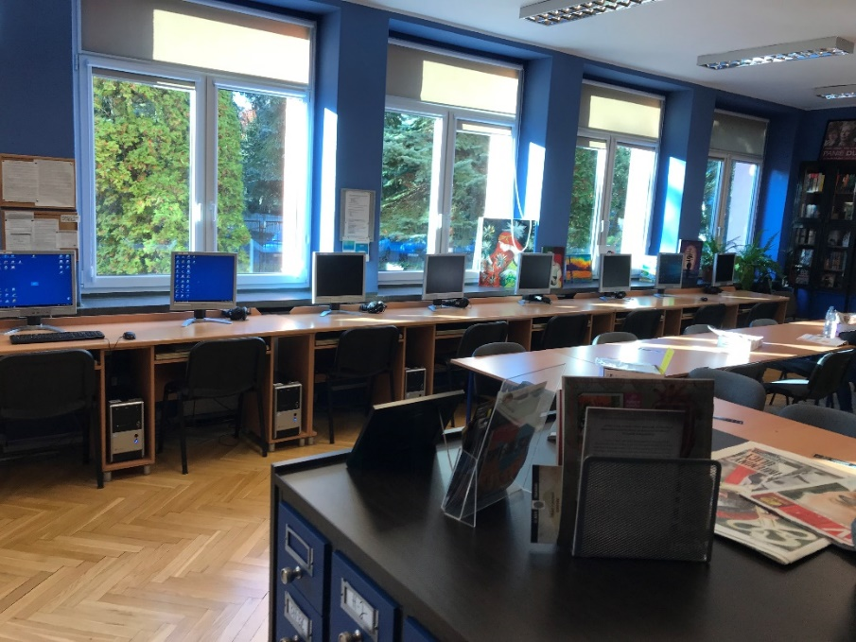
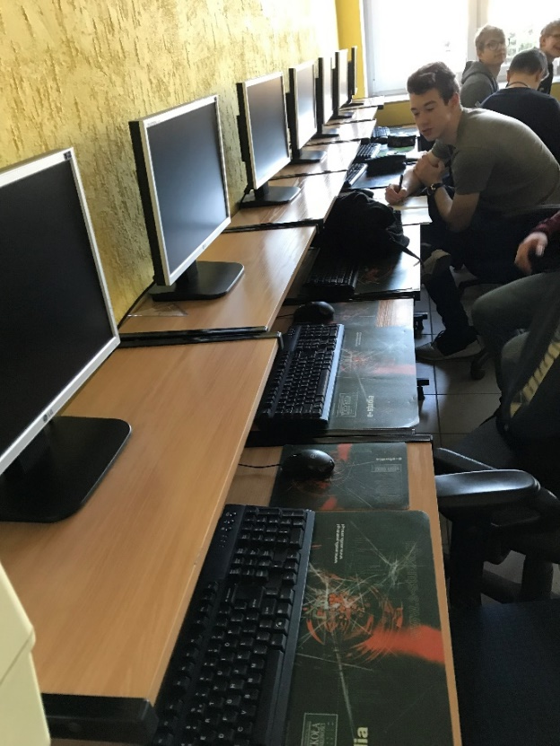
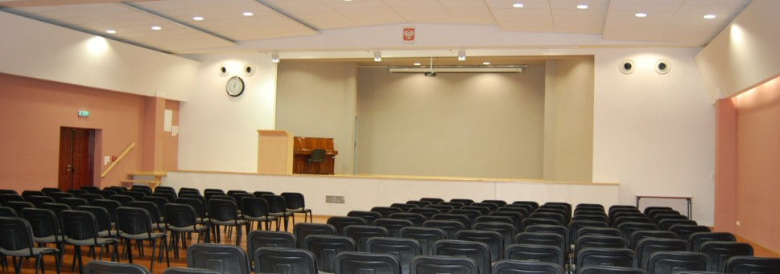
OUR PREPERATION FOR NEW INNOVATIVE TECHNOLOGIES

Slide 14
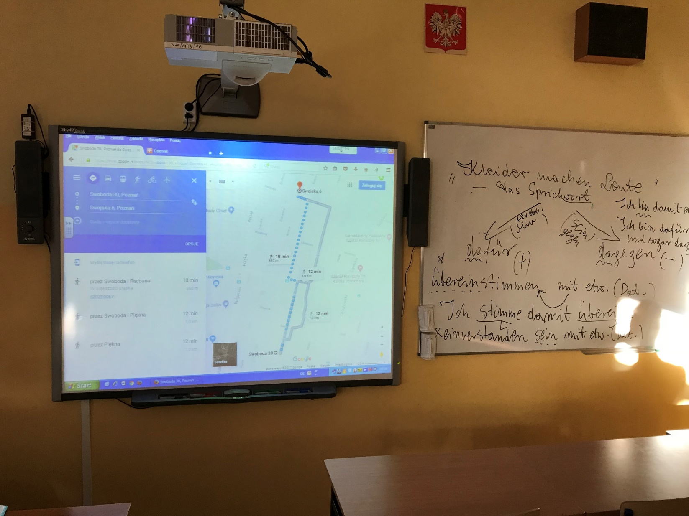

Slide 15



OPEN - SOURCE LEARNING PLATFORM

Slide 16

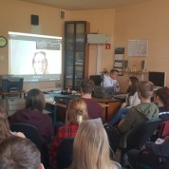
SKYPE LESSONS WITH NATIVE SPEAKERS
ONLINE LESSONS WITH OUR PROJECT PARTNER LANGUAGE SCHOOL IN DERRY – LESSONS BASED ON SPEAKING, ENGLISH AND IRISH PHONETICS, CULTURE AND HISTORY OF THE EMERALD ISLE

Slide 17




EVALUATION TASKS – ONLINE WORKSHEETS
ONLINE COURSEBOOKS
PODCASTS
QUIZLET, KAHOOT
QR CODES

Slide 18



Slide 19
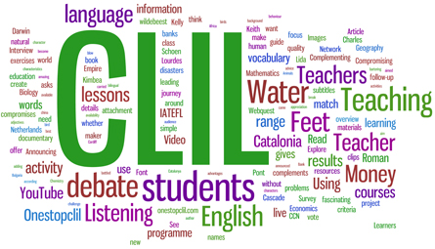
Content and Language Integrated Learning (CLIL)
Noticing of the language by the learners
Focus on lexis rather than grammar
The miniskirt is a skirt whose hemline is high above the knees (generally 200-300 mm above knee-level). Its existence is generally credited to the fashion designer Mary Quant, who was inspired by the Mini Cooper automobile, although André Courrèges is also often cited as its inventor, and there is disagreement as to who invented it first.

Slide 20

TRADITIONAL METHODS OF TEACHING POLISH LANGUAGE

Slide 21



DISCUSSION
GROUP WORK
PRESENTATIONS AND LECTURES
DRAMA BASED TASKS
PROJECT WORK
PROBLEM-BASED METHODS OF TEACHING
BRAINSTORMING
PSYCHOLOGICAL DIDACTIC GAMES
PANEL DISCUSSIONS
DECISION-MAKING DIDACTIC GAMES
ROLE – PLAYING GAMES

Slide 22

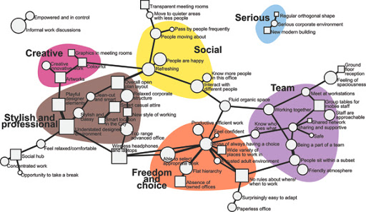
WORKING WITH A TEXT ON POLISH LESSONS
WORKING WITH A TEXT
FORMULATING THE MAIN IDEA OF THE TEXT
FINDING SYNONIMIC WORDS AND EXPRESSIONS FOR PARAHRAPHS
PARAPHRASING THE MAIN IDEA OF THE TEXT
DIFFERING BETWEEN INFORMATIONA AND OPINION
TRUE AND FALSE TASKS
SOLVING CROSSWORDS ON THE BASIS OF THE TEXT

Slide 23

Teaching A native language with modern INNOVATIVE methods

Slide 24

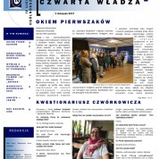
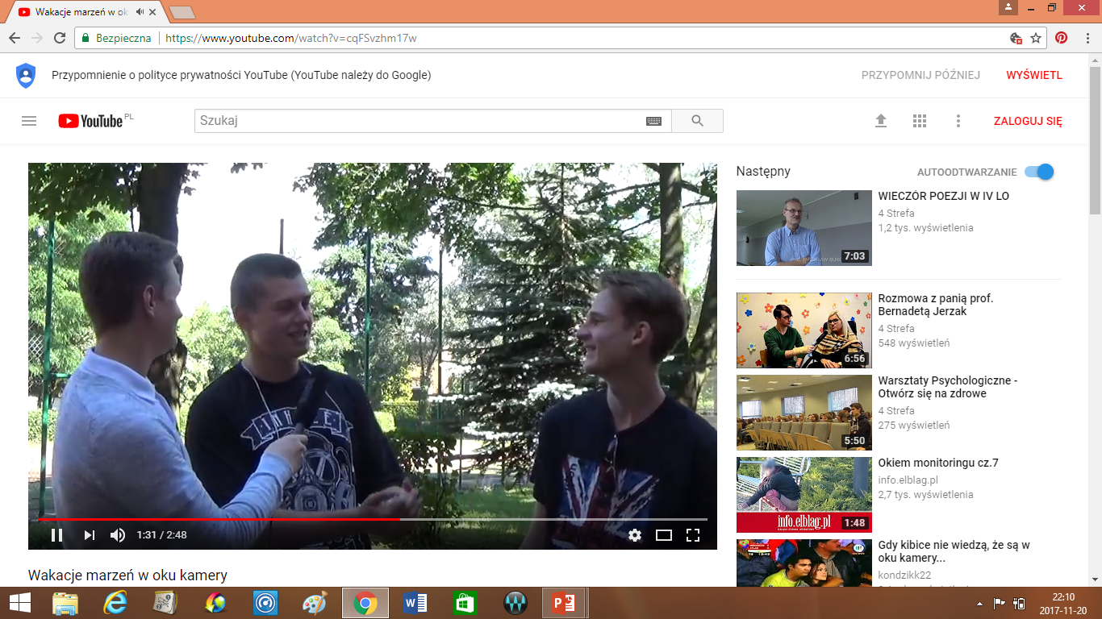
SCHOOL NEWSPAPER
VIDEO BLOG https://youtu.be/cqFSvzhm17w

Slide 25

POWERPOINT PRESENTATIONS
INTERNET AS THE MAIN SOURCE OF INFORMATION
www.cke.edu.pl
język-polski.pl
edulandia.pl
etc.

Slide 26
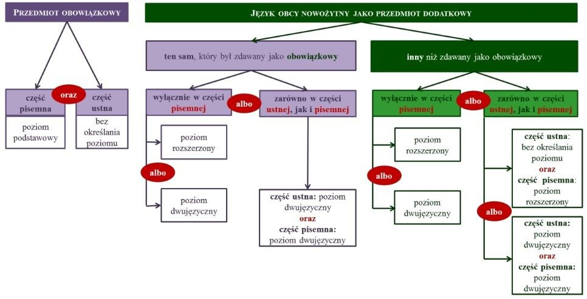
FINAL EXAMS-FOREIGN LANGUAGES
PRZYKŁADOWE ZADANIA
SCHEMAT ARKUSZA

Slide 27
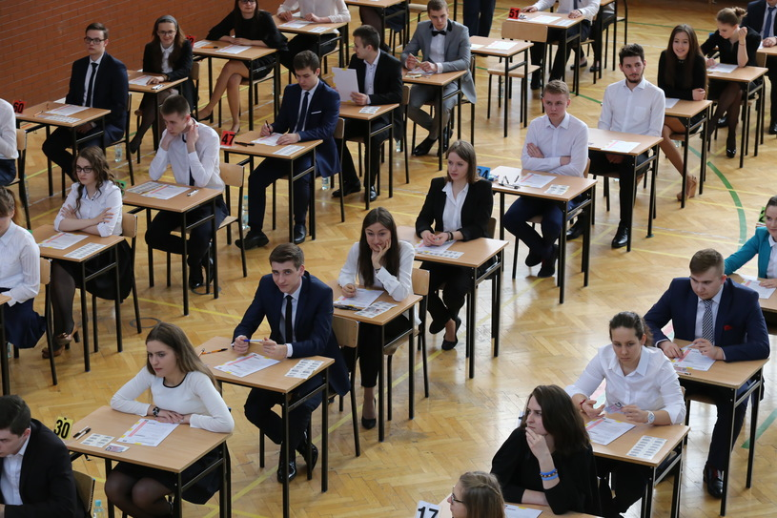
WRITTEN FINAL EXAMS

Slide 28


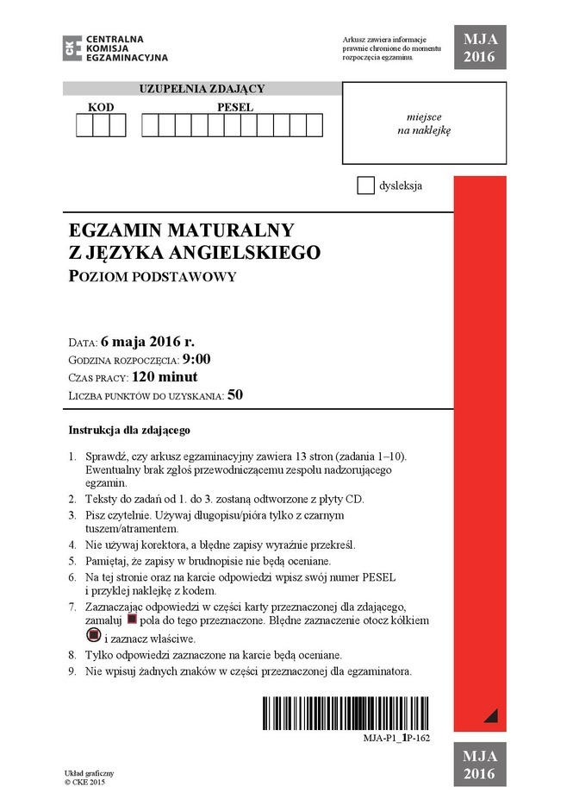
FOREIGN LANGUAGES – BASIC LEVEL
150 MINUTES – 50 POINTS
3 LISTENINGS
3 READINGS
3 TASKS ON COMMUNICATION SKILLS (GRAMMAR AND VOCABULARY)
WRITING: BLOG, E-MAIL, NOTE
80-130 WORDS

Slide 29
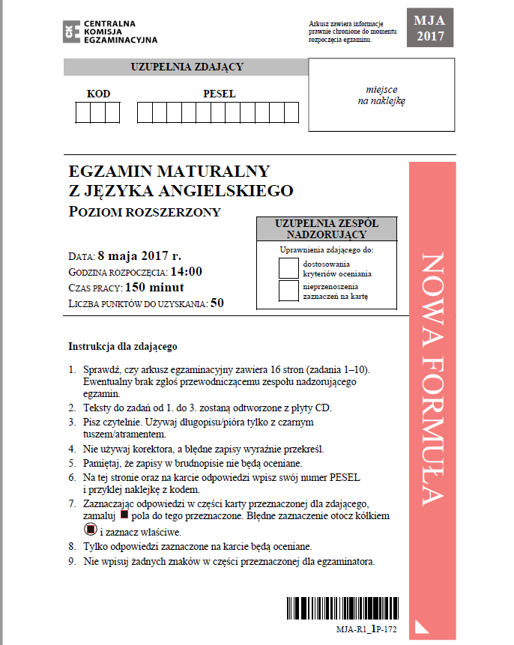
FOREIGN LANGUAGES- EXTENDED LEVEL
150 MINUTES – 50 POINTS
3 LISTENINGS
3 READINGS
3 TASKS ON COMMUNICATION SKILLS (GRAMMAR AND VOCABULARY)
WRITING: ARTICLE, ESSAY, FORMAL LETTER
200-250 WORDS

Slide 30

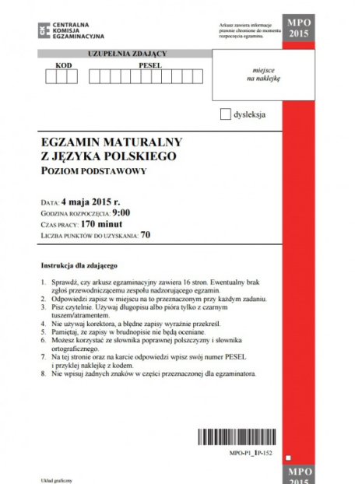
POLISH LANGUAGE- BASIC LEVEL
170 MIN – 70 POINTS
READING COMPREHENSION- TASKS ON CLOSED AND OPEN QUESTIONS (GRAMMAR AND LEXICAL ITEMS)
TEXT SUMMARY – 60-70 WORDS
ESSAY-200-250 WORDS OR INTERPRETATION OF POETRY ON 200-250 WORDS

Slide 31
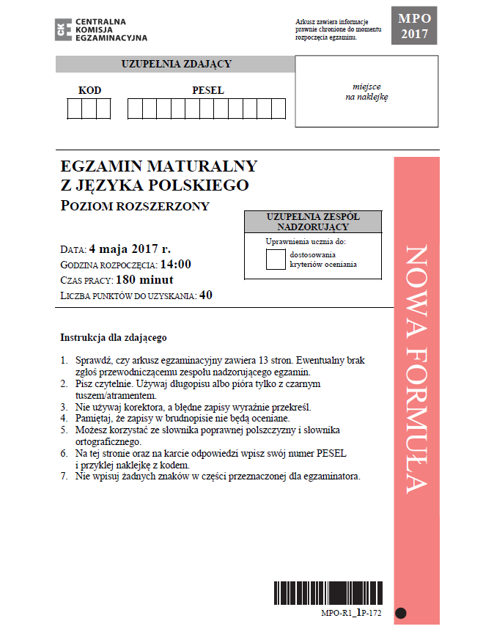
POLISH LANGUAGE- EXTENDED LEVEL
180 MIN – 40 POINTS
ESSAY-MIN 300 WORDS
ANALYSIS OF A LITERARY TEXT OR INTERPRETATION OF 2 POEMS

Slide 32
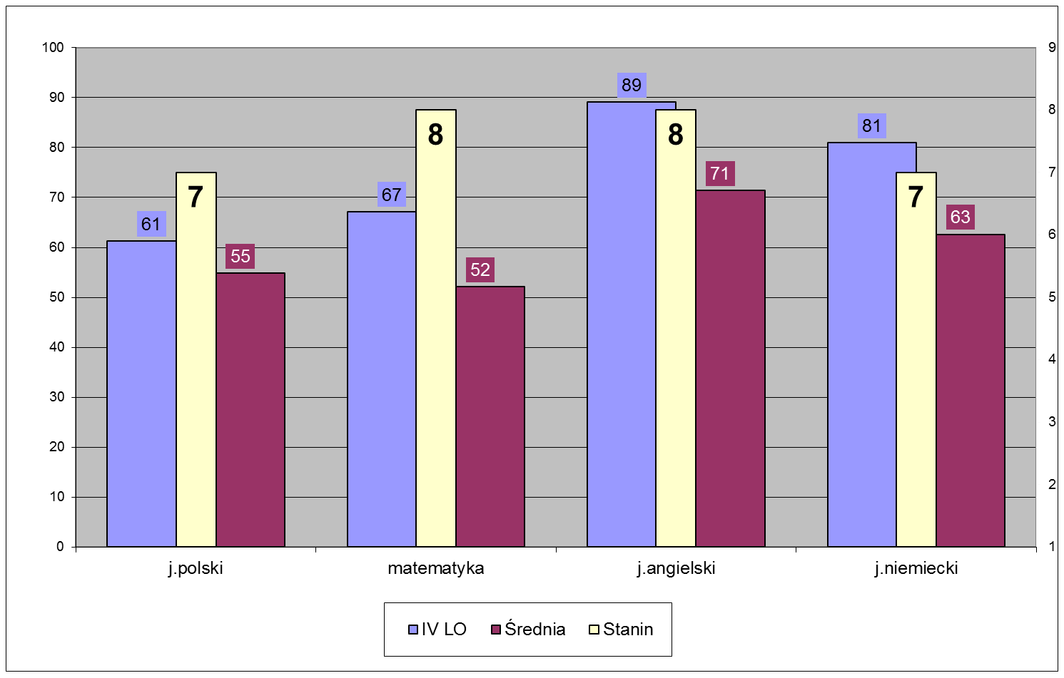
FINAL EXAMS 2017 (A-LEVELS)
POLISH, MATHEMATICS, ENGLISH, GERMAN
IV HIGH SCHOOL
AVERAGE RESULTS IN WIELKOPOLSKA REGION
STANINES

Slide 33

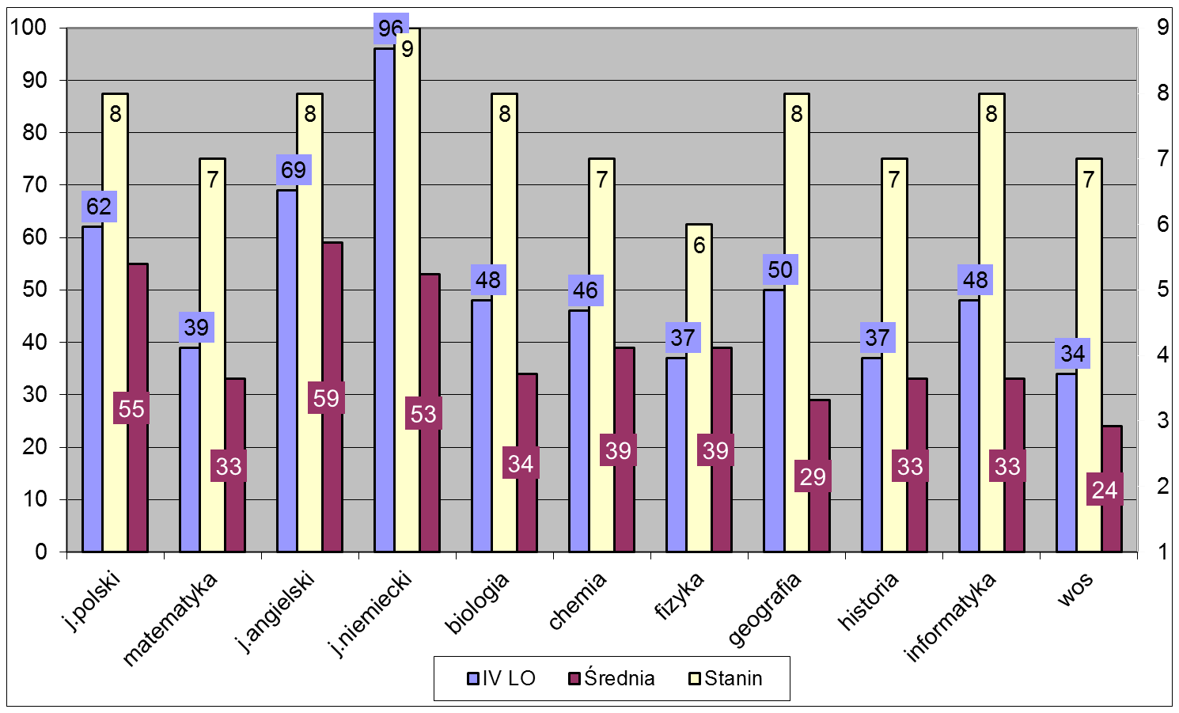
FINAL EXAMS
ACCORDINGLY: POLISH, MATHEMATICS, ENGLISH, GERMAN, BIOLOGY, CHEMISTRY, PHYSICS, GEOGRAPHY, HISTORY, INFORMATION TECHNOLOGY, SOCIAL AFFAIRS
IV HIGH SCHOOL
AVERAGE RESULTS IN WIELKOPOLSKA REGION
STANINES

Slide 34

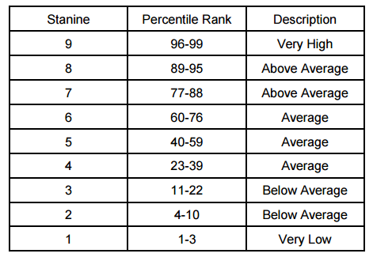
Stanine (STAndard NINE) method of scaling test scores on a nine-point standard scale with a mean of five and a standard deviation of two

Slide 35
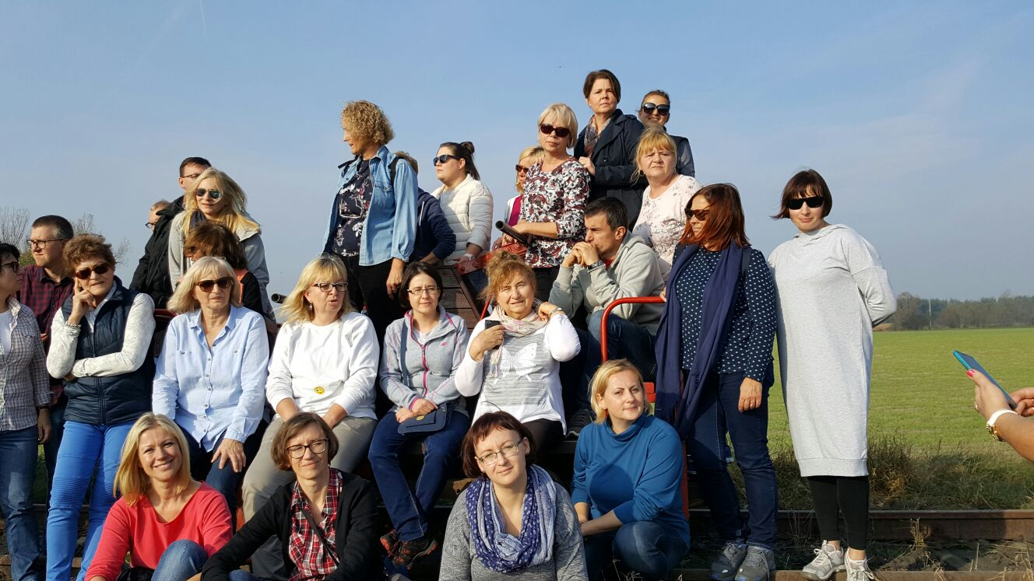
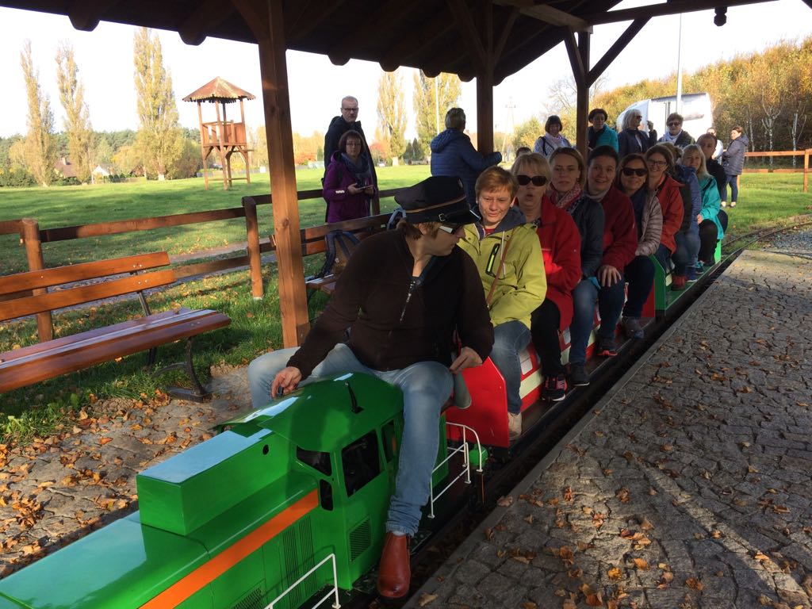
PRESENTATION BY:
ANNA BRODZISZEWSKA
ANNA PIĄTKOWSKA
ELŻBIETA GORĄCZNIAK
ON THE BASIS OF SOURCE MATERIALS PREPARED BY POLISH AND FOREIGN LANGUAGE TEACHERS IN IV HIGH SCHOOL

