Slide 1
Workshop on a healthy lifestyle

Slide 2
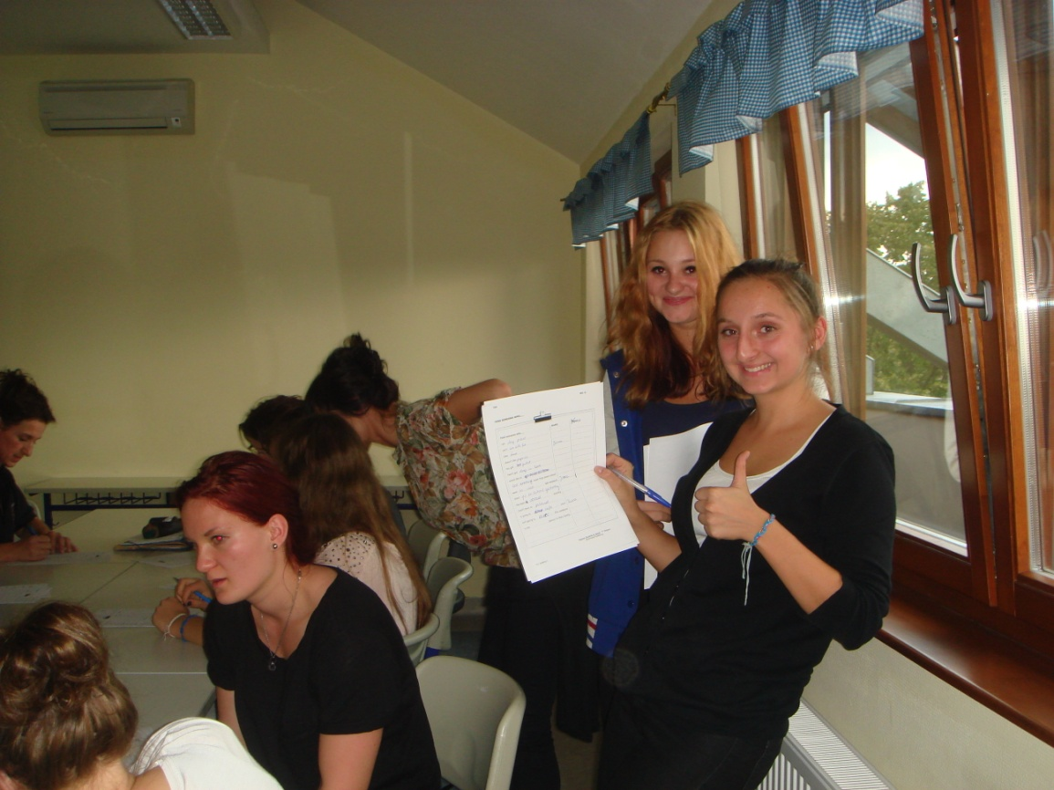
First day Getting to know each other

Slide 3
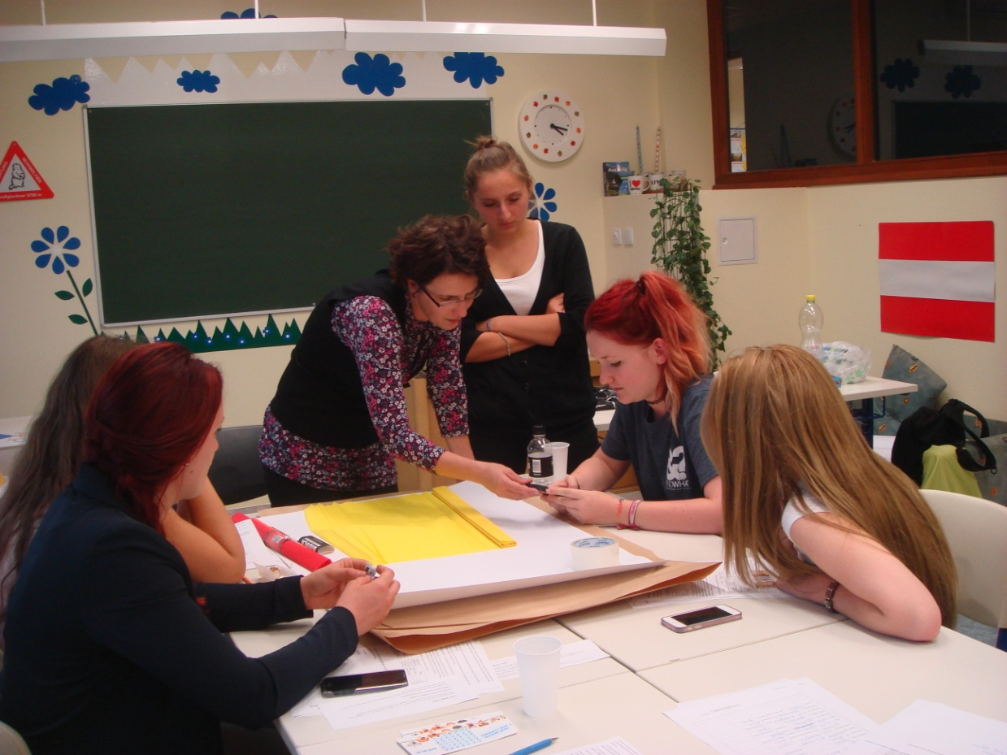
Unhealthy poster group: →
← Healthy poster group

Slide 4
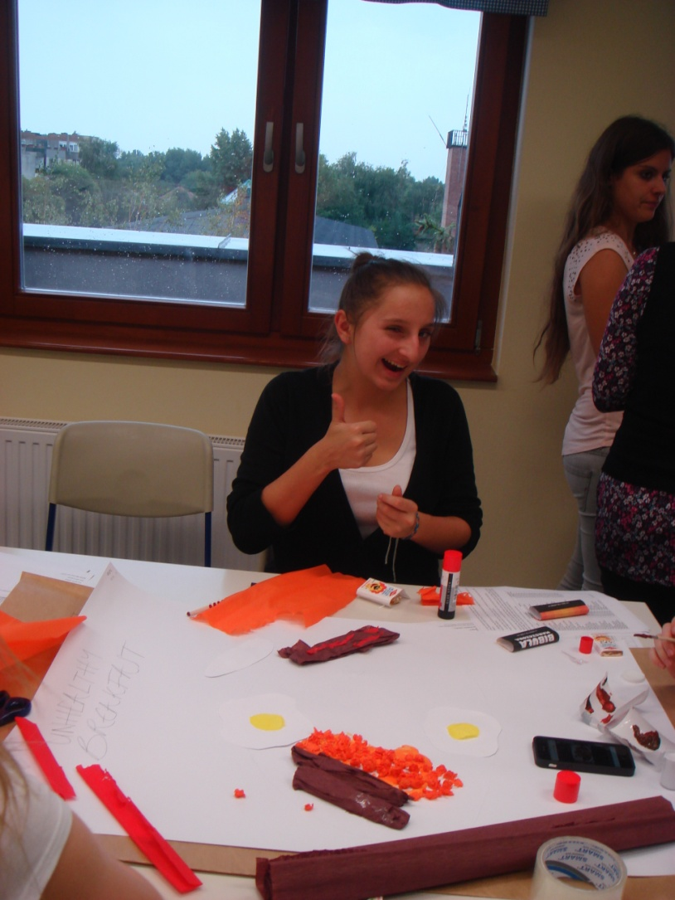
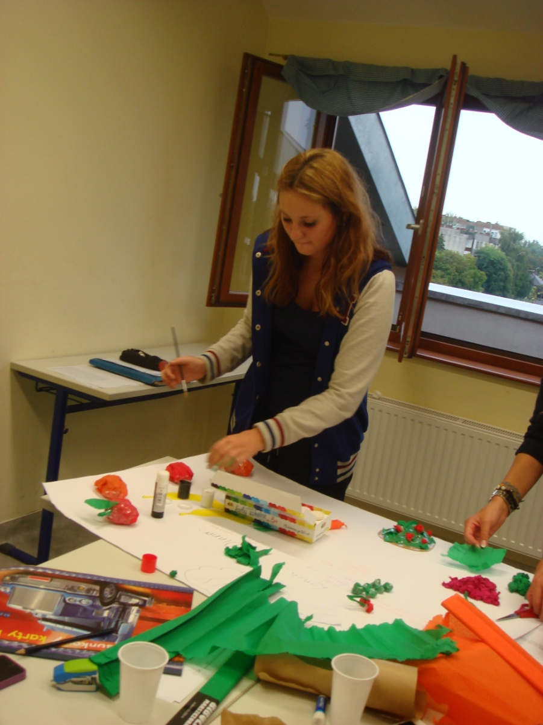

Slide 5
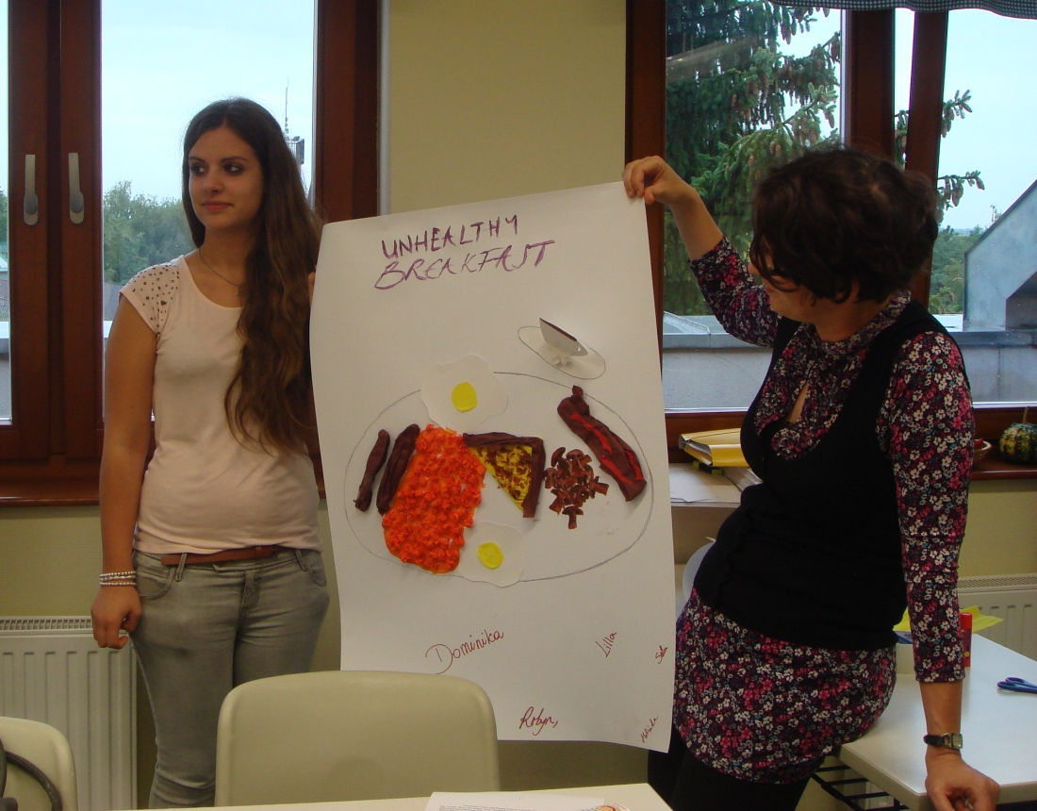
Our finished healthy and unhealthy posters

Slide 6
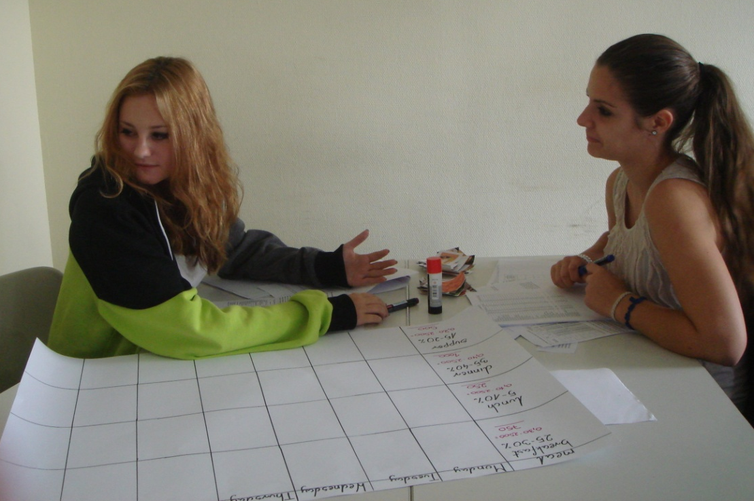
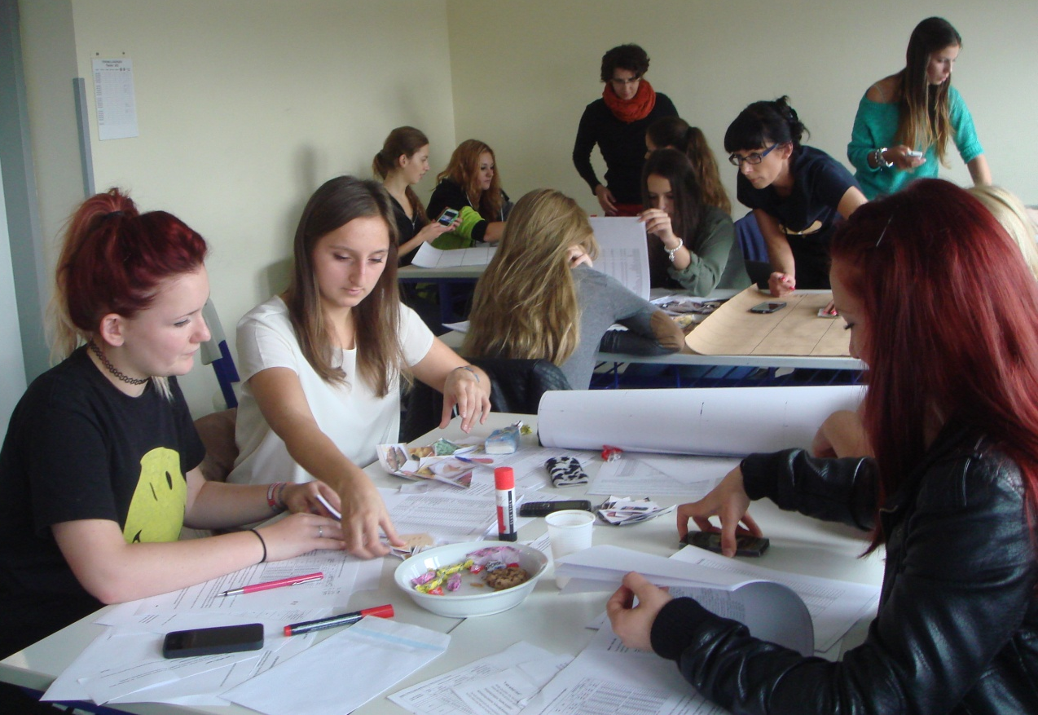
Second day We made a healthy menu

Slide 7
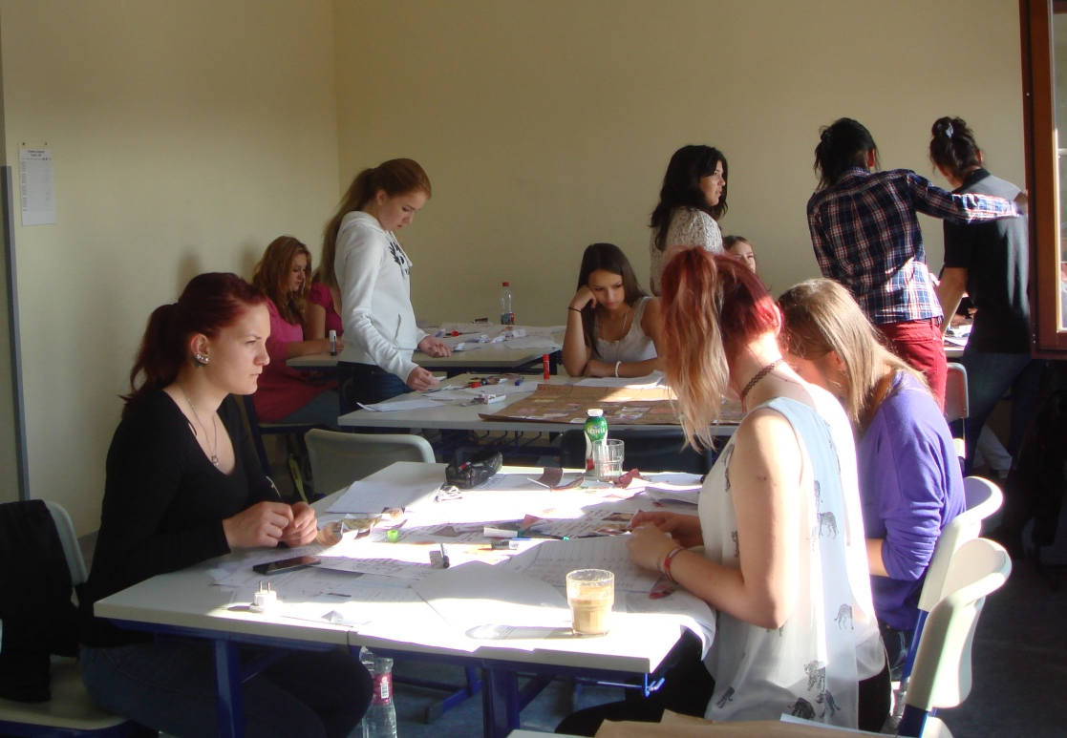
Third day we finished our menus
Jess

Slide 8
Katarina →
← Lea

Slide 9
Lilla →
←Klaudia

Slide 10
Jagoda
Iwona

Slide 11
We went to the supermarket:

Slide 12
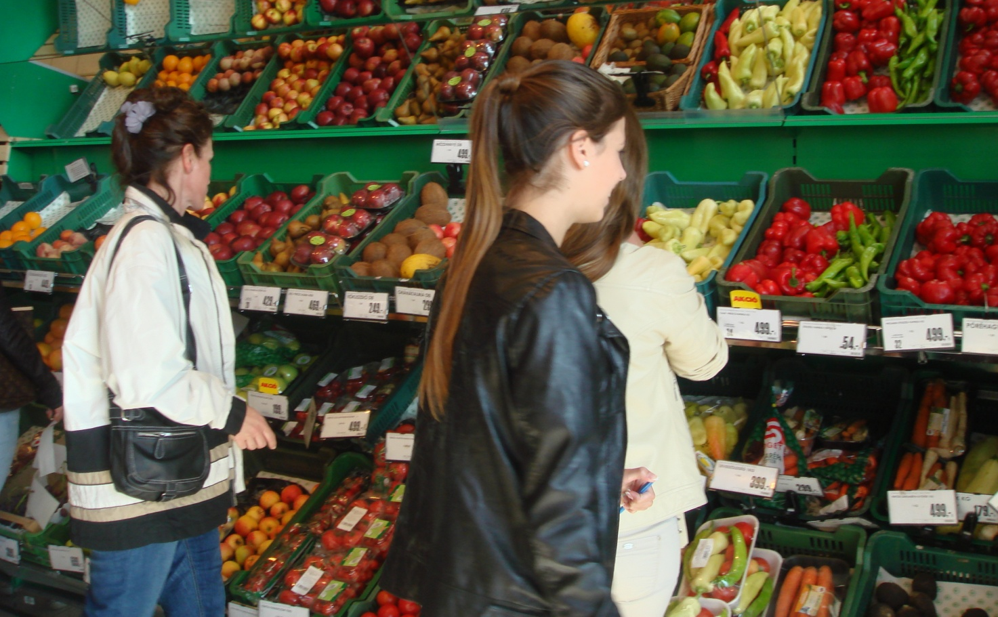

Slide 13
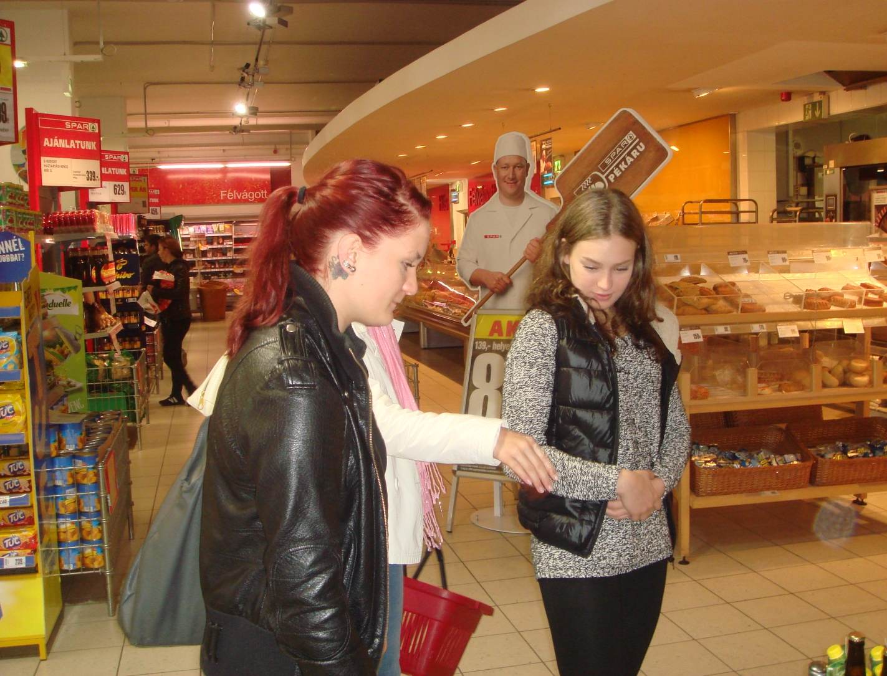
Satu Jonna
Dominika

Slide 14
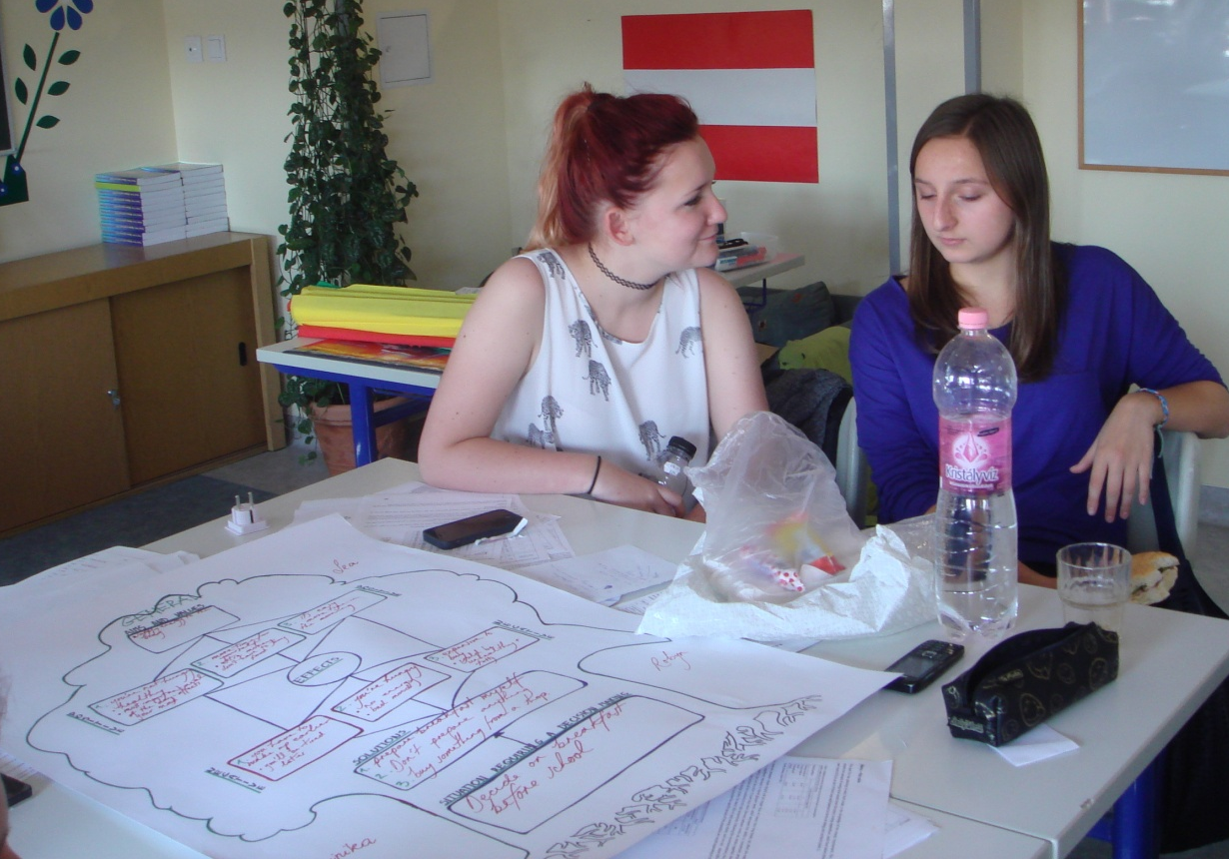
We made mind maps
←Enikő
Robyn
Adrienn

Slide 15
Melinda

Slide 17
Fourth day We made sandwiches

Slide 18
Thank you for listening! ☺

Slide 19
Mission accomplished! ☺

Slide 20
Thank you for the beautiful days Iwona and Jagoda ! ☺ <3

