Slide 1
MUSIC FROM FINLAND
We introduce to you some Finnish artists and tell you something about the history of Finnish music.

Slide 2
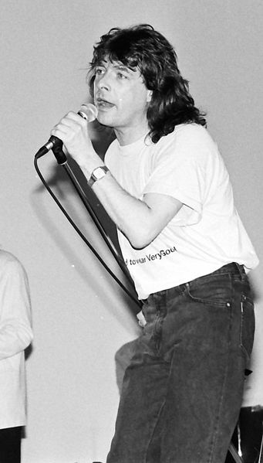
60’s
Music from abroad spread across Finland.
Finland took part to the Eurovision song contest for the first time.
Olavi Virta
http://www.youtube.com/watch?v=WE5SrkzxYdY
Kirka
http://www.youtube.com/watch?v=GjiDoGIyBGo

Slide 3
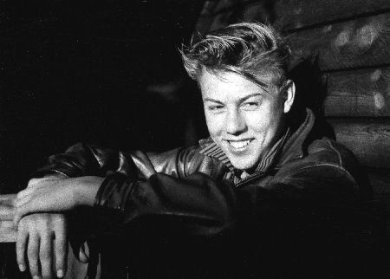
70’s
Finnish rock-music borned.
The first rock-festival Ruisrock arranged at Turku, Ruissalo at 1970.
Danny
http://www.youtube.com/watch?v=dsJ0vpWWN6Y
Hector
http://www.youtube.com/watch?v=x5c1df-esx8

Slide 4
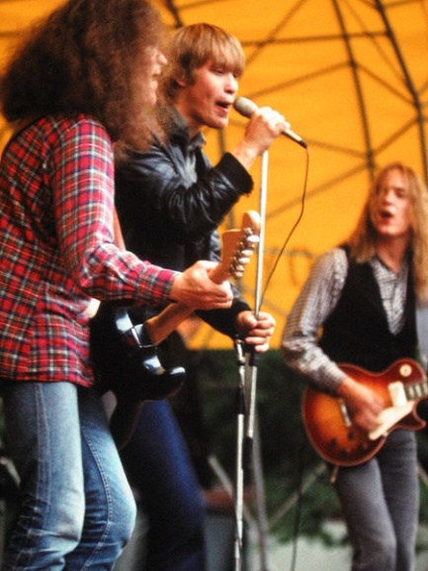
80’s
Finnish rock music had its golden time
The international radio stations started to play also Finnish rock.
Dingo
http://www.youtube.com/watch?v=8GcR4Sgu0Fk
Eppu Normaali
http://www.youtube.com/watch?v=d0zFJ71hGH4

Slide 5
90’s
Hiphop, rap, techno, dance pop.
Finnsh rock started to rise especially in Europe, the USA and Japan.
Bomfunk MC’s
http://www.youtube.com/watch?v=ymNFyxvIdaM
Darude
http://www.youtube.com/watch?v=erb4n8PW2qw

Slide 6
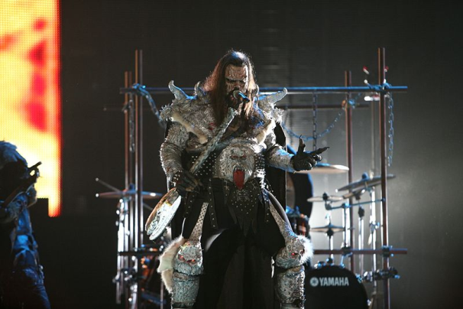
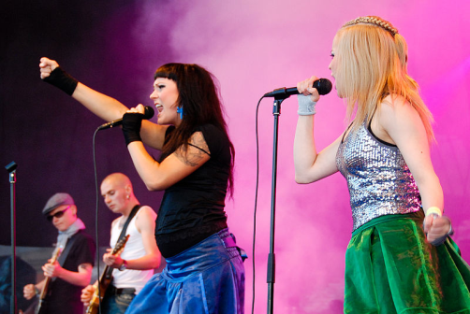
2000-
Finland won the Eurovision song contest for the first time (Lordi-Hallelujah).
Finnish rap was really popular.
Girl bands.
Lordi
http://www.youtube.com/watch?v=-6Xl9tBWt54
PMMP
http://www.youtube.com/watch?v=QjJ7drm_oqE
Fintelligens
http://www.youtube.com/watch?v=yFu9kfgHIfU

Slide 7
2010-
Finnish music has become more international.
Young singers.
Finnish rap has its golden time.

Slide 8
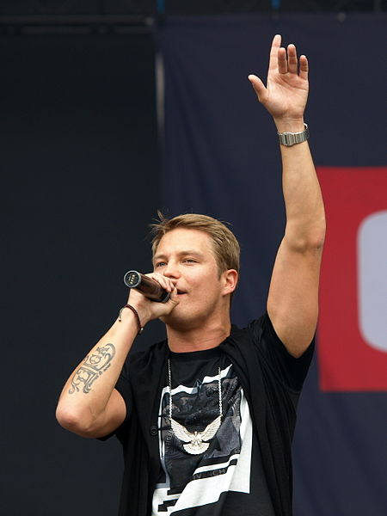
2010-
Redrama
https://www.youtube.com/watch?v=7Zg2vcm0rJQ
Disco Ensemble
http://www.youtube.com/watch?v=r0DzYZTRuVk
Isac Elliot
http://www.youtube.com/watch?v=H6Ykor-8MAM
Diandra
http://www.youtube.com/watch?v=OIbi8NKEnCU
Krista Siegfrids
http://www.youtube.com/watch?v=v7Z6nQNJPiA
Cheek
http://www.youtube.com/watch?v=81Ejyr-ddgw
Robin
http://www.youtube.com/watch?v=lAZL5M8xxr0

Slide 9
2010-
Here’s some popular and international groups that have Finnish members.
Studio Killers
https://www.youtube.com/watch?v=egUQju95vT8
Jutty Ranx
https://www.youtube.com/watch?v=n8qL_u_4L3M

