Slide 1
Mobile Learning for Mathematics
in formal /informal education in South Africa/Finland
Education for All | Sustainability | Scalability | Accessibility | Affordability

Slide 2
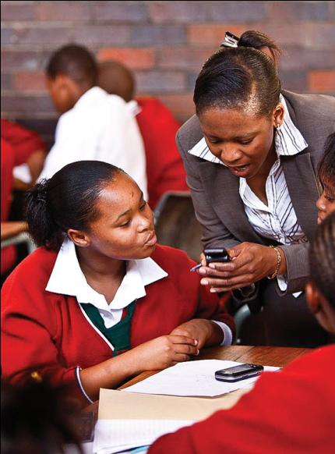
Active learning environment
(not only content push or pull)
Aligned to the current South African curriculum for Grade 10 mathematics.
Theory and questions from a database of approximately 10,000 questions categorized by topic and degree of difficulty.
Topic tests
Immediate feedback
Compare results with their classmates in their school, in other provinces, and nationally.
Peer to peer support via Mxit/Ovi chatting
Competitions
Add hoc test
Moodle LMS
Digital support for learning processes (e.g. Dynamic topic-specific hints)
Self-testing (activity score, competence score)
Multi-dimensional messaging and collaboration

Slide 3

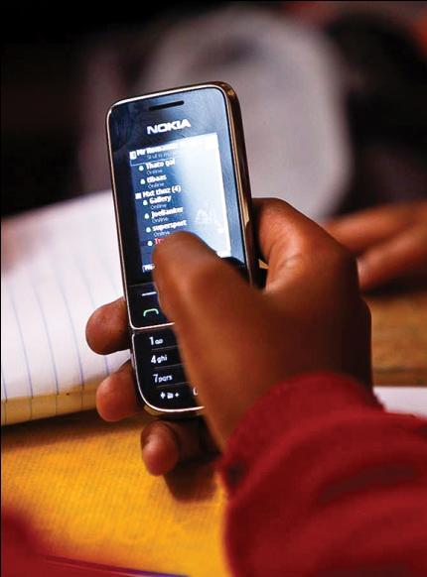
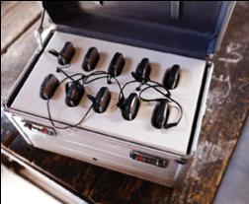

Implementation methodologies
In class or independently
Mobile access:
Own mobile
Shared mobile
Mobi-kit
2011 access content via Internet also

Slide 4

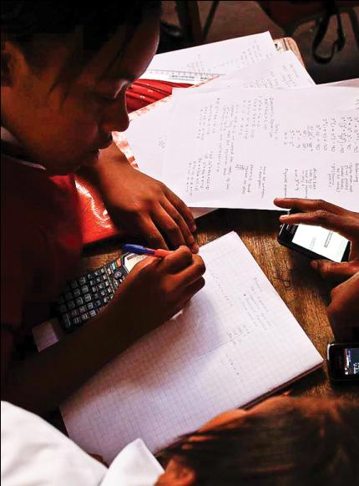
Benefits for a learner
24/7 access to high quality learning materials - 10 000 additional exercises
short theory for each topic
immediate feedback
hints to guide learners to solve the problems
better awareness of own skills
internal competition
external competition (national/global activity score, competence score, ranking list)

Slide 5
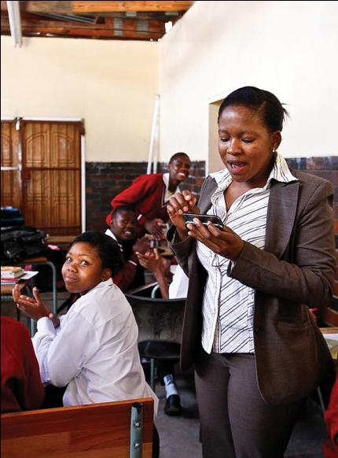
Benefits for a teacher
Additional exercises bank for teaching
Better understanding of the skills in class
Better communication possibility with learners
Diagnostic tool for problem areas
Homework administration (setting, marking and recording)
Improved digital literacy skills
Improved use of learning and teaching time

Slide 6

Implementation methodologies
Approaching and engaging children with their own tools
Learning is part of children’s life
Learner is focused
Positive competition
For formal and for informal learning
Combining learning and social networking
For learners and for teachers
Free service for learners
For all phones
Scalable
Affordable
Replicable
Sustainable
Co-operation with global and local experts
Partners
Nokia , NSN., South African operators (MTN, CellC), Finnish operators (Telia Sonera, Elisa, DNA), Content provider (MML/Pearson Foundation), Provincial DOE, Mxit, DOE, SAFIPA, DST, DOC, Presidency, Local experts, MERAKA, NBA

Slide 7



What makes this project successful
Sustainability, affordability, scalability and replicability considerations have driven the concept design
Research results have played important role in further development of the service – learning by doing and learning by implementing
Zero rating of the IP address
Service for all phones
Focus on learner
Real 24/7 service
Lowers the cost of technology required to use such a service
Brings mathematics into the social networking space already used by youth
Does not put additional pressure on computer infrastructure in schools
Minimal teacher training

Slide 8
Achievements to date
Usage statistics at the end Sept 2011
4 provinces, 172 schools, appr 700 teachers, more than15 000 Grade 10 learners (potential group appr. 25 000 learners). NOTE: Free State joined in Aug- Sept and Eastern Cape widen the number of schools in May
Half a million (491,958) attempts at maths tests and exercises
468,496 maths tests and exercises completed by 11,062 Grade 10s (600,546 views and posts). 23,462 maths tests and exercises completed by 743 Grade 11s (who continued to use Momaths Grade 10). (we do not have yet Grade 11 content)
Impact for learners
Very positive feedback from learners and teachers
82% of use was outside of school time
Continued use during weekends, holidays and strike
Continued use over one full year (often, despite non-use by teachers)
Interest for mathemathics has raised
Learners awarenes of own maths skills have raised
Preliminary analysis (Feb – June 2010) shows impact on learner results – 14 % better maths results fro those who were using the service

Slide 9
Momaths Timeline
Oct 2008
Government request
South African President’s office request a project exploring use of mobile technologies to support formal education in South Africa
Feb 2009
South African pilot
~300 learners
6 schools , 3 provinces:
North West
Western Cape
Mpumalanga
Jan 2010
South Africa service scales up
~4000 learners
30 schools, 3 provinces:
North West
Eastern Cape
Western Cape
Jan 2011
South African provincial implementation
~25 000 learners
172 schools, 4
provinces:
North West
Eastern Cape
Western Cape
Free State
Jan 2012
Grade 10 and 11
Potential target group 50 000 learners.
Sep 2010
Finnish pilot
~60 learners (grade 10)
Jan 2011
Finnish pilot
~300 learners (grade 10)
Maths for first year of secondary schools
April 2009
August 2009
March 2010
June 2010
Dec 2010
June 2011
Dec 2011
Evaluation

Slide 10
Momaths Timeline
Achievements
Proof of concept
Proof of affordability
Proof of scalability
Proof of sustainability
Evidence for uptake
(learners, teachers)
Proof of impact for learners’ competencies
Proof of replicability
Localization and knowledge transfer
Teacher training
Teacher training
Training for teachers, PDOE and Provincial Admin and local partners
Service handover to South Africa (SchoolNet, Mindset)

Slide 11



www.momaths.org
Many thanks to the Department of Education for their ongoing support
of the Momaths project

