Slide 1
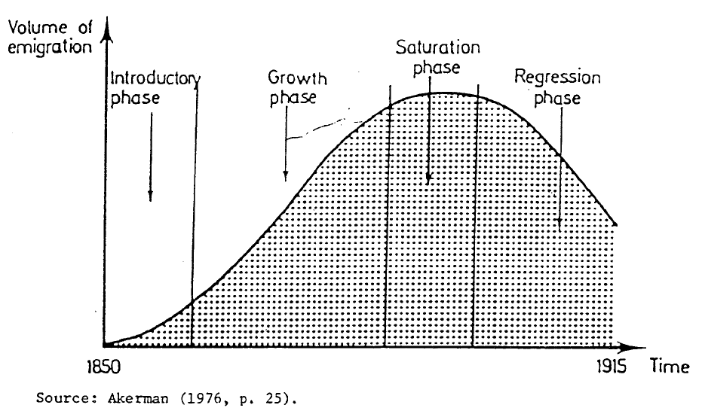
Composition of Migrant Flows (to USA)
Initially migrant flows came from northern Europe but increasingly after 1890 they came from southern (Italy, Spain, Portugal) and eastern Europe (Austria-Hungary and Poland).

Slide 2
Explanations for this migration
Arguments proposed by historians have included:
‘History matters’ – past migrants encourage others (friends and families) to migrate
Specific events such as famines (eg Great Famine in Ireland, 1845-52) and pogroms (eg Russia, 1881-1917)
Wage gaps between ‘home’ and ‘abroad’
Impact of industrialization
Impact of the demographic transition

Slide 3
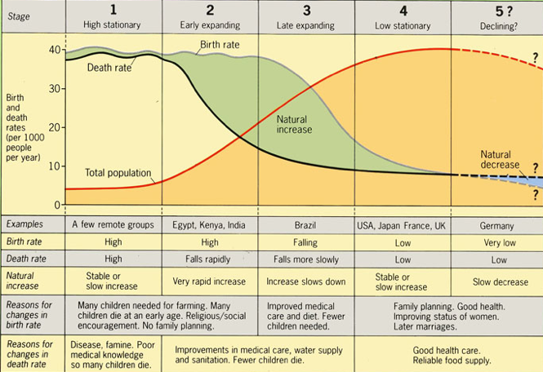
Relevance of the Demographic Transition Model

