Slide 1
PE Games and Fitness Workout
Physical Education
IES Saavedra Fajardo
Murcia – Spain

Slide 2
WARM UP
Jogging
Groups formation
Joint movility
Ankles
Knees
Hip
Spine
Shoulders
Neck

Slide 3
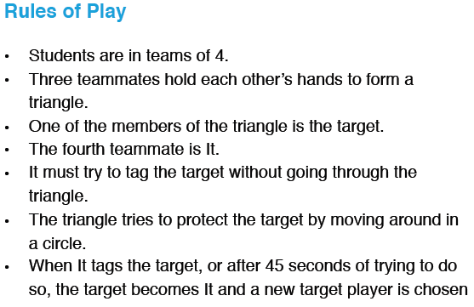
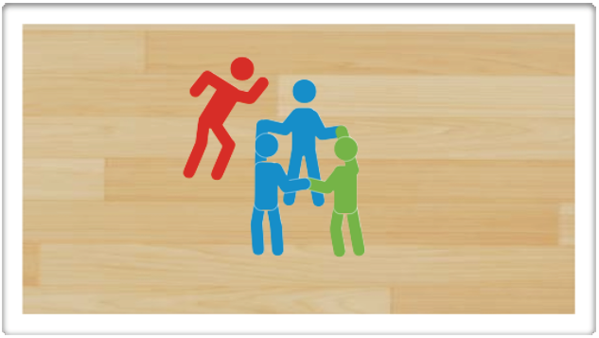
TRIANGLE TAG
TALKING…
How do you work as a team to protect the “target”?
How do you prepare your body to move in different directions?
What strategy do you use to try and tag the “target”?

Slide 4
“MATE”
There are two teams, each team into a half-court.
A soft ball is used to be thrown to the opposite players, just to impact on the adversary’s body before the ball bounces.
If someone is hit he is killed and he goes to the graveyard (cemetery), that is located behind the adversary baseline. But he continues throwing when the ball arrives.

Slide 5
PIRATE BALL
Divide the gym into 4 quarters. One team in each section.
Each team has a hoop in their back corner and a mat in their section too.
In each hoop are 6 objects. The aim of the game is to steal all objects related with your group personality.
Whenever you're in someone else territory you can be tagged. If tagged, you go to their mat(jail).
To get out of jail, someone from your own team must come and tag you out then you get a free walk back. Person freeing you does not get a free walk

Slide 6
FITNESS WORKOUT
EXERCISE | REPETITIONS /SETS
PUSH UPS | 10 / 2
SIT UPS | 30 / 2
SQUAT JUMP | 10 / 2
ARMS (biceps) WITH ELASTIC BANDS | 20 / 2
HOW CAN WE DO THEM HARDER?

Slide 7
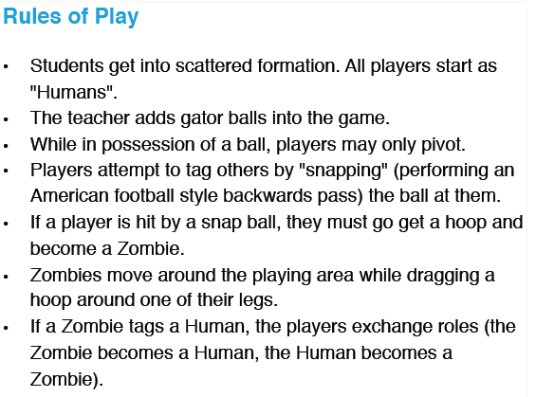
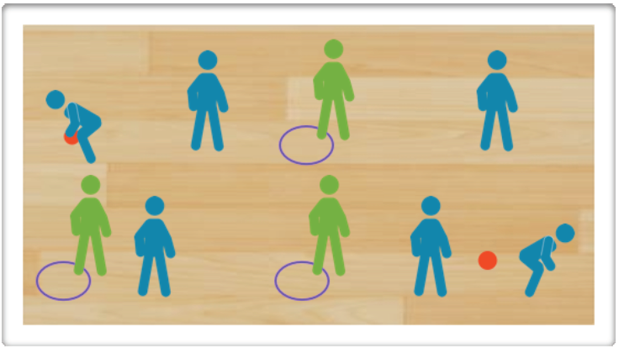
ZOMBIE-BALL-TAG

Slide 8
COOL DOWN
Stretching exercises:
Quads
Calves
Hamstrings
Back muscles
Arm muscles

