Slide 1
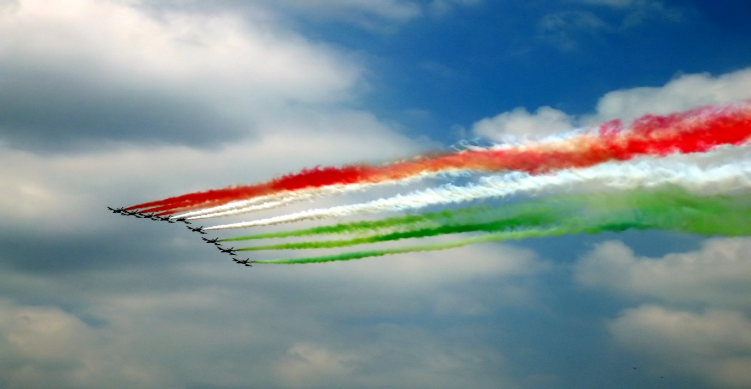
The Italian Air Force AERONAUTICA MILITARE
Made by
Alvise Celant
Giovanni Mascherpa
Giorgio Tromboni

Slide 2
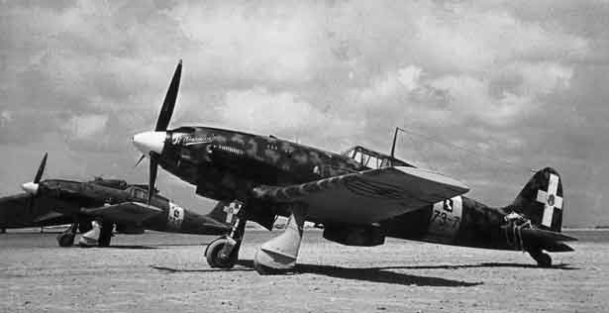
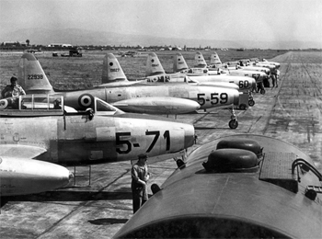
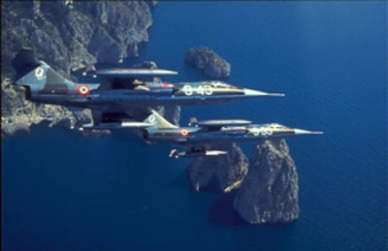
HISTORY
The Italian Air Force was founded in 1923 as Arma Azzurra, (Sky Blue Army) and later as Regia Aeronautica (Royal Air Force) but the Italian Army used airplanes since 1909. Italy was the first nation to ever use airplanes in combat during the war against Turkey in 1911. The Italian air force fought during both the WW1and the WW2 then it was Renamed Aeronautica Militare (Italian Air Force)

Slide 3
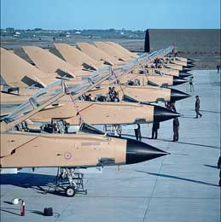
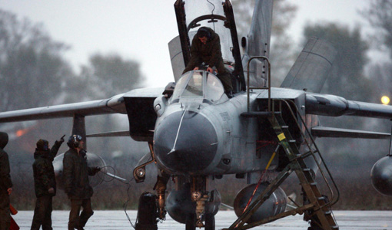
PRESENT DAY
Today the Italian Air Force is one of the most advanced in the world and took part to many large operations and wars such as the Gulf War, The Bosnian War, Afghanistan and finally the Libyan Civil War.

Slide 4
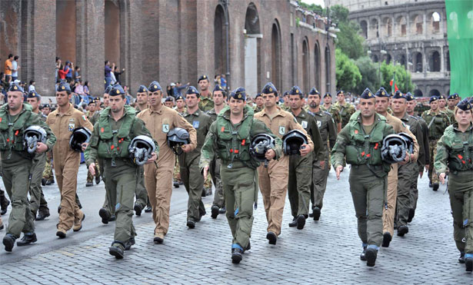
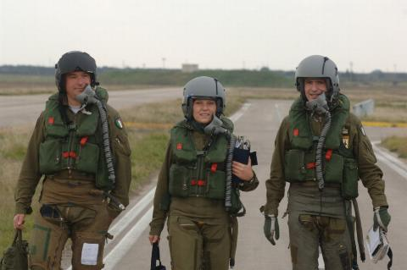
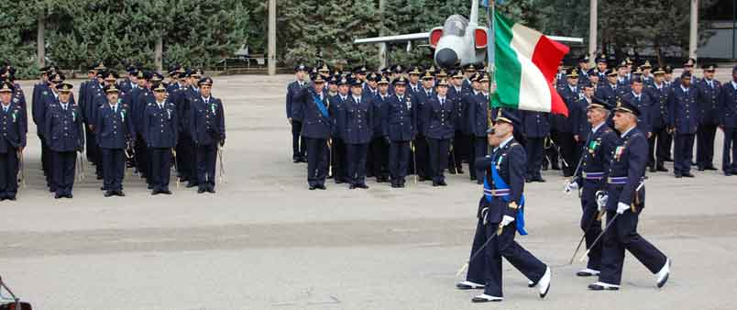
PERSONNEL
The Italian Air Force is composed by about 43.000 Men and Women of which
6.000 Officers, 29.000 Sergeants and 6.000 Soldiers.

Slide 5
ORGANIZATION
The Italian air force has strength of about 700 aircrafts and Helicopters whit some ground units for special duties. It is divided in Three Main Commands:
- Operational Forces Command
- Logistic Command
- Schools Command
- Operation Command
The Operations Command controls all Radar Units, the other commands are going to be explained later.

Slide 6
OPERATIONAL FORCES COMMAND
It is located in Centocelle near Rome and Controls all combat units of the Italian Air Force. It is then divided into
The Combat Forces Command: Located in Milan command all Front-Line units of the Air Force.
The 1st Special Air Brigade: Located in Padova command all special operations units.
The 46th Air Brigade: Located in Pisa control the Transport Planes.
Then there are other units that are not controlled by any of this command.
Now we are going to see all units that compose it.

Slide 7
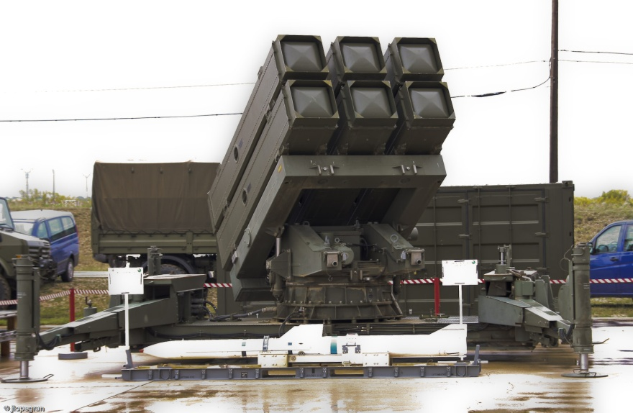
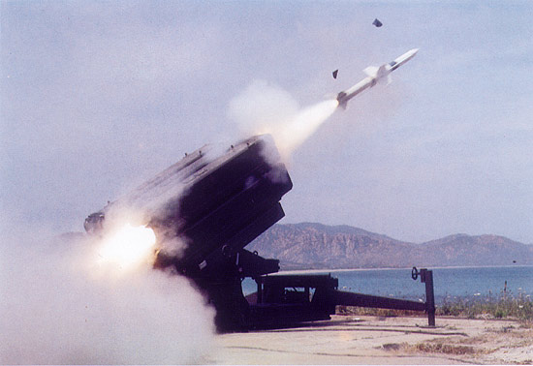
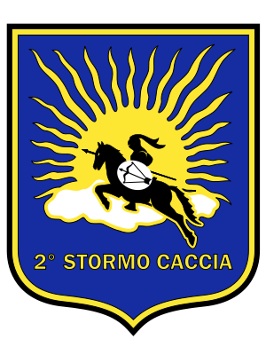
2° Stormo 2nd Wing
It is air Defence Unit equipped with Spada Missiles. Its command is in Rivolto

Slide 8
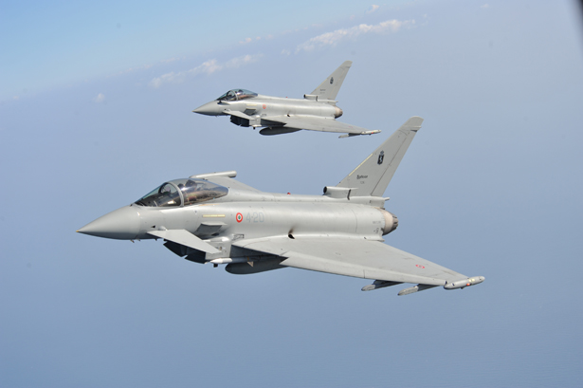
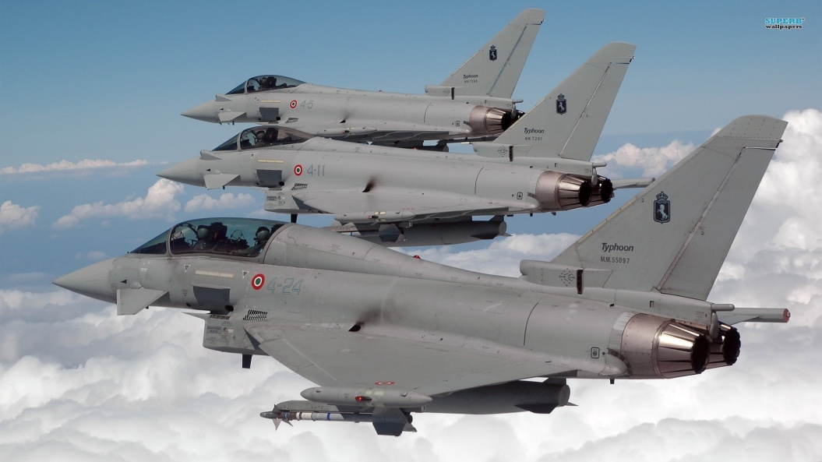
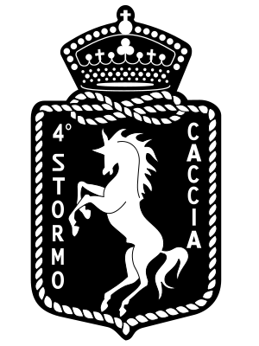
4°Stormo 4th Wing
The 4th Wing is a Fighter unit of the Italian Air Force Equipped with Eurofighter Typhoon. It is Based in Grosseto

Slide 9
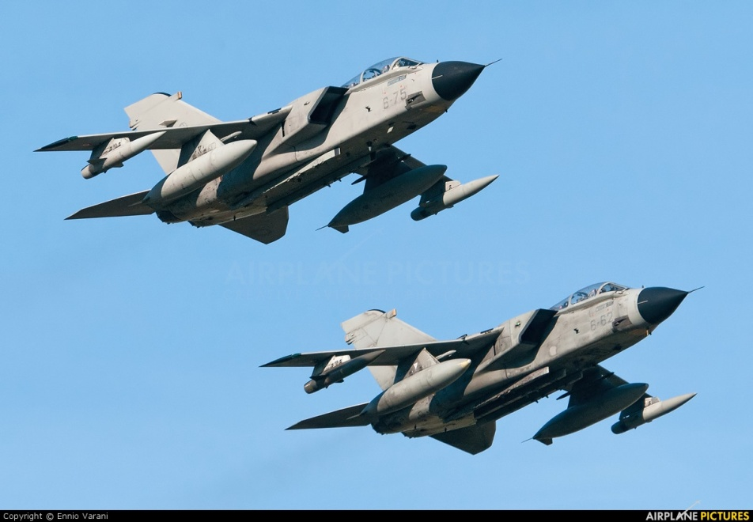
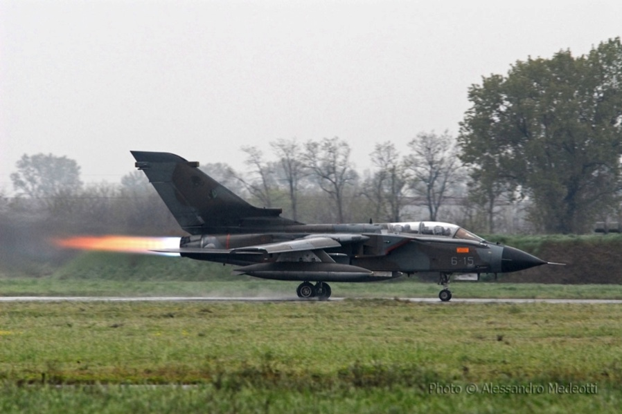
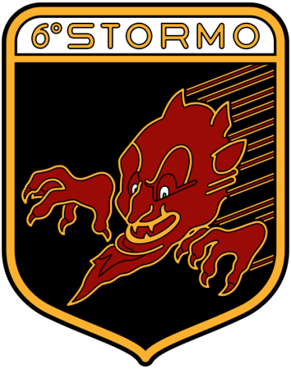
6°Stormo 6th Wing
The 6th Wing is a Ground Attack Unit based at Ghedi. It is equipped with Tornado IDS

Slide 10
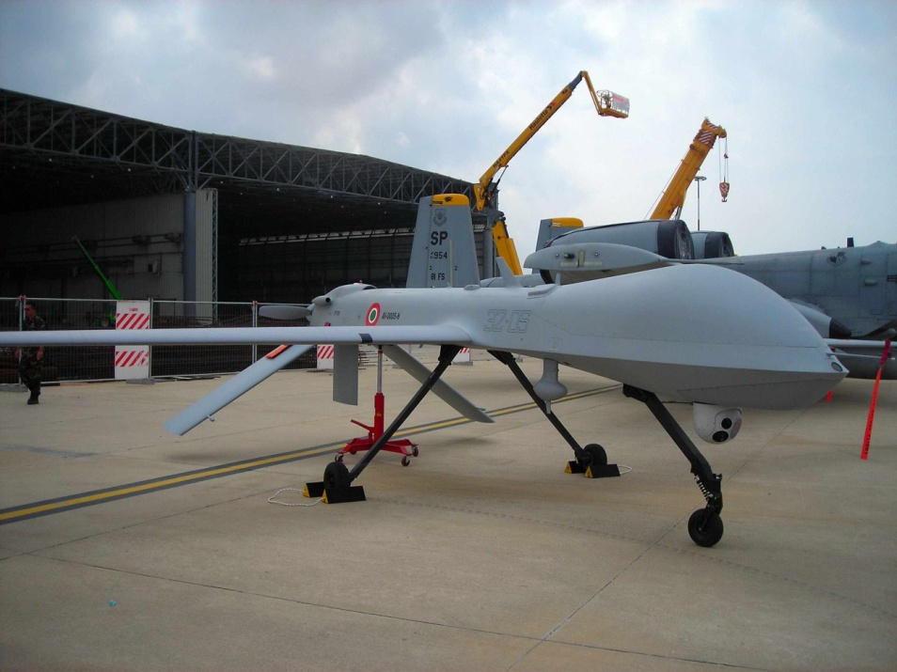
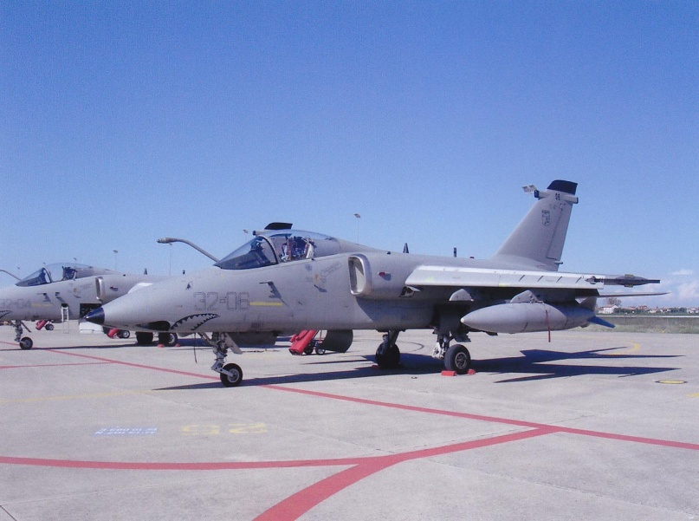
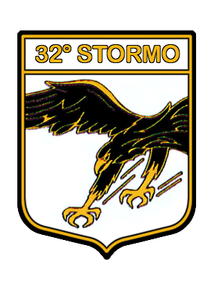
32°Stormo 32nd Wing
The 32nd Wing is an air support unit Equipped whit AMX and Predators. It is Based in Foggia

Slide 11
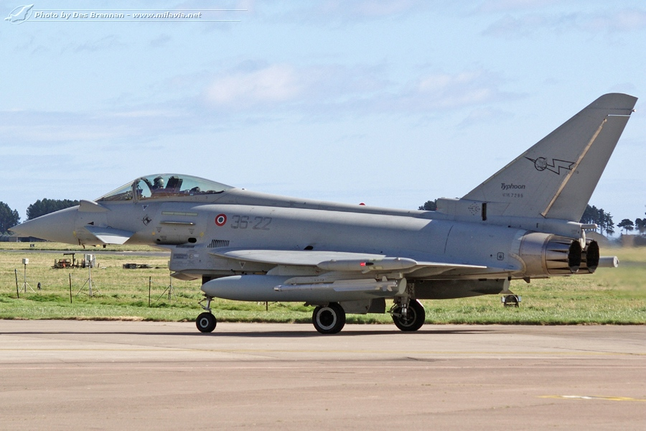
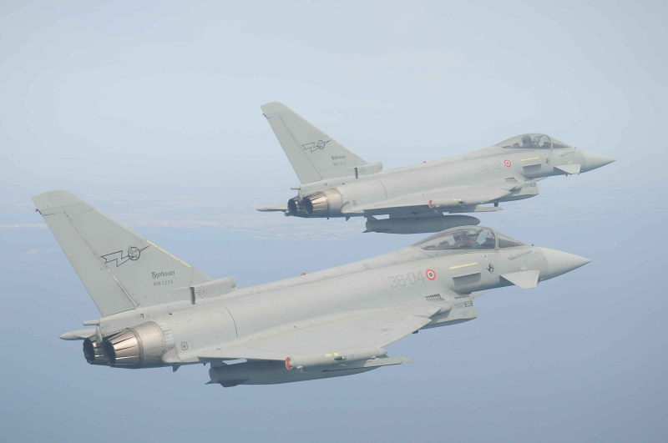
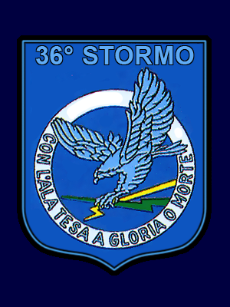
36°Stormo 36th Wing
The 36th Wing is an Air Superiority Wing based in Gioia Del Colle. It is Equipped whit Eurofighter Typhoon

Slide 12
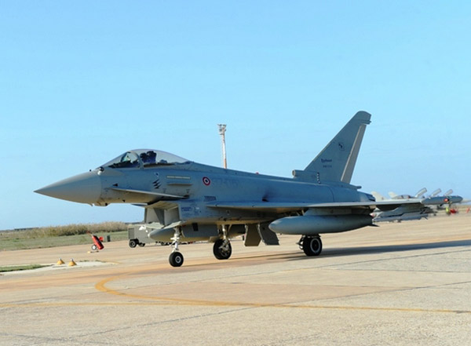
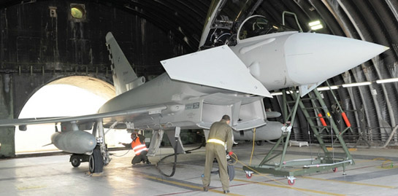
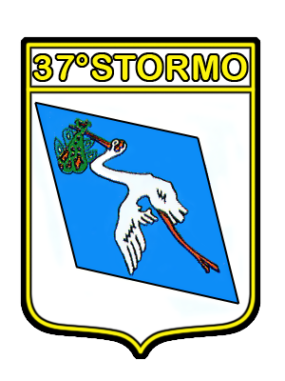
37°Stormo 37th Wing
The 37th Wing is an Air Superiority unit based in Trapani equipped with Eurofighters

Slide 13
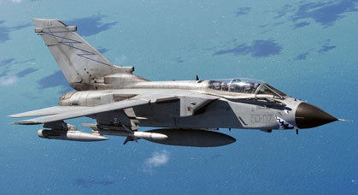
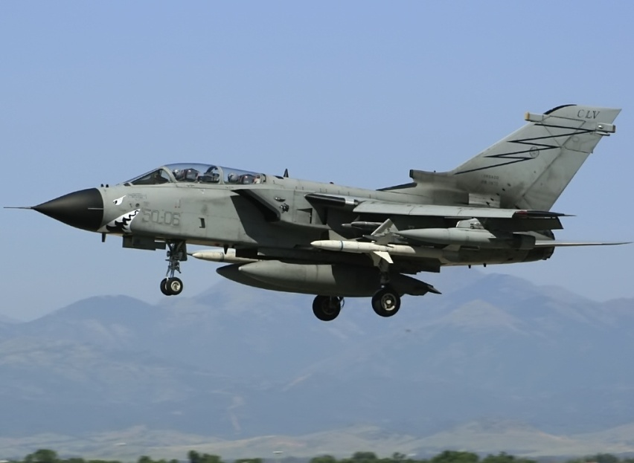
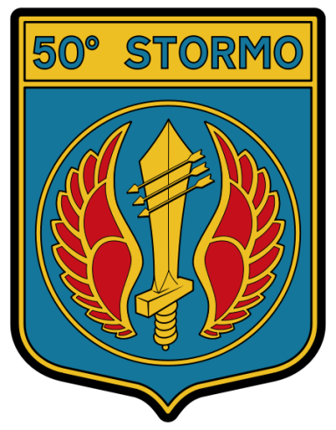
50°Stormo 50th Wing
The 50th Wing is an Electronic Warfare unit equipped whit Tornado ECR. Its
base is in Piacenza.

Slide 14
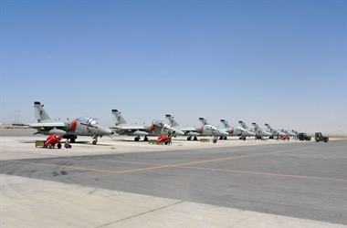
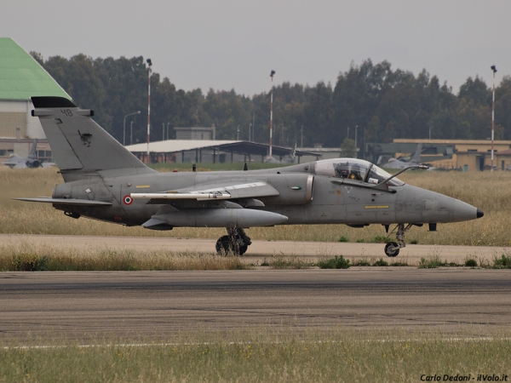

51°Stormo 51st Wing
The 51st Wing is an Air Support unit equipped with AMX. It is Based in Istrana.

Slide 15

THE SPECIAL AIR BRIGADE
As We Said Before the Special Air Brigade controls all Special Operations Units of the Italian Air Force. Usually it cooperates with other units from the Army and Navy.

Slide 16
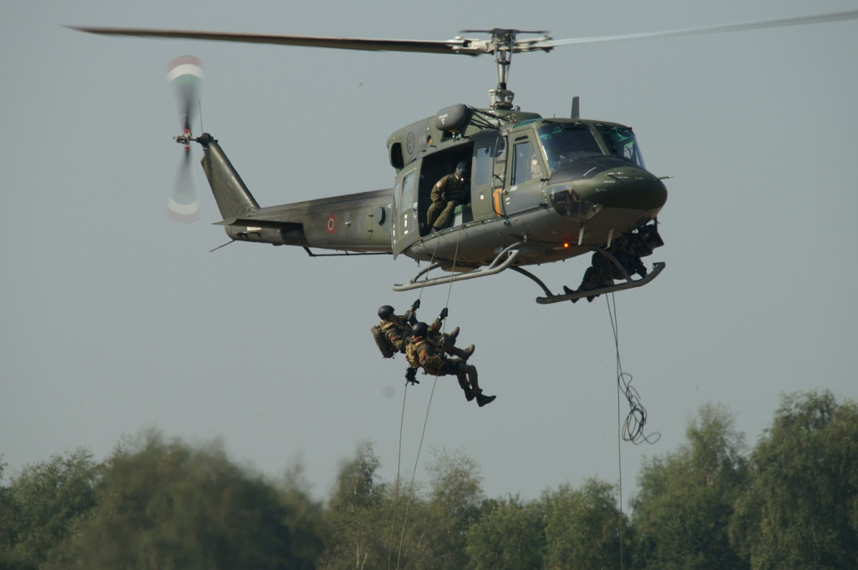
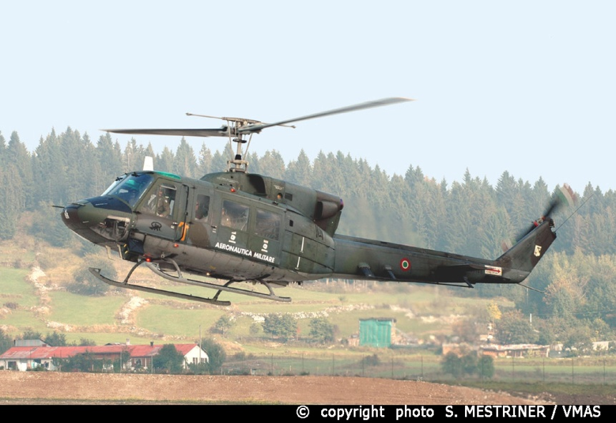

9° Stormo 9th Wing
The 9th Wing is a Helicopter Unit of the Italian air force specialized in special operations support. It is Equipped withAB-212

Slide 17
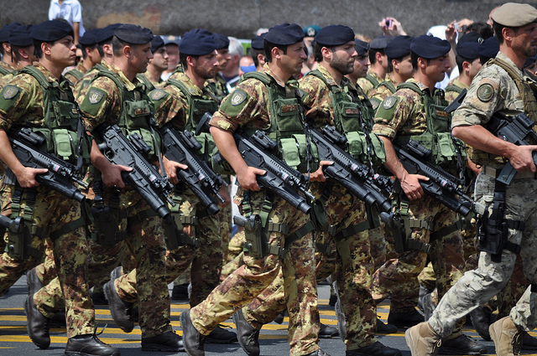
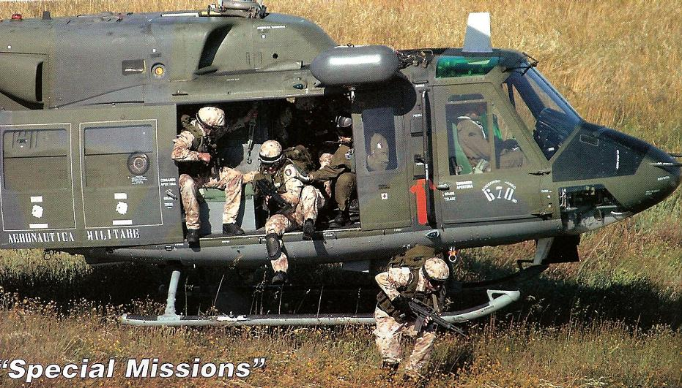
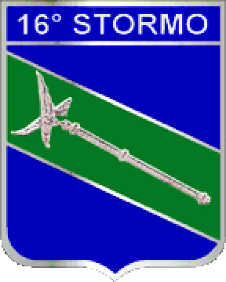
16°Stormo 16th Wing
The 16th Wing is an Infantry Unit of the Italian air Force. It is Tasked with protection of Air Force installations and operations in Italy and Abroad

Slide 18
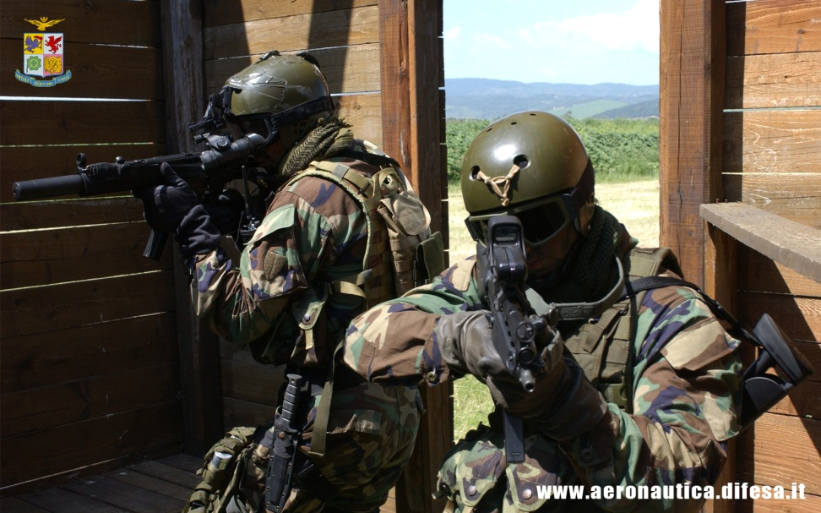
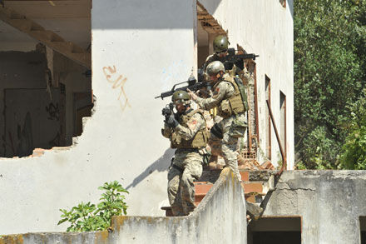
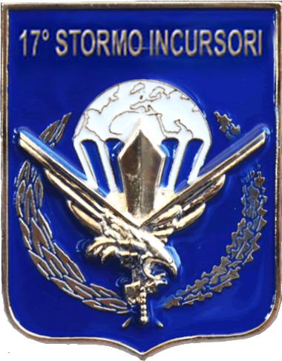
17°Stormo 17th Wing
The 17th Wing is an Elite Special Forces unit of the Air Force. It has many tasks such as: Rescue of Downed Pilots, Reconnaissance, Hostage Rescue and Raids

Slide 19
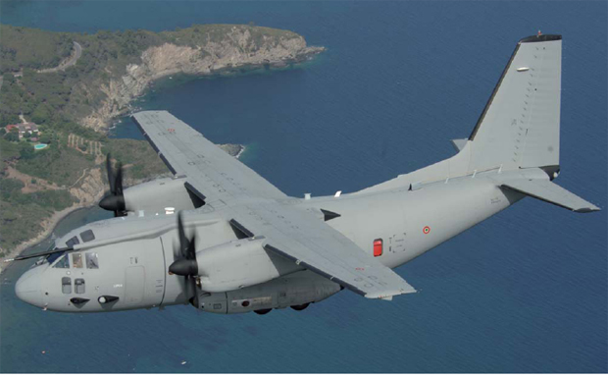
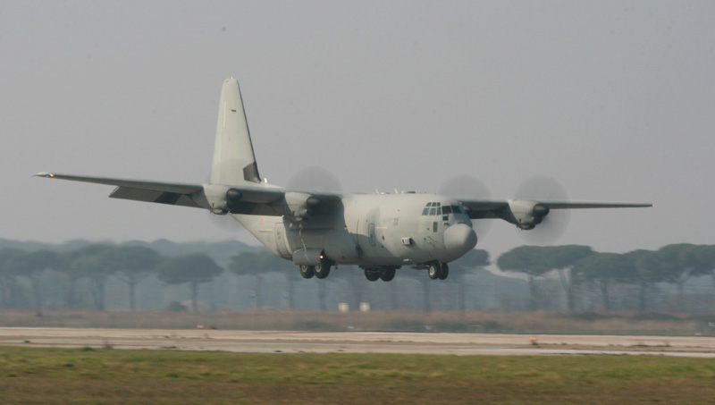
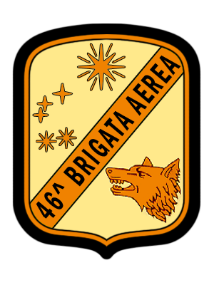
46a Brigata Aerea 46th Air Brigade
The 46th Air Brigade is a Transport unit. It is Based in Pisa and Equipped with C-130J and C-27J

Slide 20
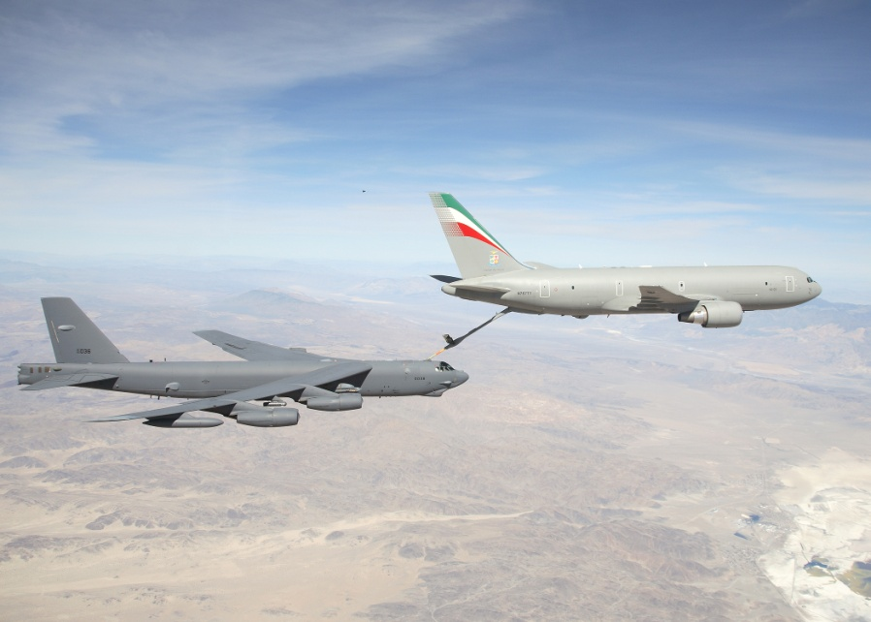
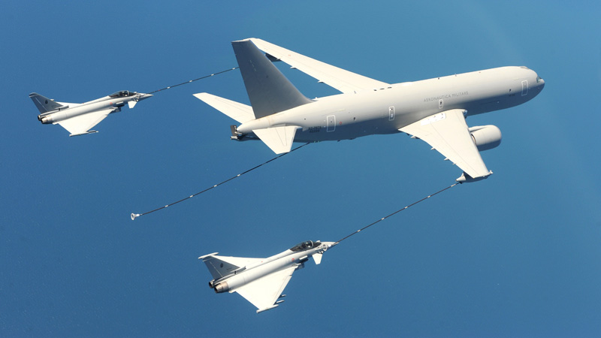
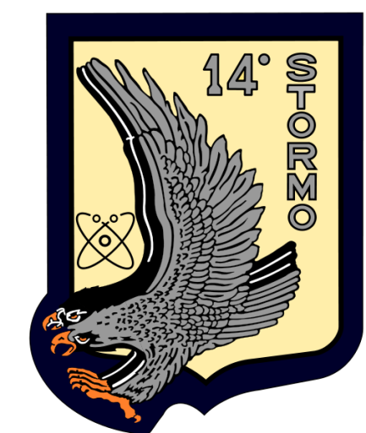
14° Stormo 14th Wing
The 14th Wing is the Support unit of the Italian Air Force. It is equipped with different planes such as: KC-767 and G-222VS

Slide 21
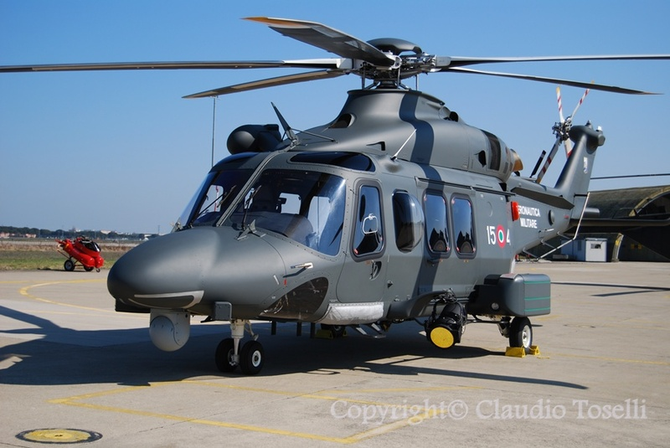
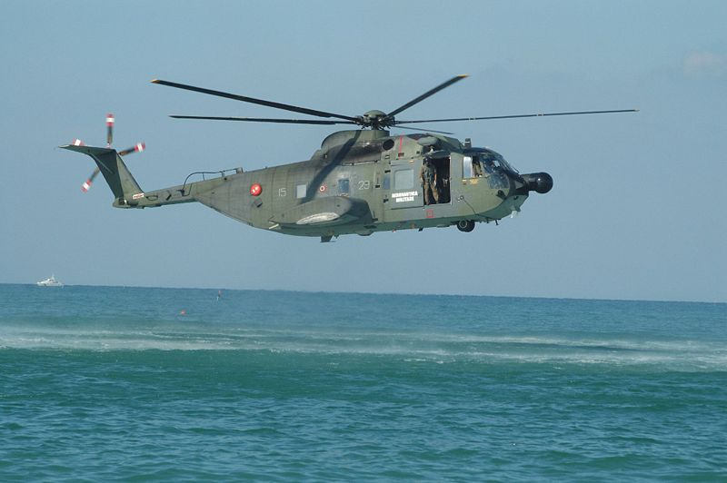
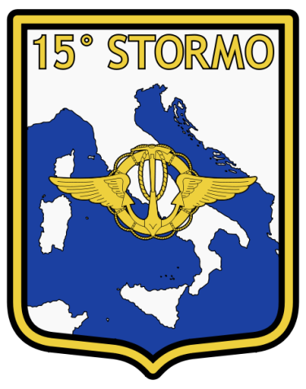
15°Stormo 15th Wing
The 15th Wing is the Research And Rescue unit of the Italian Air Force. It takes care of rescue all dispersed Pilots and Civilians on both sea and Land.

Slide 22
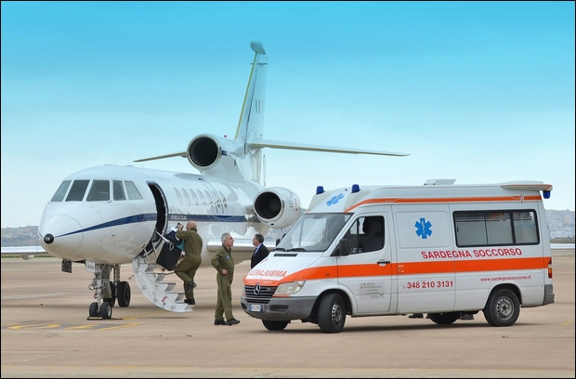


31°Stormo 31st Wing
The 31st Wing is a Transport unit. It carries the most important members of the Italian Government Around the World and also operates as Air-Ambulances. It Uses different Aircraft like P.180, Airbus 319 and Falcon 900.

Slide 23



313 a Squadriglia “Frecce Tricolori”
The 313rd Squadron is the Aerobatic Team of the Italian Air Force. It is Composed by 10 Planes and is one of the most Famous all over the World.

Slide 24

SCHOOL COMAND
The Schools comand control all Training and Formation units and Structures of the Italian Air Force. Such as:
- The Troops Formation Division
- Foregin Languages School
- Air Cooperation School
- Pilot Training Unit Program in the United States
And More that we are going to see.

Slide 25



AIR FORCE ACCADEMY
The Italian Air Force Accademy is Located in Pozzuoli and prepares all Future italian Air Force Officers. It Forms around 70 Officers each year.

Slide 26



61° Stormo 61St Wing
The 61st Wing is an Advanced Training unit of the Italian Air Force. It is Based at Lecce and equipped withMB-339

Slide 27



70°Stormo 70th Wing
The 70th Wing is the Basic Training Unit of the Italian Air Force. It is Equipped with SF.260 and based at Latina.

Slide 28



72°Stormo 72nd Wing
The 72nd Wing is a Helicopter Training Unit of the Italian Air Force. It is Equipped whit NH-500 and takes care of Training for All Italian armed Force Helicopter Pilots

Slide 29

THANKS FOR LISTENING
We hope you Enjoyed this Presentation

