Slide 1
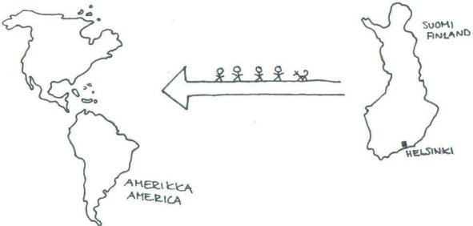
emigration from Finland

Slide 2
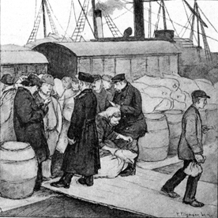
From countryside to emigration
People moved from countryside to bigger cities and as immigrants to other countries from the beginning of the 19th century.
Crofters and peasants were the biggest target group of the change of population.
In 1890–1920 about 300 000 people moved from Finland to United States of America, canada, New Zealand and Australia. 2/3 of them are concidered to be landless. In U.S.A Finnish people settled down mainly to the northern and western parts of U.S.A.

Slide 3
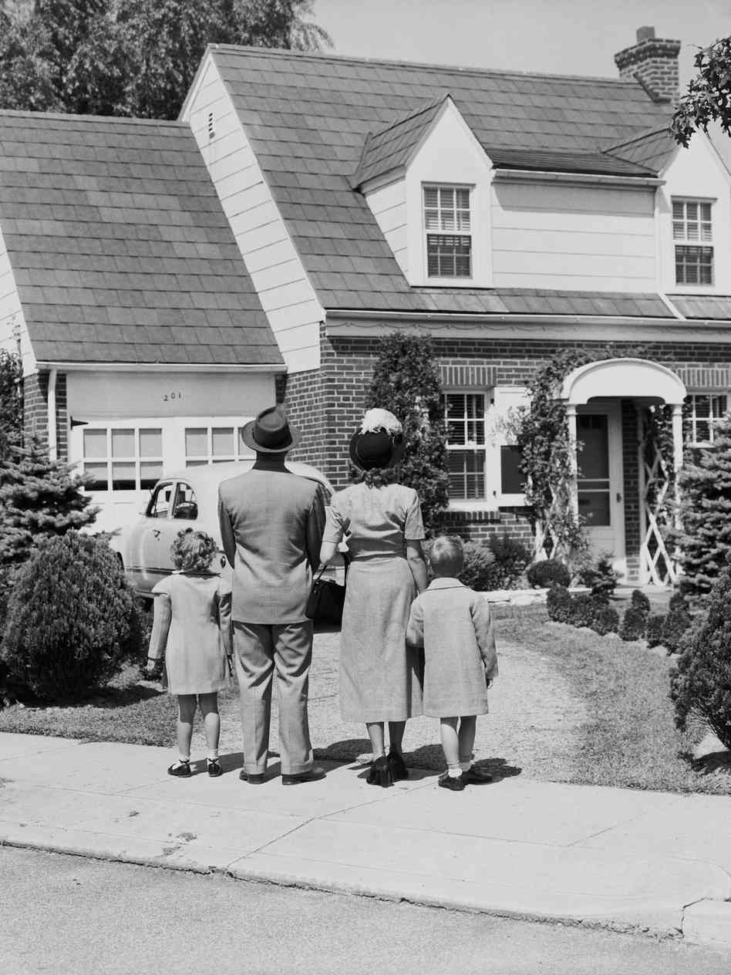
Reasons for emigration
Lack of jobs in Finland.
Hope of a better life and wealth.
Spirit of adventure.
”The American dream”. People thought that life in America would be easier and happier.
Some people wanted to avoid military service under the Russian rule.

Slide 4
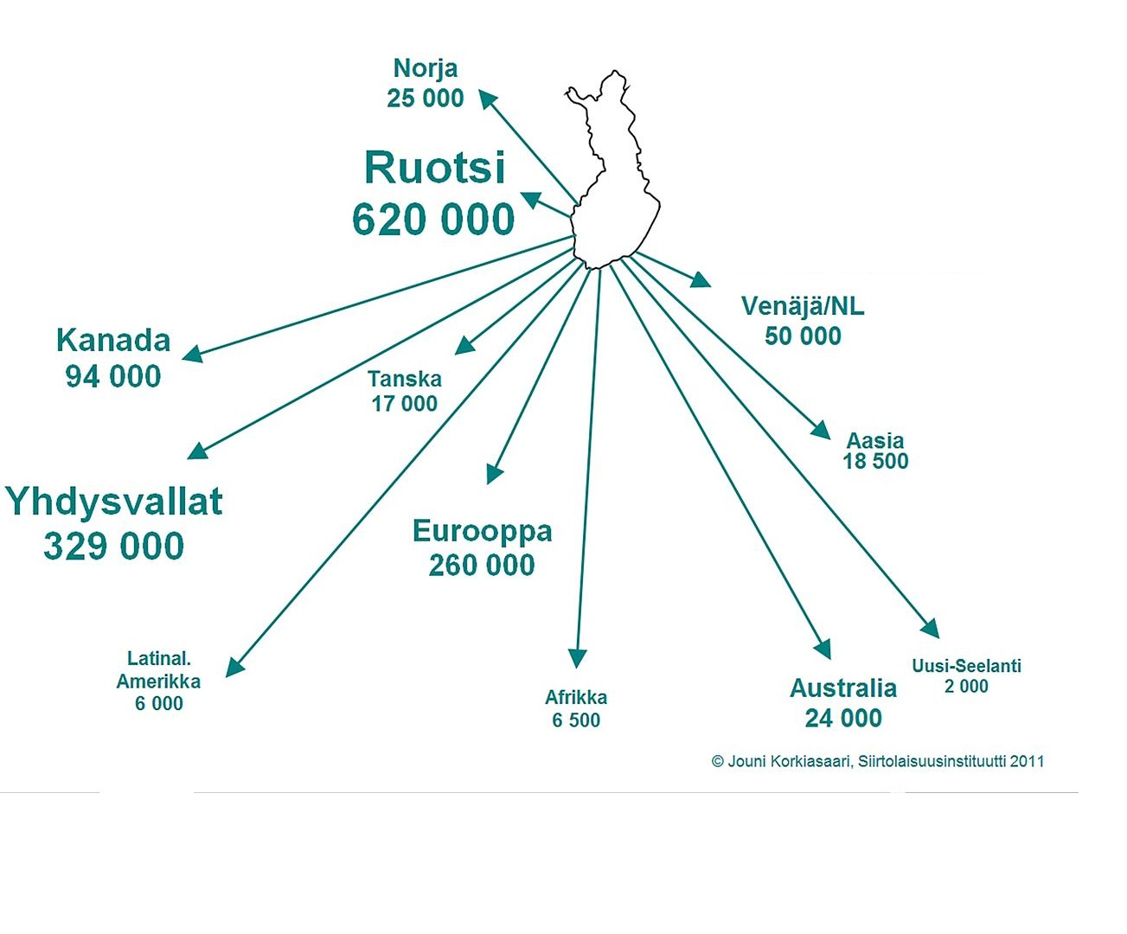

Slide 5
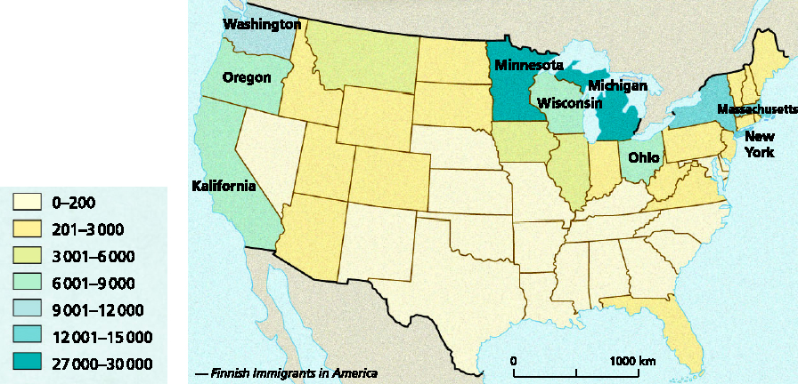
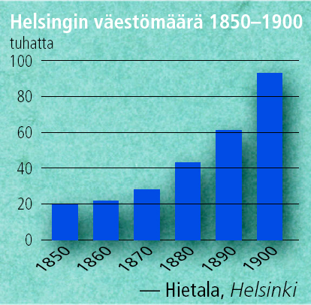
Where Finns lived in USA?
The living area of Finnish in 1920
Population of Helsinki 1850–1900

Slide 6
A story about an immigrant from Alajärvi
Kalle Jokiaho, who was born in 1891 was an immigrant from Alajärvi. He worked as a farmer, but as an adult he went to live in Canada. He didn’t really have money, but he moved to Canada at the age of 20 to work there. In 1911 he left to Canada where he lived with some other immigrants from Alajärvi. Before he came back to Finland he worked in a mine and in a factory until he raised enough money to move back to Finland. When he came back he was rich enough to buy a little farm from Alajärvi.

