Slide 1
Finns eat mushrooms

Slide 2
In Finland people use mushrooms to many foods.
Before useing the people have to ”ryöpätä”, some mushrooms. ”Ryöpätä” means mushroom parboiling.
You can make almost everything from mushrooms.

Slide 3
Food recipes

Slide 4
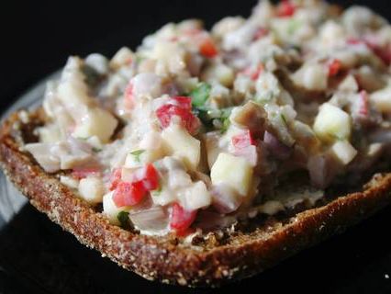
Mushroom-vegetablesalad
You need:
3 dl salted mushrooms
1 red onion
1 apple
1 small red pepper
2 tbsp. shredded parsley
1 little can of sour cream
black pepper
Making:
Parboil or soak the salted mushrooms suitably salted.
Mince mushrooms. Cut up onions, apple and pepper to small, same size cubes. Shred parsleys
Mix up everything and add sour cream. Spice it with black pepper.
You must let the salad “rest” in fridge before serving it.

Slide 5
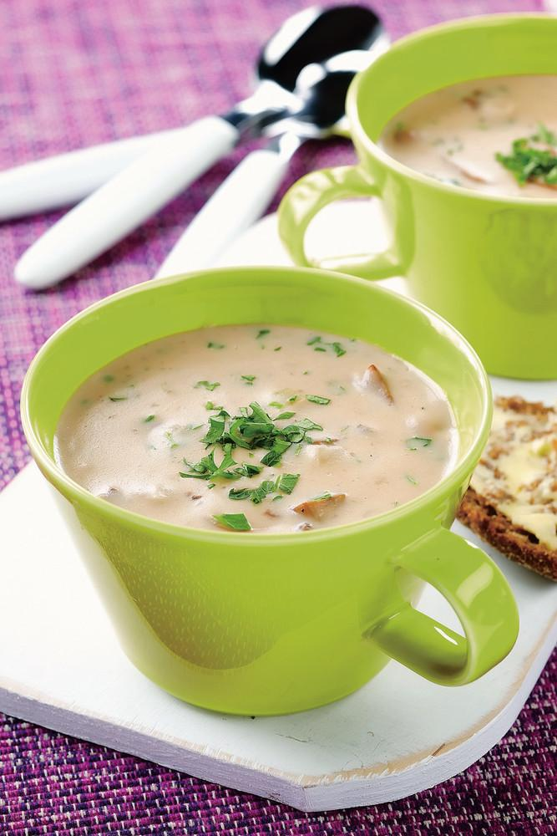
Mushroomsoap
Ingredients
- 1 l (250-300 g) chanterelles or (brown) mushrooms
- 1 (100 g) onion
- 2 tbsp butter
- ¾ cup flour
- 7 cup water
- ¾ tps
- 1 cup blue cheese crumbs
- 2 tbsp ketchup
- black peppers
- 1 tsp (2 ml) light cream or sour cream
- 1 cup parsley, finely chopped
Step 1. Cut the refined mushrooms and chop the peeled onion. Place the mushrooms coated saucepan and heat until the mushroom liquid has evaporated. Add the melted butter and onions. Saute.
Step 2. sprinkle flour pan. Add water and salt. Let simmer on low heat under the lid for about 5 minutes.
Step 3. Season with blue cheese, ketchup and pepper. Add the cream and parsley. Heat but do not boil. Serve mushroom soup with bread

Slide 6
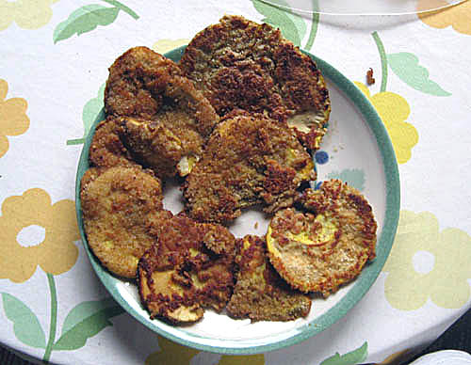
Sheep polypore steak = Lampaankääpäpihvi
You need/ Ingredients:
1 ½ Sheep polypore
2 pcs. Eggs
3 tbsp. Graham flour
3 tbsp. Wheat flour
4 tbsp. Butter
Extras: Lemon pepper, garlic powder and salt
At first clean the mushrooms and take the mushroom’s hats off. Break the eggs and whisk them. Grease steaks with eggs.
Sprinkle with mushrooms in flour and fry both sides.

Slide 7
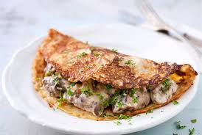
Sienimuhennos
Ingredients
1/2 l (200 g ) fresh chanterelles boletus or chanterelle
1 tablespoons butter
1 (100 g) onion
1/2 dl flour
2 dl sour cream
3 - 4 dl low-fat milk
touch black pepper or white pepper
3/4 teaspoon salt
1/2 dl persley or chives
Recipe
Clean and chop the mushrooms. You can use any period of edible mushrooms or cultivated mushrooms. Fry the mushrooms in a pan on low heat, until the mushrooms come off the liquid has evaporated.
Add the butter and chopped onion. Saute, stirring. When the onion is translucent and soft, sprinkle on top of the flour, mix well. Add the cream and milk. Cook for 2 - 3 minutes. If the stew is too thick, add a little milk and heat. Season.
Serve with boiled potatoes or pancakes or an omelette with stuffing

Slide 8
Pizza Berlusconi
Pizza Berlusconi is one famous mushroom pizza in Finland
Kotipizza's name for its smoked reindeer, red onion and chanterelle pizza. Kotipizza is finnish pizza company
With Pizza Berlusconi, Kotipizza won the America's Plate International pizza contest in New York. Italians came second.
Kotipizza named its smoked reindeer pizza "Pizza Berlusconi“ because Italian Prime minister Berlusconi reproached the Finnish foods by saying that Finns make bad food and the foodtradition in Finnland is primitive

