Slide 1
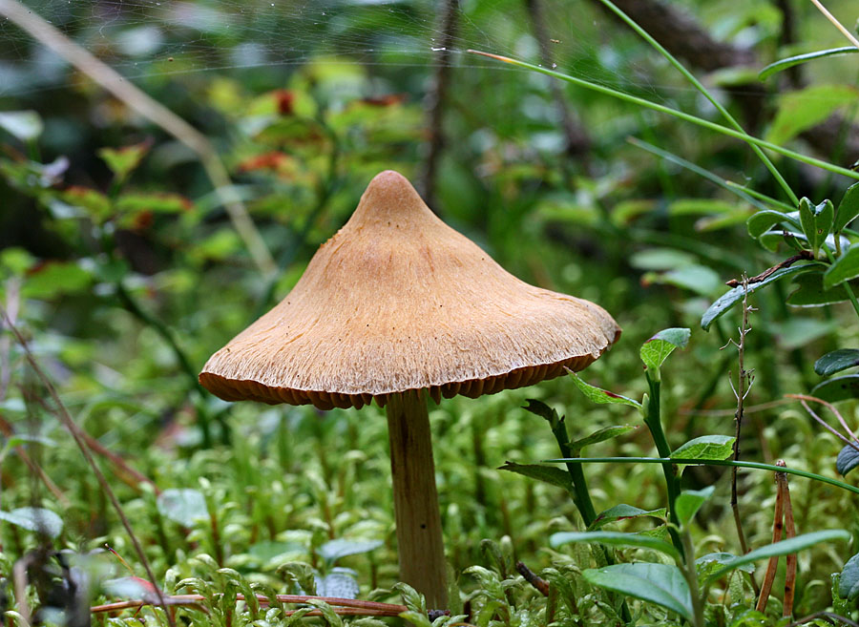
How do Finns use fungus?

Slide 2
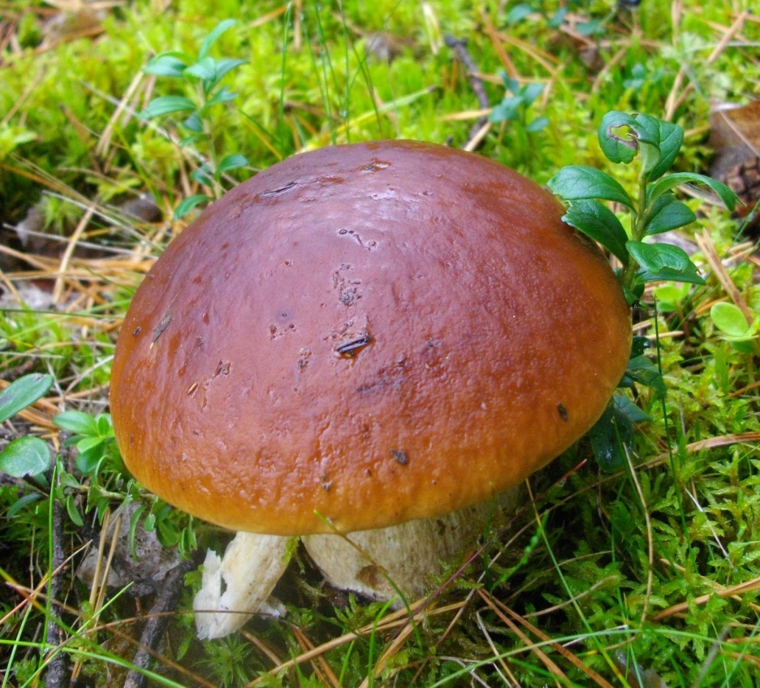
Fungus are really useful organisms
Fungus are being used for many different purposes
  Edible mushrooms
  Coloring
  Drugs

Slide 3
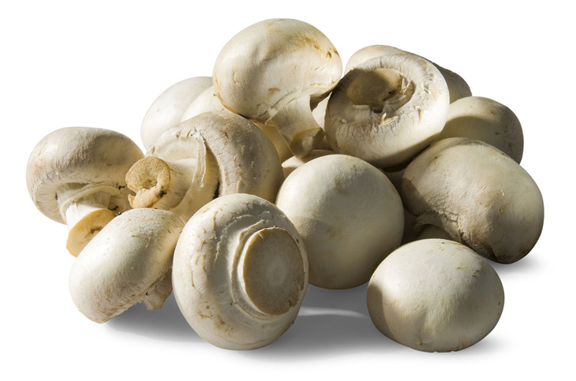
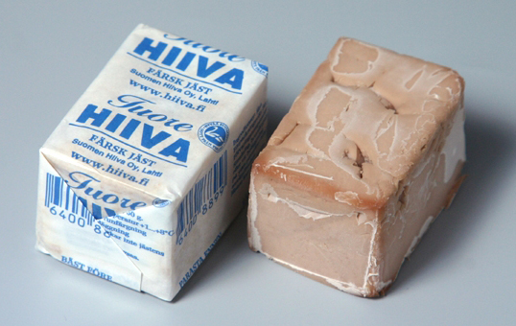
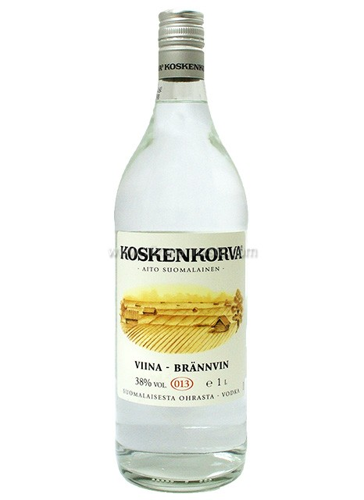
Edible mushrooms
  Are well-known examples of fungi
  Many are commercially raised, but others must be harvested from the wild
  Common mushroom is the most widely used edible mushroom
  Mushrooms are used in salads, soups and other dishes
  Yeast is also used for baking and making alcohol (koskenkorva)

Slide 4
Koskenkorva

Slide 5
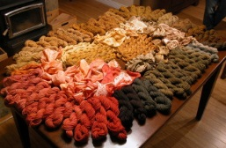
Mushrooms coloring
There are many different dyes in mushrooms that can be utilized
Use of fungi as textile dye became general in 1970
Many fungi are suitable for dyeing, and can produce colors that are otherwise difficult or impossible to produce by plant dyeing, such as dark red or blue
Many fungi are at their best in dyeing over-age, even rotten

Slide 6
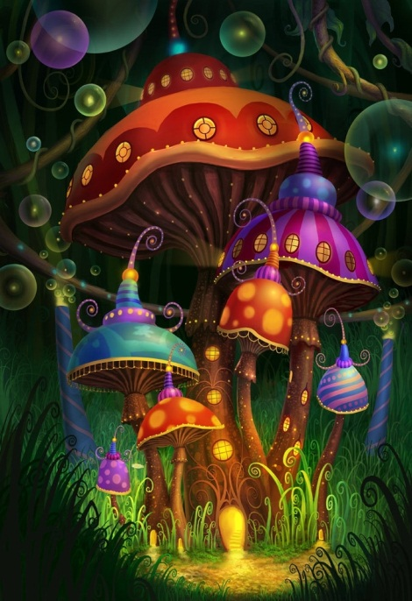
Drugs
Mushrooms includes antibacterial agents, and have been used to treat wounds in different parts of the world
The most famous example of the use of medicinal fungus is a penicillin
Human do also use mushrooms as drugs
These mushrooms include psilocybin which is hallucinating substance

Slide 7

Shamanism and mushrooms
Shaman means Laplands witch
Shamans have been healers and prediktors
Shamans use fungi in order to reach trance
  By that they try to reach to the dead
Shamans try to strengthen theirselves by eating fungus and the poison in them

