Slide 1
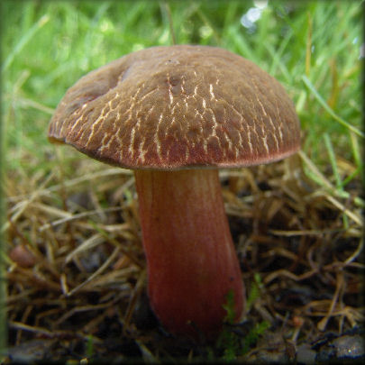
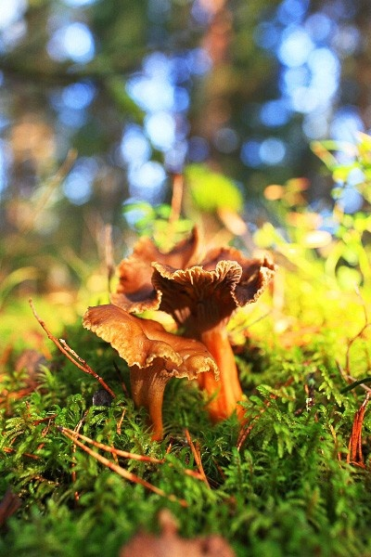
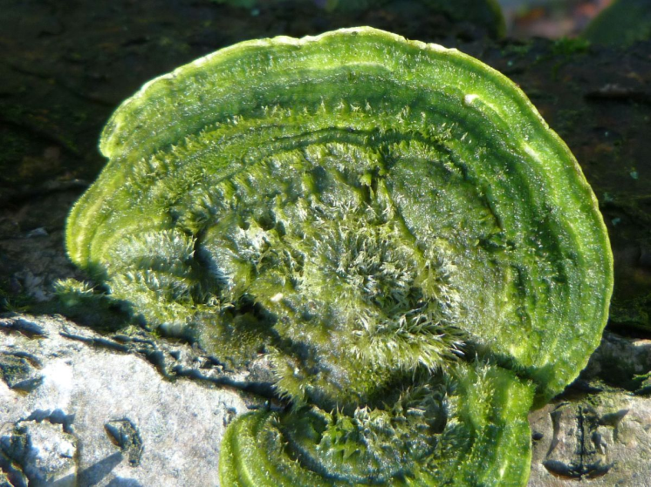
Ecological meaning of mushrooms in the forest

Slide 2
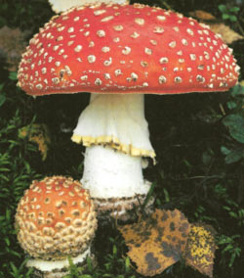
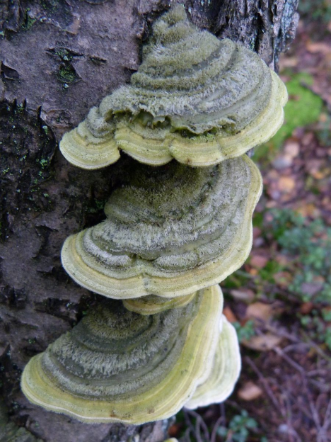
General information
Most fungi work as decomposers.
They live on rotten or decomposing surfaces.
Thanks to fungi, the litter, tree leaves and other organic matter that ends up in the forest floor is decomposed.

Slide 3
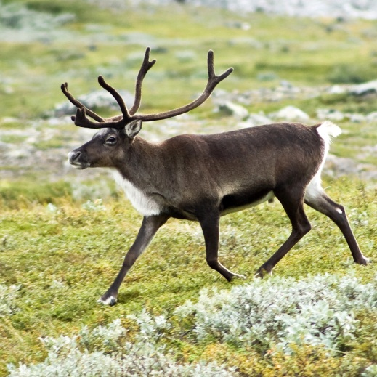
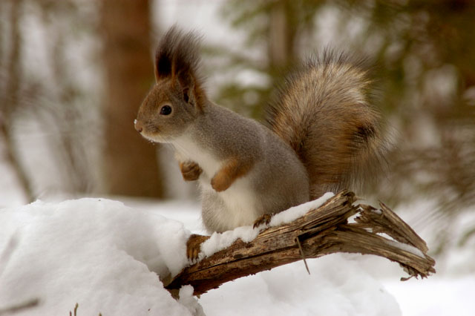
Animals
Mushrooms also provide food and home for many animals.
Reindeers eat mushrooms in preparation for the winter.
Snails and squirrels also eat high-protein mushrooms.

Slide 4
