Slide 1
The structure and reproduction of fungi

Slide 2
The cell structure of fungus
Eukaryotic
Cell wall made of chitin
Most of the fungus are microscopic
Some are single celled and they are called yeast
Multisellular fungus make sporocarp for reproduction

Slide 3
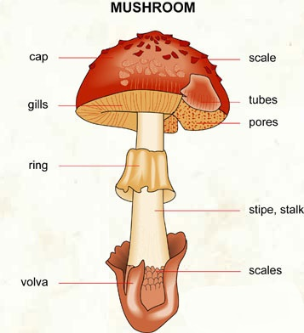
Sporocarp is the strucrute for reproduction
Under the cap, the spores develope and come out from gills or pores
Stalk keep the cap up
Under the sporocarp, there is a lot of mycelium in the ground

Slide 4
Reproduction circle

